Slide 1
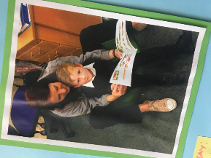
Developing Reading for Pleasure at St Bride’s RC PS Cowdenbeath
Eileen Chapman – Headteacher
@StBridesRCPS

Slide 2
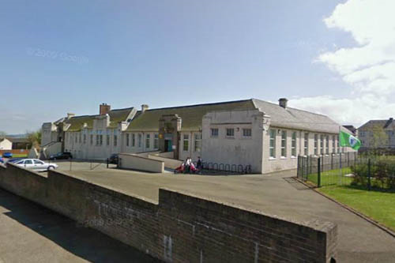
School Context
Situated in Cowdenbeath, a former mining town within Fife.
Innovation Fund School 2016/2017 – ‘Learning together in Cowdenbeath’ in partnership with a local school
1 HT, 1 PEF DHT, 1 PT, 10 class teachers (2 probationers) 4 PSAs.
20% children were not achieving as they should be in reading at the end of 2016/2017
24% FSM
33% SIMd 1 and 2
190 children across 9 classes and 35 Nursery Children

Slide 3
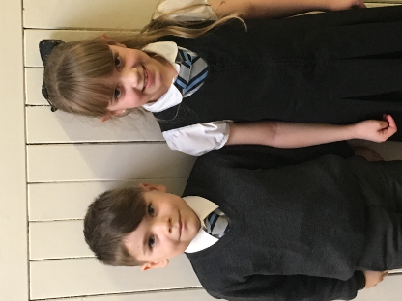
School Context
Professional Dialogue has been key to driving improvements
Nothing is done in a rush – small tests of change
Partnerships with other agencies have supported us in our thinking
Mindsets of children, staff and families
Building capacity at every level
Everyone Learning together in Love

Slide 4
Lightbulb moment!

Slide 5
Find out from parents/carers how they wanted to engage in literacy work
Begin to close the vocabulary gap through promoting reading for pleasure.
What we wanted to achieve
Develop staff leadership to drive improvement

Slide 6
What we are trying to achieve
By the end of session 2017/2018 13 targeted children (not all SIMD one/two or FSM) will have had at least one story read to them a week at home.
By the end of session 2017/2018 80% of 13 targeted children across P1-3 will have a parent attend shared reading on a regular basis.

Slide 7
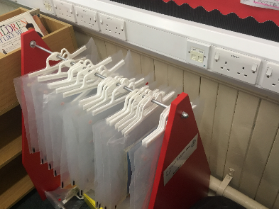
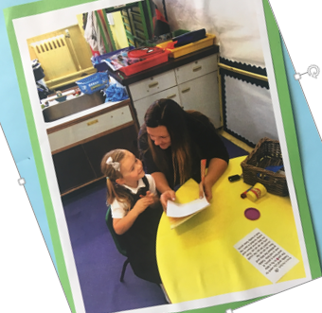
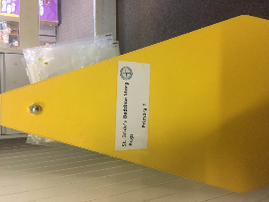
What we did
1. Story Sacs 2. Weekly Shared Reading Events

Slide 8
Progress with Story Sacs
7 of the 11 children now have other stories read to them at home, as well as their story sac book.
They stated that this has happened since the story sacs started going home.
‘My Mummy goes to work at the pub at night time so we read the story before she goes. I love it ‘cos we never used to have a story’.
Class Teachers reported that 7 of the targeted group visit the classroom library more readily in choosing time

Slide 9
Progress with Monday Reading Sessions
August-October holidays 8/11 of the targeted parents attended more than 2 sessions.
All 8 parents said that they found the sessions relaxed and worthwhile.
6 of the 8 parents who attend regularly are finding they read more stories at home as a result of this intervention.

Slide 10
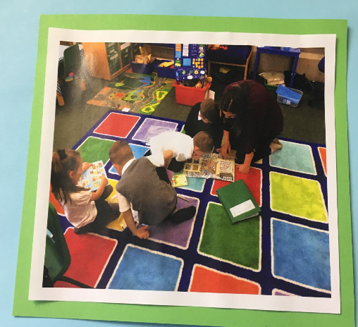

Slide 11
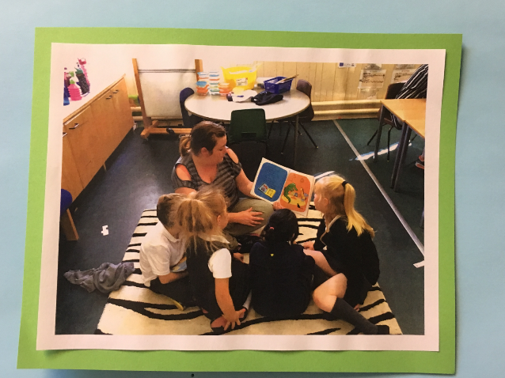

Slide 12
Impact on our children and families
57% of the children who have an adult attend regularly, state that they feel happy about this and look forward to Monday Reading Sessions.
This intervention has led to a parent led ‘Mystery Reader’ session once a week..

Slide 13
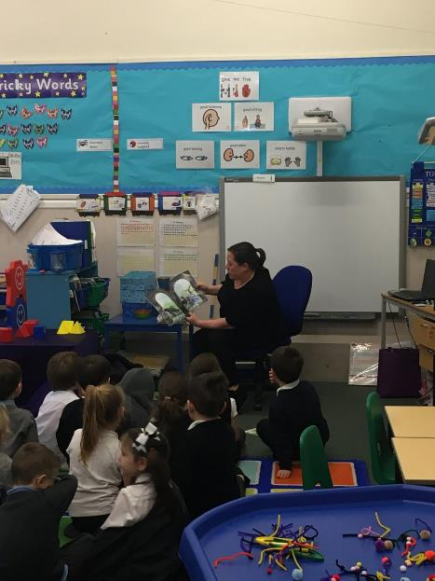
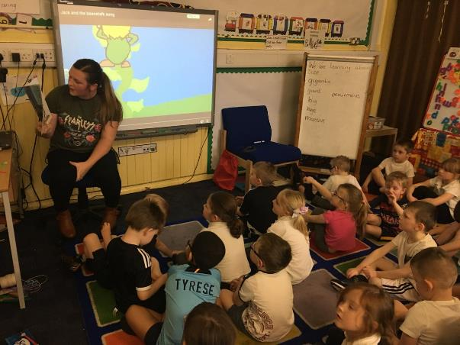

Slide 14
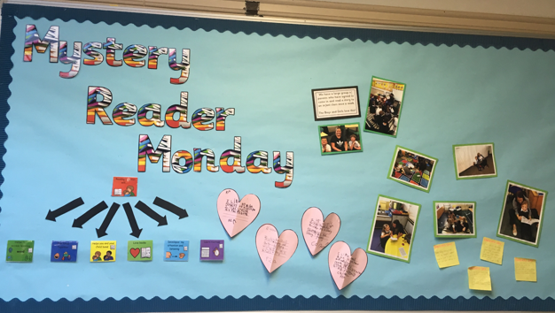

Slide 15
What we have learned?
The importance of nurturing honest, positive relationships with adults
Staff need to understand the vision and promote strategy for strategic change and sustainability
Use data to measure impact and be ready to change if it’s not working

Slide 16
Discussions
Consider an initiative that you have tried to implement but which did not result in the anticipated outcome for learners.
What barriers limited success and how might you approach school improvement in the future?
Share examples of when family engagement in learning led to improved outcomes for children.
Share examples of resources and of practical things schools can try to improve reading for pleasure.

Slide 17
Contact details and suggested reading
Find us on Twitter: @StBridesRCPS
Zhao has also formed part of our thinking on why a deficit approach should be avoided.

