Slide 1
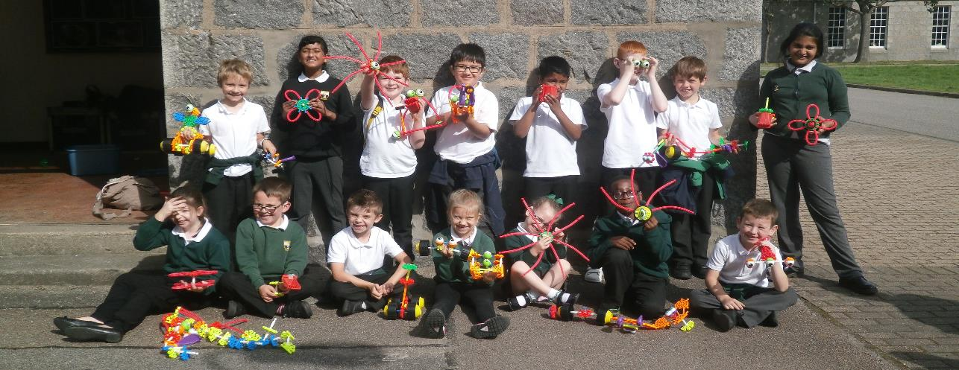
Magnificent Maths Engaging parents in supporting/extending their child’s maths at home.

Slide 2
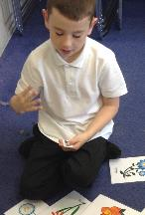
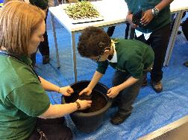
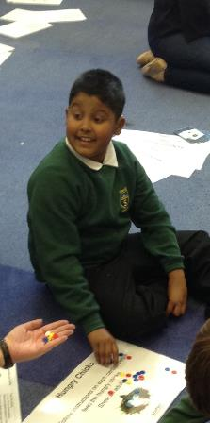
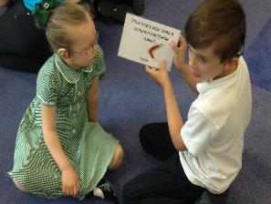
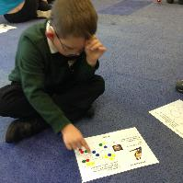
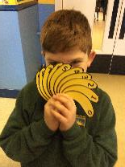
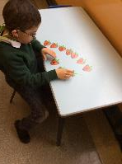
Our Context at Aberdeen School for the Deaf
School Roll: 15
Percentage of pupils within targeted group: 56.25%
We have 45% of the identified pupils (FSM and SIMD 1,2 &3) that are also EAL learners
All of these children use British Sign Language or Signed Supported English
PEF allocation: £14,400
Cost of this intervention: £400

Slide 3
Intervention Rationale: Working together
Staff
Pupils
Parents

Slide 4
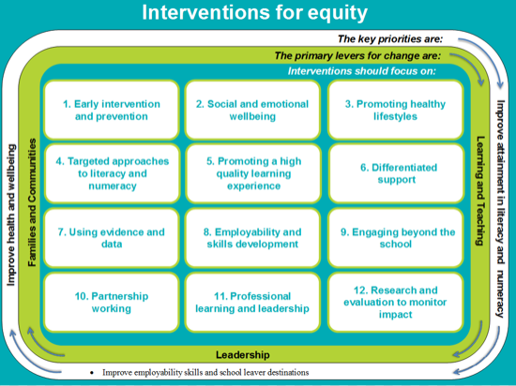

Slide 5
What we knew…
Parental engagement with homework was low
Submission of homework (especially maths) was low
Supporting children is challenging when you are unsure of the methods and resources being used at school!

Slide 6
What the Research says…
“One of the greatest barriers to engagement can be parents’ own experiences of
education (Harris and Goodall 2007; Harris and Goodall 2008). Shah (2011) likens the experience felt by parents as to that of a child in an unfamiliar environment, even suggesting that such situations can provoke personal feelings that the parent had experienced themselves as a child in school. De Carvalho
(2000) takes this argument further and questions the value of parental engagement
to those parents who perceive that they have had a sub-standard education themselves.
He explains that expecting to engage parents in something they see as being
of little value, such as school, is unrealistic. This highlights the importance of
showing parents, as well as school staff, that it is parental engagement with children’s
learning, rather than parental interaction with schools, which holds the greatest
chance of benefit for the child. This dialogue can begin to build some of the
bridges between parents and schools, which have been destroyed by that previous
experience.”
Goodall and Montgomery (2013)

Slide 7
How confident did our parents feel about supporting their child at home? How much did parents feel they knew about the resources we use in school to teach maths?

Slide 8
Number Notion Resources
The Goody Bag!
Activity Booklet
Number fan
100 square
Multiplication grid
Number Tube
Strawberry Digits
Clocks
Number Lines
Place Value Tabs
Keywords

Slide 9
‘
‘The Why?’
Benefits of using maths resources at home
How?
Explored resources together looking at the maths skills that we can practise/develop
When?
Discussed opportunities in busy home life
Benefits of practical activities
How consolidating at home can impact learning at school
Played a variety of games and quick fire activities
Highlighted versatility
Opportunities for language development
Explained new structure of homework tasks
Targeting parents who didn’t attend…
The Workshop…

Slide 10
Impact
Higher levels of engagement with maths homework from parents.
Pupil’s increased confidence in maths both at Aberdeen School for the Deaf and in their mainstream setting.
Higher rates of submission for weekly maths homework tasks.
Parent’s increased confidence levels when supporting their children at home.
Parents who didn’t attend the session have responded well and started using the resource pack at home.

Slide 11
Feedback from parents
100% felt they had a better understanding of the resources and language we use to teach maths at school.

Slide 12
10 weeks later…
“My child really embraced this pack of resources. It has opened up a lot of opportunities for play and questions. His favourite thing to use is the clock!”
P4 Parent
“It has helped to engage both of my children, not just the son who attends Aberdeen School for the Deaf. My son in Primary 1 will now come and ask me if we can play the games together.”
P1 Parent
“We use the pack every week. My daughter uses it to help with her homework, it’s completely changed what we do. I feel really confident now. I’m happy to get involved and know how to use the resources and different language to help her.”
P3 Parent

Slide 13
Video the session for our school website
On Reflection…
More information pre- workshop
Use social media to engage parents
Upload video clips of example activities
Next Steps…
Invite parents back to show progress
Use social media to continue to promote use of resources

Slide 14
Discussion Questions
How effectively do we support parents and carers to participate in, contribute to and understand their child’s learning?
Share other initiatives you have tried that have led to an increase in parental engagement

