Slide 1
Inclusion Wellbeing & Equalities Professional Learning Framework The Brain and Emotional Regulation Informed Level
@ESInclusionTeam
For Scotland's learners, with Scotland's educators
Do luchd-ionnsachaidh na h-Alba, le luchd-foghlaim Alba
Notes:
Purpose of these Slides
Read title​
This professional learning is pitched at an informed level and suitable for anyone working with children and young people in an educational context.
How to use the slides:
To be used to facilitate professional learning in a group or whole-setting, or as a self-directed learning activity as an individual.
General Guidance
There is a requirement to cover all the slides.
Please do not change the provided slides.
Facilitators are welcome to add slides or activities relevant to your own setting, to support discussion and exploration of the topic. Facilitators will know their participants’ needs best.
Anyone who works in an educational setting can be a facilitator and use these slides.
It is important to establish a safe space which encourages respect and honesty to ensure that everyone is able to participate.

Slide 2
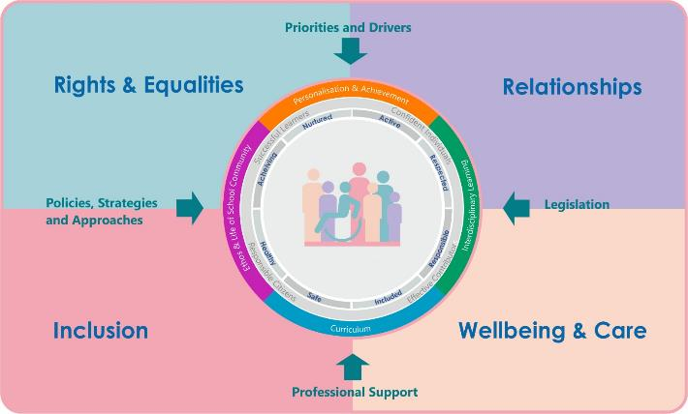
Interconnectivity
Notes:
All of the professional learning in the Framework fits into one of these four themes. The four themes are interconnected and interdependent.​
This activity forms part of the professional learning in the Relationship theme.

Slide 3
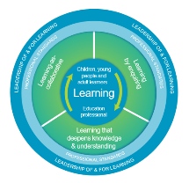
How to use this resource
These slides can be used to facilitate professional learning in a group or
whole-setting, or as a self-directed learning activity as an individual.
Facilitation notes are included at the bottom of each slide.
Please do not remove or change any of the slides included.
Facilitators are welcome to add slides or activities relevant to your own setting, to support discussion and exploration of the topic. Facilitators will know their participants’ needs best.
Anyone who works in an educational setting can be a facilitator and use these slides.
For reflection or discussion activities, it is important to establish a safe space which encourages respect and honesty to ensure that everyone is able to participate.
Notes:
Option to skip slide as these are instructions for facilitators only. No need to read to audience.

Slide 4
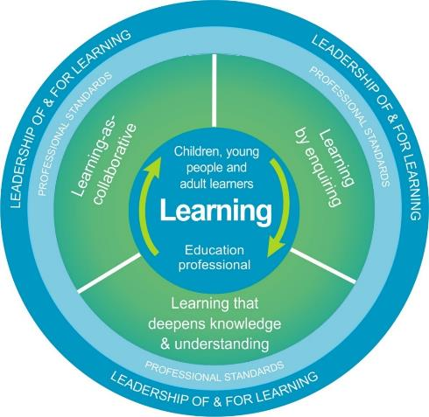
National Model for Professional Learning
This professional learning resource will support you to deepen your knowledge and understanding.
You will have the opportunity to consider how to take this learning forward on your own and with others.
The National Model of Professional Learning (education.gov.scot)
Notes:
This professional learning forms part of the national model for professional learning and is designed to help you gain more knowledge and have a deeper understanding of inclusion, wellbeing and equalities​​
On completion of this professional learning, you will be asked to consider what your next steps will be​​.
Please take some time to consider the reflection questions at the end

Slide 5
Welcome
This session provides an opportunity to:
To explore the different sections of the brain and their function
To explore the brain and emotional regulation
To consider emotional regulation, emotional intelligence, and learning, and behaviour
To consider trauma, the brain, and challenges to emotional regulation
Notes:
Link activity to national model

Slide 6
Our Amazing Brain
3:07 mins
Video by sentis.com.au
If viewing as a PDF please click this link to watch the film https://youtu.be/5_vT_mnKomY
Notes:
In order to understand emotional regulation, how it effects how we feel and behave, and therefore our ability to learn, we first have to understand the structure of the brain and each parts function.
This short film gives a simple overview of our amazing 3-part brain.

Slide 7
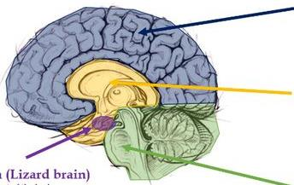
Parts of the Brain and their Function
Thinking
Neocortex (Thinking)
Newest, most advanced
Rational thinking
Higher level thinking
Language, imagination, ideas
Limbic System (Feeling)
Emotions, feelings, dreams
Habit control
Memories
Interaction with others
Feeling
Primitive
Amygdala
Oldest
Survival brain
Fight, Flight, Freeze
Fear, Pleasure, anxiety, anger
Reptilian Brain - Instinctive
Basic body functions
Unconscious
Notes:
So each part has a specific function. Depending on which part is dominate at any given time will determine what we are able to do and how we react and respond to people and situations.

Slide 8
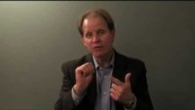
The Hand Model of the Brain and Emotional Regulation
2:31 mins
If viewing as a PDF please click this link to watch the film https://youtu.be/gm9CIJ74Oxw
Notes:
Dr Dan Siegel uses a very simple model to describe how the brains functioning affects emotional regulation and why it’s important for us to understand this and potentially teach it to our learners.

Slide 9
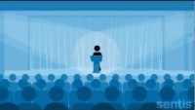
The brain, emotions, and our ability to engage in learning
We can’t learn when:
the amygdala is activated
we are in fight/flight mode
we are distressed or dysregulated
we are disconnected from our thinking brain
See the Modules:
Regulation, Dysregulation, and Self-Regulation
Regulate, Relate, Reason, and Restore
2:03 mins
If viewing as a PDF please click this link to watch the film https://youtu.be/xNY0AAUtH3g
A distressed person finds it really hard to think!
Notes:
The brain, our emotions, and our ability to regulate our emotions has a profound effect on our ability to engage in learning.
If we are dysregulated, we essentially can’t think rationally, reason, or learn.
This has implications for how we understand and respond to distressed or challenging behaviour.
Bruce Perry has provided us with a model or Sequence of Engagement that is sympathetic to how the brain works. In his model he shows we should help, or give the person time , to regulate their emotions, we should try to relate to them by validating their feelings (not their actions), and only then try to reason with them.
We often jump to the ‘reasoning’ part too soon when the person isn’t actually able to engage in the reasoning.
You can find out more about the ‘Sequence of Engagement in a separate learning module..

Slide 10
Emotional Regulation What is it, why we need to know about it, and how is it linked with how our brain works
Emotional regulation is the ability to recognise, manage, and respond to our emotions
When we don’t know how to regulate our emotions, we can become emotionally overwhelmed, and this can impact the way we relate to ourselves, others, and the world in general
Emotional regulation is an important tool for mental well-being and protects our relationships with others
Notes:
Essentially emotional regulation is the ability to recognise, manage, and respond to our emotions.
When we don’t know how to regulate our emotions, we can become emotionally overwhelmed, and this can impact the way we relate to ourselves, others, and the world in general.
Emotional regulation is an important tool for mental well-being and protects our relationships with others.
Dan Siegal talks about naming it to tame it. So naming our emotions helps us manage our emotions.
Just remember many learners have a very limited understanding of their emotions and a limited language of feelings. This may be something we need to explicitly teach them.

Slide 11
Emotional regulation, feelings, and behaviour
When we ARE emotionally regulated we can:
feel balanced and in control of our reactions
manage stress
listen to others and are aware of their needs
express our needs in constructive ways
act appropriately in a range of situations
stay calm during challenging situations
don’t take things personally
protect important connections/relationships
When we ARE NOT emotionally regulated we may:
feel off kilter and out of control
feel stressed
are unable to listen or think
express our needs in destructive ways
act inappropriately
lose our cool
take things personally
damage relationships or connections
Remember: Emotional regulation is a skill we can learn and is part of our emotional intelligence
Notes:
Emotional regulation impacts how we feel which in turn impacts how we behave.
When we ARE emotionally regulated we can:
feel balanced and in control of our reactions
manage stress
listen to others and are aware of their needs
express our needs in constructive ways
act appropriately in a range of situations
stay calm during challenging situations
don’t take things personally
protect important connections/relationships
When we ARE NOT emotionally regulated we may:
feel off kilter and out of control
feel stressed
are unable to listen or think
express our needs in destructive ways
act inappropriately
lose our cool
take things personally
damage relationships or connections
Of course, emotional regulation is something that we can learn and get better at over time. It’s part of our emotional intelligence.

Slide 12
Emotional Intelligence
Emotional regulation is a skill we can learn and is part of our emotional intelligence (EQ) EQ is our ability to learn about ourselves and use that knowledge to understand and relate to others Emotional intelligence (EQ) is essential for good mental health and healthy relationships It may be even more important than IQ because it is linked to our happiness Emotional Intelligence has 5 components: Self-awareness Self-regulation Motivation Empathy Social Skills
Improving any of these components can potentially increase our happiness!!!
In the Scottish curriculum these should be taught through the ‘Responsibility of All’ part of the Health and Wellbeing Curriculum or as part of a bespoke Social Emotional Learning Programme
Notes:
Emotional Intelligence (EQ): Components and Tips | Psych Central (Popularised by Daniel Goleman)
Emotional regulation is a skill we can learn and is part of our emotional intelligence (EQ)
EQ is our ability to learn about ourselves and use that knowledge to understand and relate to others
Emotional intelligence (EQ) is essential for good mental health and healthy relationships
It may be even more important than IQ because it is linked to our happiness
Emotional intelligence has 5 key components:
Self-awareness - you can see your own patterns of behaviors and motives. You know how your emotions and actions impact those around you, for better or for worse. You can name your own emotions when they come up and understand why they’re there. You can also recognize your triggers, identify your strengths, and see your own limitations. Associated with humility.
Self-regulation - If you can self-regulate, your emotional reactions are in proportion to the given circumstances. You know how to pause, as needed, and control your impulses. You think before you act and consider the consequences. It also means you know how to ease tension, manage conflict, cope with difficult scenarios, and adapt to changes in your environment. It’s all about bringing out the part of yourself that helps manage emotions.
Motivation - If you’re intrinsically motivated, you have a thirst for personal development. You’re highly driven to succeed, whatever your version of success looks like. You’re inspired to accomplish goals because it helps you grow as a person, rather than doing it for outside rewards like money, fame, status, or recognition.
Empathy - If you’re empathic, you’re a healthy level of self-interested — but not self-centered. In conversations, you can understand where someone is coming from. You can “walk a mile in their shoes,” so to speak. Even if the exact scenario hasn’t happened to you, you can draw on your life experience to imagine how it may feel and be compassionate about what they’re going through. You’re slow to judge others and possess the awareness that we’re all just doing the best we can with the circumstances we’ve been given. When we know better, we do better.
Social Skills - If you’ve developed your social skills, you’re adept at working in teams. You’re aware of others and their needs in a conversation or conflict resolution. You’re welcoming in conversation, using active listening, eye contact, verbal communication skills, and open body language. You know how to develop a rapport with others or express leadership, if the occasion calls for it.
Improving any of these components can potentially increase our happiness!!! Helping our learners develop any of these can potentially increase their happiness.
Should we consider teaching these things explicitly as part of a Social Emotional Learning Programme?

Slide 13
Challenges to our emotional regulation
The way we deal with emotions may, in part, have to do with how we were brought up, particularly if we faced adverse experiences during our childhood or trauma.
“Developmentally, when an infant or child does not have their emotions responded to, validated, or explained by a caregiver, parts of the brain [limbic and cortex] don’t learn to talk to each other,….. emotional information continues to be overwhelming as the child gets older and emotional dysregulation occurs” (Kori Hennessy, Family Therapist)
Emotional regulation isn’t simple, will depend on our experiences, and how our brain has developed, and will therefore be different for everyone.
Notes:
We all deal with emotions in different ways and have different capacities to deal with strong emotions. The way we deal with emotions may, in part, have to do with how we were brought up, particularly if we faced adverse experiences during our childhood or trauma.
Kori Hennessy, a Family Therapist, says “Developmentally, when an infant or child does not have their emotions responded to, validated, or explained by a caregiver, parts of the brain [limbic and cortex] don’t learn to talk to each other,….. emotional information continues to be overwhelming as the child gets older and emotional dysregulation occurs”
So emotional regulation isn’t simple, our ability to regulate our emotions will depend on our experiences, how our brain has developed, and it will therefore be different for everyone.
The following Film gives us some insight into how trauma in childhood effects the brain and potentially our behaviour.

Slide 14
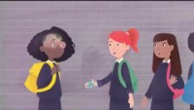
Childhood Trauma and The Brain
5:10 mins
If viewing as a PDF please click this link to watch the film https://youtu.be/xYBUY1kZpf8
Notes:
https://www.youtube.com/watch?v=xYBUY1kZpf8

Slide 15
Reflection
From what you have learned so far, think about:
How has this made you feel?
What has this made you think about?
What one action would you like to take forward?
How can you link what you plan to do with others in your setting?
How you will know that this learning has made a difference?
Notes:
Facilitation notes:
You can do this in groups...
Encourage educators to take this forward in an enquiry
Consider impact of the actions / learning

Slide 16
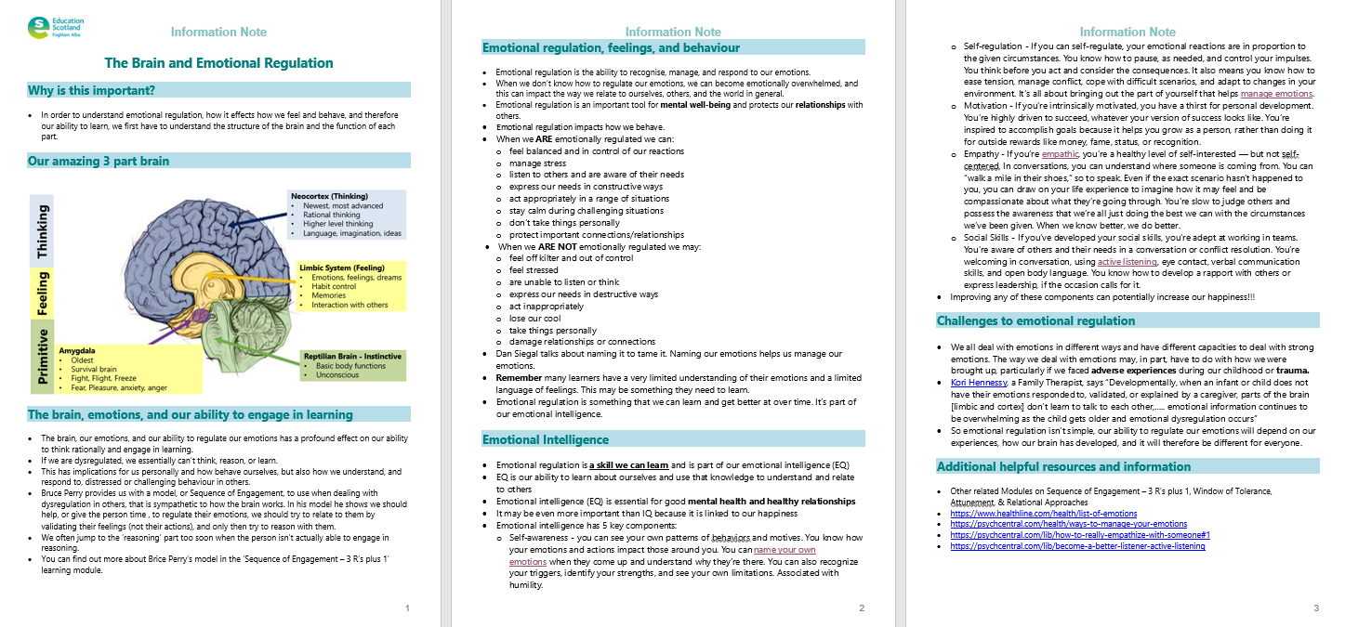
Resources and Information to help

Slide 17
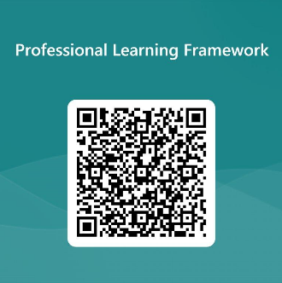
We value your feedback
From now until March 2024 we will be taking feedback on these resources so that we can make changes in advance of a formal launch of the Professional Learning Framework in June 2024
Your feedback could help us improve this resource
Please complete this short form, using the link or QR code, to let us know what you thought of it and any suggestions you have on how it could be improved
LINK: https://forms.office.com/e/b5PCpJJJ3P

Slide 18
For Scotland's learners, with Scotland's educators
Do luchd-ionnsachaidh na h-Alba, le luchd-foghlaim Alba
Education Scotland
Denholm House
Almondvale Business Park
Almondvale Way
Livingston EH54 6GA
T +44 (0)131 244 5000
E enquiries@educationscotland.gsi.gov.uk

