Slide 1

What is Political Literacy?
Professional Learning Resource for Practitioners

Slide 2

Contents
What is political literacy?
Future scenarios
What was the experience of schools and learners during the Scottish referendum?
Referendum effect: Votes at 16
Understanding the key skills of political literacy?
Final reflections

Slide 3

What is political literacy? (Video)

Slide 4
Futures Scenario:
How to build a healthy democracy and engage young people with political processes and ideas?
Democracy
Best case scenario in 5 years
Questions and barriers
Worst case scenario in 5 years
What does political literacy look like in your setting?
Notes:
Create a carousel activity with the four headings on different sheets of paper. Participants use post-it notes to res

Slide 5
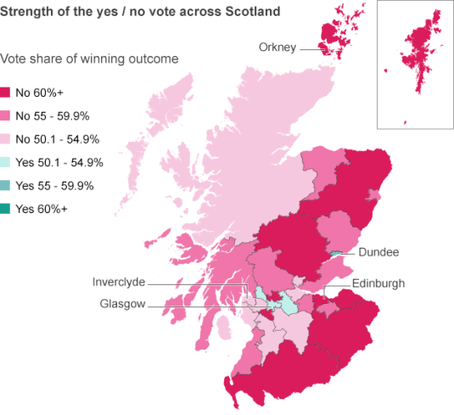
Referendum: 16-17 year old first time voters
  16-17 year olds vote for the first time
  75% turnout of 16-17 year olds
  84.6% overall voter turnout
  No – 55.3%
  Yes – 44.7%
Notes:
Source: http://www.electoralcommission.org.uk/find-information-by-subject/elections-and-referendums/past-elections-and-referendums

Slide 6
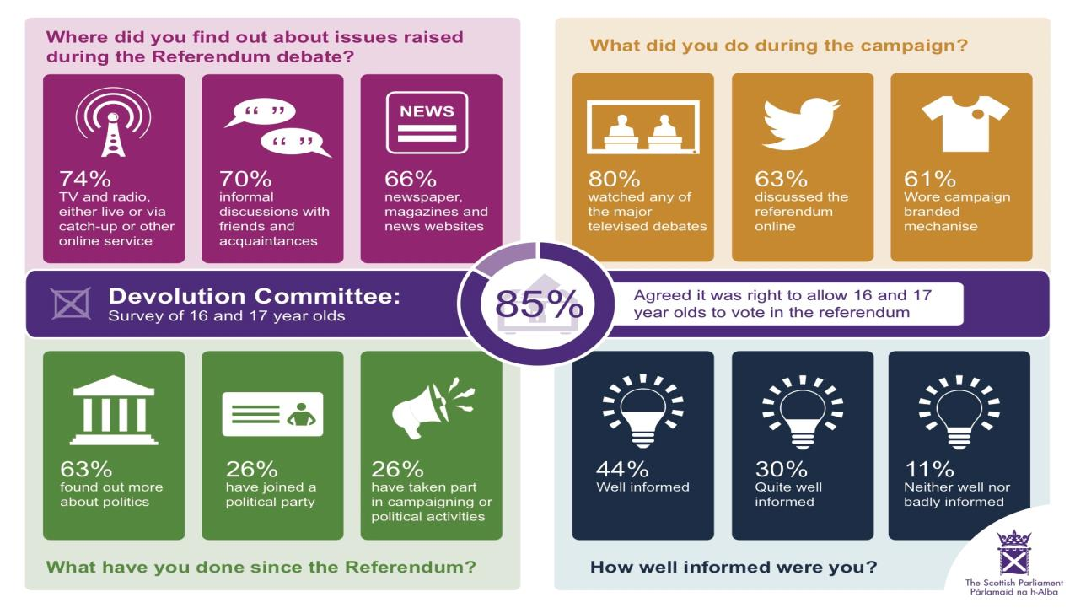
Notes:
Source: http://www.scottish.parliament.uk/parliamentarybusiness/CurrentCommittees/85740.aspx

Slide 7
Referendum (teachers’ views):
Problems in teaching political issues
PROBLEM | % OF RESPONSES
Lack of curricular time | 53
Concern about pupils misreporting bias | 42
Lack of suitable materials | 39
Concern about handling extreme views | 31
Difficulty of achieving balance | 24
Other | 12
RECOMMEND MATERIALS FOR CONTROVERSIAL ISSUES | % OF RESPONSES
Balanced handouts or materials | 28
Debate / discussion | 26
DVDs / on-line materials | 13
Visiting MSPs or other speakers | 13
PowerPoint presentations | 7
Group work | 4
Other | 10
Notes:
http://www.gla.ac.uk/schools/socialpolitical/research/politics/stevensontrust/newsandevents/headline_404844_en.html
Source:
Schools, political literacy and the 2014 Scottish referendum (2015)
Stevenson Citizenship Trust, University of Glasgow

Slide 8
Referendum (young peoples’ views):
What more could the school do to help decide?
METHOD | % OF RESPONSES
Debate or discussion | 60
More teaching | 34
Presentations | 4
Involve pupils more | 1
Leaflets | < 1
Speakers | < 1
‘Give us information from both sides of the argument’
‘We know as much as our parents about political issues’
‘Age should not be the deciding factor on whether or not you can vote’
Notes:
http://www.gla.ac.uk/schools/socialpolitical/research/politics/stevensontrust/newsandevents/headline_404844_en.html
Source:
Schools, political literacy and the 2014 Scottish referendum (2015)
Stevenson Citizenship Trust, University of Glasgow

Slide 9
Reflective questions about the referendum?
  How effective were schools and community settings in teaching about the Scottish referendum?
  What methods did you apply to discussing the referendum?
  What were the barriers to you discussing the referendum?
  What made the referendum a controversial subject?
  What support or guidelines would have made political literacy and referendum discussions easier in your school / community setting?

Slide 10
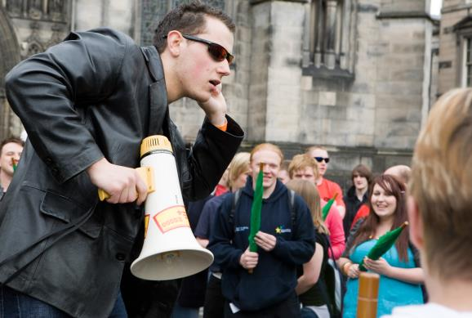
Strong evidence to suggest there was a referendum effect.

Slide 11
VOTING PARTICIPATION IN 2015 GENERAL ELECTION
HIGHER VOTER TURNOUT
The percentage of 18 – 19 year olds certain to vote by nation and age.
(Restricted to those eligible to vote)
* sample size too small
 | 18-19 | 20-24 | 25-44 | 45-64 | 65 or older | All ages
England | 34 | 38 | 51 | 70 | 80 | 63
Scotland | 65 | 57 | 66 | 81 | 88 | 76
Northern Ireland | * | * | 42 | 60 | 74 | 55
Wales | * | 28 | 56 | 70 | 82 | 64
UK | 42 | 39 | 54 | 72 | 82 | 65
Notes:
HIGHER VOTER TURNOUT
http://www.aog.ed.ac.uk/news/last_3_months6/new_aog_briefing_on_votes_at_16
UK wide online panel based survey which also investigated the lasting effects from early enfranchisement experience in referendum for Scottish 16-17yearolds.
Conducted February 2015
Jan Eichhorn, Daniel Kenealy, Richard Parry, Lindsay Paterson & Alexandra Remond
University of Edinburgh
School of Social and Political Science (Social Policy)

Slide 12
POLITICAL ACTION
MORE ACTIVE CITIZENS
The percentage of 18 – 19 year olds taken part in any political action, by nation and age.
Signing a petition, writing to an MP, taking part in a boycott or taking part in a demonstration
* sample size too small
 | 18-19 | 20-24 | 25-44 | 45-64 | 65 or older | All ages
England | 47 | 41 | 48 | 63 | 68 | 56
Scotland | 71 | 54 | 60 | 67 | 63 | 63
Northern Ireland | * | * | 49 | 65 | 67 | 57
Wales | * | 41 | 53 | 65 | 65 | 59
UK | 53 | 43 | 52 | 64 | 67 | 58
Notes:
MORE ACTIVE CITIZENS
Source: http://www.aog.ed.ac.uk/news/last_3_months6/new_aog_briefing_on_votes_at_16

Slide 13
SATISFACTION WITH DEMOCRACY
BUT
UNIVERSAL
DISSATISFACTION WITH DEMOCRACY!
Percentage ‘very’ or ‘rather’ satisfied with democracy in Britain, by nation and age
* sample size too small
 | 18-19 | 20-24 | 25-44 | 45-64 | 65 or older | All ages
England | 26 | 30 | 29 | 21 | 22 | 25
Scotland | 21 | 25 | 24 | 20 | 22 | 22
Northern Ireland | * | * | 16 | 17 | 21 | 17
Wales | * | 20 | 18 | 15 | 21 | 18
UK | 24 | 26 | 25 | 20 | 22 | 23
Notes:
UNIVERSAL UNSATISFACTION WITH DEMOCRACY
Source: http://www.aog.ed.ac.uk/news/last_3_months6/new_aog_briefing_on_votes_at_16

Slide 14
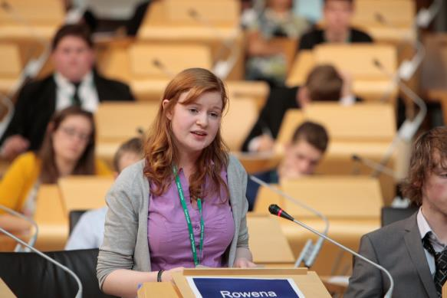
18th June, 2015: Voting age lowered to 16 in
Scottish parliamentary elections

Slide 15










What other countries can vote in national elections at 16?
ARGENTINA
GERMANY
NICARAGUA
AUSTRIA
BRAZIL
ICELAND
CUBA
ECUADOR
HUNGARY
ITALY

Slide 16

What other countries can vote in national elections at 16? ANSWERS
ARGENTINA
NICARAGUA
AUSTRIA
BRAZIL
CUBA
ECUADOR
HUNGARY
CAN VOTE AT 16 IN HUNGARY IF YOU GET MARRIED
Notes:
Source: http://www.theguardian.com/politics/datablog/2015/jun/18/votes-for-16--and-17-year-olds-where-else-outside-scotland

Slide 17
ATTITUDES OF 16-17 YEAR OLDS
Variables | Descriptive results | Scotland | RUK
Making a difference who gets elected | % saying 9-10 on 0-10 scale | 67 | 39
Making a difference who gets elected | % saying a great deal/quite a lot | 58 | 50
Making a difference to own life how UK is governed | % saying a great deal/quite a lot | 47 | 40
16-year olds should be allowed to vote in all elections | % approving | 66 | 52
Politics is difficult to understand | % strongly agreeing/agreeing | 57 | 60
Political participation | % taken part in at least one form | 57 | 40
Number of information source types used | % used 3-6 (of 6) | 60 | 43
Significant difference
Marginal difference
Non-significant difference
Notes:
Comparison with Scotland and the rest of the UK
REFERENDUM HAS NOT MADE POLITICS ‘EASIER’
Source: http://www.aog.ed.ac.uk/news/last_3_months6/new_aog_briefing_on_votes_at_16

Slide 18
ATTITUDES OF 16-17 YEAR OLDS
Variables | Descriptive results | Scotland | RUK
Making a difference who gets elected | % saying 9-10 on 0-10 scale | 67 | 39
Making a difference who gets elected | % saying a great deal/quite a lot | 58 | 50
Making a difference to own life how UK is governed | % saying a great deal/quite a lot | 47 | 40
16-year olds should be allowed to vote in all elections | % approving | 66 | 52
Politics is difficult to understand | % strongly agreeing/agreeing | 57 | 60
Political participation | % taken part in at least one form | 57 | 40
Number of information source types used | % used 3-6 (of 6) | 60 | 43
Significant difference
Marginal difference
Non-significant difference
Notes:
SIMILAR ATTITUDES TO THE REST OF THE UK
Source: http://www.aog.ed.ac.uk/news/last_3_months6/new_aog_briefing_on_votes_at_16

Slide 19
ATTITUDES OF 16-17 YEAR OLDS
Variables | Descriptive results | Scotland | RUK
Making a difference who gets elected | % saying 9-10 on 0-10 scale | 67 | 39
Making a difference who gets elected | % saying a great deal/quite a lot | 58 | 50
Making a difference to own life how UK is governed | % saying a great deal/quite a lot | 47 | 40
16-year olds should be allowed to vote in all elections | % approving | 66 | 52
Politics is difficult to understand | % strongly agreeing/agreeing | 57 | 60
Political participation | % taken part in at least one form | 57 | 40
Number of information source types used | % used 3-6 (of 6) | 60 | 43
Significant difference
Marginal difference
Non-significant difference
Notes:
SIGNIFICANT DIFFERENCES IN THESE 4 KEY AREAS
More Scottish 16-17 year olds think it makes a difference who you elect (the power of the vote)
More Scottish 16-17 year olds think they are ready for the vote
More Scottish 16-17 year olds are active politically
More Scottish 16-17 year olds use a larger variety of information sources

Slide 20
ATTITUDES OF 16-17 YEAR OLDS
Variables | Descriptive results | Scotland (%) | RUK (%)
Have you ever taken a subject in school in which mainly issues about politics and society were discussed? | Yes, as a course I had to take | 21 | 20
 | Yes, as a course I chose to take, but didn’t have to take | 43 | 18
 | Yes, but I don’t know whether I had to take it | 4 | 12
 | No | 32 | 50
Have you been in a class in school during the last three months in which current political issues were discussed? | Yes | 64 | 54
 | No | 32 | 40
 | Didn’t have classes | 4 | 6
Discussed how the UK is governed in the last three months with family | Yes | 63 | 39
Discussed how the UK is governed in the last three months with friends | Yes | 65 | 38
Significant difference
Marginal difference
Non-significant difference

Slide 21
Voting at 16 –What next?
  Early enfranchisement in the referendum has been successful
  Lasting positive effect on young people in Scotland
  Differences between Scotland and RUK partially because of differences in political education and more young Scots engaged in political discussion
  Positive effect because of discussions of politics in the classroom
  Distinctive role for formal “civics” education and classroom discussions as well as the role of family and friends
  BUT - There is a substantial amount of inequality in terms of access to political education
Notes:
Source: http://www.aog.ed.ac.uk/__data/assets/pdf_file/0019/171109/Briefing_-_Scotland_and_the_Process_of_Constitutional_Change.pdf
and
Source: http://www.aog.ed.ac.uk/news/last_3_months6/new_aog_briefing_on_votes_at_16
UK wide online panel based survey which also investigated the lasting effects from early enfranchisement experience in referendum for Scottish 16-17yearolds.
Conducted February 2015
Jan Eichhorn, Daniel Kenealy, Richard Parry, Lindsay Paterson & Alexandra Remond
University of Edinburgh
School of Social and Political Science (Social Policy)

Slide 22



Identify the key skills of political literacy
SKILLS
RESEARCH
DEBATE
PARTICIPATION

Slide 23
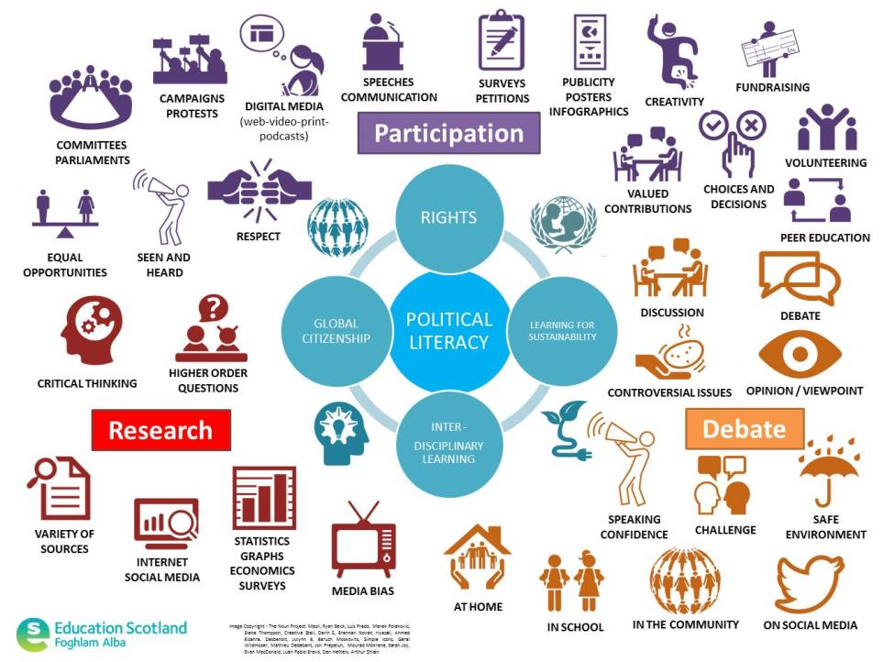

Slide 24
Skill | Early | First | Second | Third | Fourth
Research | Demonstrates how to use different resources to find interesting information, e.g. photograph, poster, story book Chooses a useful resource to learn something new. | Understands what a question is asking. Finds and selects different information to answer a question. | Creates a number of specific questions to research a topic. Finds and selects relevant information from a range of sources. Identifies and decides what sources are trustworthy with justification. | Creates a hypotheses for a piece of research. Uses a range of evidence to link information to a theme or issue. Identifies exaggeration and bias in a source of information. Identifies sources to support an argument or theory. | Analyses a range of evidence to answer a question and conduct research. Evaluates evidence to investigate a hypotheses. Evaluates the usefulness of a source of information in terms of author, date published /written, content, purpose, bias and exaggeration. Evaluates evidence to develop a sustained line of argument, informed opinion or justified conclusion.
 |  |  | Skims and scans text to select and record information from a source to take notes under headings. Paraphrases information to make notes under headings. Summarises the main points of research into own words in a concise piece of text.
Debate | Describes an event Listens to the views of others and responds with own views | Develops an argument on a local issue | Develops an argument and supplies evidence for a local issue. Compares arguments on a local issue. Organises evidence for an argument in a logical manner. | Uses a range of evidence to form an opinion. Identifies and accepts others’ points of view Focuses on argument and purpose to engage an audience. | Uses a range of evidence to develop a sustained line of argument and persuade others on a controversial issue.
Notes:
Skills progression in political literacy

Slide 25
Suggested themes for assessment within political literacy | Make | Say | Write | Do
Rights Local and Global Citizenship Cooperation and conflict Fairness, Justice and Rule of Law Participation | DVDs/Films/animations/radio programmes and podcasts about social issues, local people and community Creating campaign materials and displays/viral ads or campaigns for social media Collecting, editing and presenting news material for mock publications or broadcasts TV /poster adverts Publicity flyers Information factsheets Academic posters Audio-Visual presentations Graffitti wall/models/artwork as communication Talking heads video clips Digital storytelling Blogs, wikis etc. Graphs/maps/infographics | Answering questions and giving ideas during story sessions Asking questions about issues Offering explanations for ideas Building on the ideas of others Use of effective questioning /higher order skills Presenting to an audience Delivering speeches and talks Creating campaign songs Floor questions in debates Experience of a variety of formal and informal debate and discussion techniques/discussions with key figures Hustings event Peer reflections | Campaign posters (with key message) Captions for photos Story beginnings/endings Evaluations/Peer Evaluations – ‘I like this because…’ ‘I don’t like this because…’ Lists giving tips or advice Letters/emails to… Postcards to…from… Reflective journal entries Protest banners Extended writing about…(reports, articles, essays, diaries, biographies, obituaries, manifestos, policy writing) Social media conversations/blogs Surveys/questionnaires/ opinion polls Note taking and making for research | Any actions that convey participation e.g. litter pick; garden tidy; class/group rep; Fair Trade/shoe box appeals/school committee etc. Local and global action campaigns Planning and running information or enterprise days/fairs/ Designing and making advertising materials Supporting local organisations Volunteering for charities and other organisations Planning and organising hustings to discuss social issues Participating in local environmental action (e.g. clean-ups, Soup kitchens etc. Holding a debate to persuade others Running a TV station / radio station / school newspaper / magazine / online chat / youtube channel Conducting surveys / opinion polls Running a mock election or school committee Researching methods and higher order thinking
Notes:
Planning for assessment evidence in political literacy

Slide 26
Reflective questions
  What more could schools and community settings do to develop the key skills of political literacy?
  What would a good political literacy lesson / programme look like for you subject / stage / school / community setting?
  What further professional support or training do you require to give you confidence with political literacy skills?

Slide 27

Image Copyright - The Noun Project: Mazil, Ryan Beck, Luis Prado, Marek Polakovic, Blake Thompson, Creative Stall, Darin S, Brennan Novak, riyazali, Ahmed Elzahra, Desbenoit, Julynn B, Baruch Moskovits, Simple Icons, Geral Wildmoser, Mathieu Dedebant, Jon Prepeluh, Mourad Mokrane, Sarah Joy, Evan MacDonald, Juan Pablo Bravo, Dan Hetteix, Arthur Shlain
Education Scotland
Denholm House
Almondvale Business Park
Almondvale Way
Livingston EH54 6GA
T +44 (0)141 282 5000
E enquiries@educationscotland.gsi.gov.uk
https://education.gov.scot

