Slide 1
The Curriculum Story Project: 4. Balancing Expectations
Discussion Activities
For Scotland's learners, with Scotland's educators
Notes:
This is a front cover page and can only be used once. Use the corresponding green internal and back pages if you are using this page. You may add a title and a subtitle if needed only. Do not add anything else or move elements around.

Slide 2
How to use this download pack
The discussion and practical activities in this pack connect to the case studies and ideas around interdisciplinary learning of
The Curriculum Story Project 4: Balancing Expectations.
While there is value in using them as standalone resources, we encourage teams to read the case studies, together, as part of their own reflective practice.
From 2020-22, The Curriculum Story Project from Education Scotland brought together nearly 200 practitioners to understand the components, processes, and thinking behind successful interdisciplinary learning and the development of broader learner pathways.
The case studies and activities are designed by NoTosh, a firm specialised in helping people think differently and choose the way they learn and work.

Slide 3
Discussion activities
First read the case studies for The Curriculum Story Project – Balancing Expectations. Then use one of these discussion points for a learning session or team meeting.
Discussion 1. How would planning look for IDL projects if you begin with the learner and unique context of your setting?
For example, what specific learners’ needs should you consider and opportunities for increased partnership working?
Discussion 2: What are the challenges you face in managing the coverage of Es&Os?
For example, would whole-school focus weeks and days be helpful as examples of how to bundle groups of Es&Os across the school year?
Discussion 3: How could you use the context of personal achievement as a cornerstone for IDL projects?
For example, how can you encourage diversity through academic and non-academic learning pathways, and amplify learners’ agency and achievements in meaningful ways?
For Scotland's learners, with Scotland's educators
Notes:
This is an internal page in green and can be duplicated to create additional pages. Always keep the heading and footer as shown. Use the corresponding green front and back pages if you are using this page.

Slide 4
The Curriculum Story Project: 4. Balancing Expectations
Practical Activities
For Scotland's learners, with Scotland's educators
Notes:
This is a front cover page and can only be used once. Use the corresponding blue internal and back pages if you are using this page. You may add a title and a subtitle if needed only. Do not add anything else or move elements around.

Slide 5
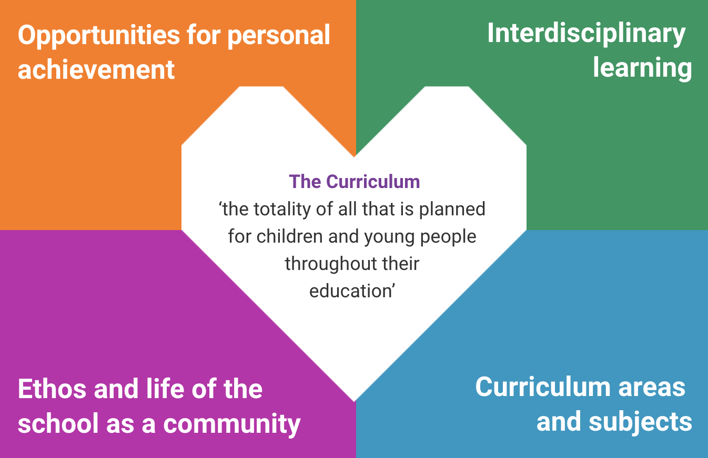
1. Circle of Viewpoints – exploring different perspectives informing curriculum design
The four contexts for learning are suggested as a more productive starting point for curriculum design than the Es & Os. They emphasise the diverse needs of individual learners and amplify the unique contexts of community settings.
Therefore, a useful activity is to consider the different perspectives of how these contexts are interpreted and understood. Curriculum-making guidance highlights the importance of understanding the different needs and perspectives of your learners and community partnerships.
For Scotland's learners, with Scotland's educators
Notes:
This is an internal page in blue and can be duplicated to create additional pages. Always keep the heading and footer as shown. Use the corresponding blue internal and back pages if you are using this page.

Slide 6
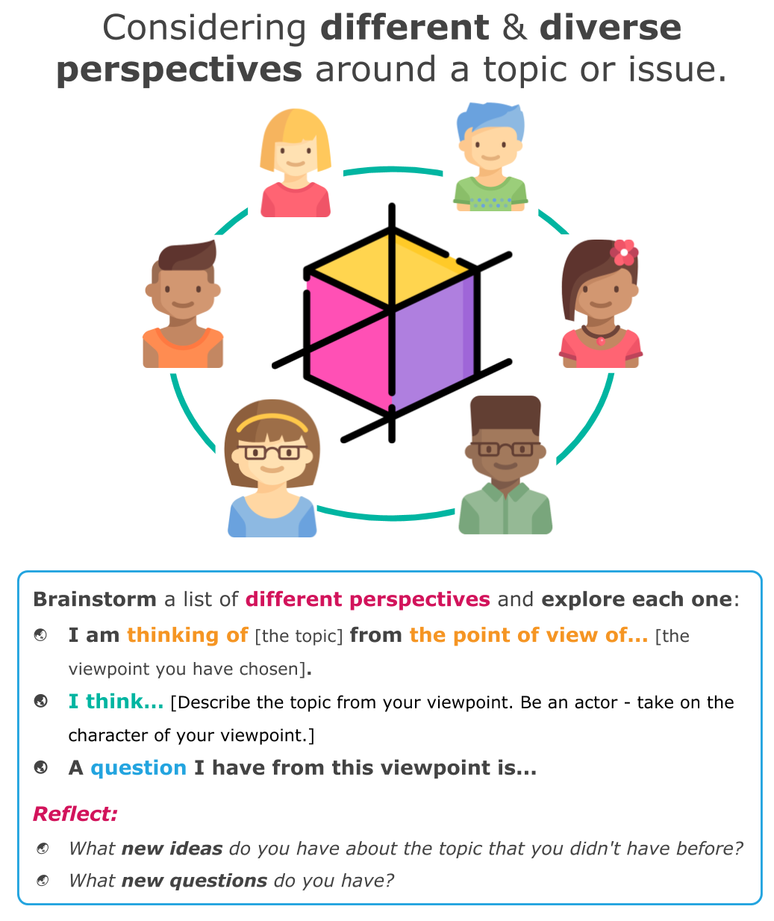
1. Circle of Viewpoints – exploring different perspectives informing curriculum design
Circle of Viewpoints is a thinking routine from Project Zero at the Harvard Graduate School of Education.
Brainstorm different perspectives to consider to enhance the curriculum design of IDL.
For example: learners with different needs, different subject lenses, different parental viewpoints, different community and partner viewpoints.
Individually or in groups, choose an existing or prospective IDL project and explore it in more depth from one of these perspectives. Use the sentence starters to frame your thinking.
© https://learn.wab.edu/attl/pz/graphics
For Scotland's learners, with Scotland's educators
Notes:
This is an internal page in blue and can be duplicated to create additional pages. Always keep the heading and footer as shown. Use the corresponding blue internal and back pages if you are using this page.

Slide 7
2. Beginning, Middle, End thinking routine to explore the potential effect of an IDL project on the learner pathways and personal achievement of learners
Beginning, Middle, End is a thinking routine from Project Zero at the Harvard Graduate School of Education. It uses the power of narrative and storytelling to imagine and project how the IDL project will enhance the personal achievement of learners.
Choose a recent IDL or collaborative project in your setting. You may wish to also use one of the learner viewpoints from the previous activity. Then, working in groups, choose one of these questions (consider both positive and negative scenarios):
If the IDL project is the beginning of a new learner pathway for the learner, what might happen next?
If the IDL project is the middle of a learner pathway for the learner, what came before it? Where could it go next?
If the IDL project is the end of a learner pathway for the learner, what might the story of personal achievement be?
For Scotland's learners, with Scotland's educators
Notes:
This is an internal page in blue and can be duplicated to create additional pages. Always keep the heading and footer as shown. Use the corresponding blue internal and back pages if you are using this page.

Slide 8
Education Scotland
Denholm House
Almondvale Business Park
Almondvale Way
Livingston EH54 6GA
T +44 (0)131 244 5000
E enquiries@educationscotland.gsi.gov.uk
For Scotland's learners, with Scotland's educators
Notes:
This is a back cover page in blue. You may edit the address if needed only. It can only be once and at the end of the PowerPoint presentation. Use the corresponding blue internal and back pages if you are using this page.

Slide 9
Notes:
This is a front cover page and can only be used at the beginning of a PowerPoint presentation once. Do not add anything else to this screen if it is being used.

