Slide 1
Effective use of data
5. Developing a data informed culture
Practitioners
Notes:
All information is correct as of May 2024
These slides are intended to support senior leaders, middle leaders and practitioners in schools and local authorities to explore the effective use of data for improvement. There are a set of six workshops available for senior leaders and middle leaders and a set of six workshops for practitioners. The workshops were co-designed with educators from across Scotland and are based on an Education Scotland literature review: The Effective use of data for improvement in education.
Establishing the purpose and use of data
Defining and classifying data
Creating effective processes and systems
Interpreting and analysing data
Developing a data informed culture
Using data for improvement
(hyperlinks for each workshops can be found on the next slide)
The PowerPoint is a template that presenters can adapt to suit their own context and style of presenting. The workshops can be delivered individually or grouped together and delivered in a longer session. Individual workshops have been designed for facilitators to deliver in 1 to 2 hours.
Within the slide notes key messages, suggested tasks, ‘talking-points’ and reflective questions are included.
It is anticipated the facilitator will have read the Education Scotland literature review: The Effective use of data for improvement in education.

Slide 2
The national model of professional learning
The national model of professional learning | Professional Learning | Education Scotland
Notes:
Key Messages
This module has been designed using the national model of professional learning and the principles of adult learning or andragogy. It has been designed to think about:
The why – opportunities for participants to understand the rationale through professional standards, research, current policy landscape and national/local priorities.
The what – opportunities for participants to consolidate and develop relevant knowledge and skills
The how – opportunities for participants to take part in peer discussion, explore case studies or share experiences
Apply – a chance to reflect on learning, next steps and further support
A link to further information about the national model of professional learning can be found below.
edscot-model-of-professional-learning-outline.pdf (education.gov.scot)

Slide 3
Draft Group Agreement and Protocols
Work together
Learn from, with, and on behalf of each other.
Create a safe space to share ideas and build learning.
Agree that everyone is an equal and valued participant.
Remain in the room (emails and phone protocol)
Notes:
Key Messages
Take a moment to establish group protocols.
Ask participants to check and comment on anything they would like to add or amend.
The protocols on the slide are suggestions and may be amended for your school context.

Slide 4
Connector
In groups/pairs share a good book recommendation. It can be something you have read recently or an all-time favourite. Please share the name of the book and a brief explanation of why you enjoyed it.
Notes:
Key Messages
This is an example of a simple connecter activity. It is recommended that facilitators use a connector activity that allows participants to take part in an informal discussion.
This is to ensure that participants are relaxed, focused and ready for an interactive workshop.

Slide 5
Re-cap
In workshop 1 we looked at the purpose and use of data including: the meaning of data and evidence, the ways in which data is used and what we mean by ‘big’ and ‘small’ data.
In workshop 2 we considered different categories of data and how these may be intersected to support improvement.
In workshop 3 we looked at the importance of developing effective data systems and processes.
In workshop 4 we looked at ways to analyse data from a range of sources including contextual, attainment and comparator data.
Notes:
Key Messages
This slide offers a brief recap of content covered in previous workshops.

Slide 6
Aims
In this workshop we will consider:
national guidance and research,
what an effective data culture may look like,
key considerations when developing a positive data culture, and
improving a data culture scenarios.
Notes:
Key Messages
The aims of the session to read to participants.

Slide 7
Content coverage
National guidance and research
Defining a positive data culture
Key considerations
Scenarios activity
Reflection and feedback
Notes:
Key Messages
This slide shows the content covered throughout the workshop. Further details and suggested timings are provided below. Facilitators can amend content and timings to suit their needs and context.
National guidance and research – This section explores guidance and research. It contains a task in which participants are asked to reflect on a selection of quotes about culture. Allow 10 mins for this section with 10 mins for the quotes task. It can be extended to 20 mins if facilitators wish to provide time for participants to read and discuss the relevant section of the evidence review.
Defining a positive data culture – This section is a task in which participants are asked to consider the key components of a data culture. Allow 20 mins for this activity.
Key considerations - This section explores some key considerations for leaders developing positive data cultures. Allow 15 minutes for this section.
Scenarios activity - this section contains a task that provides participants the opportunity to discuss how they would approach different data culture scenarios. Allow 20 mins for this activity.
It is expected that this workshop should take between 1 hour and 5 mins and 1 hour and 15 mins to deliver.

Slide 8
Culture quotes
It’s a butterfly effect. In positive cultures, the most effective teachers talk to each other about teaching, learning and assessment.
Sir Tim Brighouse
In a healthy school culture, data is information, not condemnation.
Anthony Muhammad
When a culture is strong people work with each other for each other. A culture is weak when people work against each other for themselves.
Simon Sinek
My definition of a good culture is just one that is consistent between what it thinks, what it says and how people act. I think the frustration and dissatisfaction most people have is from inconsistency.
Bob Glazer
Notes:
Key Messages
This workshop will focus on developing positive data cultures.
Please read the culture quotes and share with a partner/group any that resonate with you and why.

Slide 9
GTCS Standard for Full Registration and Career Long Professional Learning
Curriculum and Pedagogy
3.1.1 - Plan effectively to meet learners’ needs
3.1.4 - Effectively employ assessment, evaluate progress, recording and reporting as an integral part of the teaching process to support and enhance learning.
Professional Learning
3.3.2 - Engage in reflective practice to develop and advance career-long professional learning.
GTCS The Standard for Full Registration
GTCS - The Standard for Career-Long Professional Learning
Notes:
Key messages
The GTCS Standard for full registration and for Career Long Professional Learning highlights the importance of the use of data in decision-making.
The standard is the same for both groups.
This standard emphasises the importance of data being used to support planning and enhancing learning.
Reflective Questions
How wide ranging and robust is the data you are using in school? How do you know?

Slide 10
HGIOS 4
Staff make effective use of current available data on levels of child poverty and apply this to ensure equity (1.5)
All teachers have well-developed skills of data analysis which are focused on improvement (2.3)
We use data to evaluate the effectiveness of interventions designed to improve outcomes for all learners (2.3)
Notes:
Key Messages
How Good is Our School 4 describes the ways in which schools may use data effectively for improvement. This includes:
Gathering data to monitor and track progress
Regular interrogation of data
Making effective use of data on child poverty to ensure equity, and
Ensuring that all teachers have well developed skills of data analysis
Reflective Questions
How confident are we in using data to focus on improvement?

Slide 11
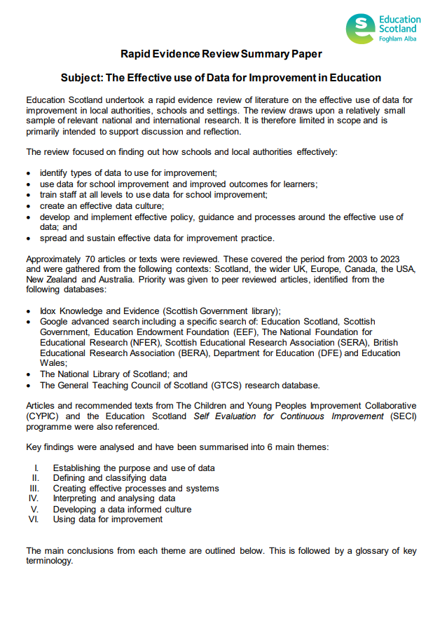
Rapid Evidence Review Paper
Section five of the Education Scotland Rapid Evidence Review on developing a data informed culture highlights that:
It is vital to provide time for collaboration and discussion around data.
Foster a ‘high challenge, low threat’ approach to data.
It is important that data for improvement is understood and utilised at all levels.
Clear policies, frameworks and governance can help to clarify roles and expectations.
Notes:
Key Messages
Section five of the rapid evidence review on creating effective processes and systems highlights that:
It is vital to provide time for collaboration and discussion around data.
Foster a ‘high challenge, low threat’ approach to data.
It is important that data for improvement is understood and utilised at all levels.
Clear policies, frameworks and governance can help to clarify roles and expectations.
The Effective use of data for improvement in education
Talking Points
This may be a good point to ask participants to read section five on developing a data informed culture.
Reflective Questions
How have you supported a data informed culture? What have the challenges been? What was successful?

Slide 12
What is a positive data culture?
A culture is often defined as the attitudes, beliefs and practices of a specific group of people / organisation.
A culture is also about behaviours.
Let’s consider what a positive data culture might look like in schools / educational settings.
What would it look like?
What would it feel like?
What sorts of things would happen?
Notes:
Key Messages
This task is designed to provide participants with an opportunity to establish a vision around what an effective or positive data culture might look like.
Facilitators may wish to take extended feedback and record key features on a flipchart that can be referred to later / throughout the workshop.

Slide 13
Clear and consistently applied policy and guidance
Establishing clear policy and guidance around data use, systems and processes can help to ensure consistency and clarity. You may wish to consider:
Do we have access to clear and accessible guidance/policy around the use of data?
Are we aware of how and when we use data during different parts of the improvement cycle?
Do we know how or where to access support?
If guidance is in place – are we applying it effectively?
Notes:
Key Messages
This section explores some key considerations for leaders developing positive data cultures.
Establishing clear policy and guidance around data use, systems and processes can help to ensure consistency and clarity. You may wish to consider:
Do we have access to clear and accessible guidance/policy around the use of data?
Are we aware of how and when we use data during different parts of the improvement cycle?
Do we know how or where to access support?
If guidance is in place – are we applying it effectively?

Slide 14
Clear and consistently applied policy and guidance – part 2
This slide is a place holder for facilitators to consider adding in any local authority links to guidance or policy around data.
This slide can be added to or removed as appropriate.
Notes:
Key Messages
It may be helpful for facilitators to insert local examples of commonly used data, presented in the ways in which school leaders would be expected to read and analyse.
This would provide participants with an opportunity to review and check their understanding of how to read the data that they may access through the local authority if this is additional to / different from national data examples.

Slide 15
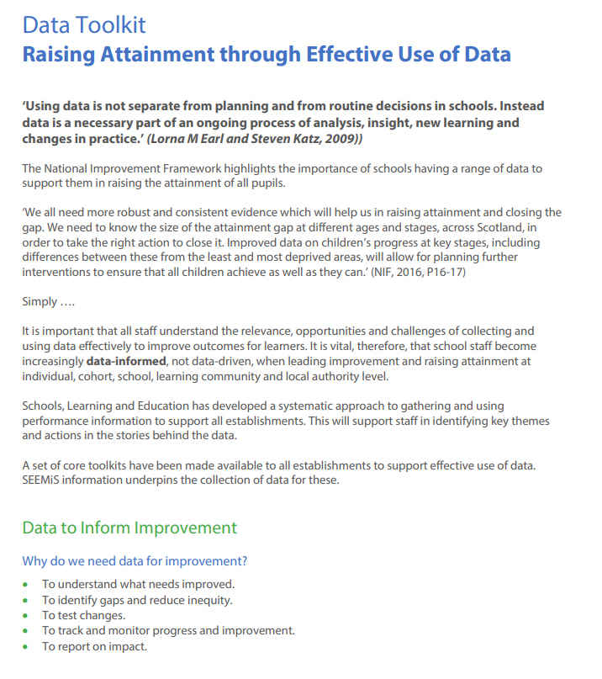
Policy and guidance improvement hub case study
Stirling’s Excellence and Equity Strategy | Resources | National Improvement Hub (education.gov.scot)
Notes:
Stirling’s Excellence and Equity Strategy | Resources | National Improvement Hub (education.gov.scot)
Key Messages
Signposting to a case study from Stirling local authority on the Education Scotland Improvement hub.
Stirling have developed a data toolkit.

Slide 16
Clear roles and responsibilities
It is important the whole staff, learners, partners and families are aware of the way in which data is used and their roles and responsibilities around it.
Levels of knowledge, skill and engagement may vary between roles, but it is important to establish that data is ‘everyone’s business.’
We all have the responsibility to collect, analyse and develop actions around the data.
Data and evidence are only impactful if everyone is engaged. Improvement is often most directly influenced by those working closest to the learner.
Notes:
Key Messages
It is important the whole staff, learners, partners and families are aware of the way in which data is used and their roles and responsibilities around it.
Levels of knowledge, skill and engagement may vary between roles, but it is important to establish that data is ‘everyone’s business.’
We all have the responsibility to collect, analyse and develop actions around the data.
Data and evidence are only impactful if everyone is engaged. Improvement is often most directly influenced by those working closest to the learner.
Reflective Questions
Why is it important that all staff, learners, families and partners are able to engage in data at an appropriate level?

Slide 17
Training and development
As a staff we need:
opportunities to reflect on our existing beliefs and practices and be challenged in a non-threatening manner,
interactive training experiences, with opportunities for active learning through observation, meaningful discussion and reflection, demonstration of skills, deliberate practice, and feedback.
structured support to help us apply our learning,
to feel comfortable seeking support and guidance.
Notes:
Key Messages
It is likely that your staff levels of knowledge, skills, confidence and experience around data will be varied.
It is important to have a clear view of the range and development needs so that leaders can plan to ensure that everyone has the skills and knowledge they need to engage with data.
Staff need to be aware of what they are entitled to:
opportunities to reflect on our existing beliefs and practices and be challenged in a non-threatening manner,
interactive training experiences, with opportunities for active learning through observation, meaningful discussion and reflection, demonstration of skills, deliberate practice, and feedback.
structured support to help us apply our learning,
to feel comfortable seeking support and guidance.
Reflective Questions
In relation to the points on this slide, where do our strengths as an establishment lie? What could we do better in order to develop your confidence and knowledge in relation to working with data?

Slide 18
Meaningful collaboration and dialogue
The Sutton Trust produced a report in 2015, on Developing Teachers . It highlights that ‘professional collaboration benefits all and leads to innovation and creativity’.
When thinking about fostering positive data dialogue and collaboration, it may be helpful to consider whether:
as a staff we engage in formal or informal collaborative discussions, analysis and planning involving data or evidence,
leaders are modelling informal and formal data discussions, and if
we look outwards and seek to collaborate with other schools to improve our understanding and use of data.
Notes:
Key Messages
The Sutton Trust produced a report in 2015, on Developing Teachers . It highlights that ‘professional collaboration benefits all and leads to innovation and creativity’.
When thinking about fostering positive data dialogue and collaboration, it may be helpful to consider whether:
staff engage in formal or informal collaborative discussions, analysis and planning involving data or evidence,
leaders are modelling informal and formal data discussions, and if
we look outwards and seek to collaborate with other schools to improve our understanding and use of data.

Slide 19
An embedded and ‘joined up’ approach
In an effective data culture, the use of data and evidence is embedded throughout all areas of the improvement cycle.
Data and evidence are used to plan, track, monitor and evaluate improvement at whole school and classroom level.
Informal and formal data discussions take place between educators who feel challenged but psychologically safe. They openly share and are curious about data.
All stakeholders understand the role of data and evidence in school and their part in utilising it effectively.
The use of data and evidence is part of ‘normal’ everyday activity.
Notes:
Key Messages
In an effective data culture, the use of data and evidence is embedded throughout all areas of the improvement cycle.
Data and evidence are used to plan, track, monitor and evaluate improvement at whole school and classroom level.
Informal and formal data discussions take place between educators who feel challenged but psychologically safe. They openly share and are curious about data.
All stakeholders understand the role of data and evidence in school and their part in utilising it effectively.
The use of data and evidence is part of ‘normal’ everyday activity.

Slide 20
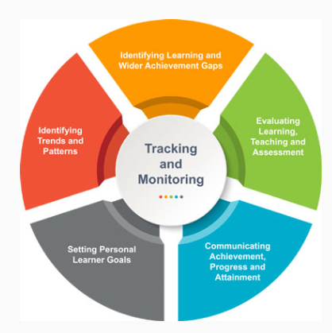
An embedded approach – signposting to tracking and monitoring guidance.
Resources to support effective tracking and monitoring | Resources | Education Scotland
Notes:
Key Messages
A link to signpost participants as appropriate to an Education Scotland resource with guidance around effective tracking and monitoring and how this may be imbedded into your systems and processes (also referenced in workshop 3).

Slide 21
Data culture challenges activity
A. Data is viewed as the role or domain of the leadership team.
B. As a staff we collect a lot of data but are sometimes unsure of the purpose of collecting some of it.
C. Learners, families and partners are not involved in data.
D. Data systems and processes are unreliable, inconsistently used or inaccurate.
E. We feel as if we have a lot of data but are unsure how to use it – data paralysis.
F. Data is gathered and analysed but it is not used to effectively improve outcomes – planning, ongoing tracking and evaluation.
Notes:
Key Messages
This activity has been designed to give participants the opportunity to problem solve fictional scenarios around ensuring a positive data culture.
Ask participants to work in pairs or small groups with an allocated or chosen scenario. (Facilitators may wish to adapt scenarios to known needs in their context as appropriate).
Participants should discuss and note down
Why the scenario is an issue? What are the problems/risks?
What may be the likely cause for this scenario?
How can we work together as an establishment to improve the scenario?
Facilitators can take feedback from around the room or ask groups with different scenarios to share with each other.

Slide 22
Aims Review
In this workshop we will consider:
national guidance and research,
what an effective data culture may look like,
key considerations when developing a positive data culture, and
Improving a data culture scenarios.
Notes:
Key Messages
The aims of the session to read as a recap for participants.

Slide 23
Reflection activity
Area | 0 | 1 | 2 | 3 | 4 | 5 | Actions?
Clear and applied policy and guidance
Effective data training and development
Established roles and responsibilities
Regular collaboration / data dialogue opportunities
High challenge and low threat environment – psychological safety around data
Data and evidence is embedded in everything we do – being data informed is ‘the norm’ for all staff.
Notes:
Key Messages
This reflection activity is designed for individual participants to consider where their school is in each area. They can rate it from 0-5 and note down some brief actions as appropriate.
Facilitators may wish to copy and print the table for participants or create a version using an online tool. It is intended to be a personal reflection. It is advised that any online collection approach is anonymous and that participants can still ‘take-away’ their thoughts for further consideration in their school/setting.

Slide 24
Feedback
Insert you own evaluation code here
Notes:
You can insert your own feedback link here.
Thank-you. We hope that you found this resource useful.
Please provide feedback on the materials here https://forms.office.com/e/viKTsvQj9d
Your comments are appreciated and will be used to inform future resources.
This link should not be shared with the audience.

