Slide 1
Inclusion, Wellbeing and Equalities Professional Learning Framework
Mirrors and Windows: Diversity in the Curriculum
Level – Informed
@ESInclusionTeam
For Scotland's learners, with Scotland's educators
Do luchd-ionnsachaidh na h-Alba, le luchd-foghlaim Alba
Notes:
SLIDE 1:
Inclusion Wellbeing & Equalities Professional Learning Framework – Mirrors and Windows: Diversity in the Curriculum
This professional learning is pitched at an informed level and is suitable for anyone working with children, young people and adult learners in an educational context.

Slide 2
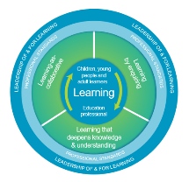
How to use this resource
Pause for Thought…
These slides can be used to facilitate professional learning in a group or whole-setting, or as a self-directed learning activity as an individual.
Facilitation notes are included at the bottom of each slide
Please do not remove or change any of the slides included.
Facilitators are welcome to add slides or activities relevant to your own setting, to support discussion and exploration of the topic. Facilitators will know their participants’ needs best.
Anyone who works in an educational setting can be a facilitator and use these slides.
For reflection or discussion activities, it is important to establish a safe space which encourages respect and honesty to ensure that everyone is able to participate.
Notes:
Slide 3:
[Option to skip this slide as instructions for facilitators only. No need to read to audience]
These slides can be used to facilitate professional learning in a group or whole-setting, or as a self-directed learning activity as an individual.
Facilitation notes are included at the bottom of each slide
Please do not remove or change any of the slides included.
Facilitators are welcome to add slides or activities relevant to your own setting, to support discussion and exploration of the topic. Facilitators will know their participants’ needs best.
Anyone who works in an educational setting can be a facilitator and use these slides.
For reflection or discussion activities, it is important to establish a safe space which encourages respect and honesty to ensure that everyone is able to participate.
FACILITATION NOTES can also be found on a separate Word document on the Education Scotland Inclusion, Wellbeing and Equalities Professional Learning Framework.

Slide 3
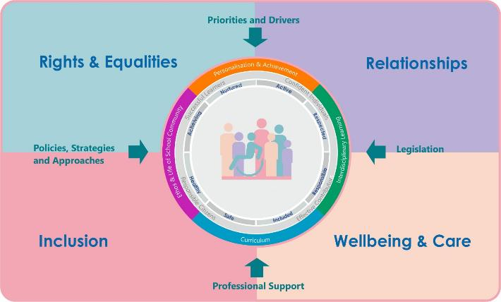
Inclusion, Wellbeing and Equalities Professional Learning Framework
Notes:
Slide 3
This professional learning resource comes under the Rights and Equalities theme of the Inclusion, Wellbeing and Equalities Professional Learning Framework.

Slide 4
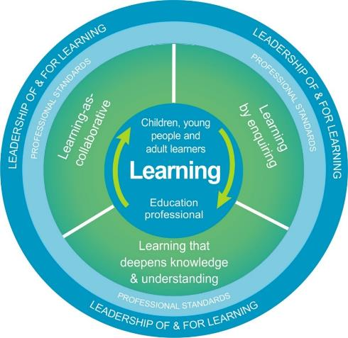
National Model for Professional Learning
This professional learning resource will support you to deepen your knowledge and understanding.
You will have the opportunity to consider how to take this learning forward on your own and with others.
The National Model of Professional Learning (education.gov.scot)
Notes:
Slide 4:
This professional learning resource follows the national model for professional learning and is designed to help you gain more knowledge and have a deeper understanding of inclusion, wellbeing and equalities.
You will have the opportunity to consider how to take this learning forward on your own and with others and, on completion of the professional learning, you will be asked to consider what your next steps will be.
Please take some time to consider the reflective questions at the end of this resource
Links: The National Model of Professional Learning

Slide 5
Welcome
Pause for Thought…
This session provides an opportunity to:
Consider the importance of embedding diversity and equalities in the curriculum.
Explore a practical and simple approach – Mirrors and Windows – to embedding equalities in the curriculum.
Notes:
Slide 5:
This session aims to provide an opportunity to:
Consider the importance of embedding diversity and equalities in the curriculum.
Explore a practical and simple approach – Mirrors and Windows – to embedding diversity in the curriculum.

Slide 6
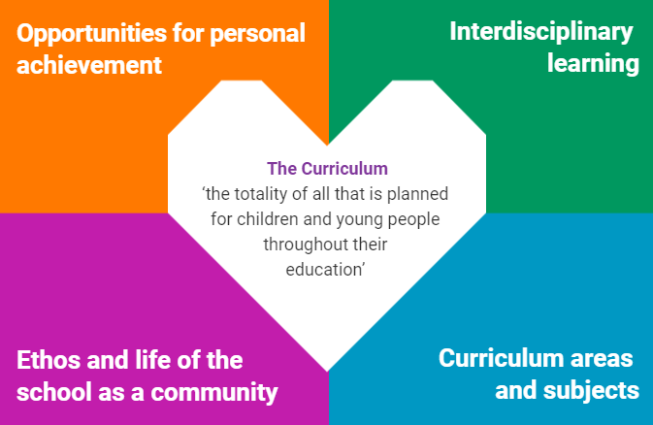
Scotland’s Curriculum: Totality of Learning Experiences
Scotland’s curriculum is defined as the totality of all that is planned for children and young people from early learning and childcare, through school and beyond (Scotland’s Curriculum).
Everyone who works with children and young people can contribute to embedding diversity and equalities in curriculum.
Notes:
Slide 6:
Scotland’s curriculum is defined as the totality of all that is planned for children and young people from early learning and childcare, through school and beyond (Scotland’s Curriculum: https://scotlandscurriculum.scot/4/).
Scotland’s curriculum is not restricted to curriculum areas and subjects. It isn’t restricted which texts we teach and what happens in a classroom. It also includes opportunities for personal achievement, interdisciplinary learning and the ethos and life of the learning setting.
Scotland’s Curriculum is designed to be a coherent, flexible and enriched curriculum that is adaptable and responsive to the diverse needs of individual learners and which reflects the uniqueness of their communities. It is important that all children and young people are represented, see themselves in the curriculum and recognise that it is relevant to them.
As such, everyone who works with children and young people can contribute to embedding diversity and equalities in curriculum. This includes Pupil Support Assistants, janitors, caterers, police officers and more.

Slide 7
When Diversity is Lacking in the Curriculum
Missing perspectives
Absorption of biases & prejudice
Masking
diversity
Less empathy & understanding
Discrimination & bullying
Internalising stereotypes
Notes:
Slide 7:
When diversity is lacking in the curriculum...
Perspectives are missing. The curriculum is incomplete and inaccurate. Knowledge is shared from a monocultural, monolinguistic, narrow perspective of the world. The dominant perspective (often white, male, middle class, cisgendered, heterosexual, able-bodied, neurotypical, English-speaking, Christian...) is seen as "normal" and everything else is considered "other."
As a result, learners put in a lot of effort to fit into the narrow "norm." This often means spending a lot of time masking their diversity (e.g. pretending to be neurotypical, not speaking any other language than English, hiding their religion/home culture and food, changing their name and accent, pretending they don't experience or provide care, pretending they aren't experiencing poverty, etc.)
Diverse learners also risk internalising stereotypes and negative messages about themselves that limit their potential and their aspirations (e.g. choosing career paths based on gender, race, social class, etc., believing they can't do well in X subject because of their diverse identity, etc.)
Every learner risks absorbing biases and prejudiced ideas that exist in a curriculum that lacks diversity (e.g. believing stereotypes about groups that don't share the same identities as them and developing unconscious/implicit biases about girls, LGBT people, Black people, Jewish people, etc.)
As a result of prejudiced ideas and narrow perspectives on diverse people, learners have less empathy and less of an understanding of the lives and perspectives of diverse people
This can lead to an increase in discrimination and bullying.

Slide 8
What do we mean by "diversity"
and "diverse people"?
Pause for Thought…
Notes:
Slide 8:
In this session, we refer to diversity and diverse people. It’s helpful to clarify first what we mean by diversity. What do you understand by "diversity"? What do you understand by "diverse people"?
(If there is time in a group setting, you can pause here for a short discussion of participants' understanding of those terms)

Slide 9
Diversity
Linguistic
Religion / Belief
Pause for Thought…
Socioeconomic
Ethnic/Cultural/Racial
Disability
Gender/Sex
Neurodiversity
Sexual Orientation
Age
Family
Notes:
Slide 9:
When exploring the concept of “diversity” and embedding diversity in the curriculum, it is worth considering this diagram illustrating some of the features of diversity.
Look at the types of diversity illustrated on the diagram (linguistic; religious/faith; ethnic/cultural/racial; gender/sex; sexual orientation, family; age; neurodiversity; disability; socioeconomic). For each feature of diversity, there are different groups of people and issues to keep in mind. For example, diversity of family can include care-experienced learners, young carers, LGBT families, lone parent families, religious and cultural diversity in families and more. Issues linked to these groups can include, for example, homophobia, racism, antisemitism and isolation.
The features of diversity represented on the diagram have been inspired by the protected characteristics (disability, age, race, religion & belief, sex, gender reassignment, pregnancy and maternity, sexual orientation and marriage and civil partnership) from the Equality Act 2010, the non-protected characteristics that are most relevant in the context of Scottish education and groups that are protected under the Education (Additional Support for Learning) (Scotland) Act 2004.
When we take a closer look at different features of diversity, it’s important to remember that the groups of people and issues mentioned are not exhaustive. It is also worth bearing in mind that diverse people are not homogenous, we all hold unique identities and strengths, and we should not be viewed through a lens of deficit.
Are there are any types of diversity that you would like to explore further?
[If there is time, feel free to expand using the other Diversity resources on the Education Scotland Inclusion, Wellbeing and Equalities Professional Learning Framework. Otherwise, signpost the resource for future learning and development.]

Slide 10
Normalising Diversity
Notes:
Slide 10:
Sometimes people assume there is a "normal" and that diversity is something to be feared or hidden, or that our differences are a reason to hurt or bully another person. The curriculum can help learners understand the ways in which we are the same and the ways in which we differ from one another. The curriculum can help learners see this as something to accept, respect and also like about themselves and others.
A curriculum which represents everyone involves normalising diversity within the curriculum so that learners routinely see language, content and imagery that reflects the diversity of culture, identities, and experiences, including their own.
This ‘normalising’ is more powerful than one-off lessons, activities or events that explore diversity or celebrate difference. The latter can have the unintended consequence of ‘Othering’ those who are not from the group which is in the majority (e.g. Black and minority ethnic people, LGBT people, disabled people, etc.) and in some cases this can lead to increases in prejudice-based bullying.
As celebrating difference may reinforce stereotypes, careful consideration is advised. Normalising diversity within the curriculum, as opposed to normalising the majority groups, gives every learner the important message of being valued and belonging.
You can normalise diversity using the concept of Mirrors and Windows.

Slide 11
Mirrors and Windows
Dr Rudine Sims Bishop coined the term “Mirrors and Windows” in her essay on multicultural literacy. In it, she explains that:
Children need to see themselves in books, otherwise they learn a powerful lesson about how they are devalued in society.
Books can also serve as windows to give readers a glimpse into the lives and experiences of others.
(Mirrors, Windows, and Sliding Glass Doors (scenicregional.org))
Dr Rudine Simms Bishop explains the concept of Mirrors, Windows and Sliding Glass Doors - YouTube
Notes:
Slide 11:
African-American scholar, Dr Rudine Sims Bishop coined the term “Mirrors and Windows” in her 1990 essay on multicultural literacy. (Mirrors, Windows, and Sliding Glass Doors (scenicregional.org))
In her essay, Dr Bishop explains that children need to see themselves in books, otherwise they learn a powerful lesson about how they are devalued in society. She also argues that books can also serve as windows to give readers a glimpse into the lives and experiences of others.
The concept of Mirrors and Windows has become a useful practical approach to embed diversity and equalities in the curriculum. While Dr Bishop’s essay focuses on multicultural literacy and books, the concept of Mirrors and Windows can extend to all aspects of the curriculum, such as the wider ethos and life in a learning setting, as outlined in the slide on the Curriculum as the Totality of Learning Experiences.
(The following 5min video of Dr Rudine Simms Bishop can be shown if there is time: https://www.youtube.com/watch?v=_AAu58SNSyc)

Slide 12
Mirrors: Learners See Themselves
Mirrors ensure that diverse audiences of children and young people can see themselves reflected in their learning, and see others like them.
Mirrors can help learners:
Develop a positive self-image and sense of identity, which increases confidence, self-esteem and general wellbeing
Feel seen, better understood and safer
Reduce feelings of shame, of exclusion and of needing to mask their diverse identities to be accepted
Decrease the internalisation of negative stereotypes and biases about themselves
Learn about their own rights and freedoms (Equality Act, UNCRC and human rights)
Be their true and authentic selves.
Notes:
Slide 12:
Mirrors ensure that diverse audiences of learners can see themselves reflected in their learning, and see others like them.
Mirrors can help learners:
Develop a positive self-image and sense of identity, which increases confidence, self-esteem and general wellbeing
Feel seen, better understood and safer
Reduce feelings of shame, of exclusion and of needing to mask their diverse identities to be accepted
Decrease the internalisation of negative stereotypes and biases about themselves
Learn about their own rights and freedoms (Equality Act, UNCRC and human rights)
Be their true and authentic selves.
Mirrors have the potential to be included in every aspect of the curriculum and the totality of the learners’ experiences: in posters, books, stories, media, role models, historical figures, the staff in the setting and more. These should be naturally included.
For example, mirrors for Black, Asian and Minority Ethnic children in a nursery setting can include having dolls with multiple skin colours, colouring pencils of different skin tones, culinary utensils they use at homes like chopsticks.
To take another example, mirrors for children with disabilities in primary schools can include learning about historical role models with disabilities and learning with the ToysLikeMe arts and play-based project which stimulates conversations about disabilities to boost self-esteem and open minds: Home (toylikeme.org)
For LGBT young people in secondary schools, the LGBTeducationscotland platform provides a range of lessons plans and resources with LGBT role models: Curriculum Resources – LGBT Inclusive Education | National Platform (lgbteducation.scot)
For Community Learning and Development settings, the Improving Gender Balance and Equalities webpage includes several examples of strategies for challenging gender stereotypes: Improving Gender Balance and Equalities in Community Learning and Development | Resources | Education Scotland

Slide 13
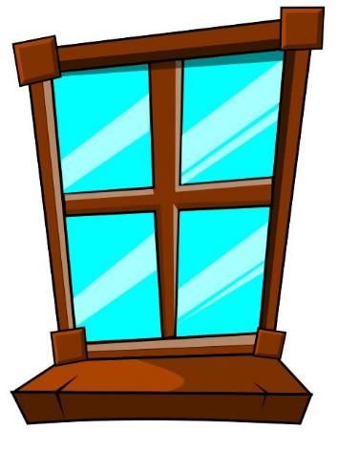
Windows: Learning and Normalising Diversity
Windows provide learners with the opportunity to look through the curriculum and learn about the experiences of different groups of people, build empathy and understanding.
Windows can help learners:
Learn about the experiences and perspectives of different people
Understand and normalise diversity and difference
Build empathy and a shared sense of humanity
Respect the rights and freedoms of others (Equality Act, UNCRC and human rights)
Identify and challenge stereotypes, prejudice, discrimination and bullying.
Notes:
Slide 13:
Windows provide learners with the opportunity to look through the curriculum and learn about the experiences of different groups of people, build empathy and understanding.
Windows can help learners:
Learn about the experiences and perspectives of different people
Understand and normalise diversity and difference
Build empathy and a shared sense of humanity
Respect the rights and freedoms of others (Equality Act, UNCRC and human rights)
Identify and challenge stereotypes, prejudice, discrimination and bullying.
Windows also have the potential to be included in every aspect of the curriculum and the totality of the learners’ experiences: in posters, books, stories, media, role models, historical figures, the staff in the setting and more. These should be naturally included.
I've already shared examples of mirrors for Early Learning, primary, secondary and Community Learning settings, and all of those examples can count as windows for learners who don't share those diverse identities. In other words, a heterosexual pupil will benefit from a curriculum with meaningful representation of LGBT people.
Dr Rudine Sims Bishop who coined the concept of Mirrors and Windows is a good example of a window for many of us non-Black educators, seeing the valuable contributions she has made to education as an African-American woman.

Slide 14
Distorted Mirrors and Windows
Pause for Thought…
Limiting messages about ourselves
Stereotypes
Linguistic
Religion / Belief
Socioeconomic
Ethnic/Cultural/Racial
Diversity
Disability
Gender/Sex
Neurodiversity
Sexual Orientation
Age
Family
Notes:
Slide 14:
A note of caution. Some Mirrors and Windows in the curriculum can contain outdated representations and negative stereotypes. When diverse representation is provided but it could have a negative impact on learners’ perceptions of themselves or others, these can be described as ‘distorted Mirrors and Windows.’
For example, using Islamic countries and Islam more generally to explore how women are not being treated fairly or equally. This gives the inaccurate and unfair impression that Islam and Muslims are all the same, it undermines the emphasis on equality in the religion (for example the explicit statement in the Quran that men and women are equal before God) and the work of Muslim feminists. It could also tacitly give the impression that other religions, such as Christianity, have a good track record when it comes to gender equality. Instead discussion could explore the ways many religions do and don't support gender equality. This approach could also avoid the dangers of oversimplification and presenting any one faith as a monolith.
Another common example has to do with fundraisers – how are the people or communities benefitting from the fundraising represented? Are they seen as poor and helpless? How can more nuance be added present a fuller and more accurate picture?
If those representations go unchallenged and learners are not encouraged to think critically about what might be wrong or missing in those representations, distorted Mirrors and Windows can be harmful for all learners. Diverse learners might internalise negative and limiting messages about themselves. Other learners might absorb biases and prejudiced notions about a diverse group of people. If they act upon those biases, they might discriminate and engage in harmful behaviours (whether conscious or unconscious, intentional or unintentional).
To avoid this, it is best to include more, and a wider variety of, Mirrors and Windows. This can reduce the risk of tokenism, othering and stereotyping. Moreover, encouraging learners to think more critically about the representations they see can help address distorted Mirrors and Windows.
Further reading and guidance on encouraging critical thinking about diversity can be found here:
A curriculum which reflects diversity – Promoting Race Equality and Anti-racist Education (glowscotland.org.uk)
Literacy and English – Promoting Race Equality and Anti-racist Education (glowscotland.org.uk)

Slide 15
Where are the Diverse Mirrors and Windows in your Curriculum?
The following questions can be considered individually, in groups or in departments/teams:
Can learners see themselves reflected in what they are learning (Mirrors), and can they look out to wider society to learn about the experiences of others (Windows)?
Are there any distorted Mirrors and Windows? Is it necessary to remove them, or can they be complemented with additional resources and critical thinking?
Do we have Mirrors for all learners, and do we provide Windows to learn about all diverse characteristics?
What could be strengthened? Where could Mirrors and Windows be added? What resources could be used to do this?
Linguistic
Religion/Belief
Socioeconomic
Ethnic/Cultural/Racial
Diversity
Disability
Gender/Sex
Neurodiversity
Sexual Orientation
Age
Family
Notes:
Slide 15:
A learning walk of a setting can be considered to audit where the Mirrors and Windows already are in a curriculum and how they might be strengthened.
The following questions can be considered individually, in groups or in departments/teams:
Where are the diverse Mirrors and Windows in our curriculum? Can learners see themselves reflected in what they are learning (Mirrors), and can they look out to wider society to learn about the experiences of others (Windows)?
Are there any distorted Mirrors and Windows? How might these be addressed? Is it necessary to remove them, or can they be complemented with additional resources and critical thinking?
Are there any aspects of diversity in the diagram missing in your curriculum? Do we have Mirrors for all learners, and do we provide Windows to learn about all diverse characteristics?
What could be strengthened? Where could Mirrors and Windows be added? What resources could be used to do this?

Slide 16
Reflection
From what you have learned so far, think about:
How has this made you feel?
What has this made you think about?
What one action would you like to take forward?
How can you link what you plan to do with others in your setting?
How you will know that this learning has made a difference?
Notes:
Slide 16:
[Participants can do this in groups.
Encourage participants to look at reflection questions and consider how they may be taken forward in enquiry.
Consider the impact of the actions on learning.]
From what you have learned so far, think about:
How has this made you feel?
What has this made you think about?
What one action would you like to take forward?
How can you link what you plan to do with others in your setting?
How you will know that this learning has made a difference?

Slide 17
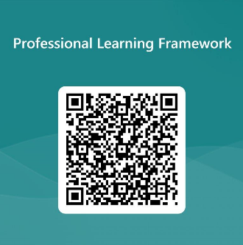
We value your feedback
From now until March 2024 we will be taking feedback on these resources so that we can make changes in advance of a formal launch of the Professional Learning Framework in June 2024
Your feedback could help us improve this resource
Please complete this short form, using the link or QR code, to let us know what you thought of it and any suggestions you have on how it could be improved
LINK: https://forms.office.com/e/b5PCpJJJ3P
Notes:
Slide 17

Slide 18
For Scotland's learners, with Scotland's educators
Do luchd-ionnsachaidh na h-Alba, le luchd-foghlaim Alba
Education Scotland
Denholm House
Almondvale Business Park
Almondvale Way
Livingston EH54 6GA
T +44 (0)131 244 5000
E enquiries@educationscotland.gsi.gov.uk

