Slide 1
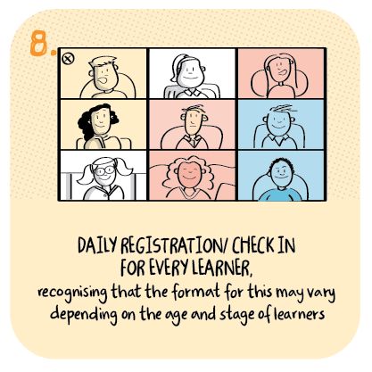
Tracking engagement with remote learning Alford Primary School, Aberdeenshire Council
>National overviews of practice<

Slide 2
Alford Primary School
All children have the opportunity to have a daily check in with their teacher in a small group setting. This supports engagement and encourages children to interact with their peers. Staff also report that this daily interaction is conducive to promoting the wellbeing of all.
Staff record the level of engagement and participation each week and this data is then analysed by stage, class and family.
The Senior Leadership Team contact the parents/carers when lack of activity is a cause for concern and provide support as required. Class teachers monitor and support children who may be at risk of decreased engagement and participation. Engagement levels across the school are positive.

Slide 3
Pupil Engagement - Week Beginning 18 Jan 2021
 |  |  |  | Engaged with online learning? Yes/No |  |  |  |  |  |  | For use by SLT | For use by SLT
Known As | Surname | Reg. Class | Year/Stage | Mon | Tue | Wed | Thu | Fri | Work Submitted | Google Meet | Action Req'd | Action Taken
 |  | P1/2 | P1 | yes | yes | yes | yes | no | 10+ submitted | yes
 |  | P1/2 | P1 | yes | yes | yes | yes | yes | 10+ submitted | yes
 |  | P1/2 | P1 | yes | yes | yes | yes | no | 10+ submitted | yes
 |  | P1/2 | P1 | yes | yes | yes | yes | yes | 10+ submitted | yes
 |  | P1/2 | P1 | yes | yes | yes | yes | no | 10+ submitted | yes
 |  | P1/2 | P1 | yes | yes | yes | yes | no | 10+ submitted | yes
 |  | P1/2 | P1 | yes | yes | yes | yes | yes | 10+ submitted | yes
 |  | P1/2 | P2 | yes | yes | yes | yes | yes | 10+ submitted | yes
 |  | P1/2 | P2 | no | yes | no | no | yes | 10+ submitted | yes
 |  | P1/2 | P2 | yes | yes | yes | yes | yes | 10+ submitted | no
 |  | P1/2 | P2 | yes | yes | yes | yes | yes | 10+ submitted | yes
 |  | P1/2 | P2 | yes | yes | yes | yes | yes | 10+ submitted | yes
 |  | P1/2 | P2 | no | no | yes | no | yes | 5-10 submitted | no
 |  | P1/2 | P2 | yes | yes | yes | yes | yes | 10+ submitted | yes
 |  | P1/2 | P2 | yes | yes | yes | yes | yes | 10+ submitted | yes
 |  | P1/2 | P2 | yes | yes | yes | yes | no | 10+ submitted | yes
 |  | P1/2 | P2 | no | no | no | no | no | None submitted | no | Yes
 |  | P1/2 | P2 | yes | yes | yes | yes | no | 10+ submitted | yes
 |  | P1/2 | P2 | no | no | no | yes | no | 1-4 submitted | no
 |  | P1/2 | P2 | yes | yes | no | no | no | 1-4 submitted | yes
 |  | P1/2 | P2 | no | no | no | yes | no | 10+ submitted | yes
 |  | P1/2 | P2 | no | no | no | no | no | None submitted | no | Yes
 |  | P1/2 | P2 | yes | yes | yes | yes | yes | 10+ submitted | yes
 |  | P1/2 | P2 | yes | yes | yes | yes | yes | 10+ submitted | yes
 |  | P1/2 | P2 | yes | yes | yes | yes | yes | 10+ submitted | yes
 |  | P1/2 | P2 | yes | yes | yes | yes | yes | 10+ submitted | yes
Alford Primary School have shared an example of their tracker, which they use to increase engagement in remote learning.

