Slide 1
Early learning experiences which reflect the principles of Curriculum for Excellence Burnbrae Early, Midlothian Council
>National overviews of practice<

Slide 2
Burnbrae Early
Home Learning Impact
We will ‘provide learners with a creative and high quality learning experience to engage them in remote learning tasks’ in accordance with Midlothian Education Guidance, Principles and Expectations for Remote Learning (Midlothian Council, 2021).

Slide 3
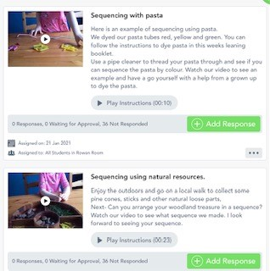
Accessible
‘Plan and deliver appropriate learning opportunities to ensure all ELC children receive their entitlement to an ELC experience’
‘Create a paper version of regular remote learning for children and young people with no or limited access to a device/internet’
Voice recorded instruction and videos to support accessibility.

Slide 4
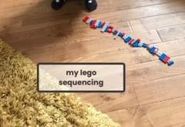
Our Impact
Created a Home Learning Team; EYP from each room, SEYP & EYO
Plans complied incorporating Burnbrae Early seasonal block plan
Information sharing via Seesaw, school website and App
All children able to access a digital device to date
Distributed iPads to all ELC practitioners to comply with GDPR
Digital Literacy Support phone calls, produced a parent guide to Seesaw
Ease of participation at home, for example planning incorporating free, everyday learning experiences, household items, natural resources and fresh air
Mindful of current restrictions and Government guidance when sharing home learning tasks
Make use of what you have at home.

Slide 5
Relevant
‘Year plans have already been created at the beginning of the session’.
‘Practitioners should identify suggested areas of learning for children relevant to current season, weather, local/ national holidays etc. Additional activities which link to this should be shared weekly’
‘Include new curriculum content, scaffolded by teacher instruction via video or text, as appropriate to the needs of individual learners’.
Burns Day 25th January 2021

Slide 6
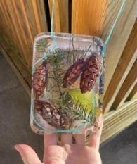
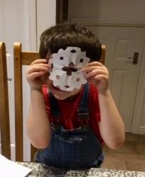
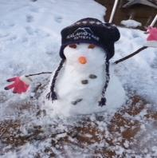
Our Impact
Planned for Home Learning incorporating the Seasonal Overview already in place for Winter
Responsive planning to support learning relevant to the change in weather taking advantage of learning through playing with snow and ice
Celebrations and Festivals; Burn’s Day, Australia Day, RSPB Big Bird watch, Children’s Mental Health Week 2021 included in planning with specific learning provocations linked to overall plan
Weekly plan scaffolded by daily interactive recordings and invitations to learning designed to support and encourage engagement with the weekly plan in bite size pieces
Snow and ice play based learning

Slide 7
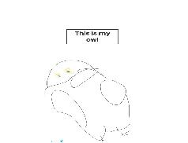
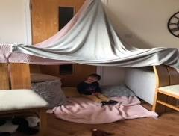
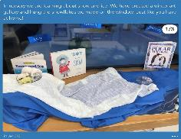
Burnbrae Early Ethos
‘Parents should be encouraged to send information about completed activities e.g. photos /drawings etc. and wider achievements’
‘There should be some form of response to all submitted work to encourage and develop dialogue between teacher and pupil. Feedback should be appropriate to the task and not all set work will require detailed comments’.
Sharing learning at home and in nursery

Slide 8
The Burnbrae Early Loop
Observations
in Setting & on Seesaw
Experiences & Observations
At Home
The Child
EYP’s Feedback
to Parents shared at pick up/drop off & on seesaw
Parents Feedback
to EYP’s at pick up/drop off & through Seesaw
Provision in
Home to extend learning & experience from Seesaw
Learning responded to in setting provision & on seesaw

Slide 9
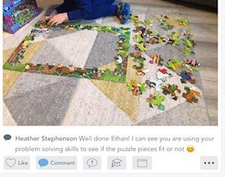
Our Impact
Link between home learning and in nursery through shared planning; EYP’s in setting supporting children to access Seesaw on smart board, Floorbook, leaning overview shared at beginning of week
Leading questions invite families to share their interactions with the learning
Encouraging use of voice notes
Staff rota to ensure that all learning shared is responded to and valued
Tailored responses from EYP’s to children and families
Individual dialogue in response to children's learning
Highlighting the learning when responding.

Slide 10
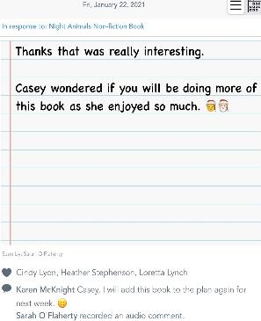
Responsive
‘Continue with the observation and planning cycle remotely and respond as responsively as much as we can’
‘along with ongoing evaluations of current remote learning experiences’.
‘EY Practitioners use the information gathered to plan next steps’
‘An approach to achieving differentiation is to set activities without a specific outcome or ‘right’ answer, allowing a more interpretative or creative approach. This gives pupils the flexibility to arrive at a more personalised result, with outcomes that match their current level of understanding’.
Variety of fiction, non-fiction, lengthy and short stories.

Slide 11
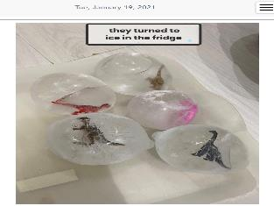
Our Impact
Referenced the CfE Early Level in weekly planning shared to parents in response to feedback from families in March 2020 lockdown
Built in a bedtime story element to home learning plan in response to family and child feedback
Responsive planning and next steps incorporated into planning from children’s responses to taking the learning forward, for example pasta bracelet sequencing, frozen dinosaur eggs and nests and interest in non-fiction books
Open ended experiences and materials suggested to encourage creativity with no predetermined outcomes, allowing individuality and interpretation
Follow child interest

Slide 12
Expectation
‘A clear framework for when work is issued and returned will help children maintain good working habits throughout the week and allow families to plan use of work space and resources’
‘Support your child to engage and be actively involved in their learning as best you can’
‘Find ways that work for your family’
‘Text or recorded video/audio introduction to the task (5 minutes max)’.
‘Learning intentions and success criteria shared with the activity resources’
Video recording – familiar face and voice to enhance connections

Slide 13
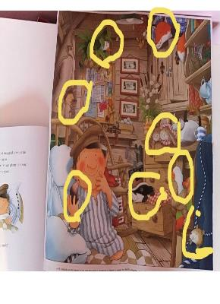
Our Impact
Week plan shared on a Friday at 4pm in line with school guidance
Weekly announcement to families embedding the Burnbrae Early Ethos
Encouraging families to tailor their learning to their home routine, lifestyle and time constraints
Connected learning intentions to everyday experiences to enable families to incorporate home learning into their day
A balance of interactive posts that allow children to become independent in their learning
EYP’s contribute to planning for week ahead, posting learning provocations, responding to learning and end of week catch up’s within working hours
Digital and touch screen skill development.

Slide 14
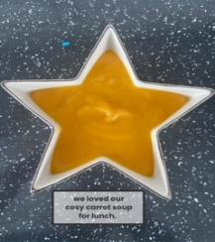
Interactive
‘EY Practitioners review the task and provide feedback’
‘Support your child to engage and be actively involved in their learning as best you can’

Slide 15
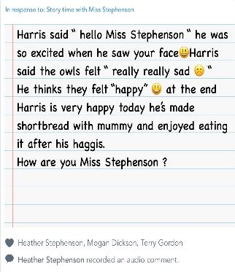
Our Impact
Strengthening the PICL Loop
Using Seesaw as a platform to empower parents as well as learners to share voice and interact with us
Virtual coffee morning planned to further build relationships with families
Encouraging a variety of ways to engage, written notes, voice notes, photo’s and videos.

Slide 16
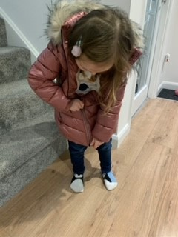
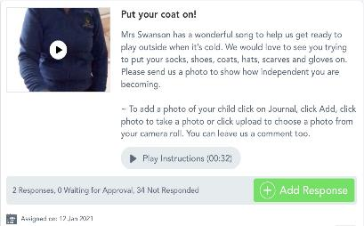
Songs, Rhymes
‘include opportunities for some face to face learning interactions, for example a recorded message from practitioners, video clips of ‘how’ to to do things e.g. making playdough, reading stories, singing songs or sharing rhymes’
Learning through song

Slide 17
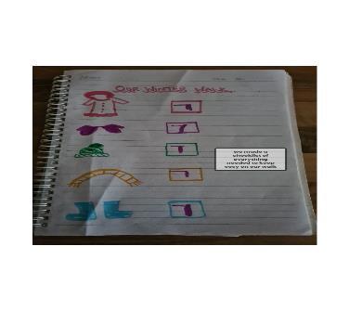
Our Impact
Story of the week with opportunities for extended learning
Daily bedtime story
Song of the day linked to the weekly learning theme
Interactive video’s, photos and voice recordings to support a broad curriculum of learning experiences
Ensuring literacy, numeracy, health and wellbeing are the golden thread of our weekly planned experiences whilst promoting other curricular areas
Holistic curriculum for home learning

Slide 18
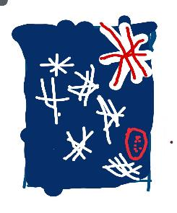
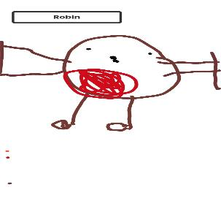
Digital Literacy Action Plan
‘Key digital platforms for learning (Google Classroom, Seesaw and Microsoft Teams)’
‘it is important that staff feel confident in using different modes if they choose to do so. For that reason, CLPL will be available to those who wish to develop skills in this area further’.
Promoting digital literacy skills

Slide 19
Our Impact
Stop/Start training with time to experiment and consolidate learning helped
A negative experience with a Positive gain; Although we were plunged into the unknown depths of Seesaw we have pulled together as a team to embrace the learning curve bringing positive outcomes for;
Children; able to access Seesaw, developing digital literacy skills e.g. navigation, voice recording, drawing, dragging and touch screen use.
Families supported to navigate both Seesaw Apps
EYP’s training to ensure confidence in using Seesaw. Home Learning Team able to post, search seesaw library, schedule and interact fully with families on Seesaw
Above learning supports the Burnbrae Early Digital Literacy action plan going forward
Using Seesaw in lockdown has helped build confidence…
Comments from BBE Early Years Practitioners
Good team support means I don’t worry about getting it wrong!
I’m much more confident!

Slide 20
Our Feedback
“I have been hearing some inspiring stories of your staff using Seesaw, they have really embraced this technology whilst holding on to your core values and ethos. A lovely example of a team working together, embracing something new and taking it forward”(Sally Ward, Quality Improvement Officer).
“The feedback and engagement from families is wonderful. Thank you for all your enthusiasm and embracing this new way of learning with such positivity” (Kerry Knight, DHT).
“your work has brought sunshine into a darker time” (BBE parent)
“It’s nice to be apart of a little world of happiness
in these difficult times were all facing” (BBE parent)

Slide 21
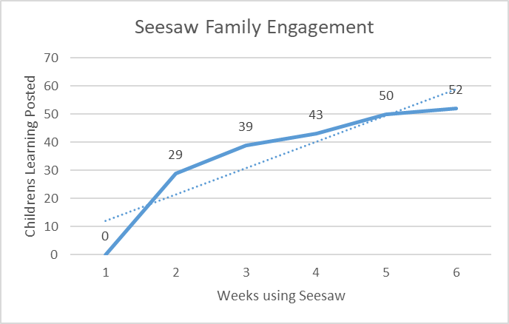
Family Engagement
Data shows a steady increase in families engaging with Seesaw each week

Slide 22
Parent’s Voice – Chestnut Room
“Nursery is L’s entire world, I can't thank the staff enough for the interaction, L gets so excited when I tell her she has a message from one of the teachers and its the first thing she tells her daddy when he comes home from work” (L’s Mummy).
“Its amazing, the range of activities are great, I didn't expect it to be so good and L loves seeing his teachers on there. What a great way to record L’s learning” (L’s Mummy).
“S is loving seesaw, everyday she asks to see what new things there is to do. She loves the stories and is so excited to see all her teachers. S really likes the voice comments Mrs Gordon has sent her.

Slide 23
Parent’s Voice – Oak Room
C’s mum said she was so impressed with seesaw. It is giving her ideas on things to do and they are doing them together as a family with the younger brother. C has particularly enjoyed the stories and feedback from staff. Mum asked if we could provide voice feedback for C which has also been actioned.
S’s Dad is a teacher and currently working from home, he is loving being with his girls and the home learning is making it so much easier to keep them going as the ideas for engaging them are already there. S’s older sister is also joining in.
“A has enjoyed seeing his teachers on it” (A’s mum).

Slide 24
Parent’s Voice – Rowan Room
“Now Seesaw is working E is loving being able to do her ‘school work’ whilst her big sister does hers. The content has been great so far. Big thumbs up from E and her mummy! Thank you for all the hard work you are doing on this.” (E’s Mummy)
“A really enjoyed your story tonight Mrs McCairney. He says he liked when Ned looks down and finds lots of leaves for a home. Thank you for sharing with us.” (A’s daddy)
“Seesaw has been great so far. C is enjoying it and is
confidently using the videos and voice recording.”
(C’s Mummy)

Slide 25
The Way Forward…
Burnbrae Early Seesaw Action Plan
‘Daily registration/check in for every learner’
Emotional check in via Seesaw launched on Friday 29th January 2021, will be trialled daily during week commencing 1 February 2021 further emotional check in Tuesday 16th February 2021.
‘it is important that staff feel confident in using different modes if they choose to do so. For that reason, CLPL will be available to those who wish to develop skills in this area further’
Seesaw Training delivered to all EYP practitioners in Rowan, Oak and Chestnut room’s EYO, on return to setting Home Learning Team to share their knowledge, learning and tips to support in their room
‘Key workers should continue to engage with their group of children wherever possible to ensure consistency and continuity for children and families. Other interactions which could happen during the week include, phone calls home, group chats and celebrating achievements and life events’
Protected time for all practitioners out with home learning team to access seesaw, respond to children's learning.
EYP’s encouraged to share a story or song if they feel confident to do so/using Seesaw
After training from week commencing 16 February 2021
All EYP’s will have protected time to read, record and share a story with their key children

Slide 26
The Way Forward…
Burnbrae Early Seesaw Action Plan
‘Consider the individual needs of each child and build on their learning priorities’
Once EYP’s are familiar with Seesaw and confident in its use;
EYP’s will use Seesaw as a platform for sharing learning observations
EYP’s will identify one learning priority for each child to be shared with family on seesaw
EYP’s will create a home learning experience that will support the child’s identified learning priority
DHT to upload progression pathways to Seesaw
Team Meeting/Training to enable practitioners to build confidence in using Seesaw skills tab to link learning to progression pathways
‘Create a paper version of regular remote learning for children and young people with no or limited access to a device/internet’
Remain mindful of the potential need to create paper version for families not accessing Seesaw

