Slide 1
Effective use of data
6. Using data for improvement Practitioners
Notes:
All information is correct as of May 2024
These slides are intended to support senior leaders, middle leaders and practitioners in schools and local authorities to explore the effective use of data for improvement. There are a set of six workshops available for senior leaders and middle leaders and a set of six workshops for practitioners. The workshops were co-designed with educators from across Scotland and are based on an Education Scotland literature review: The Effective use of data for improvement in education.
Establishing the purpose and use of data
Defining and classifying data
Creating effective processes and systems
Interpreting and analysing data
Developing a data informed culture
Using data for improvement
(hyperlinks for each workshops can be found on the next slide)
The PowerPoint is a template that presenters can adapt to suit their own context and style of presenting. The workshops can be delivered individually or grouped together and delivered in a longer session. Individual workshops have been designed for facilitators to deliver in 1 to 2 hours.
Within the slide notes key messages, suggested tasks, ‘talking-points’ and reflective questions are included.
It is anticipated the facilitator will have read the Education Scotland literature review: The Effective use of data for improvement in education.

Slide 2
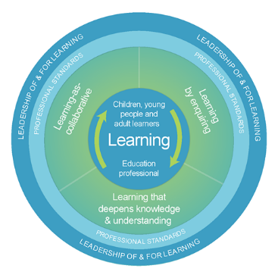
The national model of professional learning
The national model of professional learning | Professional Learning | Education Scotland
Notes:
Key Messages
This module has been designed using the national model of professional learning and the principles of adult learning or andragogy. It has been designed to think about:
The why – opportunities for participants to understand the rationale through professional standards, research, current policy landscape and national/local priorities.
The what – opportunities for participants to consolidate and develop relevant knowledge and skills
The how – opportunities for participants to take part in peer discussion, explore case studies or share experiences
Apply – a chance to reflect on learning, next steps and further support
A link to further information about the national model of professional learning can be found below.
edscot-model-of-professional-learning-outline.pdf (education.gov.scot)

Slide 3
Connector
In groups/pairs:
Share your favourite music artist or band.
Notes:
Key Messages
This is an example of a simple connecter activity. It is recommended that facilitators use a connector activity that allows participants to take part in an informal discussion.
This is to ensure that participants are relaxed, focused and ready for an interactive workshop.

Slide 4
Draft Group Agreement and Protocols
Work together
Learn from, with, and on behalf of each other.
Create a safe space to share ideas and build learning.
Agree that everyone is an equal and valued participant.
Remain in the room (emails and phone protocol)
Notes:
Key Messages
Take a moment to establish group protocols.
Ask participants to check and comment on anything they would like to add or amend.
The protocols on the slide are suggestions and may be amended for your school context.

Slide 5
Re-cap
In workshop 1 we looked at the purpose and use of data including: the meaning of data and evidence, the ways in which data is used and what we mean by ‘big’ and ‘small’ data.
In workshop 2 we considered different categories of data and how these may be intersected to support improvement.
In workshop 3 we looked at the importance of developing effective data systems and processes.
In workshop 4 we looked at ways to analyse and interpret data.
In workshop 5 we thought about how to develop positive data cultures including what a positive data culture might look like.
Notes:
Key Messages
This slide offers a brief recap of content covered in previous workshops.

Slide 6
Content coverage
National guidance and research
Data, planning and setting aims
Developing clear measures
Evidence and research
Tracking and monitoring
Data driven dialogue
Target setting with learners
Notes:
Key Messages
This slide shows the content covered throughout the workshop. Further details and suggested timings are provided below. Facilitators can amend content and timings to suit their needs and context.
National guidance and research – This section explores guidance and research. Allow 5 minutes for this section. This section could be extended if facilitators wish participants to engage in reading the relevant section from the evidence review (10 mins)
Data, planning and setting aims – This section covers how data can be used to support the improvement planning process. Allow 5-10 minutes. There is an activity to support participants to reflect on current approaches to setting aims.
Developing clear measures - allow 10 minutes. Includes a quiz on different measurement types.
Evidence and research – allow 5 minutes. Explores the importance of data, evidence and research
Tracking and monitoring – allow 10-15 minutes. Explore the roles of the practitioner in tracking and monitoring
Data driven dialogue – Allow 10 minutes, 30 minutes if choosing to carry out the data driven dialogue process with participants using data relevant to the participants.
Target setting with learners – allow 10 minutes – explores the importance of involving learners in the target setting process.
It is expected that this workshop should take approximately 1 -1.5 hours to deliver. Facilitators can shorten the timings to suit by adapting the activities.

Slide 7
Aims
In this workshop, we will consider the following:
using data for planning and setting aims
developing clear measures
the role of evidence and research
tracking and monitoring
using data driven dialogue
target setting with learners.
Notes:
Key Messages
Aims to share with participants.

Slide 8
GTCS Standards for Full Registration and Career Long Professional Learning
Curriculum and Pedagogy
3.1.1 - Plan effectively to meet learners’ needs
3.1.4 - Effectively employ assessment, evaluate progress, recording and reporting as an integral part of the teaching process to support and enhance learning.
Professional Learning
3.3.2 - Engage in reflective practice to develop and advance career-long professional learning.
GTCS The Standard for Full Registration
GTCS - The Standard for Career-Long Professional Learning
Notes:
Key messages
The GTCS Standard for full registration and for Career Long Professional Learning highlights the importance of the use of data in decision-making.
The standard is the same for both groups.
This standard emphasises the importance of data being used to support planning and enhancing learning.
Reflective Questions
How wide ranging and robust is the data you are using in school? How do you know?

Slide 9
HGIOS 4
Staff make effective use of current available data on levels of child poverty and apply this to ensure equity (1.5)
All teachers have well-developed skills of data analysis which are focused on improvement (2.3)
We use data to evaluate the effectiveness of interventions designed to improve outcomes for all learners (2.3)
Notes:
Key Messages
How Good is Our School 4 describes the ways in which schools may use data effectively for improvement. This includes:
Gathering data to monitor and track progress
Regular interrogation of data
Making effective use of data on child poverty to ensure equity, and
Ensuring that all teachers have well developed skills of data analysis
Reflective Questions
How confident are we in using data to focus on improvement?

Slide 10
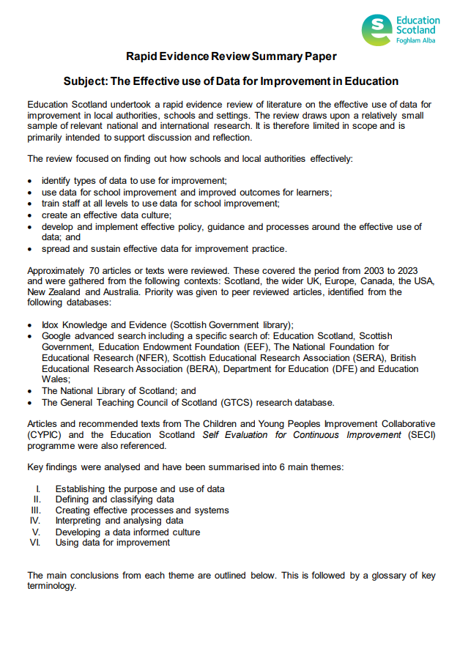
Rapid Evidence Review Paper
Section six of the Education Scotland Rapid Evidence Review on using data for improvement highlights that:
Data and evidence should be used to inform improvement planning.
Data does not make improvement decisions but once organised, interpreted and analysed it should inform action.
Data should be used to challenge perceptions and assumptions.
Using data to inform target setting at all levels is important.
Time should be allocated to ensure teacher professional judgements are secure.
Notes:
Key Messages
Section six of the rapid evidence review on using data for improvement highlights that:
Data and evidence should be used to inform improvement planning.
Data does not make improvement decisions but once organised, interpreted and analysed it should inform action.
Data should be used to challenge perceptions and assumptions.
Data driven dialogue approaches can support all staff to engage in data
Using data to inform target setting at all levels is important.
Time should be allocated to ensure teacher professional judgements are secure.
The Effective use of data for improvement in education
Talking Points
This may be a good point to ask participants to read section six on using data for improvement.
Reflective Questions
How do you use data to inform improvement?

Slide 11
Scottish Attainment Challenge – Stretch Aims
The Framework for Recovery and Accelerating Progress has been developed to support the Scottish Attainment Challenge. It aims to do the following:
Reinforce our collective commitment to equity in education, to mitigate the impact of poverty on children’s outcomes and tackle the poverty-related attainment gap.
Set high expectations, including ambitious locally identified stretch aims for achieving the mission of the Scottish Attainment Challenge.
Notes:
Key Messages
In 2022 the Framework for recovery and accelerating progress was launched – with the aim to: (read slide).
Some of the data and evidence we engage with is around stretch aims.
Each LA has set their own stretch aims focusing on CfE levels at P1, P4 & P7 for literacy and numeracy and progress in closing the poverty related attainment gap Q1-Q5.
Purpose is not to go into depth about these but provide information on the national context and provide some of the ‘why?’ for this workshop. These exist and will feed into the improvement work carried out in the classroom/setting.
Reflective Questions
Are all staff aware of the aims and the implications for their own use of data, pedagogy and practice?

Slide 12
Planning – using data to carry out a needs analysis
The process of using data for planning begins before a plan is completed.
Data and evidence should be used to carry out a needs analysis to identify key areas of improvement for departments, classes, groups or individuals.
This will ensure that improvement aims, and activity, are evidenced-based and data informed.
Self-evaluation information gathered at the end of one improvement cycle should form part of your needs analysis for the next.
Notes:
Key Messages
The process of using data for planning begins before a plan is completed.
Data and evidence should be used to carry out a needs analysis to identify key areas of improvement for whole school, departments, groups or individuals.
This will ensure that improvement aims, and activity, are evidenced-based and data informed.
Self-evaluation information gathered at the end of one improvement cycle should form part of your needs analysis for the next.

Slide 13
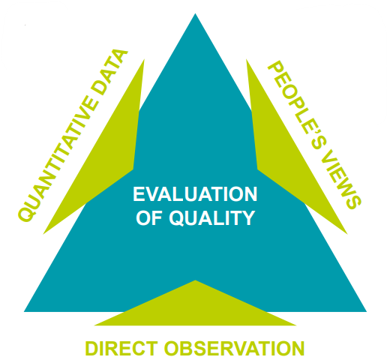
Getting your contextual analysis right
Data Analysis: using your tracking & monitoring for your class can you spot any trends - look at key groups (S1, ASN, Gender etc) etc.
How does this link with your school improvement plan?
Are you taking the views of learners, parents & partners – how can you use this?
When do you gather this data? Is the timing right?
Monitoring: formal & informal – what are you seeing happening in your class?
Are you adapting your teaching to respond?
Notes:
Key Messages
Considering our self-evaluation: where are we now? How do we know?
Click 1: talk over the type of self-evaluation evidence that supports your contextual analysis emphasise the need to triangulate evidence
Click 2 Important to be honest with yourself. We can cut data, monitor or collect views about many things but are these the things we really need to address. Honest self-evaluation needs to lead this work
Click 3: Keep calm consider:
Is this the right order. (writing before reading? Or moderation before data use?)
Is this the right time: staff readiness/commitment to change ( Do you need to do more on 'the why?' before the how)
Is this the right priority: will this give pupils the biggest gains
https://www.youtube.com/watch?v=M1MYqrBVBf0
Self- evaluation, to do that you need triangulation of data.
Be honest and knowing yourself – kitten that perceives themselves to be a lion.
Be honest on what you need to improve – but need to sensible, proportionate and realistic – what is going to lead to improved outcomes.

Slide 14
key demographic groups – ASN, EAL, SIMD etc.
curriculum
pedagogical approaches such as differentiation, modelling, or questioning.
relationships with learners/families
environment
practical or human supports
work e.g. in jotters
ongoing diagnostic/formative assessments
assessment for learning – observations, feedback etc.
engagement scale
SNSA / ACEL / SCQF
Demographic
Input
Output
Perception
questionnaires
surveys
focus group discussions
Notes:
Key Messages
This slides provides a recap of data categories from workshop 2 so that participants can be reminded about the categories of data they may need to intersect to understand why a pattern, trend or gap exists.

Slide 15
Data and implementation – organising and gathering data
It is important to consider:
who will be gathering the data and how the data will be stored,
who will need access to the data, how often it will need to be collected and whether data needs to be recorded in a consistent way to support analysis,
the accuracy of data. For example, it is difficult to analyse attainment data by demographic information if the information is incomplete or inaccurate,
whether educators require training or guidance,
whether systems are manageable and meaningful - the simplest tracking systems will be the most successful, and
if it is possible to reduce bureaucracy - for example, by utilising existing systems rather than creating new ones.
Notes:
Key Messages
It is important to consider:
who will be gathering the data and how the data will be stored,
who will need access to the data, how often it will need to be collected and whether data needs to be recorded in a consistent way to support analysis,
the accuracy of data. For example, it is difficult to analyse attainment data by demographic information if the information is incomplete or inaccurate,
whether educators require training or guidance,
whether systems are manageable and meaningful - the simplest tracking systems will be the most successful, and
if it is possible to reduce bureaucracy - for example, by utilising existing systems rather than creating new ones.

Slide 16
Planning - using data to create clear aims
An aim is a concise description of an overall goal. It includes:
when your aim is to be completed by,
who is being targeted/supported,
what you are trying to improve – the change you want to see (as opposed to the activity that will bring about the change), and
by how much – an indication of the baseline measure and the measure the improvement aim is looking to reach / measure of expected improvement.
Aims may also include an operational definition. This is a sentence or two of further information, if required, to explain an aspect of the improvement aim where it could otherwise lack clarity or be open to interpretation. For example, to explain what is meant by improved self-regulation or engagement.
Notes:
Key Messages
Having a clearly defined aim is an important part of improvement planning. An aim is a concise description of an overall goal. It includes:
when your aim is to be completed by,
who is being targeted/supported,
what you are trying to improve – the change you want to see (as opposed to the activity that will bring about the change), and
by how much – an indication of the baseline measure and the measure the improvement aim is looking to reach / measure of expected improvement.
Aims may also include an operational definition. This is a sentence or two of further information, if required, to explain an aspect of the improvement aim where it could otherwise lack clarity or be open to interpretation. For example, to explain what is meant by improved self-regulation or engagement.
Data is an important part of an aim. An aim should use data in the inclusion of a baseline and a measurable outcome.
We will now look at some examples. Look out for the role data plays in these aims.

Slide 17
Using data to plan - anatomy of an aim
By June 2024, the attainment of first level reading for my P4 learners will increase to over 80%.
(baseline: on track in Jan 24 was 75%)
By when
What
Who
By how much
Example for illustrative purposes only
Notes:
Key Messages
We can see the different elements of an aim in this example:
By when – June 2024
What – increased reading attainment
Who – identified learners
By how much – from a baseline of 75% - 80%
Data is an integral part of the aim giving a clear indication of the starting point and intended outcome.

Slide 18
Using data to plan - anatomy of an aim – part 2
By May 2024, the engagement* of all identified learners in the S3 target group will increase from 2 to 4 on the Leuven Scale.
By when
What
Who
By how much
Operational definition
* Operational definition of increased engagement: learners will listen to a 10–15-minute input and complete a modelled and appropriately differentiated task.
Notes:
Key Messages
We can see the different elements of an aim in this example
By when – May 2024
What – increased engagement
Who – identified learners
By how much – from 2 to 4 on the Leuven scale (an engagement scale)
Operational definition – to explain increased engagement as this could be open to interpretation
Data is an integral part of the aim giving a clear indication of the starting point and intended outcome.

Slide 19
Activity – improvement aims
When do we currently set aims?
tracking meetings and discussions
staff/department meetings
stage planning/individual planning
as part of the reporting process
as part of practitioner enquiry.
Notes:
Key Messages
This is a discussion activity that allows participants to reflect on their own current practices.
When do we currently set aims? Allow time for discussion before revealing the example bullet points. Group may come up with further examples.
Examples might include – tracking meetings, collegiate planning meetings, termly forward planning, as part of an enquiry approach

Slide 20
Planning – using data to develop clear measures
It is important to include measures at the planning stage of any improvement cycle.
Baselines are important. Without a baseline it will be difficult to measure the impact of improvement activity.
This will ensure that progress can be tracked and monitored throughout the improvement cycle (as opposed to at the end).
Ongoing tracking of outcomes against measures ensures that reflection can take place and any appropriate adjustments can be made to ensure the best outcomes for learners.
Notes:
Key Messages
Read through each point.

Slide 21
Planning – using data to develop clear measures – part 2
There are three types of measures that educators may wish to consider when improvement planning.
Outcome measure
An outcome measure will use data to provide information about whether the planned improvement is successful against the intended outcomes,
for example, increase attendance or attainment by 5 %,
Process measure
A process measure uses data to track whether the things that must be done to achieve the outcome are happening reliably,
Balance measure
Balance measures are where educators use data to check that changes in one part of the system aren’t having unintended consequences elsewhere,
for example, attendance of a targeted group has now increased due to family support and attendance initiatives, but provision needs to be adapted as there is an increase in distressed behaviour/low engagement of this group.
for example, to increase the percentage of learners who understand the learning objectives and steps to success by 20%,
all aims will generally contain an outcome measure.
for example, the amount of times attendance registers are competed correctly,
for example, the successful completion of a sequence of activities as part of an intervention.
Examples for illustrative purposes only
Notes:
Key Messages
There are three types of measures that educators may wish to consider when improvement planning.
Read through the examples and descriptions of each on the slide.
It may be important to share that
All improvement aims generally have at least one outcome measure.
Some aims will have process measures.
Balance measures may not always be something that is formally recorded and tracked e.g. in a spreadsheet. Rather they are things that should be consider during the planning process as part of strategic mitigation and kept an eye on during implementation.
Educators should consider the number of measures they are using and keep these manageable and realistic.
Reflective Questions
What are the core outcome measures you need to evidence impact?
Are there any process measures or balance measures to keep an eye on during implementation.

Slide 22
Planning – using data to develop clear measures 2
A – Outcome B – Process C - Balance
The number of learners whose engagement has increased on an engagement scale.
Notes:
Key Messages
This is a quiz task to embed understanding of different measures. Is the measure an a – outcome, b- process or c- balance measure.
Allow participants a few seconds to confer with a partner or group and then answer.
The number of learners whose engagement has increased on an engagement scale
Answer – outcome measure

Slide 23
Planning – using data to develop clear measures 3
A – Outcome B – Process C - Balance
The percentage of children in S3 who have achieved third level.
Notes:
Key Messages
This is a quiz task to embed understanding of different measures. Is the measure an a – outcome, b- process or c- balance measure.
Allow participants a few seconds to confer with a partner or group and then answer.
The percentage of children in S3 who have achieved a level.
Answer – outcome measure

Slide 24
Planning – using data to develop clear measures 4
A – Outcome B – Process C - Balance
The correct delivery (delivered as per programme instructions) of a numeracy intervention programme.
Notes:
Key Messages
This is a quiz task to embed understanding of different measures. Is the measure an a – outcome, b- process or c- balance measure.
Allow participants a few seconds to confer with a partner or group and then answer.
The correct delivery (delivered as per programme instructions) of a numeracy intervention programme
Answer – process measure

Slide 25
Planning – using data to develop clear measures 5
A – Outcome B – Process C - Balance
The introduction of 100% attendance certificates has led to a decrease in motivation for young carers.
Notes:
Key Messages
This is a quiz task to embed understanding of different measures. Is the measure an a – outcome, b- process or c- balance measure.
Allow participants a few seconds to confer with a partner or group and then answer.
The introduction of 100% attendance certificates has led to a decrease in motivation for young carers.
Answer – balance measure

Slide 26
Planning – using data to develop clear measures 6
A – Outcome B – Process C - Balance
The number of times children in a targeted writing group attend the session.
Notes:
Key Messages
This is a quiz task to embed understanding of different measures. Is the measure an a – outcome, b- process or c- balance measure.
Allow participants a few seconds to confer with a partner or group and then answer.
The number of times children in a targeted writing group attend the session.
Answer – process measure

Slide 27
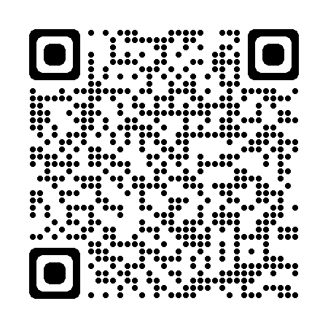
Using data to plan – using evidence and research
In Scotland we want our schools, and our education system to be research rich. Practitioner engagement in research contributes to successful school and system development.
As part of the improvement planning process, educators may find it helpful to consider research. For example:
practitioner enquiry
evidenced-based interventions
collaboration with other schools or agencies who have had success in an identified area.
Notes:
Key Messages
In Scotland we want our schools, and our education system to be research rich. Practitioner engagement in research contributes to successful school and system development.
As part of the improvement planning process, educators may find it helpful to consider research. For example:
practitioner enquiry
evidenced-based interventions
collaboration with other schools or agencies who have had success in an identified area.
On the slide is a link to research and enquiry professional learning offered by education Scotland.
Research and enquiry | Professional Learning | Education Scotland

Slide 28
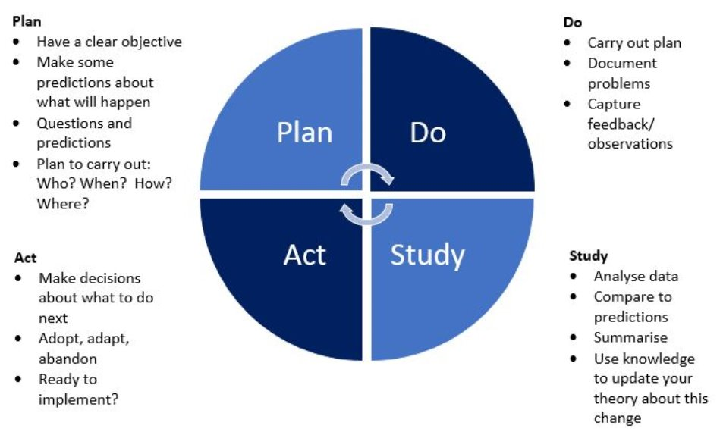
Quality Improvement:
https://learn.nes.nhs.scot/2274/quality-improvement-zone/qi-tools/pdsa
Notes:
Key Messages
PDSA approach was briefly mentioned in workshop 4.
Other approaches are available, this is just one example of a common improvement approach.
Using this approach can support us to use the data we collect to set clear aims/objectives, try out small (or sometime larger) tests of change, use a variety of data to analyse the impact and then make decisions about what to do next.
The data we collect in this cycle should be varied in accordance with the messages provided across each of the workshops in this series e.g. qualitative, quantitative, demographic, perceptual, etc.
Not all types of data need to be collected every time but intersecting data is always important.

Slide 29
Data and implementation – effective tracking and monitoring
It is important to ensure that data is used throughout the implementation of planned improvement so that progress against outcomes can be tracked and reviewed in an ongoing way.
This will be easier if clear aims are established, and a set of measures have been agreed including a baseline from which to track progress.
Aims, measures and expectations for tracking should be shared with all staff before improvement activity begins.
It may help to think about by who, how and when data will be regularly reviewed during an improvement cycle.
Notes:
Key Messages
It is important to ensure that data is used throughout the implementation of planned improvement so that progress against outcomes can be tracked and reviewed in an ongoing way.
This will be easier if clear aims are established, and a set of measures have been agreed including a baseline from which to track progress.
Aims, measures and expectations for tracking should be shared with all staff before improvement activity begins.
It may help to think about by who, how and when data will be regularly reviewed during an improvement cycle.
Reflective Questions
What are the dangers of not having clear aims, measures and plans to track and review in place from the outset?

Slide 30
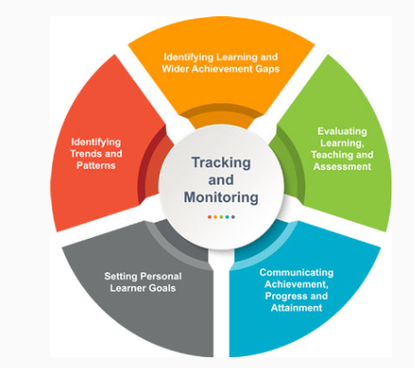
Effective tracking and monitoring systems
Education Scotland have developed a resource to support schools in developing effective tracking and monitoring systems.
The link can be accessed through the QR code.
Resources to support effective tracking and monitoring | Resources | Education Scotland
Notes:
Key Messages
This is a link to a resource Education Scotland have developed to support schools in developing effective tracking and monitoring systems.
Resources to support effective tracking and monitoring | Resources | Education Scotland
It is relevant to all stakeholders involved in the education of children and young people. The practitioner section is looked into in further detail on the next slide.

Slide 31
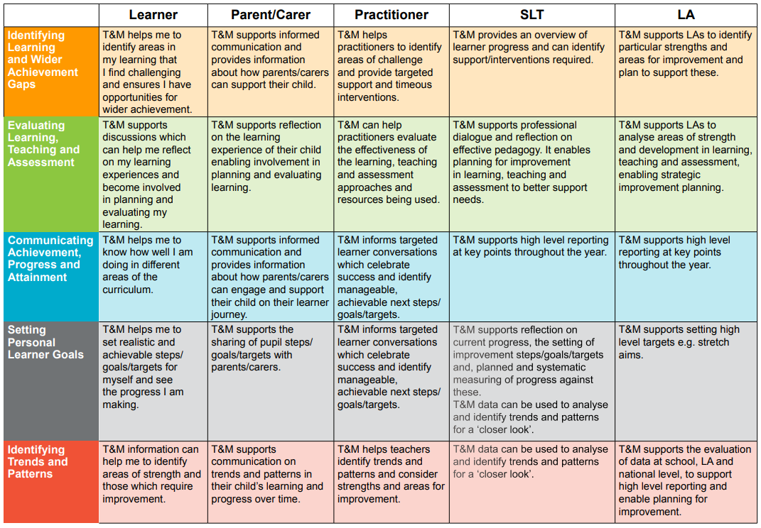
Effective tracking and monitoring systems – part 2
What current tracking and monitoring systems do we have in place currently?
Using the practitioner section of this guide, how well do these statements fit with our current practices?
Notes:
-
This is taken from the resource shared on the previous slide and aims to explore the practitioner section of the resource.
Discussion
What current tracking and monitoring systems do we have in place currently?
Using the practitioner section of this guide, how well do these statements fit with our current practices?
Are there ways we could develop our tracking and monitoring processes further?
Facilitator may wish to focus on specific statements or choose to split participants into smaller groups, each focusing on a different practitioner statement.

Slide 32
Planning - using a data driven dialogue approach to understanding data and complete a needs analysis
Taking a data driven dialogue approach is one way of supporting each other to increase our knowledge, skills and confidence in analysing data.
Involves four phases of analysis and interrogation: prediction, go visual, observations and inferences.
This approach can provide a frame for discussion when approaching data analysis.
As the name suggests, it is important that this is carried out collaboratively.
A link to the protocol and sample data can be found using the link or QR code.
NCS_PS_Toolkit_BST_Set_C_DataDrivenDialogue.pdf (uchicago.edu)
Notes:
Key Messages
Taking a data driven dialogue approach can support staff to increase their knowledge, skills and confidence in analysing data.
Using their own school level data or a set of sample data, participants go through four phases of analysis and interrogation. These are: prediction, go visual, observations and inferences.
This approach can provide a frame for staff when approaching data analysis.
As the name suggests, it is important that this is carried out collaboratively.
A link to the protocol and sample data for carrying out a data driven dialogue can be found using the link or QR code on the slide.
The next slide will provide some examples of the different parts of this approach.

Slide 33
Data driven dialogue
Phase 1 Predictions
Takes place before you see the data.
‘I assume…’ ‘I predict…’ ‘I wonder…’ ‘My expectations are influenced by…’
Phase 2
Go Visual
Re-create the data visually.
Can be drawn on large sheets of paper, trends can be highlighted, calculations carried out, pictures drawn.
Phase 3 Observations
Analyse the data for patterns, trends, surprises and new questions that ‘jump’ out.
Only facts should be noted.
Surfaces perspectives, beliefs, assumptions, predictions, possibilities, questions, and expectations.
Conjectures, explanations, conclusions and inferences are off-limits in this phase.
‘I observe that…’ ‘I notice that…’
Phase 4 Inferences
Generating hypotheses, inferring, explaining, and drawing conclusions.
Defining new actions and interactions and the data needed to guide their implementation.
Identify any additional data required
Notes:
Key Messages
This summarises the different phases of data driven dialogue.
Examples of each stage and what would be involved for us.
Note to facilitator – you may wish to carry out a practical task using the different phases in relation to data relevant to your own setting.

Slide 34
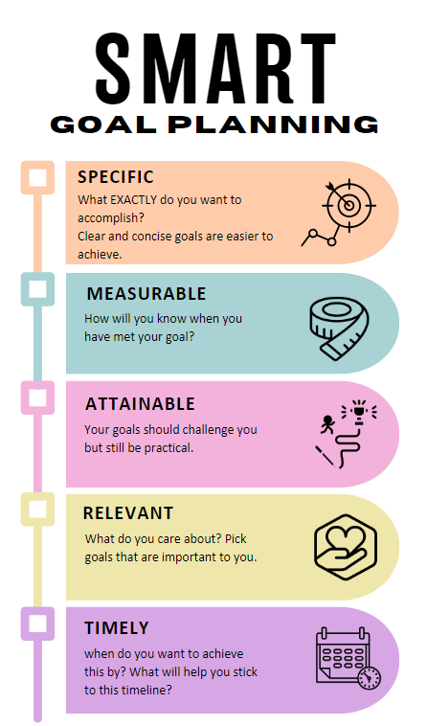
Target setting with learners
It is important to involve learners in their own learning targets,
using the data we have we can co-create some learning targets with our learners,
we can set clear, attainable and measurable targets with the learners,
we can follow up and celebrate success,
we can co-create next steps.
Notes:
Key Messages
Important to involve learners at all stages, dialogue can be adapted appropriately based on the particular learner.
Getting the targets into writing in some form can help them become tangible. Younger learners could create pictures where appropriate.

Slide 35
Target setting with learners.
Discussion
What target/goal setting approaches have we used with our learners before? Were they successful and what did we learn from them?
How can data play a role in target setting with our own learners?
Consider how we could use SMART planning with some/all of our learners.
Notes:
Key Messages
Discussion task – consider the challenges involved in this process and how we could overcome them.

Slide 36
Aims review
In this workshop, we will consider the following:
Using data for planning and setting aims
developing clear measures
the role of evidence and research
tracking and monitoring
using data driven dialogue
target setting with learners.
Notes:
Key Messages
This slide shows the aims of the session to be reflected upon at the end of the session.
Reflective Question
Did we cover all our aims?

Slide 37
Reflection activity
Something you are going to start doing right away.
The main points you are taking away from this session
What will you explore/read/learn more about?
Notes:
Key Messages
This is a reflection activity to encourage participants to think about the session and reflect on:
Starter - Is there something you are going to start doing right away?
Main – what is the main point you are taking away from the session?
Dessert – what will you explore/read/learn more about afterwards/next?

Slide 38
Feedback
Insert you own evaluation code here
Notes:
You can insert your own feedback link here.
Thank-you. We hope that you found this resource useful.
Please provide feedback on the materials here https://forms.office.com/e/viKTsvQj9d
Your comments are appreciated and will be used to inform future resources.
This link should not be shared with the audience.

