Slide 1
Four Capacities - poster
Notes:
This is a front cover page and can only be used at the beginning of a PowerPoint presentation once. Do not add anything else to this screen if it is being used.

Slide 2
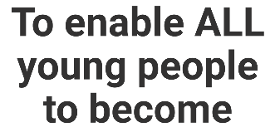
Scotland’s approach - the four capacities
with:
> enthusiasm and motivation for learning
> determination to reach high standards
of achievement
> openness to new thinking and ideas
and able to:
> use literacy, communication and
numeracy skills
> use technology for learning
> think creatively and independently
> learn independently and as part
of a group
> make reasoned evaluations
> link and apply different kinds of
learning in new situations
with:
> self respect
> a sense of physical, mental and
emotional wellbeing
> secure values and beliefs
and able to:
> relate to others and manage themselves
> pursue a healthy and active lifestyle
> be self aware
> develop and communicate their own
beliefs and view of the world
> live as independently as they can
> assess risk and take informed decisions
> achieve success in different areas
of activity
with:
> respect for others
> commitment to participate responsibly
in political, economic, social and
cultural life
and able to:
> develop knowledge and understanding
of the world and Scotland’s place in it
> understand different beliefs
and cultures
> make informed choices and decisions
> evaluate environmental, scientific and
technological issues
> develop informed, ethical views of
complex issues
with:
> an enterprising attitude
> resilience
> self-reliance
and able to:
> communicate in different ways
and in different settings
> make informed choices and decisions
> work in partnership and in teams
> take the initiative and lead
> apply critical thinking in new contexts
> create and develop
> solve problems
Ethos and life of the school as a community
Notes:
Keep as a choice – will have copies printed off
Choice here – either populate for one of the learning opportunities that has been generated on slide 4

Slide 3
Four Capacities – blank templates
Notes:
This is a front cover page and can only be used at the beginning of a PowerPoint presentation once. Do not add anything else to this screen if it is being used.

Slide 4
Scotland’s approach - the four capacities
Ethos and life of the school as a community
Notes:
Keep as a choice – will have copies printed off
Choice here – either populate for one of the learning opportunities that has been generated on slide 4

Slide 5
Me and the four capacities
Successful Learner
Confident Individual
To enable ME
to become a
Responsible Citizen
Effective Contributor
Ethos and life of the school as a community
Notes:
Keep as a choice – will have copies printed off
Choice here – either populate for one of the learning opportunities that has been generated on slide 4

Slide 6
Four Capacities - examples
Notes:
This is a front cover page and can only be used at the beginning of a PowerPoint presentation once. Do not add anything else to this screen if it is being used.

Slide 7
Numeracy and Mathematics – example of using four capacities to articulate skills and attributes in a curricular area
Demonstrate new skills
Persistence and effort
Positive Mindset in Mathematics
Challenges/Puzzles etc.
Demonstrate creativity
Work independently
Practise new learning
Use numeracy and mathematics skills/knowledge/understanding in a real life context
Solve problems
Discuss learning
Apply thinking skills
Teach someone else a maths concept
Explain how a solution was reached
Show different ways of solving a calculation
Apply skills in different contexts
Opportunities to celebrate personal successes
Critical thinking
Ask questions
Make informed decisions
Interpret information
Draw conclusions
Can see relevance in learning
View yourself as a learner
Can ‘see’ learning in lots of activities, not just work set by teacher/school
Communicate solutions
Work independently on challenges/puzzles/homework
Work as part of a team to reach solutions
Offer your own opinions
Demonstrate critical thinking
Apply mathematical skills to design/create/improve etc.
Ethos and life of the school as a community
Notes:
Keep as a choice – will have copies printed off
Choice here – either populate for one of the learning opportunities that has been generated on slide 4

Slide 10
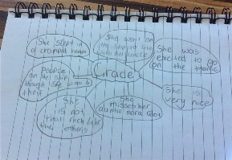
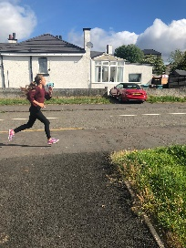
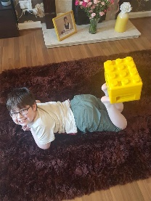
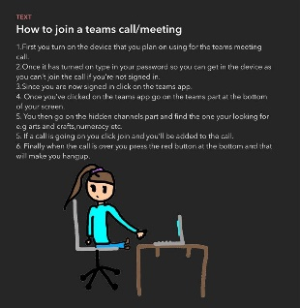
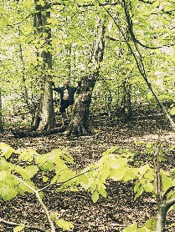
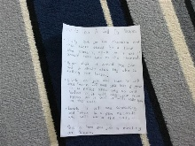
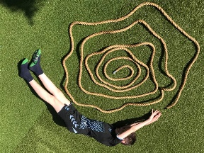
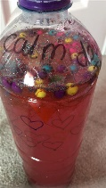
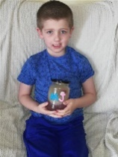
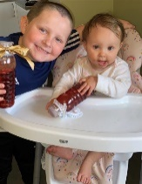
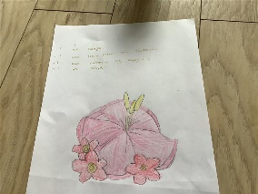
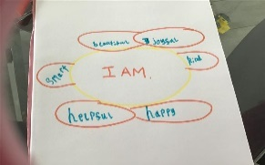
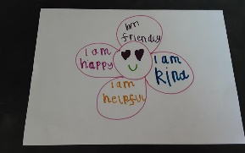
Mossend PS & NC - The Four Capacities –
Week Commencing 25th May 2020
Working independently using our NLC Comprehension Strategies to successfully complete a Visualisation task about the main character of our novel about The
Titanic.
Two of our learners achieving success in a Digital Challenge set in our Online Learning Team – share an original artistic pose with an object beginning with their initial.
In Taught Writing, using Technology to create instructions to share with peers on how to join and access Teams. Transferring learning into a real life context.
Actively striving for a healthy lifestyle linking to our Mossend Olympics IDL.
We use Microsoft Teams, OneNote and Forms for learning in a different context sharing ideas and taking on board the opinions of others. This showcases all of the different ways we have learned to communicate.
Using Emotion Works as a stimulus, children have been taught the skills and strategies to make informed choices and decisions about how they are feeling, their triggers and what they can do and use to help themselves.
We have used Flipgrid to convey our ideas and conclusions when investigating who stole Mrs Paterson’s Easter Egg in Whodunnit.
Ethos and life of the school as a community
Notes:
Keep as a choice – will have copies printed off
Choice here – either populate for one of the learning opportunities that has been generated on slide 4

