Slide 1
College Regions
Regional Improvement Collaboratives
Mapping Tool

Slide 2
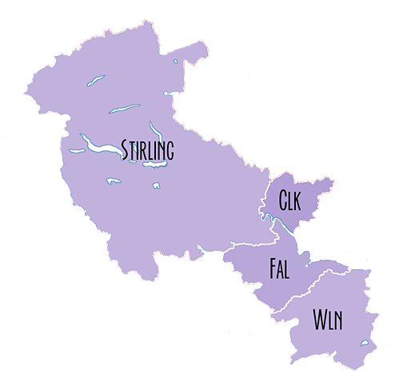
Forth Valley and West Lothian
Collaborative
&
College Regions
Forth Valley College
West Lothian College

Slide 3
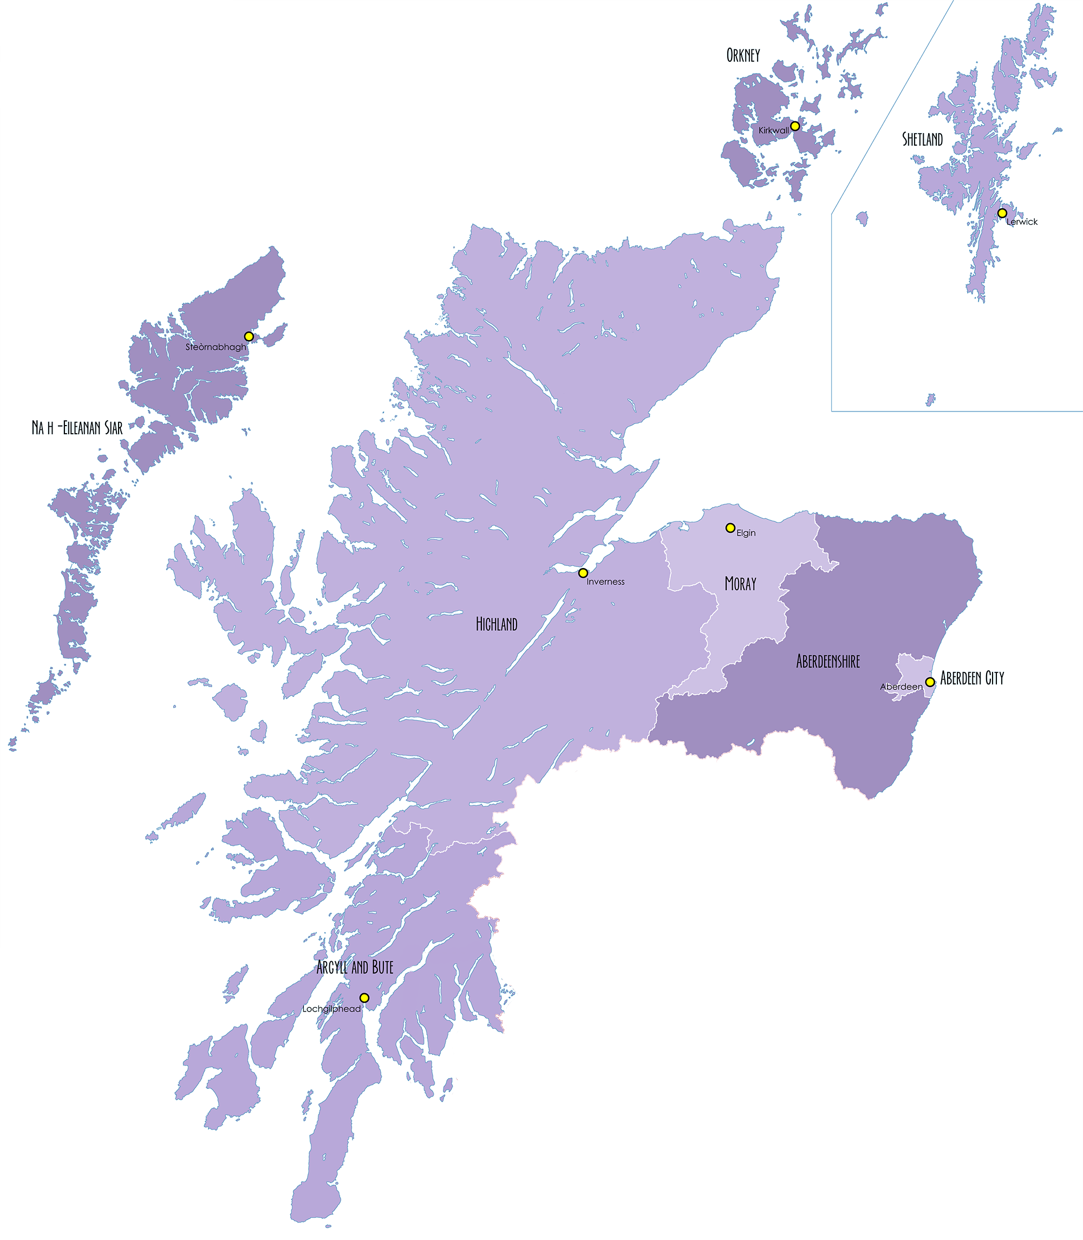
Northern Alliance
&
College Regions
Highlands and Islands
North East Scotland College

Slide 4
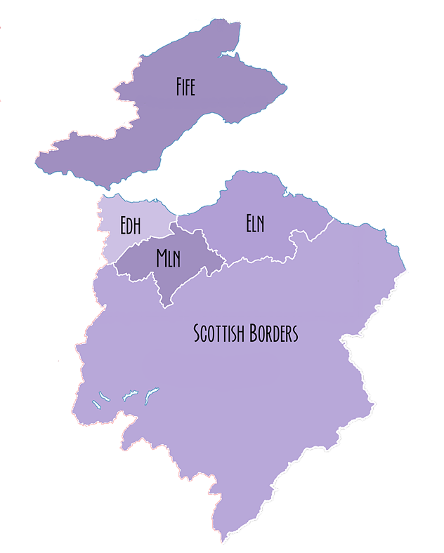
Fife College
South East Improvement Collaborative &
College Regions
Edinburgh and Lothians
(Edinburgh College)
Borders College

Slide 5
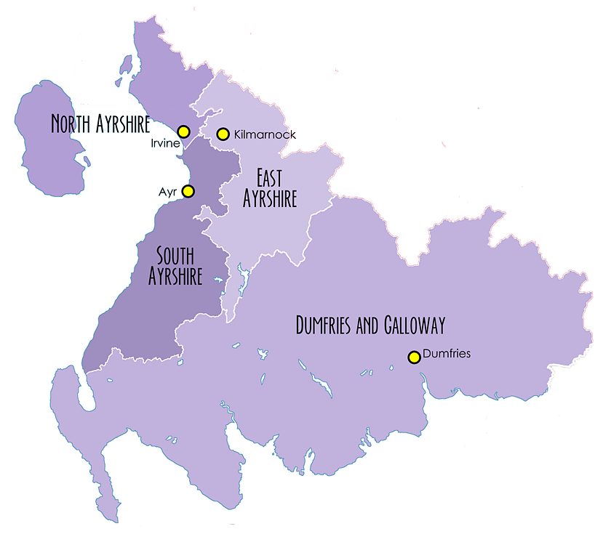
West College
South West Collaborative
&
College Regions
Highlands and Islands
Ayrshire College
Dumfries and Galloway College

Slide 6
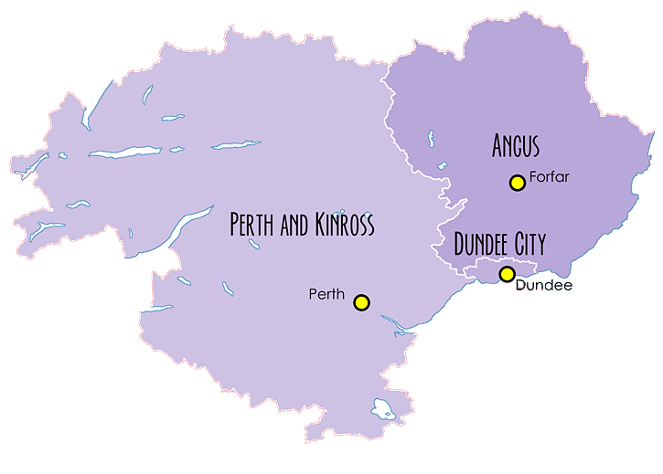
The Tayside Collaborative
&
College Regions
Tayside
(Dundee & Angus College)
Highlands and Islands
(Perth College)

Slide 7
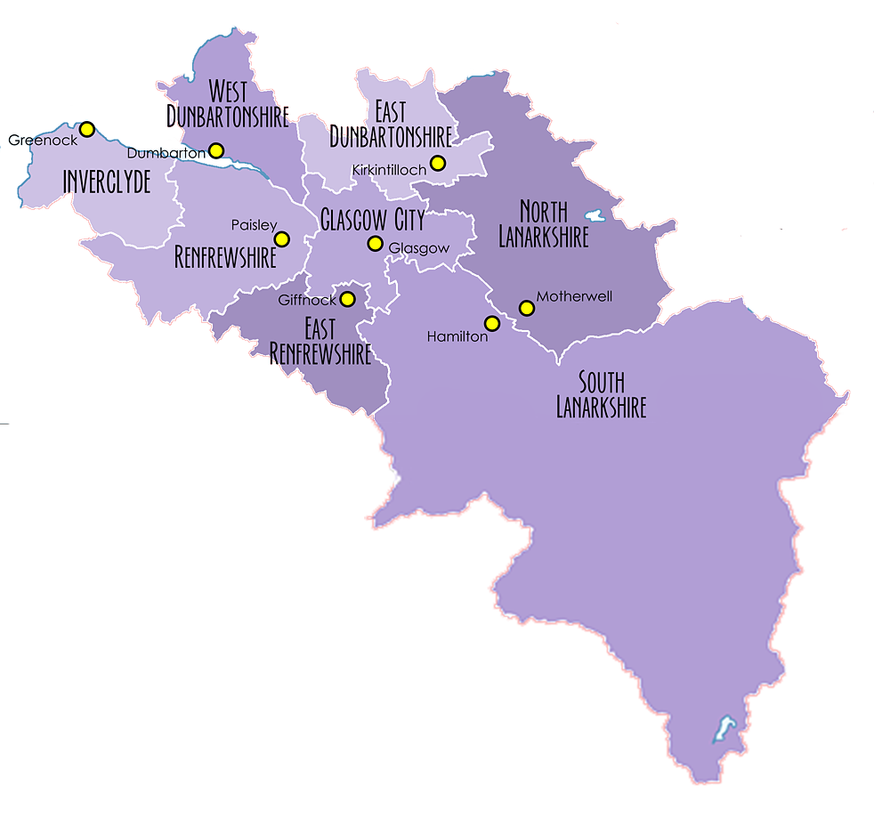
West College Scotland
The West Partnership
&
College Regions
Glasgow
Lanarkshire

