Slide 1


Aspiring to Middle Leadership
Introduction session
C
Notes:
All information is correct as of August 2026.
This PowerPoint is intended to support senior leaders, middle leaders and practitioners in schools and local authorities to deliver an introduction session to a group on the Aspiring to Middle Leadership (AML) programme. It is the first of a set of 3 to accompany the AML programme.
This PowerPoint is a template that presenters can adapt to suit their own context and style of presenting. It can be added to, but please do not remove any slides as they are all essential to the Introductory session. You may wish to add the date, a logo alongside the Education Scotland one, add dates for future sessions (2 further sessions are suggested) or to add a link to a local feedback form into the last slide. You can use these slides in person or online.
Within the slides, suggested timings, key messages to get across, facilitator notes and reflective questions are included.
The session this PowerPoint is intended to support has been designed to be delivered by facilitators in 60 -75 minutes. If you have longer, we would encourage you to use that time for (more) discussion of the reflective questions and perhaps invite some feedback. Suggested approximate timings can be found in the notes for each slide.
IMPORTANT NOTES:
This PowerPoint refers to the open access, self-directed Education Scotland Aspiring to Middle Leadership programme, at Aspiring to Middle Leadership | Self-directed professional learning | Professional Learning | Education Scotland. It is anticipated the presenter will be familiar with the content of the programme, which can be found at the Education Scotland website pages. It will be particularly useful to be familiar with Introductory Activities 1-3, before delivering this session. These are ideally completed by participants ahead of this Introductory session. The fourth and final Introductory Activity is started during this session.
If facilitating in person, you may wish participants to bring their devices for slides 14 and 15, when you present ‘The learning ahead’ that is accessed through the website. Alternatively, you could share your screen whilst viewing the AML pages of the website, to show/remind participants how and where to access the Professional Learning Activities. If online, be ready to share your screen to show these webpages.
While use of the AML Reflective Journal is optional, we would encourage its use as part of this facilitated programme. If used, it will be helpful for participants to have it to hand during this session.
Learning outcomes for this resource:
• Set the scene for professional learning
• Familiarise colleagues with the programme
• Agree/share a timeline for working together.

Slide 2
Ways of working together
We all work together
We learn from, with and on behalf of each other
We create a safe space to share ideas and build learning
We agree that everyone is an equal and valued participant
We remain ‘in the room’ (follow email and phone protocol)
Notes:
Suggested timing:
5 minutes
Key messages:
- Why establish group protocols?
Effective professional learning goes beyond simply delivering information. It fosters a learning community where educators can learn with, from, and on behalf of one another. To achieve this, the facilitator of this learning should establish clear protocols and a positive learning environment at the outset. The general notes below will support the facilitator to help everyone feel comfortable participating and contribute to a rich learning experience.
Facilitator notes:
Take some time to establish group protocols (ways of working together) for this session and any further Aspiring to Middle Leadership sessions you may deliver.
Ask participants to comment on anything they would like to add or amend.
Is there anything that participants feel is missing or anything they would like to remove?
The protocols on the slide are suggestions to be amended for your context or group.
Further notes on creating protocols:
1. Contract a safe space
Co-create a safe space agreement with your group. This agreement outlines expectations for respectful communication and active listening. A safe space allows trust to flourish, fostering a collaborative environment where everyone feels comfortable sharing ideas and taking risks.
2. Shift from top-down to collaborative learning
Move beyond the traditional model where one person imparts knowledge. Embrace a collaborative approach where all participants actively engage. This means learning with, from, and on behalf of one another. By leveraging the diverse perspectives within the group, gaining a richer understanding and creating a more impactful learning experience for everyone.
3. Holding the ladder: Shared expertise and recognition
Holding the ladder signifies a two-fold approach:
Sharing expertise: Those with experience can share their knowledge and insights.
Recognising everyone’s contribution: Actively listen and be open to learning from the unique perspectives and experiences of colleagues. Build on each other's ideas to foster a collaborative environment where everyone feels valued, and their contributions are respected.
4. Hold space for silence and respectful discussion
Hold space for silence after someone speaks or asks a question. It can be tempting to jump in to fill silence but allowing time for quiet can avoid interrupting thought and produce more thoughtful responses. Everyone deserves to be heard and understood.
Adapt the time allocation based on the size of the group and the complexity of the topic.
5. Schedule regular breaks
Schedule a break into the session (as a minimum, one 5–minute break per hour). This allows participants to process information, refocus, and return with renewed energy, leading to a more productive learning experience.
6. Centre learning in real life
Connect the learning to real-life experiences by encouraging participants to share relevant personal anecdotes or applications. This strengthens understanding and makes the learning more relatable and impactful for all.

Slide 3
Today
Connect with each other
Principles of the programme
Roles of middle leadership
Beginning self-evaluation
Inclusion, wellbeing and equalities
Supports for your learning
Next steps
Notes:
Suggested timing:
1 minute
Facilitator notes:​
​
This slide shows what will be looked at in this session, to be shared with participants. Invite any questions they may have.

Slide 4
AML learning outcomes
Leading their own learning, participants will:
  increase their knowledge of recent and emerging research around the roles of middle leadership
  enquire into their own strengths and areas for development as an aspiring or new middle leader
  increase their knowledge and understanding of the roles of middle leadership and the skills and abilities required to carry out key aspects of these roles
  increase their knowledge and understanding of an aspect of wellbeing, inclusion, equity or equalities, with a view to leading a change in this area
  make connections and learn with and from colleagues from different schools and settings.
Notes:
Suggested timing:
1 minute
Facilitator notes:​
​
This slide shows the learning outcomes for the programme, to be shared with participants. Invite any questions they may have.

Slide 5
Connector
One at a time
On your own
In the group
All together
Introduce yourselves to each other
-name
-role
-setting
-hopes for AML?
Think for a minute or two to the pre-programme activities
-Ceitidh’s blog
-Professional values
-John DeNobile’s paper and/or model
Share an aspect that resonated with you, that challenged you, that got you thinking...and why
Share with the wider group and programme leads - if you want to
Notes:
Suggested timing:
2 + 10 minutes
Key messages:
Reflecting on the activities already done will bring the group ‘back into’ the learning, having already done Introductory activities 1-3, and provide a good starting point for today’s thinking and learning.
Facilitator notes:
If participants have used the optional Reflective Journal for the Introductory activities, it will be useful to have it to hand.
If time permits, you may wish to ask each small group to feed back any key points or themes from their discussion.
If time permits, invite any further reflections with the whole group.
Further notes on connectors:
A connector activity allows participants to take part in an informal discussion.
This is to ensure that participants are relaxed, focused and ready for an interactive workshop.

Slide 6

Models underpinning the programme
‘Three fields of knowledge’- Louise Stoll (NCSL, 2006)
Public knowledge- theory and research
Practitioner knowledge-
experience and context
New knowledge- collaboration and enquiry
Notes:
Suggested timing:
2 minutes
Key messages:
Tell the group we will look at some of the research and thinking that underpins the programme. Throughout the programme we will keep in mind the ‘3 fields of knowledge’, (NCSL = National Centre for School Leadership in England).
Facilitator notes:
3 fields of knowledge:
1 - what is already known and in the public domain
2 - what we know in the room, our vast combined knowledge, skills and experience
3 - what we create by working together.
What each of you bring to the programme is very valuable - it contributes to the 3rd field of knowledge

Slide 7
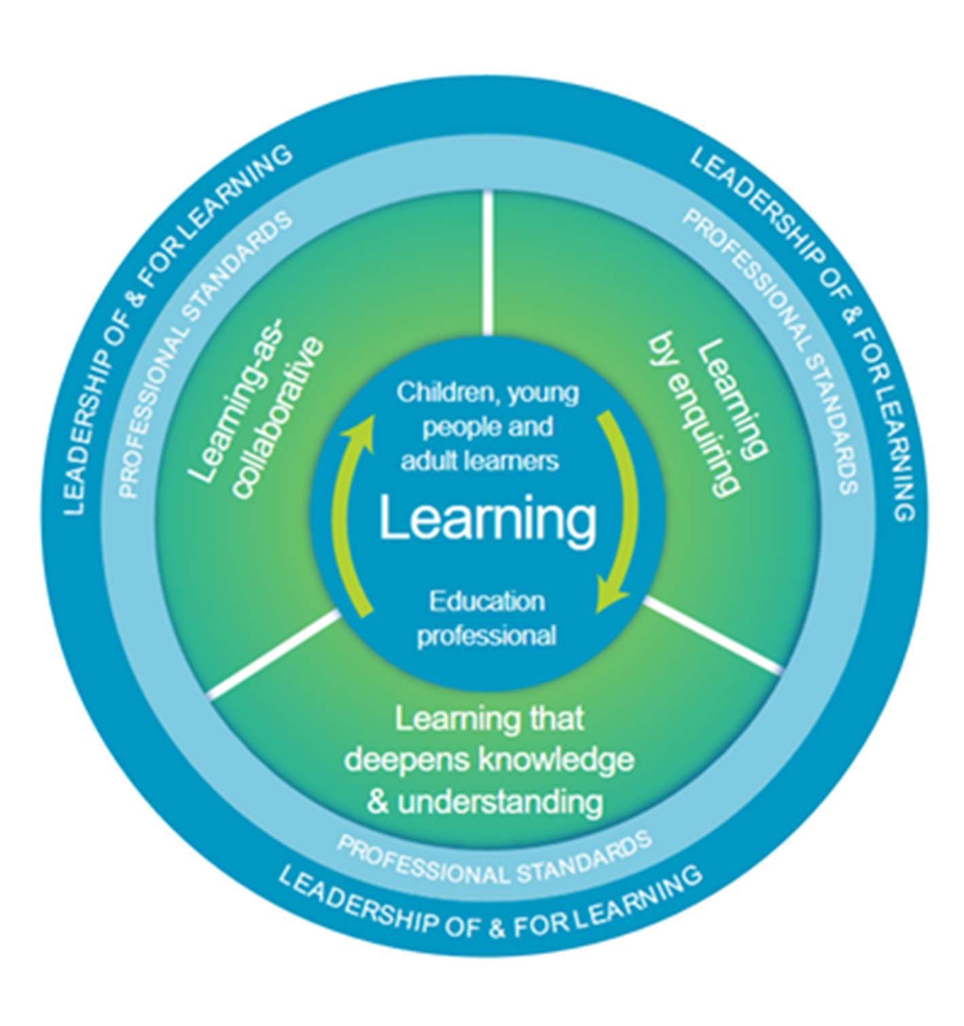
The national model of professional learning
(Scotland, 2018)
Notes:
Suggested timing:
5 minutes
Key messages:
The national model of professional learning describes the main principles and features of effective learning. These can help to build capacity and promote collaborative practices.
The national model of professional learning | National approach to professional learning | Professional Learning | Education Scotland
Aspiring to Middle Leadership has been designed using the national model of professional learning and the principles of adult learning or andragogy.
Facilitator notes:
Briefly talk through each part of the model:
The heart (centre) of the model - the professional learning in this programme should impact on you as educators and in turn impact on your learners. All effective professional learning links the educator’s learning with that of the children, young people or adult learners you work with. You will be in the role of a learner in this programme too. Please reflect throughout on the potential of your learning to impact on your learners.
The next three elements in green – the programme involves enquiry, collaboration and learning that deepens your knowledge and understanding, because these approaches are known to support effective learning that can transform practice.
The programme is linked to professional standards, whether the General Teaching Council (Scotland) (GTCS) Standard for Middle Leadership, the Scottish Social Services Council (SSSC) Codes of Practice or Standard for Childhood Practice (2015), or the Community Learning and Development Standards Council (CLDSC) Competent Practitioner Framework.
Leadership of and for learning is about creating a culture of learning in a setting, with everyone playing a part in creating that ethos, not just leadership teams.
Reflective question:
Is there anything that resonates with you and if so, why?

Slide 8
Our ‘why’
‘...to promote social justice... to navigate contexts...to flourish in creativity...to open doors of opportunity...to bridge the present to the future...to feel that education is important for the sake of our collective humanity...’
Jeffrey Boakye, ‘I Heard What You Said -
A Black Teacher, A White System’, 2023
Notes:
Suggested timing:
3 minutes
Key messages:
Reflecting on your own professional 'why' will help you remember why you educate and get you thinking about what kind of leader you want to become.
Facilitator notes:
Here's the view of Jeffrey Boakye (pronounced ‘Bo-ah-chay’), author and education commentator, on why he teaches and what he feels education is for. Read the quote out and invite reflections on these questions:
What is your why?
Why educate?
What is education for?
Why aspire to lead?
Invite the group to share any reflections.

Slide 9

Our ’how’
‘Teach children how to learn, not merely how to be taught’
Santiago Rincon-Gallardo
‘Flawlessly perfect leadership is unattainable and undesirable’
Prof. Andy Hargreaves
Notes:
Suggested timing:
3 minutes
Key messages:
Our 'how' is also very important - our skills, experiences, knowledge, abilities, attitudes, values and unique qualities matter!
Facilitator notes:
Another couple of quotes that might tell us something about how to lead in education, and how to be as a leader; the importance of authenticity and modelling to learners how to be a lifelong learner.
Encourage the group to tell their learners they are on a learning programme.
Mention that the professional standards and values also help us with the 'why' and the 'how' and encourage participants to check in with them from time to time as they as they proceed through the programme.
Invite the group to share any reflections.

Slide 10
A theoretical model of middle leadership
The roles of middle leaders
Student Focused (SF)
Supervisory (SU)
Staff Development (SD)
Strategic (ST)
Administration (AD)
Organisational (OR)
Adapted from De Nobile, 2017
Notes:
Suggested timing:
1-2 minutes
Key messages:
This model presents the evidence that underpins this programme and the roles of middle leadership on which the PLAs are based.
Facilitator notes:
Remind the group of Introductory activity 3. Recap the roles briefly (participants will have learned about it already in the Introductory activity 3, and the full model is on the next slide with detailed notes). These are the 6 roles of middle leadership identified in the research of John De Nobile (when working at Macquarie University, Sydney, Australia).

Slide 11
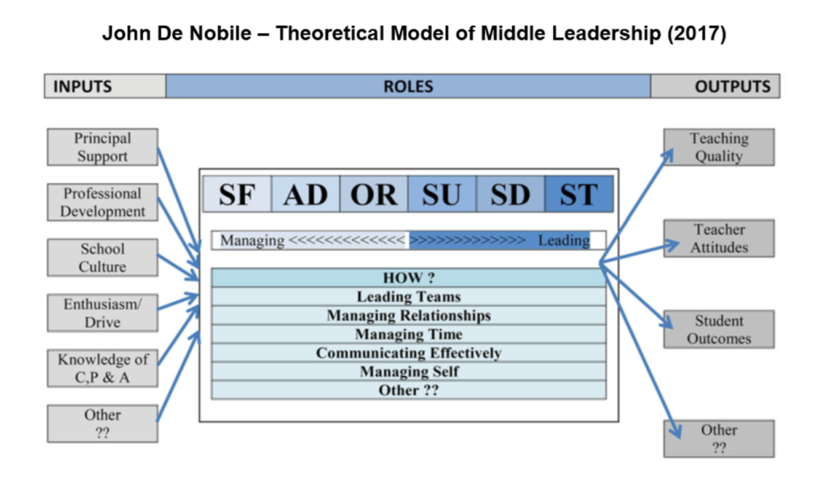
The theoretical model of middle leadership
Notes:
Suggested timing:
7 minutes
Key messages:
This model presents the evidence that underpins this programme and the roles of middle leadership on which the PLAs are based.
Facilitator notes:
Recap the model briefly (participants will have learned about it already in the Introductory activity 3).
For your own reference, in the model:
Inputs are the influences on middle leaders that determine how effectively they can carry out their role
Notes: Principal support = Headteacher support;
C, P & A = Curriculum, Pedagogy and Assessment;
‘Other??’ is included as John De Nobile acknowledged this list not to be exhaustive.
Roles are where the acronyms stand for:
SF Student focused - concerns instances when middle leaders are dealing with learner issues that are not related to the other roles. Examples of activity in this area would
include: assisting learners with academic issues, dealing with behaviour problems and addressing the welfare needs of learners.
AD Administration - concerns the development of procedures and putting them in place so that a variety of tasks can be carried out by staff members and the organisational role can be executed effectively. The ultimate goal of the administration role is efficient use of time and resources. This role includes the organisation of systems, such as files and databases for the keeping of records relating to a variety of things ranging from purchases and inventory through to learner achievement and behaviour. The middle leader develops these systems, or does so as part of a team, or may even engage school administration staff to produce the necessary resources.
OR Organisational has to do with the organisation of physical and human resources through tasks that help schools to achieve their goals and objectives. Coordination of people
and materials is the main activity. As part of this role, middle leaders organise duty rosters and teaching timetables. The role also involves planning, executing and implementing a range of programmes, events and activities. These are increasingly collaborative tasks with others in a team, department or committee. The organisational role also requires middle leaders to collect data on student achievement through the monitoring of assessment results, which can provide the basis for work in other roles.
SU Supervisory - involves monitoring and evaluating the performance of staff, including perhaps junior leaders (such as assistant department heads). The focus of this particular role is monitoring and reporting on the competency of individuals they have authority over as well as the quality of their work. This role suggests that middle leaders may be required to assess teachers. However, in some studies, middle leaders preferred a softer, collegial notion of supervision where performance was discussed rather than observed and measured. The supervisory role links to the staff development role when discussions extend to suggestions about in-service training, such as short courses or other activities to lessen knowledge gaps and improve skills.
SD Staff development - concerns building the capacity and competence of staff members so that they can do their jobs more effectively. This role is carried out in several ways. The simplest acts are offerings of encouragement, praise or support for work being done, the aim of which is to keep teachers and other staff motivated to develop their abilities and reach their potential. Another well-known way to carry out the staff development role is to lead by example. Middle leaders are often regarded as effective teachers and role models,
often reaching their position because of their capacity for leading by example. They might enhance their reach as role models by letting other staff members
observe them, providing advice to teachers, mentoring and coaching their colleagues in a
grade or subject area or simply working the way they want their colleagues to work. Middle leaders have also been observed to organise and even run professional development for teachers based on their particular expertise.
ST Strategic - primarily concerns vision forming and goal setting and acquiring the resources to achieve these. Middle leaders are increasingly being asked to develop a vision for
their area of responsibility. This means that they must also persuade those in their area of responsibility to ‘buy in’ and work towards that vision. Collaborative styles of leadership that cultivate positive trusting relationships will be useful , especially where teaching practices may need to change. The strategic role also involves motivating and persuading others to follow a
particular policy line or get involved in implementing new ideas. The strategic role is likely to be much easier to carry out if middle leaders are good staff developers, supervisors,
administrators and managers because they are creating the optimal conditions for influence and change. The larger theoretical model (De Nobile, 2017) suggests that middle leadership roles are
at the centre of what these important people do and their potential impacts on school effectiveness through their influence on the quality of teacher work.
(For full article and references please access The Roles of Middle Leaders in Schools: Developing a Conceptual Framework for Research, De Nobile, 2017 via EBSCO).
Tell participants that John De Nobile worked with Scottish Middle Leaders in 2021 through Education Scotland’s Middle Leaders Leading Change programme, and they identified some additional roles, including:
External liaison – concerns interaction with third parties such as specialists and social workers, facilitating work experience and interacting with employers or universities
Staff health and wellbeing – concerns looking after staff mental and physical health issues and other aspects of staff inclusion.
Managing and Leading are distinct but complementary and the middle leader roles will involve aspects of both. The 6 roles are distinct but interrelated.
Outputs are the impacts middle leaders can have.
How? are the skills and behaviours demonstrated by middle leaders in carrying out their roles.
Reflective Questions:
What are your thoughts about the model? Does it ring true for you in relation to what you know about middle leadership? Were there any surprises?
What might be the other inputs (influences on) and outputs (impacts)? What other aspects of the How? might there be?

Slide 12
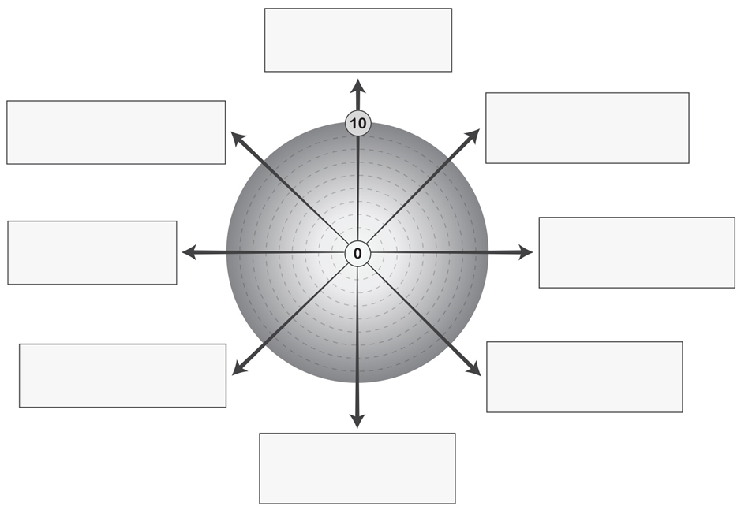

Where are YOU in all this?
Student-focused
Staff health and wellbeing
Administrative
External liaison
Organisational
Strategic
Supervisory
Staff development
Notes:
Suggested timings:
10 minutes (more time should be taken on this activity after the session, when participants are ready to start choosing which PLAs they will do).
Key messages:
This slide is about Introductory Activity 4- the self-evaluation wheel. This activity is important. Participants’ learning will be determined by this activity, as they will select their Professional Learning Activities (PLAs) based on the outcomes of it. Each item around the wheel has a corresponding PLA.
A self-evaluation wheel is a valuable tool for supporting self-evaluation. Using a wheel can help you to explore your current reality and critically reflect on yourself as a professional and your practice. It can support you to create clarity about the areas of learning you wish to focus on and perform a simple gap analysis about where you are now, and where you would like to be. You can use it independently or as part of a dialogue.
Facilitator notes:
Tell the group that this is a self-evaluation wheel with 8 boxes showing John De Nobile’s 8 roles of middle leadership. If participants are using the Reflective Journal, they will find it in there and can make a start using the Journal now. If not, encourage them to draw a wheel of their own with the 8 roles of middle leadership as shown.
Allow the group some quiet, individual time to begin scoring themselves on the wheel, by marking a cross on the ‘spokes’ to indicate a score between 0 and 10, where:
0 = not confident/ lots of areas to develop or work on/ no experience of this role
10 = very confident/ accomplished in this area/ lots of experience of this role
Tell the group they can spend more time with this later to help them plan their learning. They can select 2 ‘AML Roles of Middle Leadership’ PLAs based on their wheel. They can choose areas of strength, areas for development or areas of interest.
Reflective questions:
Questions for now: What do you think of the self-evaluation wheel as a tool? How else might you use it with colleagues?
Questions for later: After completion of the self-evaluation wheel (these appear in the Reflective Journal)-
What do you notice? What’s most important? What stands out? What’s the gap? What’s my priority? What’s a key strength? How might these roles impact on each other?
Which 2 PLAs do I want to focus on?

Slide 13


Let’s take a break
Notes:
If your session lasts over an hour, we suggest taking a break here.

Slide 14
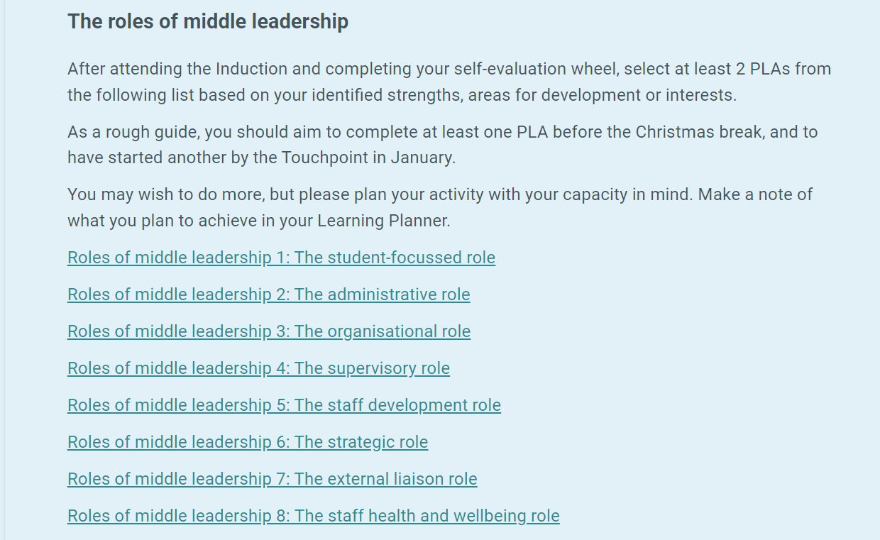
The learning ahead:
1. ‘Roles of middle leadership’ PLAs – choose 2 PLAs
Notes:
Suggested timing:
3 minutes
Key messages:
Remind the group that all the learning for the programme is contained in the Aspiring to Middle Leadership webpages.
Next steps are to choose the 2 ‘Roles of Middle Leadership’ PLAs based on their self-evaluation wheel and complete these within an agreed timeframe. The links to the 8 ‘Roles of middle leadership’ PLAs are found within the AML webpages. Remember an account is required to access the PLAs. Once logged in, the links to the PLAs will work.
Facilitator notes:
You may wish to screen-share the relevant webpage as part of the session, or if participants have devices, allow some time for them to access the pages and read through them.
Tell the group each PLA takes 2-4 hours and is in ‘bite-sized’ steps that can be saved as they go along. There are reflective questions in each step with space to record reflections. Every PLA ends with an ‘impact step’. A PDF summary of each PLA, with reflections, can be downloaded once complete. Participants can also use the optional Reflective Journal to record thoughts as they go through the PLA and perhaps when they have completed it as well.
A suggested timeframe for completing 2 PLAs is a term, but this should be negotiated and agreed with the group and /or leadership team.
Reflective questions:
Invite any questions at this point. How are the group feeling about the learning now? Are there any hopes / concerns?

Slide 15
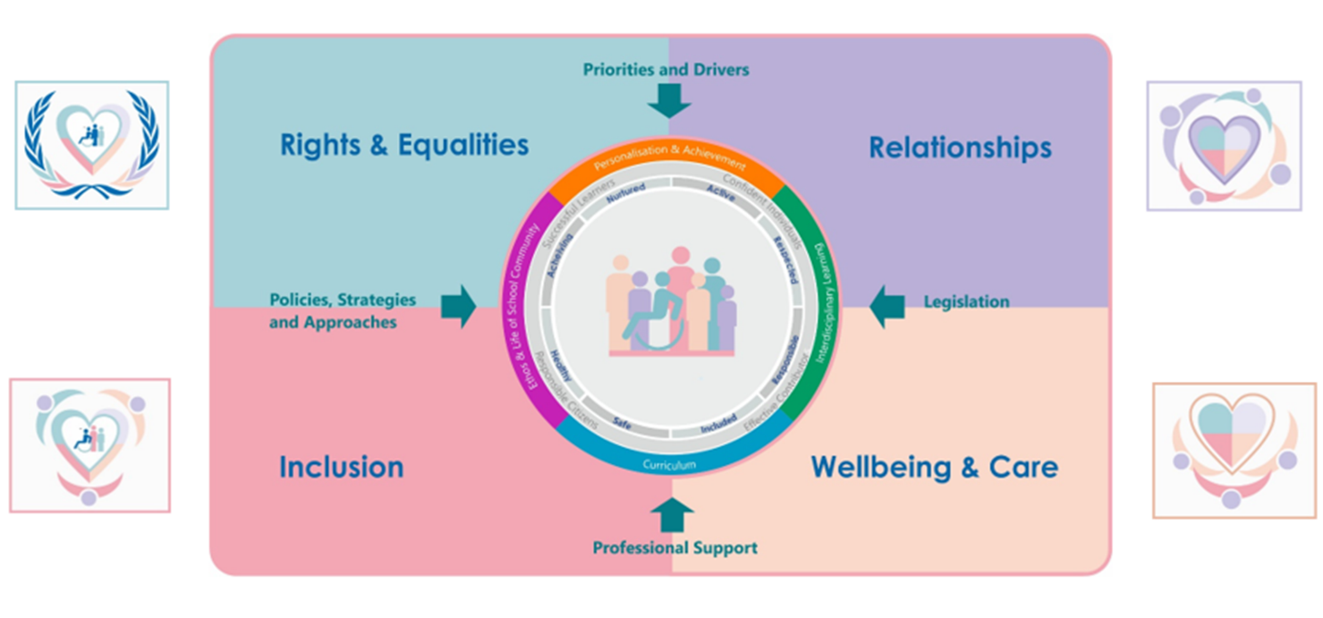
The learning ahead:
2. Inclusion, wellbeing and equalities – choose 2 PLAs
Notes:
Suggested timing:
3 minutes
Key messages:
This slide shows the national framework for Inclusion Wellbeing and Equalities (IWE). Participants will move onto learning about 2 specific areas in the second part of the programme, once 2 ‘Roles of middle leadership’ have been completed.
Facilitator notes:
You may wish to screen-share the AML webpage on Inclusion, wellbeing and equalities at this point, or if participants have devices, allow some time for them to access the pages and read through them. Some context is provided for the IWE learning and additional resources signposted at the relevant webpage. There is a short video explaining the national framework shown on the slide.
Tell the group they will select 2 further PLAs on Inclusion, Wellbeing and Equalities themes from a list available at the Aspiring to Middle Leadership webpages. These may be individual choices based on the needs of their learners, or PLAs the whole group will do, based on the school improvement plan, or perhaps one of each.
Again, a suggested timeframe for completing 2 PLAs is a term, but this should be negotiated and agreed with the group, as before.
Reflective questions:
Invite any questions at this point. How are the group feeling about the learning now? Are there any aspects of IWE they are interested in or want to learn more about?

Slide 16

Supports for your learning –
your peer supporter
What do I want
from this relationship?
Who could best provide that?
After today, agree dates, duration, approach and expectations
After PLAs 1 -2, reflect on learning and consider impact on practice
After Touchpoint session, reflect on shared learning and plan next steps
After PLAs 3-4, reflect on learning and consider impact on practice
After Looking Ahead session, reflect on programme and plan next steps
Notes:
Suggested timings:
3 minutes
Key messages:
Working with a peer supporter can have benefits for both people involved. A peer supporter will hold space for professional dialogue about your learning. A peer supporter guide [insert link] provides more information and is available at the AML webpages.
Facilitator notes:
This slide provides a suggested schedule of meetings, assuming the programme is taking place over 8-12 months. If participants are to work with a peer supporter, this can be someone from within the group who is also part of the programme but doesn’t have to be. The peer supporter can be a current middle leader or someone the participant has a good existing relationship with. They do not need to be working in the same setting.
Suggested timing for meetings is 20-40 minutes of focused reflection/discussion.
Reflective questions:
What do you want from a peer supporter relationship?
What might be the benefits?
Who might be a good fit to support me in my learning?

Slide 17



Support for your learning –
reflective journal
An optional reflective journal is provided at the programme webpages to support you in your learning. You may choose to download this and populate it during the programme. It is just for you and only for sharing if you choose.
Notes:
Suggested timings:
1 minute
Key messages:
There is some evidence to show that using a journal can help learning to 'stick' more effectively - it can help you to organise your thinking, it can crystallise your thoughts into a plan and provide a useful resource to revisit when considering changes over time.
You could use it after each PLA as a way to distil your reflections into the most salient points and key actions.
It can also act as a record of your learning.
Facilitator notes:
It's optional and you don't need to share it, unless you choose to. It's not for submission, but just for you.

Slide 18

Leading from the middle....
...what (or where) are your spheres of influence?
Notes:
Suggested timing:
3 minutes
Key messages:
Middle leaders have a wide sphere of influence and are key brokers of change and improvement.
Facilitator notes:
The image on the slide is animated if you click and press the play button.
Tell the group that Professor Andy Hargreaves in his book Leadership from the Middle describes leading from the middle as a privilege of being in a place where real change can be made. The middle is sometimes seen as the bridge between practice and SLT. This can be both an opportunity and a challenge. For Hargreaves, the middle isn't a hierarchical placemarker but more like being right in the thick of things - where the action is - and where your influence can be both far-reaching and lasting.
Dr Kylie Lipscombe, and Australian academic, describes middle leaders in schools as 'brokers' of change, as they have ‘a foot in both camps’ – with working knowledge of both senior leadership decisions and actions, and of what is happening in the classroom.
Reflective questions:
Thinking of the ripples spreading outward from the drop of water, who do you reach?
Where are your spheres of influence as an aspiring leader? Where could they be in the future?

Slide 19


Feedback and contact
We hope that you found this session useful.
Notes:
Thank the group for their time and engagement and make sure they know who to approach with any questions and how to contact them. You may wish to add these details to the slide.
You may also wish to add dates for the next one or two sessions – Touchpoint session and the final Looking Ahead session.
You may want to add a link or QR code for your own local feedback form, for this session, at this slide, or add an extra one.
If you would like to provide feedback on this resource, as a facilitator, please go to https://forms.office.com/e/edkPTYNNDC

