Slide 1


A Quality Improvement Framework for the
Early Learning and Childcare Sectors

Slide 2




Aims of session
Share the journey and update you on progress
Clarify what the framework means for you and your teams
Share our timeline for piloting and implementation of the framework
Hear your views and answer your questions
A Quality Improvement Framework for the Early Learning and Childcare Sectors

Slide 3
Stakeholder engagement
In January, we analysed all comments and data from the consultation
We shared a summary of the responses in April 2024
We continued our engagement with our stakeholder reference group, and with other professional experts to help refine and shape the draft framework

Slide 4
You asked for
CI and ES have
Reduced duplication
Sector specific content
Clarity
Consistency of language/terminology
Reduced length of framework
Challenge questions
Links to national resources
Streamlined the framework number of quality indicators (Qis) from 28 to 11
Reduced duplication of content
Provided sector specific content
Clarified specific QIs for each body
Made the framework interactive but also printable
Added challenge questions
Added links to resources
A Quality Improvement Framework for the Early Learning and Childcare Sectors

Slide 5
Existing document (Education Scotland): Core changes
Reduction in quality indicators
Leadership and management | Learning provision | Success and achievements
How good us our leadership approach to improvement? | How good is the quality of care and learning we offer? | How good are we at ensuring the best outcomes for all children?
1.1 Self-evaluation for self-improvement | 2.1 Safeguarding and child protection | 3.1 Ensuring wellbeing, equality and inclusion
1.2 Leadership of learning | 2.2 Curriculum | 3.2 Securing children’s progress
1.3 Leadership of change | 2.3 Learning, teaching and assessment | 3.3 Developing creativity and skills for life and learning
1.4 Leadership and management of practitioners | 2.4 Personalised support
1.5 Management of resources to promote equity | 2.5 Family learning
 | 2.6 Transitions
 | 2.7 Partnerships
A Quality Improvement Framework for the Early Learning and Childcare Sectors

Slide 6
Existing document (Care Inspectorate): Core changes
Reduction in quality indicators
How good is our care, play and learning? | How good is our setting? | How good is our leadership? | How good is our staff team?
1.1 Nurturing care and support | 2.1 Quality of the setting for care, play and learning | 3.1 Quality assurance and improvement | 4.1 Staff skills, knowledge and values
1.2 Children are safe and protected | 2.2Children experience high quality facilities | 3.2leadership of play and learning | 4.2 Staff recruitment*
1.3 Play and learning |  | 3.3 Leadership and management of staff and resources | 4.3 Staff deployment *
1.4 Family engagement |  |  | *4.2 and 4.3 do not apply to childminders who do not work with assistants
1.5 Effective transitions
A Quality Improvement Framework for the Early Learning and Childcare Sectors

Slide 7
A quality improvement framework for early learning and childcare sectors
Leadership | Children thrive and develop in quality spaces | Children play and learn | Children are supported to achieve
Leadership and management of staff and resources | Children experience high quality spaces and settings | Play and learning | Nurturing care and support
Leadership of continuous improvement |  | Curriculum | Wellbeing, inclusion and equality
Staff, skills, knowledge, values and deployment |  | Learning teaching and assessment | Children’s progress
 |  |  | Safeguarding and child protection

Slide 8

Core changes – sector specific
Inspection and review
Shared inspection framework
Introduction
Principles of this self-evaluation framework
Roles and responsibilities
How to use the framework
How these frameworks are structured
Shared inspection glossary
Early learning and childcare
School-aged childcare
Childminding
A Quality Improvement Framework for the Early Learning and Childcare Sectors

Slide 9
Demonstration of Digital Framework
The video is now available on the Care Inspectorate’s YouTube channel
A Quality Improvement Framework for the Early Learning and Childcare Sectors

Slide 10
The quality improvement framework…
One quality framework to be used by everyone in ELC, Childminding and School-aged childcare
Includes sector-specific sections for childminders, school-aged childcare and ELC
Substantially reduces the number of QIs used across previous frameworks from 28 to 11
Focuses on key priority areas to create and sustain quality in services for children
Includes challenge questions to support reflection and self-evaluation
Includes links to National Resources - these will be incrementally updated
Is an online document so that it can be updated and kept current
Is rights based
A Quality Improvement Framework for the Early Learning and Childcare Sectors

Slide 11
Self-evaluation
Leadership
Children thrive and develop in quality spaces
Children play and learn
Children are supported to achieve
How are we doing?
How do we know?
What are we going to do now?
The process of self-evaluation is part of a wider quality assurance approach. It requires a cycle of reflection and can be based on the following questions
A Quality Improvement Framework for the Early Learning and Childcare Sectors

Slide 12
Timeline for use of the framework
Share framework with ELC, Childminding and School-aged childcare sectors in November 2024
Pilot inspections to try out the framework with settings late January and March 2025
Full implementation from September 2025
1
2
3
4
5
6
Information sessions on self-evaluation and inspection methodology Spring 2025
Evaluation of framework with the sector in 2026
Release of framework on 14 January 2025
A Quality Improvement Framework for the Early Learning and Childcare Sectors

Slide 13

Vote
To foster inspection clarity and transparency, the Care Inspectorate and Education Scotland should develop case studies that illustrate the evaluation decision-making, including examples of strong and weak performance. Do you agree?
Yes
No
A Quality Improvement Framework for the Early Learning and Childcare Sectors

Slide 14

Question
To support improvement and a collaborative approach to inspection, would you like the opportunity to choose an additional quality indicator for us to evaluate during your inspection?
Yes
No
A Quality Improvement Framework for the Early Learning and Childcare Sectors

Slide 15

Questions
A Quality Improvement Framework for the Early Learning and Childcare Sectors

Slide 16



What does this mean for me and my team
Engage with the framework when released and discuss with your colleagues
Think about how you might use it ahead of implementation in September 2025
Consider volunteering to be part of the pilots
A Quality Improvement Framework for the Early Learning and Childcare Sectors

Slide 17
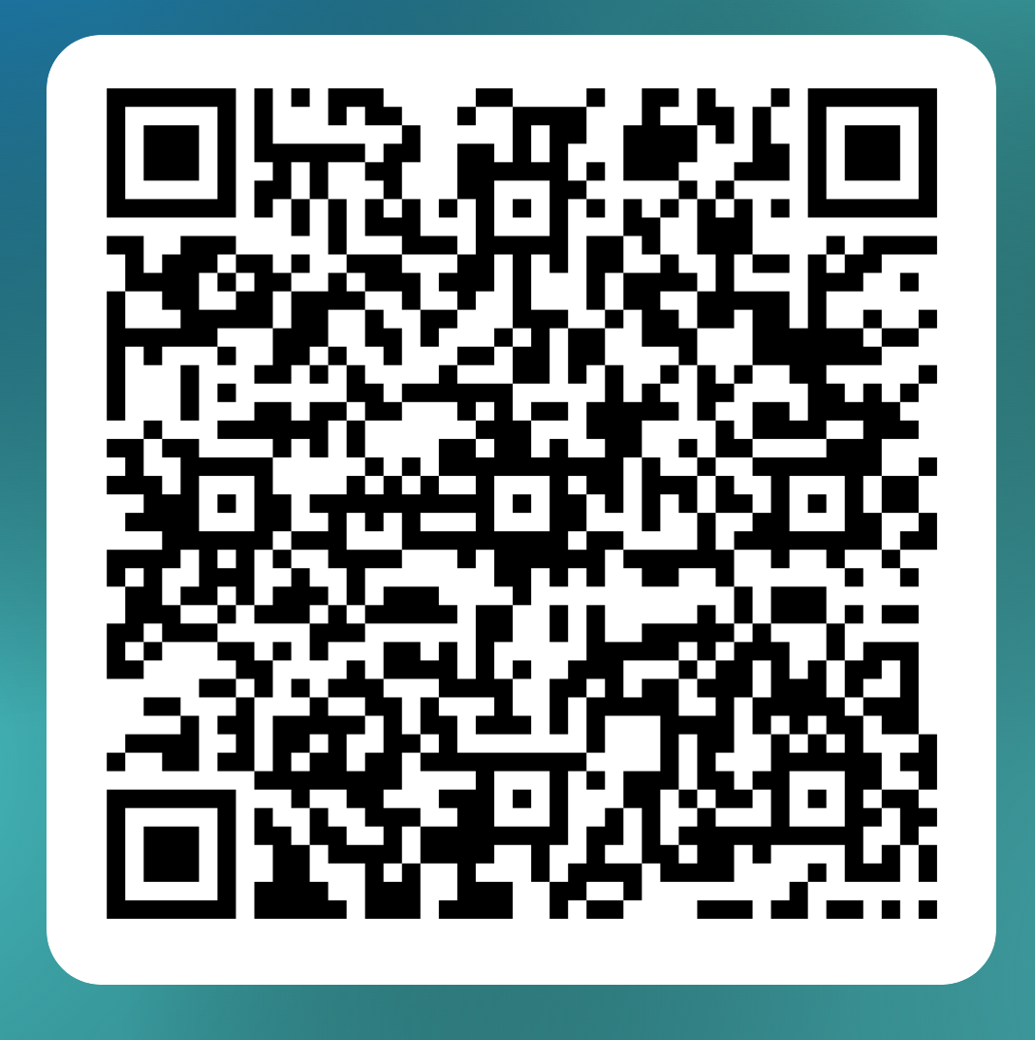
Thank you for your engagement
Volunteer for the pilot of the Quality Improvement Framework for the Early Learning and Childcare Sectors
A Quality Improvement Framework for the Early Learning and Childcare Sectors

