Slide 1


Na Seumasaich – The Jacobites
Learning about Gaelic Language and Culture Resource
Lesson 6 – Life in the Highlands in 1745 – Discussing Clothing and Colours.
For Scotland's learners, with Scotland's educators

Slide 2
Na Seumasaich – Lesson 6
In this Learning about Gaelic Language and Culture resource lesson we will learn:
about the traditional clothing of the Scottish Highlands
about the traditional clothing worn by British soldiers
to say what we are wearing in Gaelic
to discuss clothing and colours in Gaelic
a basic understanding of the gender of nouns in Gaelic
to create short texts about ourselves and others in Gaelic

Slide 3
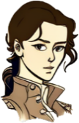
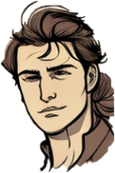
Màiri and Calum
Halò a Chaluim. Nach tu tha spaideil an-diugh?
Tapadh leat! ’S toil leam do sheacaid
Tapadh leat. Tha i donn.
Tha i snasail cuideachd.

Slide 4
Màiri and Calum 2
What kind of clothes did the Jacobites where?
Funny you should ask about clothes! Clothing plays a big part in the stories of this time period?
It was silly question I guess. I know that the Jacobites are famous for kilts.
Yes, men on both sides in the Highlands wore the kilt. However, the British government troops became famous for their red coats.
I know there are lots of interesting things about colours in Gaelic too.

Slide 5
Dathan - colours
pinc
uaine
gorm
liath
glas
buidhe
dearg
ruadh
donn
purpaidh
orains
geal
dubh

Slide 6
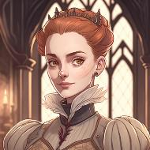
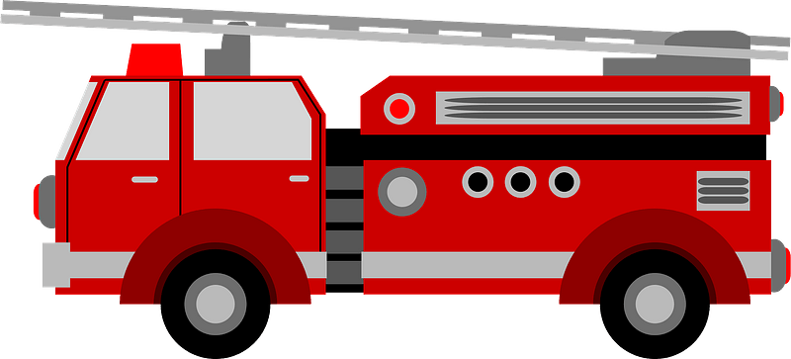
Dathan – colours - 2
gorm
liath
Colours in Gaelic don’t work quite the same way as in English. For example, there are separate words for dark blue and light blue – gorm and liath. Glas means grey in Scotland but in Ireland means green! The Scottish Gaelic for green is uaine. In can be a little confusing, but it is a good way to understand that all languages are different.
There are also different colours used for hair colour – dearg is fire engine red, but ruadh is used for red hair (and liath for grey!)
dearg
ruadh

Slide 7
Dathan – colours - Questions
gorm
liath
Use the Storlann Colour Wheel to help your concepts of colours in Gaelic Cuibhle dhathan/Colour wheel (storlann.co.uk)
Make up a colour chart in Gaelic to show the colours in Gaelic. Try and use an item or object to display each colour.
Do a special section on hair colours as an extension.
dearg
ruadh

Slide 8
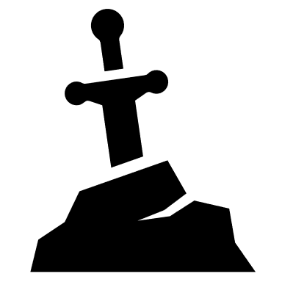




Gnè - gender
In Gaelic, the adjective always comes after the noun. We can see this in the common word “claymore” from “claidheamh mòr” – (Big Sword)
As well in Gaelic, words have a gender. They can be either masculine or feminine. The feminine nouns will change the pronunciation and spelling of many words that come after them. This is usually shown by adding an “h”.
The most common Gaelic word for mountain is Beinn is feminine. See it in comparison to the word Taigh (house) which is masculine.
claidheamh mòr
taigh gorm
taigh dearg
beinn ghorm
beinn dhearg

Slide 9
Gnè – gender - Questions
1. What does Claymore mean?
2. How many genders are there in the Gaelic language?
3. How is the change in pronunciation caused by gender often shown?
4. Use the internet to find some Gaelic placenames that use the colours “gorm”, “liath”, “dearg” and “ruadh” – where are they? Put them on a map.
claidheamh mòr
taigh gorm
taigh dearg
beinn ghorm
beinn dhearg

Slide 10
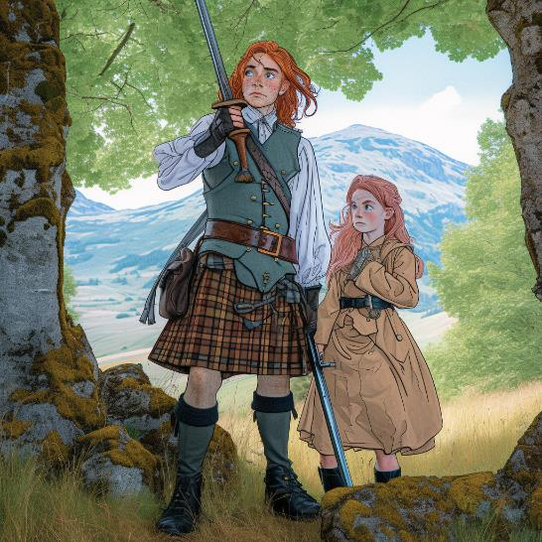
Am Feileadh - The Kilt
If you go around the world, there is probably nothing more connected with Scotland than kilts and tartan.
The Gaelic for a kilt is Feileadh. The traditional Gaelic kilt was called Am Feileadh Mòr (Big kilt) and was a long “plaid” of tartan wrapped around the waist and the rest of the plaid was tied with a brooch. After the failure of the 1745 rebellion this style of dress was banned as it was so associated with the Jacobites although everyone wore it.
The modern style of kilt is called Feileadh Beag (Wee Kilt). This style of kilt was made popular in the 19th Century when the law was changed and King George IV wore one when he visited Edinburgh. You will see this style worn today at weddings, dances, football games, funerals and military events – in fact almost anywhere Scottish people are!

Slide 11
Am Feileadh - The Kilt
Questions
What is said about the kilt in the first paragraph?
Describe a traditional kilt and how it was worn.
What happened to this style of kilt after the Jacobite rebellion?
What led to the Feileadh Beag (wee kilt) becoming popular.

Slide 12
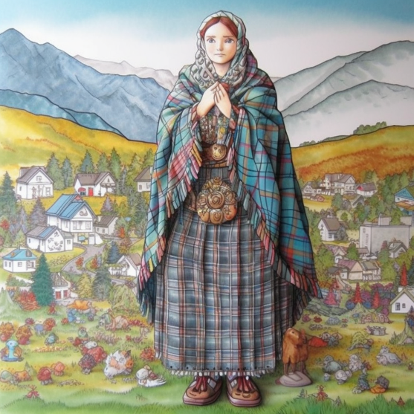
The “Earasaid”
Women did not traditionally wear the kilt. They wore a garment called an “earasaid” (or sometimes “arisaid” in English). This was a large piece of cloth, longer than the wearer was tall, and wider than the wearer’s waist. This might be plain, or tartan depending on cost. It would have to go from the ankles, and still be able to cover the head. Women of the time were expected to cover their heads, especially in church due to religious beliefs. it would be held together by a belt and broochs.
When the kilt was banned after the failure of the 1745 rebellion, this did no affect the wearing of the earasaid.
People do not wear “earasaid” these days, although people may still wear shawls made of tartan materials.

Slide 13
The “Earasaid”
Questions
Describe an “earasaid”
Why was it expected by many people that women would wear this style of dress?
What some women wear nowadays instead of the “earasaid”?

Slide 14
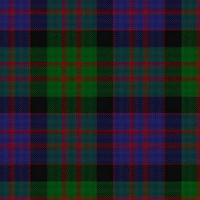
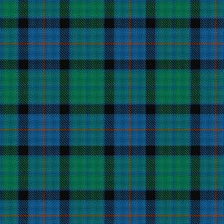
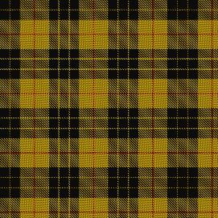
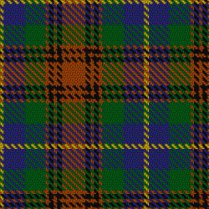
Tartan
The Gaelic for Tartan is Breacan. “Breac” means something is multi-coloured.
Traditionally, each area would have its own special patterns. Over time, because a certain clan was connected to that area, the tartan became connected with the clan.
Modern tartans are much brighter due to modern dyes and there are also lots of varieties. There are over 27 Macdonald tartans!
Tartans should be recorded with the Scottish Register of Tartans which is run by the Scottish Government.
Whilst some people think you shouldn’t wear a tartan you don’t have a connection with, there are lots of non-clan tartans, such as Flower of Scotland and one for the Sikh community. Amazon even have one!
Macdonald
Flower of Scotland
MacLeod of Lewis
Sikh
Jrockley - Own work, based on Image:Scottish clan map blank.png – Public Domain

Slide 15
Tartan – Questions
1. What does “breac” mean?
2. How did each clan get its own tartan?
3. Why are modern tartans brighter than traditional ones?
4. Who is in charge of registering tartans in Scotland?
5. Do you have to be a member of a clan to wear a tartan? Explain your answer.
Macdonald
Flower of Scotland
MacLeod of Lewis
Sikh
Jrockley - Own work, based on Image:Scottish clan map blank.png – Public Domain

Slide 16
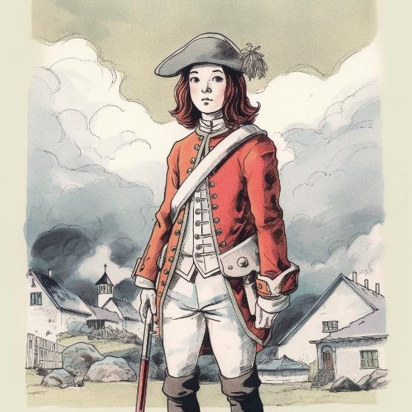
The Redcoats
The British Army at the time would wear bright red uniforms. Although today, we think of soldiers wearing khaki and camouflage, for hundreds of years English and British soldiers wore bright red. This meant that you could see them coming, but it actually wasn’t a silly thing to do.
At the time of the Jacobite rebellions, it took a long time for a gun to reload so it wasn’t too dangerous to be in red. In fact, wearing red might even have saved soldiers’ lives as it was easier to tell who was on your side if they were dressed in bright red.
Redcoat is used to refer to a British soldier in many places in the World where the people fought the British – such as in America and Ireland. The same is true in the Highlands. In Gaelic they would be known as Saighdear-dearg, (Red Soldier) còta-ruadh (Redcoat) or dearganach (Red one),

Slide 17
The Redcoats
Questions
What kind of clothes do soldiers wear nowadays?
Why was it actually a good idea for soldiers in the 18th century to wear bright colours?
Where else were British soldiers called redcoats?
What were some of the Gaelic names for redcoats?

Slide 18
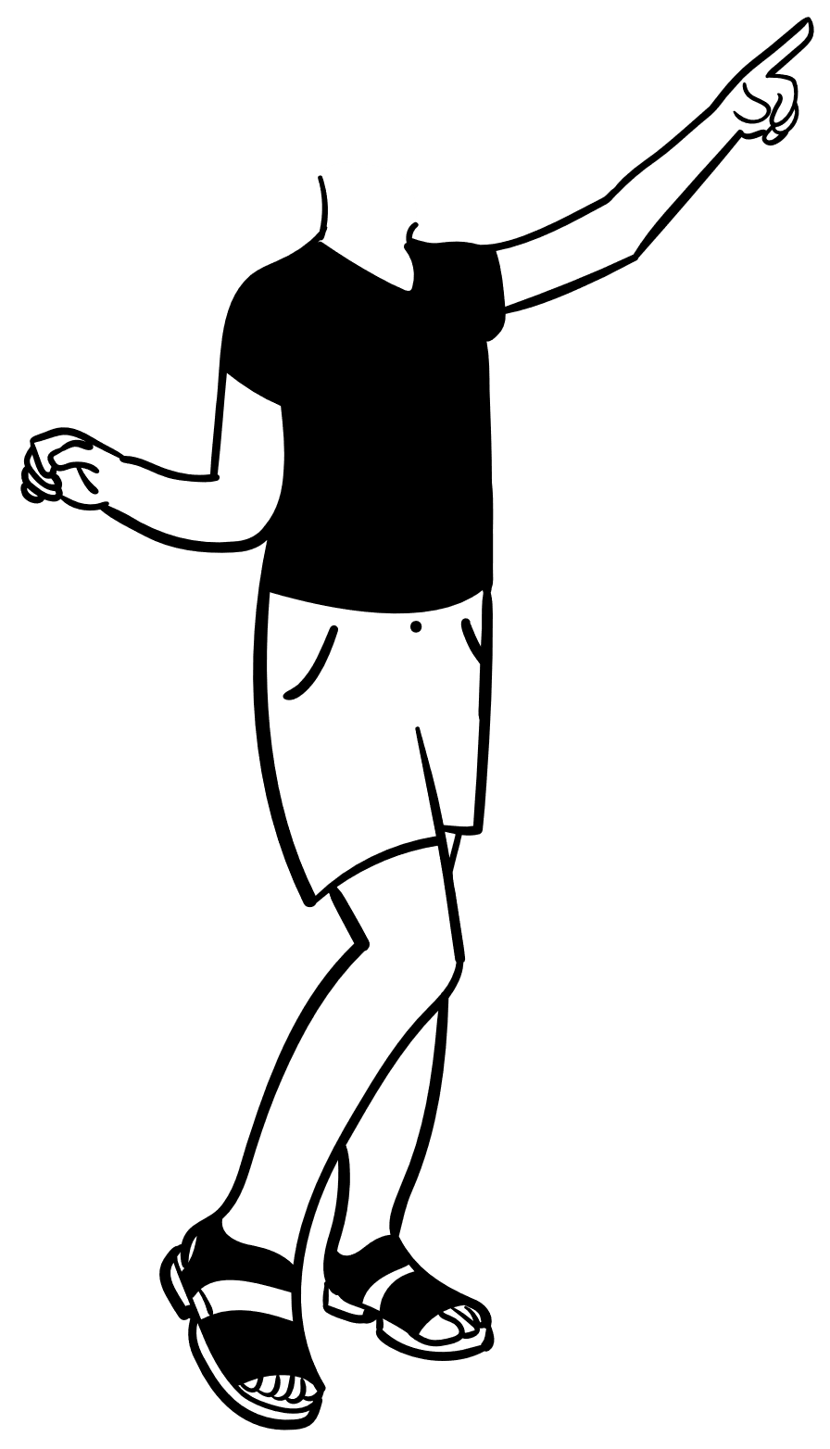
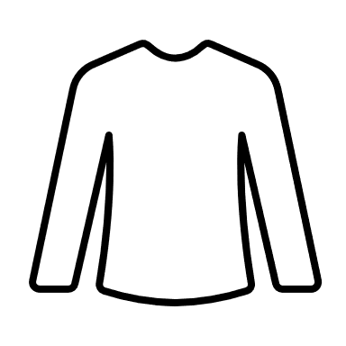

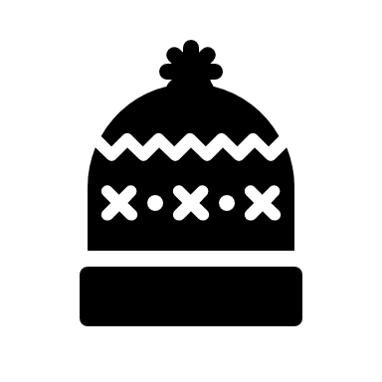
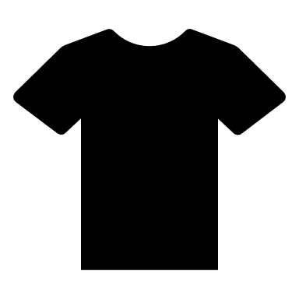
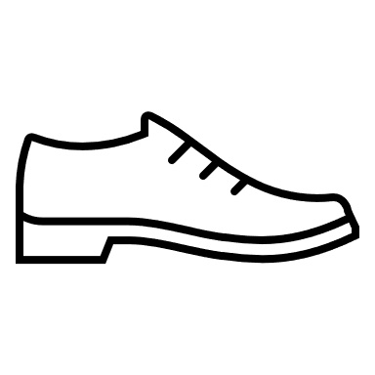

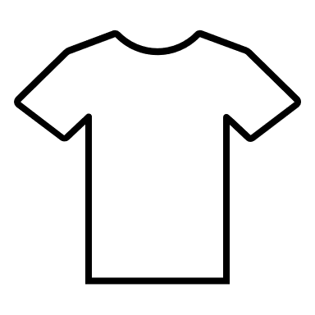
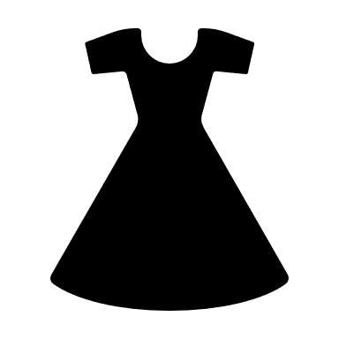
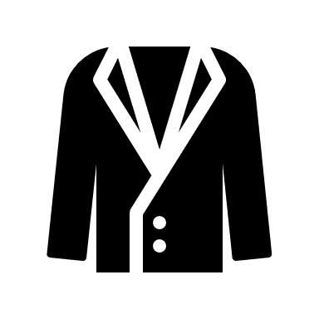
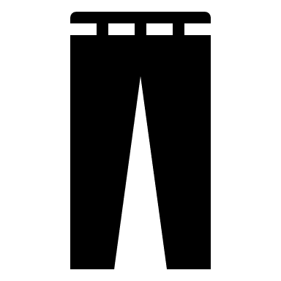

Aodach - Clothes
briogais ghoirid
Here’s the Gaelic for some modern styles of clothes
bròg
geansaidh
sgiorta
bonaid
lèine
brògan
stocainn
seacaid
taidh
lèine-t
dreasa
briogais
stocainnean

Slide 19
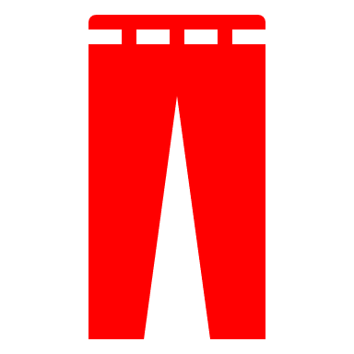
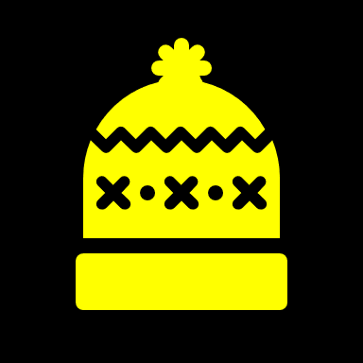
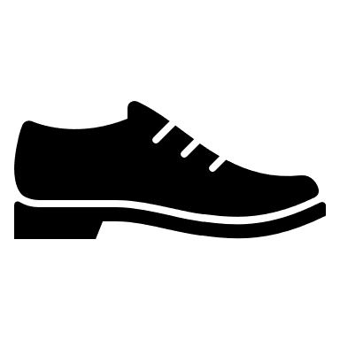

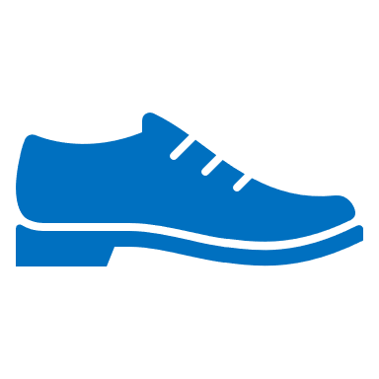


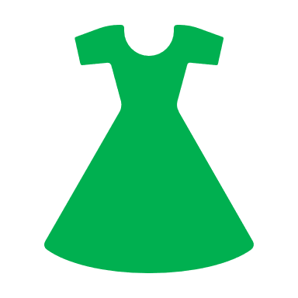
Clothes & Gender
Here’s the Gaelic for some modern styles of clothes, but organised by gender using colours to show how the words change. You’ll also see what happens when nouns are plural.
FEMININE & PLURAL
FEMININE
MASCULINE
bròg gheal
bonaid bhuidhe
briogais dhearg
geansaidh geal
bròg dhubh
brogan gorma
seacaid ghorm
sgiorta dhonn
taidh glas
1. Would Feileadh be a masculine noun or a feminine noun?
lèine dhubh
dreasa uaine
stocainn gheal
stocainnean geala
lèine-t gheal

Slide 20
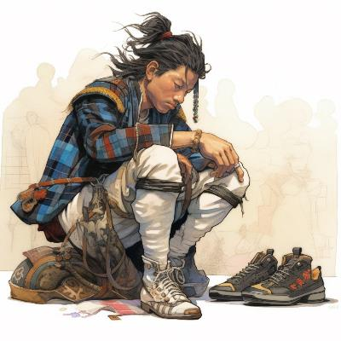
Na Brògan Ùra – The New Shoes
This is a fun Gaelic song about getting a new pair of shoes! You may want to learn the verses to this song as well and it can help you learn a lot of Gaelic vocabulary related to shoes, but the chorus goes like this. Sing along when the chorus comes along. Record your class singing it together.
O horo na brògan ùr, na brògan ùr a fhuair mi
O horo na brògan ùr, na brògan ùr a fhuair mi
Na brògan ùra, ùra, ùr, na brògan ùr a fhuair mi
O horo na brogan ùr, na brògan ùr a fhuair mi
Mairi MacInnes - Na Brogan Ura - The New Shoes (celticlyricscorner.net)
Na Brogan Ura - YouTube

Slide 21

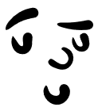
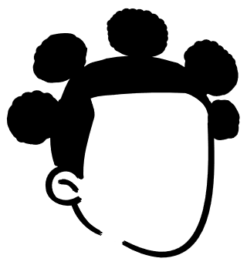
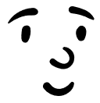
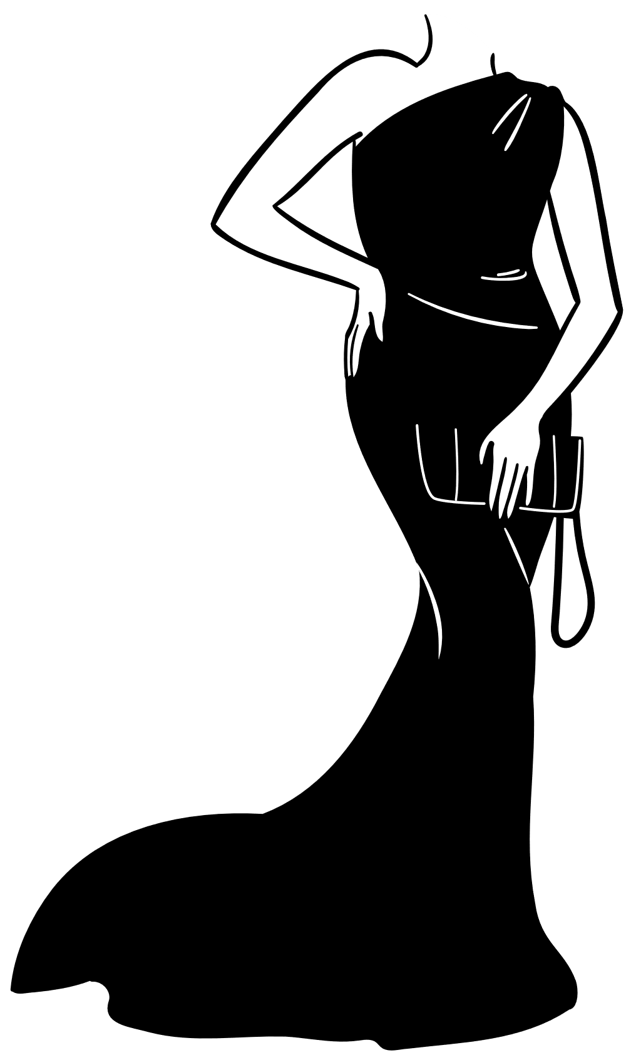
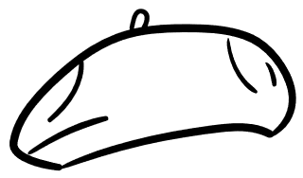
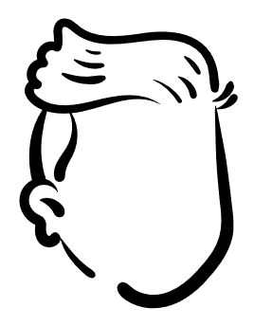
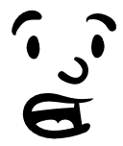
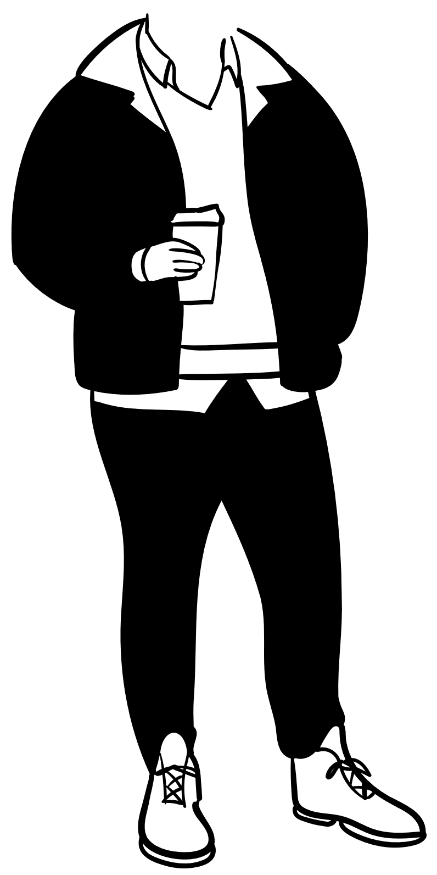
How to talk about your clothing
Dè an t-aodach a th’ oirbh?
To say you are wearing a jumper, you say Tha geansaidh orm. Orm means on me.
Depending on your level of skill you can also add in a colour Tha geansaidh gorm orm. or even another adjective Tha geansaidh mòr gorm orm.
To ask someone what clothes they are wearing, you ask
Dè an t-aodach a th’ ort?
Or if they are older or there is more than one
Dè an t-aodach a th’ oirbh?
Tha lèine-t, briogais ghoirid agus brogan orm
Tha dreasa orm
Tha còta, geansaidh, bonaid, briogais agus botannan orm

Slide 22


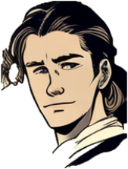
Task one – Asking the colour
Your teacher will point at or show things in the classroom and ask you Dè an dath a th’ air? Reply with Tha e… or Tha i… then the colour in Gaelic. Don’t worry if you can only say the colour
Caleb, Dè an dath a th’ air?
Buidhe! Tha e buidhe!

Slide 23
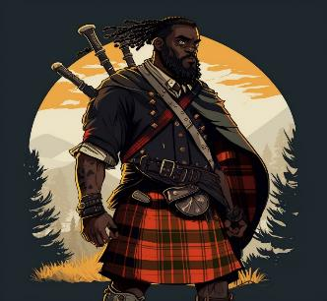
Task two – Saying what clothes you are wearing
Your teacher will ask you Dè an t-aodach a th’ ort? Reply with at least three pieces of clothing you are wearing. If you can try and add a colour in.
A Chaluim, Dè an t-aodach a th’ ort?
Tha feileadh, seacaid dhubh agus lèine gheal orm

Slide 24
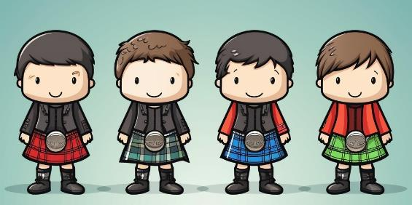
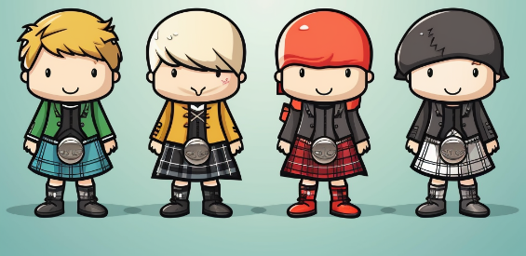
Task three – Tha còta agus feileadh orm - writing
1
2
3
4
The eight people on the right are all wearing kilts and coats. Write a sentence for each person where they say what they are wearing. Add the colours in for each one. An example is done for you
1. Tha còta dubh agus feileadh dearg orm
5
6
7
8

Slide 25
Task four - Factfile
Tha bonaid dhubh orm
Draw a picture of yourself in your favourite outfit, (use a photo if you don’t want to draw),
State what you are wearing. Add this picture and your writing to your factfile from previous lessons.
Then create a picture for your Highlander and do the same for them.
Tha còta dearg orm
Tha briogais gheal orm
Tha botannan dubha orm

Slide 26

For Scotland's learners, with Scotland's educators
Education Scotland
Denholm House
Almondvale Business Park
Almondvale Way
Livingston EH54 6GA
T +44 (0)131 244 5000
E enquiries@educationscotland.gsi.gov.uk

