Slide 1
Family Learning - Keeping the Promise Award
The following content has been adapted by Family Learning at Aberdeen City Council from the resource developed by the West Partnership Improvement Collaborative and North Lanarkshire Council’s Original Award.
Notes:
Welcome everyone. I’d like to start by telling you a little bit about the Keeping The Promise Award for Family Learning. It was originally created in North Lanarkshire Council by a broad range of staff to support children and young people, who are care experienced, on their journey through early years, school and beyond. Everyone involved in creating the original Award wanted to create a vehicle to raise awareness of care experienced children and young people and some of the challenges that they face. This version of the Award has been adapted to lend itself to Family Learning teams across Scotland, supporting children, young people and their families who may be care experienced, or requiring preventive support to keep them from becoming cafe experienced.
The Award has been developed to deepen our understanding around the national commitment made by the Scottish Government and supported by (insert Local Authority name) to improve the experiences and outcomes, and overall wellbeing of care experienced children, young people and their families.
This Award is designed to help us to identify our responsibilities to these families, and to grow in our understanding of the needs of the families that we work alongside.
The Award is simple and straightforward. It consists of two short training sessions delivered in conjunction with an e-learning course. When completed by a threshold of staff in a Family Learning team, the team will receive an accreditation – ‘The We Promise Award’. The first session covers the national context, terminology around care experience, and corporate parenting, the role of CLD, Family Learning, and what The Promise means for our practice. Throughout the sessions, where, possible, the voice and lived experience of care experienced children and young people has been used. Hopefully, these sessions will demonstrate the positive impact that Family Learning and ‘we’ as practitioners, can have on care experienced children, young people and their families.

Slide 2
Keeping the Promise Award Structure
This professional learning is for ALL Family Learning staff who have contact with children, young people and their families. There is an expectation that over time ALL Family Learning staff will complete this training.
The information should or could be part of induction training for new staff and volunteers.
The training should be regularly refreshed - at least every three years (to include refreshed materials).
Individual participants receive a professional learning I Promise Award on completion of the course.
To obtain the We Promise Award for a setting, 70% of all staff need to have completed the presentations and e-Learning module.
Notes:
This professional learning is for ALL staff who have contact with children, young people and their families. there is an expectation that over time ALL staff complete it.
The information should or could be part of induction training for new staff.
The training should be regularly refreshed - at least every three years.
Individuals can receive an ‘I promise’ Award upon course completion. To obtain a ‘We Promise’ Award for a setting 70% of all staff need to have completed the presentations and e-Learning module.

Slide 3
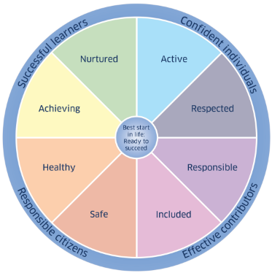
GIRFEC – Getting it Right for Every Child
GIRFEC provides Scotland with a consistent framework and shared language for promoting, supporting, and safeguarding the wellbeing of ALL children and young people.
GIRFEC promotes a common understanding of wellbeing recognising that children and young people need to grow up safe, healthy, achieving, nurtured, active, respected, responsible and included, so that they can become confident individuals, effective contributors, successful learners and responsible citizens.
GIRFEC contributes to work on family support and delivering The Promise made to all of Scotland’s children, young people and their families - a shared commitment to reorganise how we think, plan and prioritise for children, young people and their families.
Notes:
To begin, GIRFEC underpins how we work with children and young people across all services in Scotland.
It provides us with a consistent framework and shared language for promoting, supporting, and safeguarding the wellbeing of ALL children and young people including those who are care experienced.
GIRFEC promotes a common understanding of wellbeing recognising that children and young people need to grow up safe, healthy, achieving, nurtured, active, respected, responsible and included, so that they can become confident individuals, effective contributors, successful learners and responsible citizens.
GIRFEC contributes to the family support model and delivering The Promise made to all of Scotland’s children, young people and their families - a shared commitment to reorganise how we think, plan and prioritise for children, young people and their families.
GIRFEC is a strengths-based approach which seeks to realise children’s rights on a day-to-day basis. GIRFEC places the child or young person and their family at the heart of everything we do.
GIRFEC is about enhancing the wellbeing of all children and young people as well as building a flexible scaffold of support: where it is needed, for as long as it is needed

Slide 4
Terminology: Looked After and Care Experienced
Care Experienced
Looked After At Home
Looked After Away from Home
Previously Looked After
Notes:
We should start by making sure we all share an understanding of who we are talking about – our care experienced children and young people.
Some children and young people need to be looked after by their local authority when they don’t receive adequate care from their parents or there are other concerns about their wellbeing. You’ll be familiar with ‘looked after’, LAC, terminology and expressions such as children who are ‘in care’, children who are accommodated and more recently children with care experience or who are experiencing care.
What’s the difference between these terms and does it matter? YES, it matters.
It matters both legally and in terms of how we reduce the stigma around care. ‘Looked after’ is the legal term used by Scottish Government and refers to a child or young person whose care is supervised formally, on a compulsory order, by the local authority through social work services. They can be ‘looked after’ at home or away from their parental home in a range of settings or arrangements. We’ll go into the different types of care in more detail later. If a child or young person no longer needs to be formally ‘looked after’, this will be decided at a Children’s Hearing, then they become ‘Previously Looked After’. However, children and young people find the expression ‘looked after’ stigmatizing and ‘uncaring’! They prefer the expression ‘care experienced’. We therefore use care experience as an umbrella term for all of the types of care highlighted above.
Using the expression care experienced shifts the emphasis from making the person the subject rather than the object, with care being seen as something they have come through and learned from rather than simply something that defines them. Additionally, not all children and young people who experience care with people other than their parents or in places other than their parental home are formally looked after and come under the supervision of social worker. We’ll come back to this in more detail later too. But first we want to look into what it’s like for a young person experiencing care, some of the challenges they may face, and why the system supporting these young people needs to change.

Slide 5
6 min 13 sec Film created by Glasgow University. Link to access the film: https://youtu.be/P2H0GzxmLK8
Reforming Scotland’s care system with love – Jamie Dalgoutte
Notes:
Play film Reforming Scotland’s care system with love / Jamie Dalgoutte / University of Glasgow – YouTube

Slide 6
Reforming Scotland’s care system with love
Notes:
That powerful film of just one young man’s life experiences and his care and educational journey gives us a flavour of the challenges faced by care experienced children and young people. His story has ended with him accessing Higher Education but this often isn’t the case for many other children and young people who experience care. For many their journey through education and the care system isn’t always as positive. So, who are our care experienced children and young people and how are they cared for?

Slide 7
National Care Population
The 2022-2023 Social Work Statistics recorded 12206 young people looked after in Scotland
These children or young people live in many different types of care:
kinship care (with friends or relatives) 34%
foster care (living with another family) 32%
looked after at home (living with parents but under the supervision of social work) 20%
residential care (living in a children’s house) 11%
with prospective adopters 1%
in other community setting 2%
(Scottish Government, published April 2024)
Notes:
To add to the complexity of the situation – these figures only represent the group of children and young people who are officially and legally ‘looked after’.
However, we know that there is a much larger group of children and young people who are informally cared for by grannies and grandad’s, aunties and uncles, brothers or sisters, or family friends who are not formally recorded. These are often referred to as informal kinship arrangements. These children and young people may also face challenges similar to those who are legally looked after and are likely to also need our consideration and care. These children and young people are often recognised in our recording systems as those who require additional support socially and emotionally and with their behaviour. The expression ‘care experienced’ does not include children who are temporarily staying with relatives on a babysitting arrangement.

Slide 8
Local Care Experienced (Looked After) Data
 | ELC | Primary | Secondary | Total
Looked After at Home
Looked After Away from Home
Previously Looked After
TOTAL NUMBER OF CARE EXPERIENCED
Notes:
OPTIONAL Insert your own local authority data and describe the cohort. It may also be good to discuss the implications of the data.
Delete the slide if you don’t have access to this data for your Local Authority.

Slide 9
Corporate
Parenting
Officially:
Corporate parents are "the formal and local partnerships between all services responsible for working together to meet the needs of looked after children, young people and care leavers” AND “they have statutory duties to collaborate with each other in upholding the rights and securing the wellbeing of looked after children.”
(Children and Young People (Scotland) Act 2014)
Unofficially:
A corporate parent is intended to carry out many of the roles a loving parent should.
Notes:
So, let’s move on to our legal duties towards children and young people who are care experienced. Let’s start from our understanding of this expression ‘Corporate Parent’ both officially and unofficially – read the definitions on the slide.

Slide 10
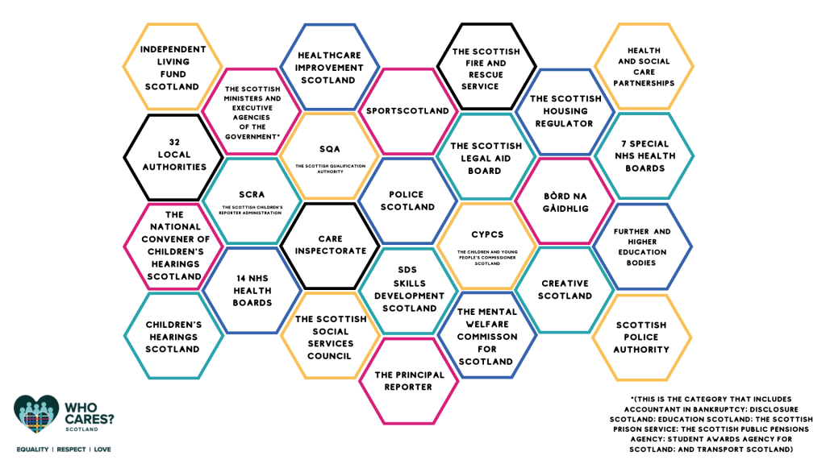
Corporate Parents in Scotland
Notes:
In the 2014 Children and Young People’s Act there are 26 Corporate Parent public bodies listed. These Corporate Parents have legal duties under the Act. Many of these Corporate Parents are large umbrella entities such as local authorities.
This means, however, that every single employee within each of the 32 local authorities is a corporate parent, and as such has legal duties towards care experienced people.
Another example is Education Scotland as an Executive Agency of the government it acts on the instruction of Scottish Ministers and is also a corporate parent.
All these corporate parents collectively have a legal duty to coordinate their efforts to support care experienced people.

Slide 11
What kind of Corporate Parent are you?
4 min 21 Sec Link to access the film: https://www.youtube.com/watch?v=G3BWDSyBQgg
Thanks go to Edinburgh Champs & Edinburgh City Council for this Film
Notes:
Play the film (4 min 21 sec) https://www.youtube.com/watch?v=G3BWDSyBQgg
Consider a brief discussion about the ways in which your professional practice reflects how you and your service fulfil your corporate parenting responsibilities.

Slide 12
The ambition for Scotland’s children…
Notes:
The ambition for Scotland’s Children is that all children grow up loved, safe, and respected so that they can realise their full potential.
However, we know it takes a village to raise a child. Educational and community settings in all their forms can have a massive impact on children, their lived experience, and their outcomes. They can be the constant in a child’s life even if everything else around them is changing. This slide reminds us that we have a duty to ensure that all children and young people but particularly those who are care experienced grow up LOVED, SAFE and RESPECTED.
So how do we know what needs to change to make things better for care experienced children and young people?

Slide 13
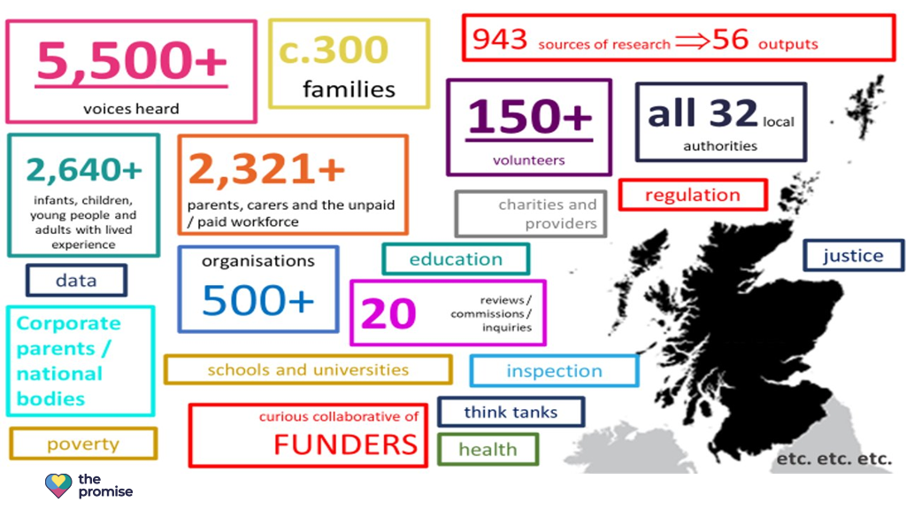
Independent Care Review
Notes:
The Independent Care Review which started in 2016 was a root and branch review as it was nationally recognised that the current care system wasn’t fit for purpose. The review was overseen by Fiona Duncan. It was extensive and included testimonials from people with lived experiences, families, carers, practitioners, corporate parents, and many other organisations and stakeholders. Over half of the voices noted in The Promise Report following on from the review were from people with lived experience.
The review took place over a 4-year period up to 2020. It exposed the fact that the care system is hugely complex, confusing and difficult to navigate. For example, there are 44 pieces of legislation, 23 pieces of secondary legislation and 3 International Conventions that govern this thing we call the ‘care system’.
To get it right for care experienced people we know we need to have a more coordinated and systematic approach. This is where everyone and more specifically Corporate Parents must work together and see a young person with care experience – holistically - in the context of their family and their community, and not just in the context of their learning or another individual aspect of their life – for example, their mental health.
The Promise was written to try to join up the supports and services around the lives of care experienced people and highlight how care experienced people think things need to change for the care system to be better.

Slide 14
Language Matters
“It’s important to note that The Care Review has avoided using the term Corporate Parent. Nevertheless, Scotland must live up to its responsibilities in relation to the children it has (and has had) responsibility for and be a ‘good parent’. It is tempting to define what a ‘good parent’ is. However, like love, to do so would only apply an institutional version of parenting and create the danger of further systemisation of care.”
The Promise 2020
Notes:
This is a quote from The Promise Report, 2020, in it they highlight that they have deliberately avoided using the term corporate parent.
Read the quote from Nevertheless…..
Care experienced children and young people, through the Review, also told us that they found the care system ‘cold, overly professionalised and uncaring’.
For a more thought provoking take on the topic of ‘language matters’, consider playing the new cartoon ‘Articulate Animation’ bringing to life the importance of language in the Children’s Hearings System which has just been launched. ohov.co.uk/wp-content/uploads/2024/05/articulate__a_film_by_our_hearings_our_voice-1080p.mp4
Please note: This video will have to be queued to play in a different window as its size meant we weren’t able to embed it in the presentation.
If you decide not to play it as part of this presentation do highlight in the resource list at the end, its well worth a watch.

Slide 15
Language Matters
(3 mins 15 sec)Link to access film https://vimeo.com/929867493?share=copy
Film commissioned by Our Hearings, Our Voice and created by Braw Talent
Notes:
Before we take a closer look at The Promise, let's consider one of its key priorities - the importance of using non-stigmatising language. Watch the animation and consider the impact of the language we all use in our professional practice. This animation brings to life the importance of language in the Children’s Hearings System.
Play the ‘Articulate Animation’ (3 mins 15 secs) https://vimeo.com/929867493?share=copy

Slide 16
Language…
It isn’t neutral
It can help or harm
It can engender respect or stigma
Does language matter to you?
Notes:
Some of the language we’ve heard in the film, and we use every day, is so ingrained in how we talk and write about children, young people, parents and carers that it’ll take time to change.
However, we need to continually realise the ambition of being LOVED, SAFE and RESPECTED and understand the power language will play in this achieving this goal.
Read the slide. Does language matter to you?
If time permits allow time to discuss the question.

Slide 17
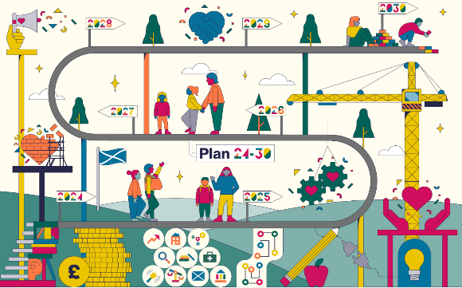
The Promise Plan - Programme Timeline
Inception Plan 21-24 Plan 24-30
Care Review Reports – Independent Care Review
Notes:
In 2020, Scotland made a promise to all its children that they would grow up loved, safe and respected, and that this would be achieved by 2030. This promise extends to all children; however, it has particular meaning to children who are, or could be, care experienced.
Scotland’s Promise was made following an independent review of the care system in 2016. As previously mentioned, 5.5 thousand people across Scotland engaged in this process, and at least half of this number were people who had lived experience of the care system.
The Promise is not a party-political agenda, it is Scotland’s promise to children, young people and families regardless of which political party leads Government. On Wednesday 5 February 2020, the Independent Care Review published seven reports. The Promise laid out five foundations and over 80 calls to action. https://www.carereview.scot/conclusions/independent-care-review-reports/

Slide 18
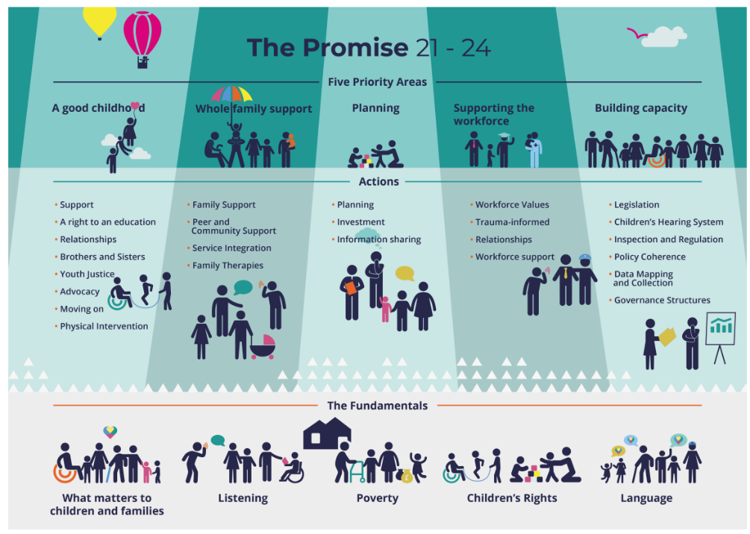
New Plan due Dec 2024
Notes:
The Promise itself has five Foundations which encompasses 84 Promises or commitments made to care experienced children and young people. These commitments have been made by all Scottish Political Parties in their Manifesto’s. Something that had never happened before.
In Plan 21-24 - Principles and Priorities were identified. The principles recognise the impact of poverty, the importance of using non-stigmatising language, the fact that we need to listen to children, young people and their families and uphold their rights. We need to focus on these things - in other words designing services and supports that meets the needs of families rather than asking families to use services and supports that don’t work for them.

Slide 19
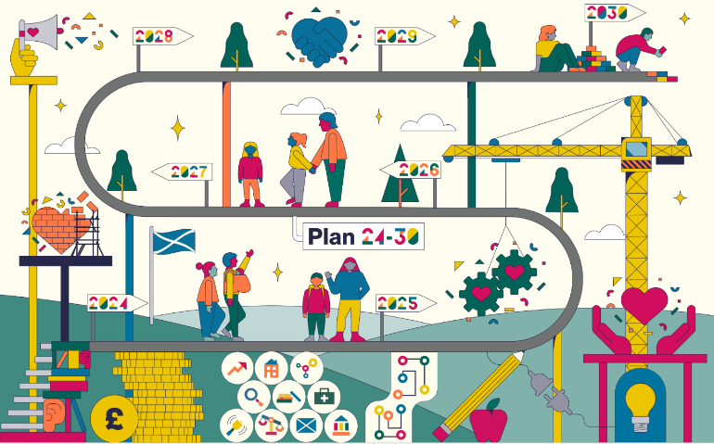
The Promise Plan 24-30
Builds on what has come before
Is devised together
Keeps everyone on track
Belongs to everyone involved
Is live and constantly updated
Notes:
The Promise Plan 24-30 will be produced by the end of 2024 however we already know that it will:
Build on what has come before
Plan 24-30 is an evolution of Plan 21-24. It details who needs to do what, by when to make sure the promise made to children, young people, families and care experienced adults in February 2020 is kept in full by 2030.
Be devised together
The development of Plan 24-30 has been done in consultation with stakeholders including the care community.
Keep everyone on track
Plan 24-30 is mapped to key policy areas such as the United Nations Convention on the Rights of the Child (UNCRC) and Getting It Right For Every Child (GIRFEC).
Belong to everyone involved
Plan 24-30 has been developed in an open and collaborative way with everyone who has a stake in the promise, including consulting with and listening to the care community. Plan 24-30 belongs to everyone, and everyone’s work is reflected in it.
Be live and constantly updated
Plan 24-30 is live and dynamic. As the route map progresses and becomes clearer, Plan 24-30 will be updated so that it keeps track of progress and what still needs to happen.

Slide 20
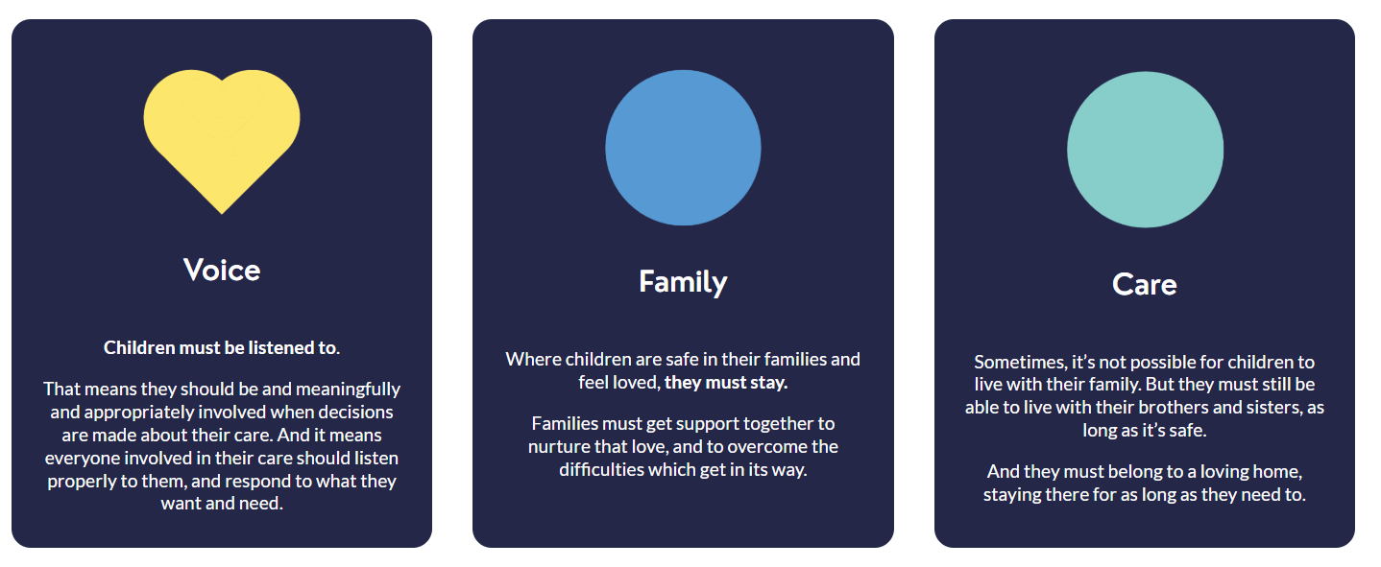
Foundations of The Promise
Notes:
What are The Promise foundations, and what do they mean?
Voice - Children must be listened to.
That means they should be meaningfully and appropriately involved when decisions are made about their care. It means everyone involved in their care should listen properly to them and respond to what they want and need. Scotland's culture of decision-making must be compassionate and caring. It must be focused on children, and those they trust.
Family - Where children are safe in their families and feel loved, they must stay. Families must get support together to nurture that love, and to overcome the difficulties which get in its way.
Care - Sometimes, it's not possible for children to live with their family. But they must still be able to live with their brothers and sisters, as long as it's safe. And they must belong to a loving home, staying there for as long as they need to.

Slide 21
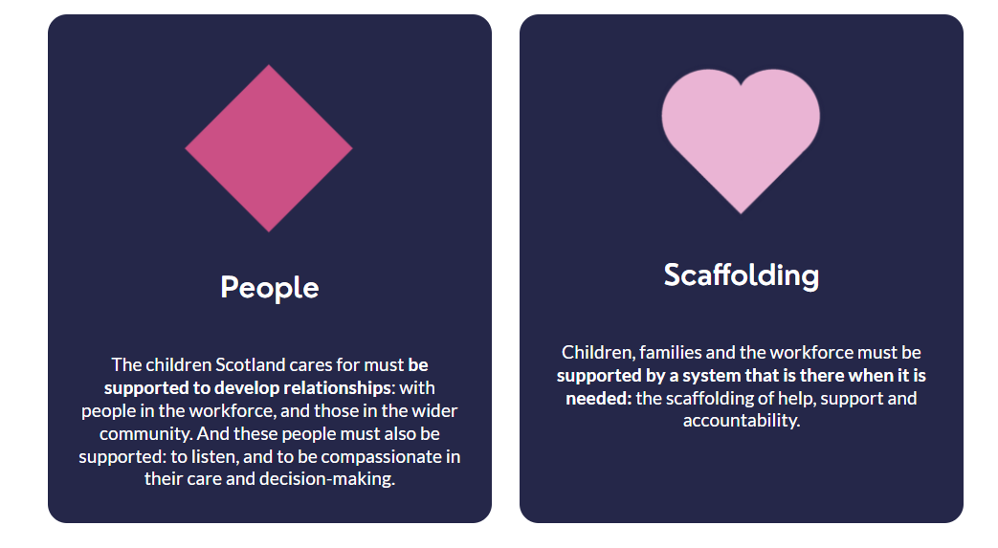
Foundations of The Promise
Notes:
People - The children Scotland cares for must be supported to develop relationships: with people in the workforce, and those in the wider community. And these people must also be supported: to listen, and to be compassionate in their care and decision-making.
Scaffolding - Children, families and the workforce must be supported by a system that is there when it is needed: the scaffolding of help, support and accountability.

Slide 22
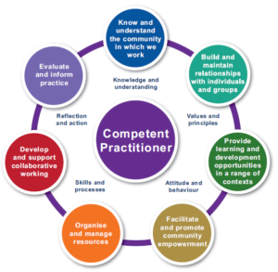
CLD Standards Council Scotland - Who Are We?
Community Learning and Development (CLD) includes a wide range of services including Youth Work, Adult Learning, Community Development and Family Learning.
Fundamental to the practice of CLD across all of its settings are the following values identified by the CLD Standards Council:
Self-determination
Inclusion
Empowerment
Working collaboratively
Promotion of learning as a lifelong activity
Notes:
Community Learning and Development have a clear role to play in helping Keep the Promise beginning with the principles fundamental to our practice.
The CLD Standards Council Scotland is the professional body for people who work or volunteer in community learning and development in Scotland, including Family Learning.
They are a member led organisation whose approach, and work aims to deliver 5 core values including:
Self-determination – respecting the individual and valuing the right of people to make their own choices.
Inclusion – valuing equality of both opportunity and outcome, and challenging discriminatory practice.
Empowerment – increasing the ability of individuals and groups to influence issues that affect them and their communities through individual and/ or collective action.
Working collaboratively – maximising collaborative working relationships in partnerships between the many agencies which contribute to CLD, including collaborative work with participants, learners and communities.
Promotion of learning as a lifelong activity – ensuring that individuals are aware of a range of learning opportunities and are able to access relevant options at any stage of their life.
Their core responsibilities are:
Delivering a professional approvals structure for qualifications, courses and development opportunities for everyone involved in CLD
Maintaining a registration system available to practitioners delivering and active in CLD practice
Developing and establishing a model of supported induction, CPD and training opportunities

Slide 23
Where the Values of CLD Overlap The Promise
Self-determination VOICE/ FAMILY
Inclusion VOICE/SCAFFOLDING
Empowerment VOICE/ FAMILY/ PEOPLE/ SCAFFOLDING
Working collaboratively VOICE/ FAMILY/ PEOPLE/ SCAFFOLDING
Promotion of lifelong learning SCAFFOLDING
Notes:
It’s clear to see what the values of CLD overlap with the foundations of The Promise. These ambitious commitments are already part of our day-to-day practice and integral to the way we represent CLD in the wider community.

Slide 24
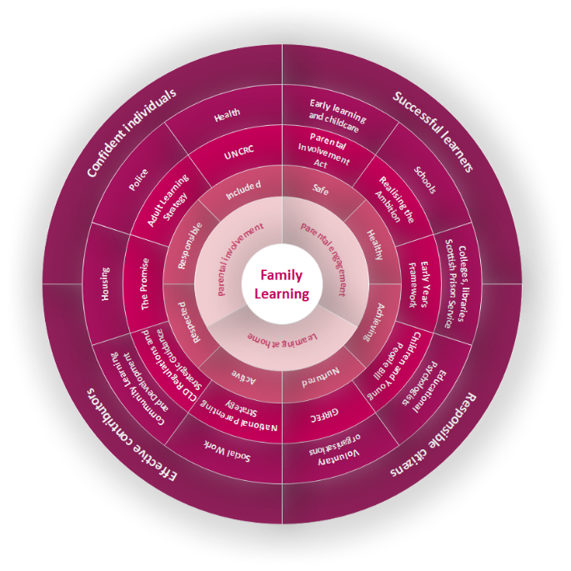
Family Learning’s Role in Keeping the Promise
Education Scotland’s Review of Family Learning Supporting Excellence & Equity (2016) describes the contribution of Family Learning as “an early intervention and prevention approach which is ideal for reaching the most disadvantaged communities. Done well, family learning helps close the attainment gap through breaking the inter-generational cycles of deprivation and low attainment. Its effects can extend beyond the duration of the intervention and provide lasting impacts and improved outcomes.”
Notes:
The Scottish Government Review of Family Learning Supporting Excellence & Equity (2016) describes the contribution of Family Learning as “an early intervention and prevention approach which is ideal for reaching the most disadvantaged communities. Done well, family learning helps close the attainment gap through breaking the inter-generational cycles of deprivation and low attainment. Its effects can extend beyond the duration of the intervention and provide lasting impacts and improved outcomes.”
The Family Learning Wheel, created by Education Scotland, shows how Family Learning can work in multiple partnerships, including education, health, housing, social work and the voluntary sector. We can directly support vital pieces of legislation, including Early Years Framework, Children and Young People Bill, UNCRC, Adult Learning Strategy 2022 -2027 and The Promise. This work is carried out by building strong, equal relationships with parents, increasing parental engagement and involvement, and taking learning opportunities to learners in their own homes or in the community.

Slide 25
Family Learning’s Role in Keeping The Promise
8 values underpin the National Occupational Standards for Family Learning. Family learning:
recognises the role of the parent as the first educator
is inclusive and is to be offered as a universal provision with open access
recognises and values diversity of culture, race, relationships and beliefs
is developed in Equal partnership with all learners and educators, regardless of generation
recognises that it is acceptable to make mistakes, which are part of the process of reflective learning
benefits the wider learning community by promoting change and empowering individuals/communities
raises aspirations and improves outcomes
operates within a culture of mutual respect for individuals, communities, colleagues and organisations
(Education Scotland, 2023)
Notes:
In 2023 the National Occupation Standards (NOS) for Family Learning were revised with the input of the family learning community from across the UK. They represent the minimum recommended performance and knowledge indicators and, alongside other relevant NOS or accepted standards, can be used to inform and underpin training courses, qualifications, and individual professional development opportunities.
The key purpose of the Family Learning NOS is to: “Plan, manage and deliver opportunities to engage adults and children to learn together as and within a family through quality formal or informal programmes”
The eight values set out in the Family Learning National Occupational Standards clearly overlap with the aims and objectives of The Promise.
IF NEEDED … the eight values in full:
Family Learning recognises the role of the parent as the first educator
Family Learning is inclusive and is to be offered as a universal provision with open access
Family Learning recognises and values diversity of culture, race, relationships and beliefs
Equal partnership is the basis for all developments in family learning: all learners and educators, regardless of generation, recognise that learners and educators can frequently exchange ideas
Family Learning recognises that it is acceptable to make mistakes, which are part of the process of reflective learning
Achievements within family learning benefit the wider learning community through promoting change and empowering individuals and communities
Family Learning raises aspirations and all outcomes of the process, including those which may not be overt, are of equal significance and importance
Family Learning operates within a culture of mutual respect for individuals, communities, colleagues and organisations

Slide 26
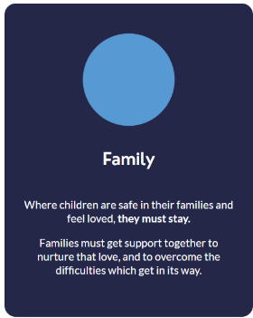
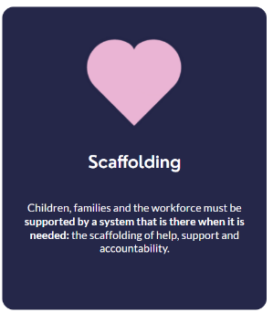
How does Family Learning support the Foundations of The Promise?
Investing in Whole Family Support
We recognise that to make a major shift in the way the care system operates we need to make a major investment in preventative action. We cannot simply transfer resources away from the current system as this system is supporting people now that have experienced the systemic problems that Keeping The Promise seeks to prevent.
As we progress towards this preventative ambition, it is important to ensure that we are providing the right kind of support to families to enable them to thrive and stay together. To assist this the Whole Family Wellbeing Funding will help transform services that support families, ensuring families can access the support they need, where and when they need it.
(Scottish Government, 2023)
Notes:
Read the content of this slide:
How does Family Learning support the foundations of The Promise? By ambitiously delivering a whole family support model.
In 2023 the Scottish Government stated “We recognise that to make a major shift in the way the care system operates we need to make a major investment in preventative action. We cannot simply transfer resources away from the current system as this system is supporting people now that have experienced the systemic problems that Keeping The Promise seeks to prevent​.
As we progress towards this preventative ambition, it is important to ensure that we are providing the right kind of support to families to enable them to thrive and stay together. To assist this the Whole Family Wellbeing Funding will help transform services that support families, ensuring families can access the support they need, where and when they need it.​”

Slide 27
Optional Slides:
Add information about your local authority’s Family Learning offer
Slides 27 & 28 offers an example from Aberdeen City Council CLD Family Learning Offer.
Delete the Aberdeen Specific slides after you have viewed them.
Notes:
Optional Slides:
Add information about your local authority’s Family Learning offer
Slides 28 & 29 offers an example from Aberdeen City Council CLD Family Learning Offer. Delete the Aberdeen Specific slides after you have viewed them.

Slide 28
Family Learning with Aberdeen City Council
Several funding streams has enabled the expansion of the Aberdeen City Council Family Learning team to provide a citywide service, offering a holistic, family-led approach with the primary focus of encouraging families to learn, develop and play together.
The team specifically design activities to enable parents to understand how best to support their families learning and development. Our method of engagement specifically fosters positive attitudes towards life-long learning, promotes socio-economic resilience, and challenges educational disadvantage.
We are uniquely placed to: know and focus on what matters to children and their families.
Notes:
OPTIONAL Local info and data related to each local authority’s Family Learning offer
Family Learning across Scotland looks and feels different depending on the needs of each specific area. Family Learning in Aberdeen has grown significantly since the Covid-19 pandemic and has carved a niche for itself though offering high-quality, early intervention support to families, whilst increasing opportunities for families to learn together.

Slide 29
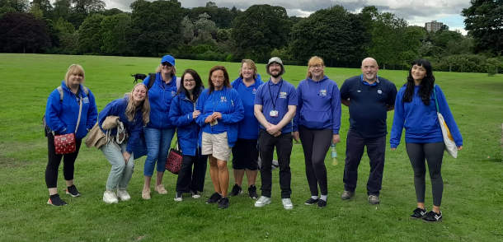
Aberdeen City Council Family Learning Team
25 dedicated and committed people made up of:
8 Development Workers across 11 Associated School Groups (ASGs)
2 Development Workers in Promise Pilot secondary schools
2 Development Workers in 2 primary schools
1 Development Worker for an ASG’s Partnership Forum
1 Development Officer in Social Work Kinship team
2 Development Officers supporting the wider team
7 City-wide Development Workers
1 Team Manager
1 Coordinator
Notes:
OPTIONAL Local info and data related to each local authority’s Family Learning offer
This slide shows how Aberdeen City Council has responded to the need for additional preventative support post pandemic:
Several different funding streams has allowed the ACC CLD Family Learning team to expand from a team of 6 (pre-Covid) to a team of 25. Staff have been recruited and allocated to specific areas of work that have included Education Recovery Fund (school area specific workers) now Strategic Equity and Whole Family Wellbeing Funding , Pupil Equity Fund (specific schools requiring their own worker), Whole Family Wellbeing Fund (2 Edge of Care Pilots within 2 local academies and 1 kinship-specific Development Officer), and core funding for the original posts within the team. This is just one local authority example of how funding opportunities can be utilised to promote an early intervention/prevention approach and answer the asks of Family Learning nationally, a Whole Family Support Model and The Promise.

Slide 30
Discussion & Planning Time
Within your role, what you do to ‘Keep The Promise’? After today’s presentation, what are your next steps?
Notes:
We can use this time to have a fuller discussion to review the session and plan our next steps. Consider the following questions:
Within your role, what you do to ‘Keep The Promise’?
After today’s presentation, what are your next steps?

Slide 31
Care Review Reports – Independent Care Review
Five Foundations infographics – Independent Care Review
Composite stories – Independent Care Review
Keep the Promise – Education
Reforming Scotland’s Care System with Love film https://www.youtube.com/watch?v=P2H0GzxmLK8
The power of ONE caring adult https://www.youtube.com/watch?v=u_Oapo1Q7_w The importance of language – Articulate Animations ohov.co.uk/wp-content/uploads/2024/05/articulate__a_film_by_our_hearings_our_voice-1080p.mp4
Whole Family Support Model Aberdeen City Council https://committees.aberdeencity.gov.uk/documents/s159026/Family%20Support%20Model%20Plan%20Final.pdf
Further Reading and Resources
Notes:
Here are some links to supportive resources.
This is not an exhaustive list but may be a starting place for any further reading or professional learning.

