Slide 1
Inclusion Wellbeing & Equalities Professional Learning Framework
Getting it right for every child (GIRFEC)
Essential for All
@ESInclusionTeam
For Scotland's learners, with Scotland's educators
Do luchd-ionnsachaidh na h-Alba, le luchd-foghlaim Alba
Notes:
Purpose of these Slides
Read title​
This professional learning is pitched at an informed level and suitable for anyone working with children and young people in an educational context.
How to use the slides:
To be used to facilitate professional learning in a group or whole-setting, or as a self-directed learning activity as an individual.
General Guidance
There is a requirement to cover all the slides.
Please do not change the provided slides.
Facilitators are welcome to add slides or activities relevant to your own setting, to support discussion and exploration of the topic. Facilitators will know their participants’ needs best.
Anyone who works in an educational setting can be a facilitator and use these slides.
It is important to establish a safe space which encourages respect and honesty to ensure that everyone is able to participate.

Slide 2
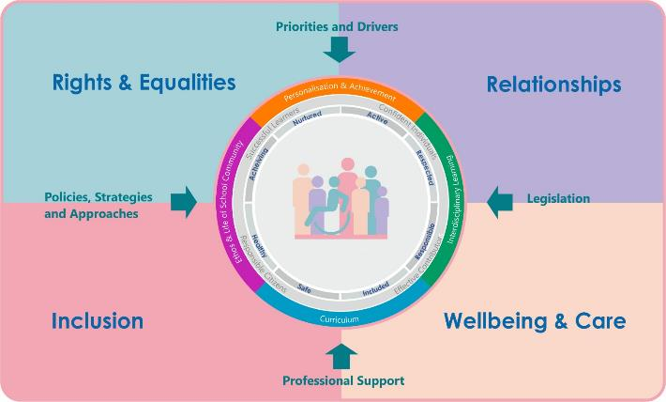
Interconnectivity
Notes:
All of the professional learning in the Framework fits into one of these four themes. The four themes are interconnected and interdependent.​
This activity interconnects with all four themes and forms part of the professional learning that is Essential for All.

Slide 3
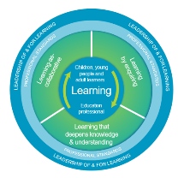
How to use this resource
These slides can be used to facilitate professional learning in a group or
whole-setting, or as a self-directed learning activity as an individual.
Facilitation notes are included at the bottom of each slide.
Please do not remove or change any of the slides included.
Facilitators are welcome to add slides or activities relevant to your own setting, to support discussion and exploration of the topic. Facilitators will know their participants’ needs best.
Anyone who works in an educational setting can be a facilitator and use these slides.
For reflection or discussion activities, it is important to establish a safe space which encourages respect and honesty to ensure that everyone is able to participate.
Notes:
Option to skip slide as these are instructions for facilitators only. No need to read to audience.

Slide 4
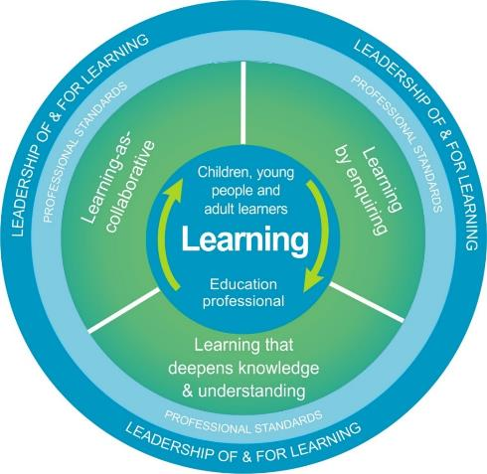
National Model for Professional Learning
This professional learning resource will support you to deepen your knowledge and understanding.
You will have the opportunity to consider how to take this learning forward on your own and with others.
The National Model of Professional Learning (education.gov.scot)
Notes:
This professional learning forms part of the national model for professional learning and is designed to help you gain more knowledge and have a deeper understanding of inclusion, wellbeing and equalities​​
On completion of this professional learning, you will be asked to consider what your next steps will be​​.
Please take some time to consider the reflection questions at the end

Slide 5
Welcome
This session provides an opportunity to:
Develop your understanding of the Scottish context for Getting it right for every child (GIRFEC)
Understand your role in recognising and supporting the wellbeing needs of children and young people.
Notes:
Link activity to national model

Slide 6
Getting it right for every child (GIRFEC)
Getting it right for every child (GIRFEC) is the Scottish Government’s commitment to provide all children, young people and their families with the right support at the right time - so that every child and young person in Scotland can reach their full potential.
Getting it right for every child (GIRFEC) forms a foundation of Scotland’s strong track record of respecting, protecting, and fulfilling children’s rights in law, policy, and practice. A central part of Scotland’s vision is to make this country the best place to grow up.
Children have the same rights as all other human beings as well as additional rights that recognise childhood as a special time that requires additional protection. A child’s fundamental human dignity as an individual, a family and a community member must be upheld in order for them to have the quality of life they need for their wellbeing and development.
Notes:
Honest reaction

Slide 7
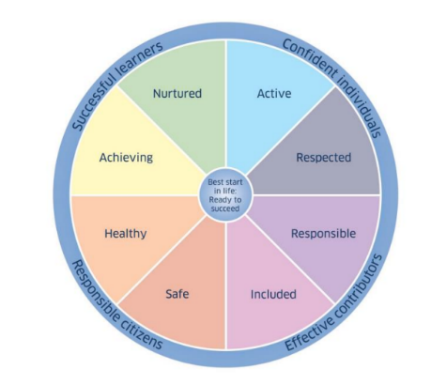
Getting it right for every child (GIRFEC)
Getting it right for every child (GIRFEC) is fundamentally about how well you know the children and young people and their families in your care.
The first stage of getting it right for every child is about relationships.
It’s all about relationships!
Recognising, recording and responding to individual needs helps us to safeguard and protect the children and young people in our care.
Through a common understanding of wellbeing, we recognise that children and young people need to grow up safe, healthy, achieving, nurtured, active, respected, responsible and included, so that they can become confident individuals, effective contributors, successful learners and responsible citizens.
Notes:
Honest reaction

Slide 8
Assessing wellbeing needs (GIRFEC)
Assessing wellbeing needs is a statutory responsibility.
(Assessment of Wellbeing 2022 – Part 18 (section 96) of the Children and Young People (Scotland) Act 2014).
An assessment of wellbeing must seek to identify all the factors in the child or young person’s life which may be affecting their physical, mental or emotional wellbeing. This will help establish how best to support the child or young person when they experience difficulties.
It will include, but is not limited to, recognising individual, family and community strengths as well as difficulties they face such as poverty, health, disability, inequalities or communication needs, and how these needs might be met to improve wellbeing
Notes:
Honest reaction

Slide 9
Getting it right for every child (GIRFEC)
GIRFEC is about enhancing the wellbeing of all children and young people as well as building a flexible scaffold of support: where it is needed, for as long as it is needed. This is delivered through the core components of:
a named person who is a clear point of contact for children, young people and families to go to for support and advice. A named person can also connect families to a wider network of support and services so that they get the right help, at the right time, from the right people;
a shared and holistic understanding of wellbeing and a single model of how this can be considered and supported; and,
a single, shared and rights-based approach to planning for children and young people’s wellbeing where support across services is needed, co-ordinated by a lead professional
Notes:
Honest reaction

Slide 10
Getting it right for every child (GIRFEC)
This video (7:09 minutes) from The Alliance provides a helpful overview of Getting it right for every child (GIRFEC).
Please take the time to watch this video to enhance your understanding of Getting it right for every child (GIRFEC).
Notes:
Honest reaction

Slide 11
What does this mean for you?
Your school, setting or local authority will have Getting it right for every child (GIRFEC) embedded within their policies. This will include an overview of the procedures and protocols that everyone should follow to respect and protect the physical, mental and emotional wellbeing of children and young people.
Which policies and procedures are you aware of in your school or setting that include an overview of Getting it right for every child (GIRFEC)?
Are you clear about your responsibility to safeguard and protect children and young people’s physical, mental and emotional wellbeing?
Notes:
Honest reaction

Slide 12
Reflection
From what you have learned so far, think about:
How has this made you feel?
What has this made you think about?
What one action would you like to take forward?
How can you link what you plan to do with others in your setting?
How you will know that this learning has made a difference?
Notes:
Facilitation notes:
You can do this in groups...
Encourage educators to take this forward in an enquiry
Consider impact of the actions / learning

Slide 13
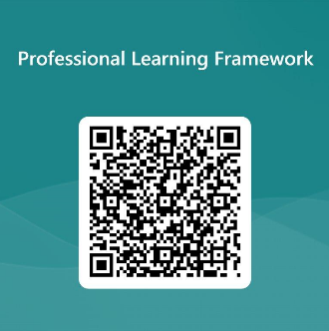
We value your feedback
From now until March 2024 we will be taking feedback on these resources so that we can make changes in advance of a formal launch of the Professional Learning Framework in June 2024
Your feedback could help us improve this resource
Please complete this short form, using the link or QR code, to let us know what you thought of it and any suggestions you have on how it could be improved
LINK: https://forms.office.com/e/b5PCpJJJ3P

Slide 14
For Scotland's learners, with Scotland's educators
Do luchd-ionnsachaidh na h-Alba, le luchd-foghlaim Alba
Education Scotland
Denholm House
Almondvale Business Park
Almondvale Way
Livingston EH54 6GA
T +44 (0)131 244 5000
E enquiries@educationscotland.gsi.gov.uk

