Slide 1


Keeping the Promise Award
Notes:
Welcome back everyone.
This is the final presentation in the Keeping the Promise Award.
The purpose of the programme is to raise awareness of the potential challenges care experienced children and young people may face and how we can individually and collectively Keep Scotland’s Promise to them in terms of improving their learning experience and educational outcomes.
This professional learning helps us identify our responsibilities to children.
In this session you will receive information and guidance on what you can do in your day to day practice to promote the wellbeing, progression and participation of any child or young person.
We all want to feel LOVED, SAFE and RESPECTED. We especially want our care experienced children and young people to feel LOVED, SAFE and RESPECTED.
Throughout the session, where possible, the voice and lived experience of care experienced children and young people has been used.
Hopefully this session will demonstrate the positive impact both education itself and ‘we’, practitioners, can have on care experienced children and young people’s lives and learning.

Slide 2
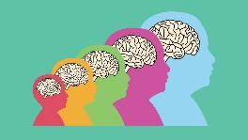
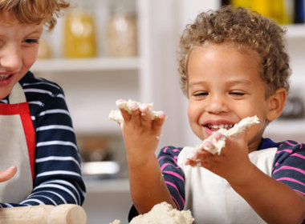
Supporting Children and Young People
(including those who have care experience)
Understanding needs & what we can do?
  Trauma
  Risk factors to wellbeing and learning
  Brain development & our Window of Tolerance
  Positive experiences & resilience
  Nurture Principles
  What children and young people say
  What do we do, what can we do?
  Every child needs a champion
  Next steps
Notes:
To support our care experienced children and young people and to actively engage in Keeping The Promise, we need to first understand how their experiences and development shape them.
Once we know this we then need to know how we can best support them.
The information shared today is relevant for all children and young people however care experienced children and young people’s lives can be very complex, more so than their non-care experienced peers, so today we will spend some time on understanding how their life journey may be impacting their wellbeing and readiness to learn.
We want you to leave today knowing that there ARE things we all can do individually and collectively to support care experienced children and young people.
At the end of the session we will signpost you to further reading and resources but if there are any of the topics we haven’t covered you can mention them in the next steps session or on the evaluation form at the end.
Health warning! Traumatic experiences are more common than we know! Today we will touch on a few difficult topics including trauma, grief and loss which may trigger thoughts about your own personal experiences. It can also be difficult to think about in terms of the children we work with and care about. These thoughts can trigger strong feelings. So please remember to be aware of your own reactions and look after yourself. If you need to take a breather, feel free to step out for a bit and if you need to, reach out to colleagues or friends you trust.

Slide 3
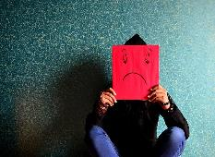
What is Trauma?
“An experience, or pattern of experiences, that impairs the proper functioning of the stress-response system, making it more reactive or sensitive.”
Bruce Perry
“An inescapably stressful event that overwhelms people’s existing coping mechanisms.”
Bessel van der Kolk
“Psychological trauma is the unique individual experience of an event or of enduring conditions in which the individual’s ability to integrate his or her emotional experience is overwhelmed (i.e. his or her ability to stay present, understand what is happening, integrate the feelings, and make sense of the experience), or the individual experiences (subjectively) a threat to life, bodily integrity, or sanity.”
Pearlman & Saakvitne
Notes:
We start today by considering trauma. Trauma is much more prevalent than we realise and many of us will have experienced trauma in our own lives. We are looking at trauma more closely today as many care experienced children and young people may have experienced some level of trauma and their trauma may even be connected to their care experience.
Here are some definitions from the literature:
Bessel van der Kolk – author of The Body Keeps the Score – read quote or give audience time to read quote.
Bruce Perry – big researcher in developmental trauma. Lots of books such as The Boy who was raised as a dog, What happened to you? – read quote or give audience time to read quote.
Pearlman & Saakvitne – they talk about trauma as an individual experience – ie. will affect individuals differently including individuals within the same family group
Read quotes or give audience time to read quote

Slide 4
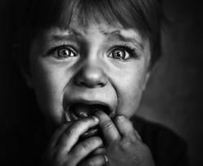
Types of Trauma
3 Broad types
Simple Trauma
Involves experiences of events that are life threatening and/or have the potential to cause serious injury, e.g. car accidents, fires.
Complex Trauma
Involves interpersonal threat, violence and violation. It way involve multiple incidents. Examples include child abuse, bullying, domestic violence, rape and war.
Collective Trauma
The psychological reactions to a traumatic event that effects an entire society.
Notes:
Children are particularly vulnerable to trauma.
For children under four the most significant trauma is witnessing a threat to a parent or carer.
Children and young people are not always consciously aware of the trauma they have witnessed, therefore, may not be able to respond or process this effectively.
Our bodies may display a physiological response to trauma in response to fear and threat. This includes increased heart rate, sweating, shaking, needing the toilet, difficulties sleeping, changes in eating habits.
Our bodies can go into flight, fight, freeze or fawn responses in order to try and avoid further trauma.
The fawn response is a trauma-related survival mechanism where individuals prioritize pleasing others to avoid conflict and ensure safety, often at the expense of their own needs.
Instinctively our bodies will focus on survival, as a result, the thinking part of the brain is overruled and instead the primitive brain takes over which does not always allow for rational thinking or responses.
This slide shows the 3 broad types of trauma.

Slide 5

Developmental Trauma:
is how complex trauma can impact on children and young people
describes how their development can slow down or become impaired following trauma
describes the impact of early, repeated abuse, neglect, separation and adverse experiences that happens within the child’s important relationships
Experiences may alter the behaviour of an adult, but it provides the organising framework of the infant and the child
An understanding of how early experiences shape neurodevelopment is imperative if we seek to impact the lives of children. This is especially true in the case of children growing up in homes plagued by violence, maltreatment and neglect.
The impact of early trauma is so profound because it occurs during those critical periods when the brain is most rapidly developing and organising.
Bruce Perry
For more information see: What is trauma? Informed level professional learning
Notes:
Children and young people who have experienced trauma may have ongoing physical responses such as: re-triggering trauma memories, flashbacks, intrusive thoughts, sleep disturbance, appetite disturbance, avoidance of people or places, mistrust of people, under or over reliance on others.
It is important to note that these are normal responses to abnormal and traumatic experiences. Responses are also dependant on a variety of factors including the intensity of the event, the experience of the individual, level of understanding/resilience and the child/young person’s developmental stage.
An ‘infant lens’ is not always applied when thinking about what matters to children. For example, while there is research indicating that most children who become ‘looked after’ in Scotland have experienced early trauma, there appears to be a common assumption that babies and very young children are less affected by traumatic experiences than older children. The impact of trauma in infancy may be under-estimated or minimised because very young children are unable to talk, and older children may not remember, understand, or verbalise their earliest experiences. It can be emotionally difficult to acknowledge the impact of traumatic experiences on very young children but it is vital to hold the infant in mind and consider their distinct needs and developmental timeframe.

Slide 6
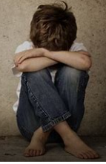
Risk factors to wellbeing and learning
Poverty
Adversity caused by neglect or abuse
Disability
Other wellbeing or health needs
Challenging family circumstances
Loss (parental separation, bereavement)
Our environment (physical, learning, social and emotional)
Notes:
Adverse childhood experiences can impact on children and young people’s wellbeing and learning. Care Experienced children and young people are more likely to have experienced a higher number of ACEs.
A 2014 study in England found that 67% of people experienced at least one Adverse Childhood Experience with 9% of the population having experienced four Adverse Childhood Experiences. (Bellis et al, 2014)
There are no similar studies in Scotland, however, a recent Welsh study found that the most Common Adverse Childhood Experience was verbal/emotional abuse (23% of households) and parental separation.
Refer to Further Viewing - NHS video on e-learning module and podcast from Bruce Perry & Oprah Winfrey on Childhood Trauma: ACES Podcast - 40 Mins

Slide 7
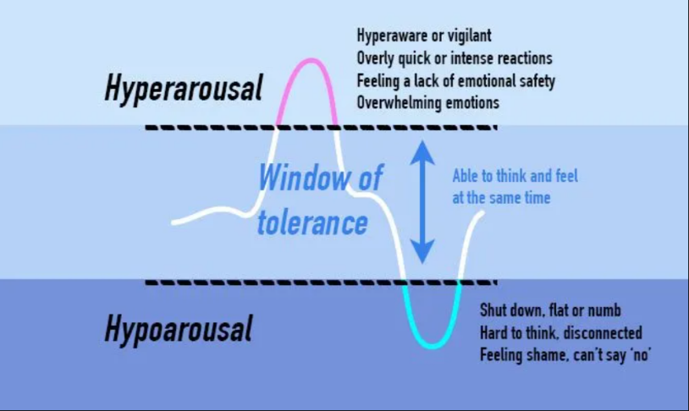
Brain development
& our Window of
Tolerance
Notes:
We are now going to watch a six-minute clip called the Window of Tolerance from the Beacon House Trust. This short clip will highlight how the brain and body react to trauma.

Slide 8

Beacon House Animation
6 min
48 sec
Video courtesy of Beacon House 2023 (Therapeutic Services & Trauma Team)
www.beaconhouse.org.uk
If you are viewing this as a pdf use this link to access the film:
https://youtu.be/0ehq5-P5OSs?si=SlJCLc1o6Y5NvBiI
Notes:
Watch film -Window of Tolerance (6 min 48 sec)

Slide 9
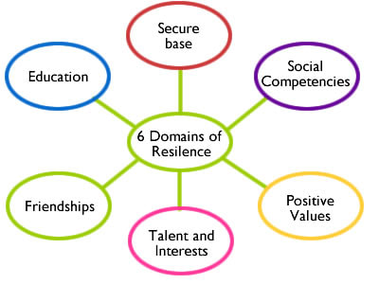
Positive Experiences
&
Resilience
Notes:
It is important to remember that children and young people also experience many positive experiences throughout their lives that can help counteract adversity and build resilience.
These include having a safe loving home (or in attachment terms a secure base), having social competency and positive values, having interests and hobbies, having connection with friends, and access to education (which is huge factor in terms of resilience).
Refer to Further Reading - Building Resilience Through Positive Childhood Experiences

Slide 10

Nurture Principles
Learning is understood developmentally
Environment offers a safe Base
All behaviour is communication
Transitions are important in children’s lives
Language is a vital means of communication
Nurture is important for wellbeing
Has experience impacted brain development
Think stage not age
Play is important at all ages
Nurture
Principles
For more information see:
Why use nurturing approaches?
professional learning
Notes:
Many care experienced children and young people have attachment issues. We cannot mention attachment without mentioning the 6 nurture principles.
One of the key elements of nurture is creating that safe space in your centre with strong positive relationships between staff and children, predictable routines and a range of spaces taking into consideration those quiet spaces.
Nurture as a practice means relating to and coaching children and young people to help them form positive relationships, build resilience and improve their social, emotional and mental health and wellbeing. These six principles help staff to focus on the social and emotional needs and development of children and young people.
During this professional learning session we will only be able to touch on the Nurture Principles but it is important to recognise the value and relevance of them to understanding children’s behaviour and how we might be able to best support them.

Slide 11


Areas of Wellbeing
Emotional Wellbeing
Positive Self-identity
Security and Comfort
Physical Wellbeing
Social Wellbeing
Notes:
Wellbeing is made up of different aspects as illustrated in the diagram. These aspects broadly encompass our physical and mental wellbeing.
Emotional Wellbeing is enhanced by dependable adults that know children well, quiet, cosy spaces, balanced pace of the day, opportunities to make choices and decisions, experiences that support health and emotional wellbeing, a balanced diet and daily free flow access to outdoors.
Positive self-identity/self-esteem is enhanced by personal resilience, knowing your strengths, and being open to inspiration, learning, or being creative. We can promote this through appropriate praise, celebrating achievements, building resilience and tenacity to try new things and attempt things that may be challenging. Having the opportunities to explore and be creative and problem solve.
Security and comfort is enhanced for children by having a safe environment, familiar adults and predictable routines with high levels of support and consistent boundaries. Adults that use a shared language that children can understand and communication methods that support children to make sense of their world around them.
Physical Wellbeing is enhanced by sleep, exercise, eating well, relaxation, pampering.
Social Wellbeing is enhanced by a sense of belonging, working as a team, positive relationships, humour and laughter. For young children this can be promoted through self registration, having a key worker and group, having responsibilities to help, being supported to develop positive relationships and social skills with peers, having fun and practitioners that recognise the patterns of attendance and pace of the day for children (particularly for long days).
Of course, physical health and mental wellbeing are interlinked, and it is important that children understand that good physical health contributes to good mental wellbeing, and vice versa.

Slide 12

Nurture for Wellbeing & Self Esteem
I am:
Good
Deserving
Capable
I am:
Bad
Unlovable
Useless
Others are:
Understanding
Responsive
Accessible
Others (are):
Unreliable
Unresponsive
Uncaring
The world is:
Unsafe
The world is:
Safe
Insecure attachment
Secure attachment
Notes:
Children who have not had those early nurturing experiences often have very negative thoughts and feelings about themselves – they often operate in the brain stem, reptilian and reactive part of the brain rather than the cognitive, thinking part of the brain.
Children and young people who feel cared for and valued are much more likely to be happy and do well in life.
Children who know themselves well and have self-respect are more likely to be resilient and strong, cope with change and challenge in life and make good choices.
We want all children and young people to feel safe and secure and be able to work in a supportive environment that promotes respect.
We want learners to establish a pattern of ‘being’ and living that is healthy and which will be sustained into adult life. These children may become parents and will hopefully raise their children to be healthy and happy.

Slide 13
The importance of
One Good Adult
Notes:
Research shows that having a supportive and trusted adult is key to how well a child or young person is connected; self-confident, future looking and can cope with problems.
The One Good Adult concept is a key element of the NHS Greater Glasgow and Clyde child and youth mental health improvement and early intervention framework.
The absence of a supportive and trusted adult is linked to higher levels of distress, anti-social behaviour and an increased risk of suicidal behaviour.
The supportive and trusted adult can be a parent, grandparent, youth worker, sports coach, teacher, janitor or someone who is available to them in times of need.
NHS Education Service asked children to right a job description for a ‘Good Adult’. The following slide gives a summary of what they said.

Slide 14
One Good Adult Job Description
Essential criteria - You must:
be authentic, calm, approachable, and welcoming.
encourage and help others to find support if they need it.
be kind, respectful and try to understand people and their lived experience. Take their concerns and worries seriously.
ask clear questions, actively listen, and explain any actions you take.
demonstrate that you’re worthy of trust by doing what you say you will.
be open-minded and fair and don’t jump to conclusions or judge.
recognise that everyone is unique and needs a personalised approach and supports.
trust that individuals know themselves so ask for and listen to their views, and you don’t patronise them.
treat children as your equal and talk directly to them.
offer realistic, helpful advice.
Desirable criteria – You:
are hopeful about the individual as well as the support you offer them.
encourage children to embrace their strengths.
are enthusiastic and positive about what they can do.
notice when someone is struggling and know the next steps to help them.
know when to use humour, and when to be serious.
can help others relax by being friendly, caring and putting them at ease.
How to be a good adult | The Knowledge and Skills Framework (NHS Education Service)
Notes:
The criteria outline qualities and attitudes that we can all have without any specialist training. This is what matters to children. This is what makes a difference to them. Do we value these qualities too?
Could you be that One Good Adult?
Optional to watch One Good Adult NHSGGC (2mins 58sec). The film describes the benefits they felt by having that One Good Adult in their lives.

Slide 15

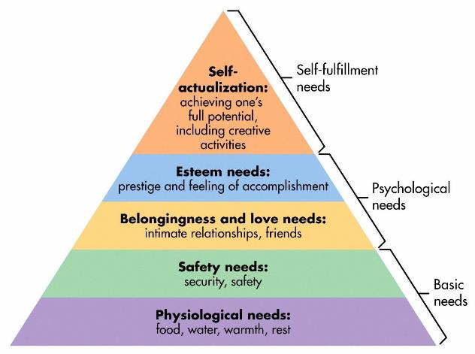
The Environment Offers a Safe Base
Maslow’s hierarchy of needs
  safety is key!
Physical safety
  environment, visuals, exit strategy
Emotional/psychological safety
  structure/relationships/key adults
Notes:
Safety is a basic human need.
Some of our children haven’t experienced what so many of us take for granted – safety, security, and stability throughout their lives.
Maslow’s Hierarchy demonstrates that feelings of safety, security, and connectedness underpinning higher-order areas such as self-esteem, social and emotional competence, and self-fulfilment. All these things are important for healthy relationships in their future.
Remember learning cannot happen effectively unless these basic needs are met first.
We may need to focus on a child’s safety and security in order for them to become learning ready before even considering developing things like resilience or growth mindsets.
So, how do we promote physical safety?
The physical environment can help create that feeling of safety and security for a child who has experienced trauma or loss. This may include creating or identifying what a safe space might look like for an individual child or young person, evaluating playroom settings, safe spaces or breakout areas, considering clutter, levels of visual or auditory stimuli etc. It’s best practice to ask the expert - the child or young person.
For emotional or psychological safety, we could look at individual support plans or other shared information. We also may need to consider options such as referral to specialist services.
You will know this is very much dependent on relationships across the setting’s community. These need to be positive and consistent to be effective.
Knowing children well and being able to work with them to identify triggers and supportive factors is vital. Providing structure, predictability, and being prepared, showing consistency and having boundaries, using praise and reassurance, and always having positive beginnings and endings during transitions are all useful approaches to take.

Slide 16
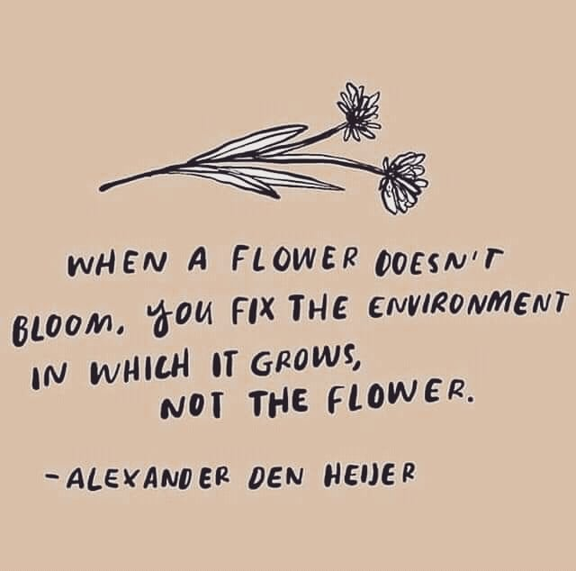
The Environment Offers a Safe Base 2
Notes:
This quote exemplifies what we are considering when promoting a sense of safety. The nurture approach aims to replace “missing or distorted” early nurturing experiences by immersing children in warm and welcoming environments which facilitate social, emotional and cognitive development (Lucas et al, 2006)

Slide 17

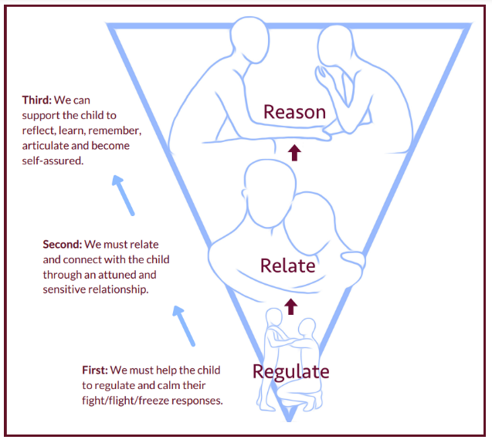
All Behaviour is
Communication
Children display both ‘desirable’
and ‘undesirable’ behaviours.
All behaviour serves a purpose.
By trying to work out the reasons, we can identify what changes we need to make our own behaviour to promote desirable ones.
Behaviour should be viewed in the context of the child’s needs and environment
The Promise there should be “no barriers to engagement”
For more information see:
Regulate-relate-reason-restore Informed-level professional learning
Notes:
Even when we provide physical and emotional safety there will still be times when we are faced with challenging behaviour. Behaviour that’s possibly a response to childhood trauma.
Some behaviour may be described as “distressed” or “dysregulated” because:
It is difficult to manage and understand
Presents a risk to the child, other children, practitioners, or others
It is not appropriate for the environment in which it is exhibited
It is inappropriate given the child’s age or developmental stage
None of these are easy to support in a early learning and childcare environment but if we can work with the child to reflect on what needs to change in order to minimise distressed behaviour we can move towards ensuring behaviour is not a barrier to engagement or accessing learning.
Use Co-regulation practice – connect before correct to support the child, name the feelings and then consider actions and alternative responses.
Using the sequence of engagement – 1. regulate, 2. relate and then 3. Reason
Not reasoning until they are regulated and you’ve validated their feelings, not their behaviour, means we are working with how the brain works and not against it.
This gives us the best chance to re-engage the child and move on.
Please ask parents/ carers not to revisit the incident to avoid feelings of shame/ anger/ break of trust. Instead discuss positive behaviours, feelings on way to the setting the next day.

Slide 18
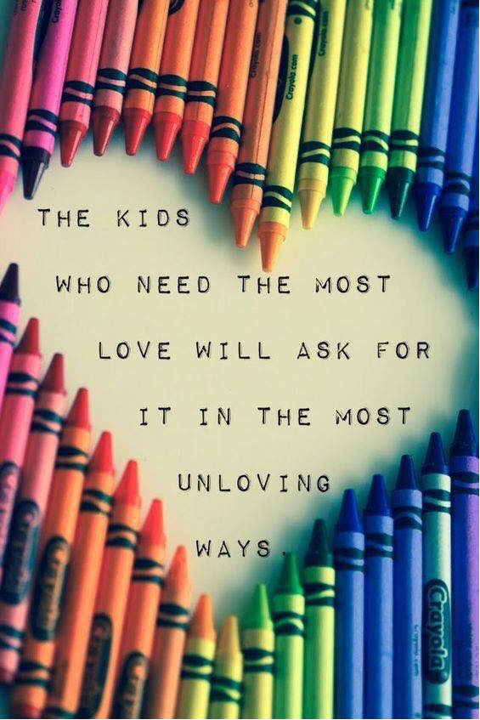
See past challenging behaviour
For more information on Emotional Regulation and the Brain, Co-Regulation, and Self Regulation see Education Scotland’s Informed Level RELATIONSHIPS Professional Learning
Notes:
This lovely graphic reminds us of what we are reflecting on! It can be difficult to see past the challenging behaviour and remain resilient and understanding at times but we should try to always remember what sits behind the behaviour.
If you feel you are struggling to manage a situation, and if its available, never hesitate to ask for some extra support. Remember co-regulating with children can be exhausting. Be aware of your own wellbeing and practice self-care. Remember it is ok to ask for help.

Slide 19

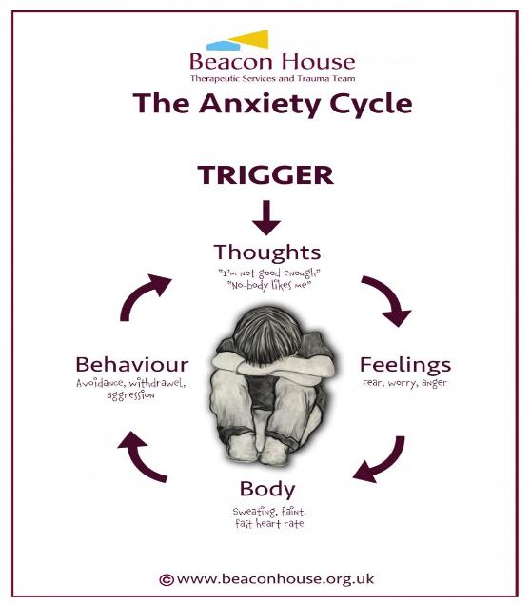
Reflection Time
What might distressed behaviour look like?
What might this be communicating?
Notes:
This activity can be adapted depending on delivery e.g. face to face, personal reflection, menti etc.
For this reflection activity take some time to consider the questions and reflect on what this behaviour may be telling you.
You will likely have one or two children in mind.
Consider what you understand about their previous or current experiences to identify what the behaviour may be telling you and where this may be coming from.

Slide 20
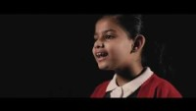
Why I am rude
2 min
26 sec
Poem written by Sarah Dillons
If you are viewing this as a pdf use this link to access the film: https://youtu.be/waeRP6jzW_U
Notes:
Identifying what is behind the behaviour can be tricky. Wouldn’t it be great if the children could tell us.
Although this film primarily shows older children they talk about underlying factors to behaviour that would also be relevant for young children.
Play the film.

Slide 21
Why I am rude?
Notes:
This film reminds us of what a child may be feeling and what it can look and feel like when the sense of safety and security is missing.

Slide 22
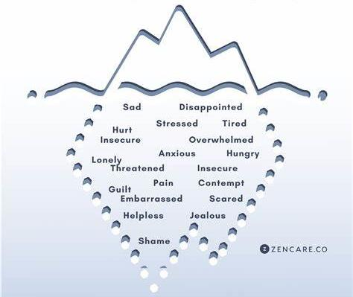
The Anger
Iceberg
Anger could be masking other feelings
Notes:
If all behaviour is communication we want to ‘get curious’ about what is causing the young person to display the behaviour. Anger is often a secondary emotion with something else underneath. Children and young people themselves often don’t have the language to articulate what they are feeling. So, at times asking them directly won’t necessarily provide us with answers. We may first need to teach, explain, or explore the language of feeling to get to the bottom of why a child or young person appears angry.
This information can be very useful for planning future support for a child or young person.

Slide 23
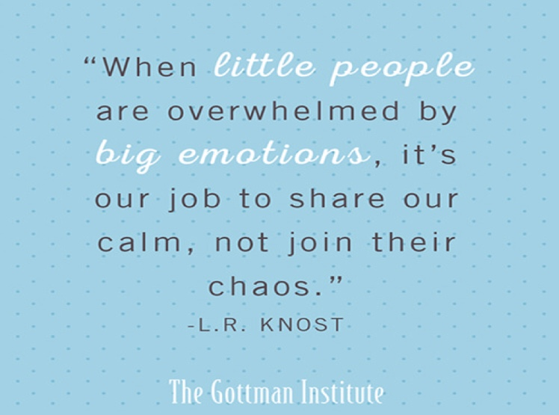
Little people with big emotions
For more information see: Co-regulation and de-escalation professional learning
Notes:
As practitioners, we need to be able to acknowledge the need for children to express anger, fear, sadness and disgust.
These are complex emotions to identify, understand and manage.
Anger in one person is often met with anger or fear in another.
This emotional transference can keep people locked in negative cycles within their relationships.
It is our job to change that cycle for children and young people by allowing ‘our calm’ to become ‘their calm’.
With patience and perseverance, we can teach them how to manage these big emotions safely.
We also need to make sure we are looking after our own emotional wellbeing when we work with those who have experienced significant trauma.
It isn’t just little people who are overwhelmed at times, adults can become overwhelmed too.

Slide 24

Notes:
Through curiosity, you can develop your understanding of what will work with children and young people both from a preventative and responsive viewpoint.
By getting to know the child or young person you are working with, you will be able to identify:
their early warning signs when they are finding it difficult to regulate their emotions (situations, stressors, tell-tale signs in their communication both verbal and non-verbal)
their interests and motivators
ideas that can be used to distract or divert attention
effective calming activities and de-escalation strategies
Ultimately it is through curiosity, that we demonstrate our commitment to helping children and young people when they are in crisis, and strengthen our relationships with them as a result.

Slide 25

Language is a Vital Means of Communication
Playfulness
Acceptance
Curiosity
Empathy
Big gestures
Cheeky grin
Varying tone of voice
Laughing together
“Help me understand…”
“Let me see if I have this right…”
“I’ve just realised…”
“What if…”
“I can see that…”
“I’m wondering if…”
“I can see how…”
“I imagine that was…”
“It’s such a big ask…”
Notes:
One of the six nurture principles, language is a vital means of communication, applies to our internal narrative and to how people view us externally.
We want to use all the verbal and non-verbal language that we can to encourage positive interactions with children and young people, to give them a sense of safety, that they are worthy of positive attention and acceptance, that people can be playful, kind and curious and want to be there for them.
That people can be empathic to what they are needing, and to what they are going through. We can remember this through PACE. We all need to go at the right PACE with our children and young people.

Slide 26
What Happens If We Reframe Our Thinking and Language?
Angry
Aggressive
Defiant
Not engaging
Rude
Withdrawn
Attention seeking
Avoidant
Unacceptable behaviour
Distressed
Frightened
‘In fight’ survival mode
Doesn’t feel safe yet
Self protective
Cautious
Attachment seeking/attention needing
‘In flight’ survival mode
Understandable behaviour
Notes:
Our internal use of language, how we label, describe and interpret what is happening, is important as it directly influences how we respond to every given situation.
Therefore, the more accurate we are with our language, and the more we focus on positive, helpful language that encourages us to see growth and opportunity for positive change, the better placed we will be to support the young people we are working with.

Slide 27

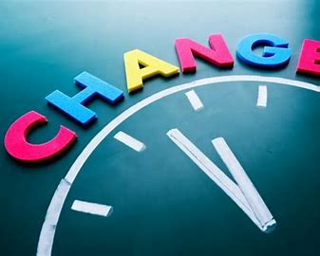
What are Transitions?
“Passing or change from one place, state or condition to another”
Notes:
When we are talking about transitions in a child or young person’s life this includes the big vertical transitions such as a move from early learning and childcare to primary or change of care placement but also the smaller horizontal transitions such as a change from free play to lunch, home to ELC, play to nappy changing.
This could also be subtle changes within a child’s environment such as the change of a key worker or change in the way the playroom is arranged.
Transitions are challenging because they force us to let go of the familiar and face the future with a feeling of vulnerability.
When children and young people have developed secure attachments with their primary care givers and when they are confident in their relationships in early learning and childcare, then transitions can be key times for development of new skills and, while causing nerves, can be approached as exciting opportunities for new experiences.
For children who have grown up with disrupted attachments at the centre of their emotional life, then any stable element of their life is held to as an anchor for their feelings and the sense of panic and dread in the approach to a transition, however small, can result in emotional dysregulation and reactive behaviours that are centred on fear of the unknown and what can’t be controlled.
When all the personal aspects of their life at home have been subject to flux and unannounced change, then every element of control that they can exert in their relationships at school helps them to validate their sense of self. When this control is threatened by a transition then their immediate response is to fight for the status quo. So we may want to ‘get curious’ and ask ourselves:
Why might transitions be difficult for this child?

Slide 28
Supporting all Transitions
‘Big’ transitions
Changing EYC
Change of care placement
Moving to a new room
Family separation
New siblings
Changes in family circumstances
Holiday periods
‘Small’ transitions
Getting up in the morning
Different staff in today
Moving from home to EYC
Change in playroom environment
Beginning an activity
Tidying up after an activity
Moving from EYC to home
Going to bed
Notes:
When children live through a chaotic home life with no validation of their worth from unreliable and indifferent care givers, they seek to test the relationships that develop at their ELC setting on the basis that they may fracture, as all previous relationships that may have fractured in their emotional life.
Changes in their environment, routine and experience of ELC will feel to them as warnings of new change and disruption and as further examples of rejection and confirmation of their low self-worth.
Children who have experienced such chaotic home lives in their infancy and early childhood and have moved into new care arrangements will carry the imprint of their previous experiences in how they approach change and how they cling to whatever feels permanent.
Yet change is inevitable in life and including in early learning and childcare settings, where the impact variations in routines - small changes and large changes – need to be carefully considered, and children sensitively supported through them.
How do we support children to accept and work through change?
The first key principle is to give children time to process a change before that change occurs. Depending on the extent of the change and the individual needs of the child the time required could be hours to months. The larger the change the more time required to talk through with the child the implications of the change and how other key things will remain constant. In ELC settings you may use concrete objects, timers, now and next boards or a visual routine to support this.
The second thing to emphasise is how the changes will not undermine relationships that have developed and how what has grown between staff members and a child will not be lost and can be revisited and enjoyed in other ways.
An example of a small change: Seating at lunch – A child who is hypervigilant to threats may like to ‘scan’ a room so they have a view of what is going on around them. If the place they sit in the lunch area has changed this may prevent them from settling.

Slide 29
Worden’s Model of Grief
4 Tasks
Accepting change
Recognising that life has changed, sometimes suddenly or without explanation. Consistent trauma informed adults are vital
Exploring feelings
Need to feel safe, have trusted spaces to express complex emotions like anger, sadness, guilt or confusion.
Rebuilding Identity
Rediscovering who they are, forming a new sense of self and belonging. Peer support groups can be powerful.
Finding meaning and connection
Encouraging them to hold onto important memories while forming new, healthy relationships. Creative activities can support this.
When we think about grief, we often imagine it as something that happens after someone dies.
But grief can come from many kinds of loss - losing family, friends, schools, routines, and even a sense of identity.
Children and young people with care experience often experience far more change and loss than their peers.
Additional resource:
Supporting children and young people through bereavement
Notes:
When we think about grief, we often imagine it as something that happens after someone dies.
But grief can come from many kinds of loss - losing family, friends, schools, routines, and even a sense of identity. Children and young people with care experience often experience far more change and loss than their peers.
The diagram to the left shows an adaption of Worden’s model of grief. Instead of describing grief in terms of stages Worden describes grief in terms of tasks that need to be undertaken to allow grief to be processed.
Worden’s model acknowledges that children and young people go back and forward between tasks and may revisit the tasks at different developmental stages and at different points throughout their lives.
The first task is Accepting Change: recognising that life has changed, sometimes suddenly or without explanation. This is where consistent, trauma-informed adults are vital.
Next is Exploring Feelings. Young people need safe, trusted spaces to express emotions like anger, sadness, or confusion. Storytelling and life narrative work help them make sense of their experiences.
Rebuilding Identity is about helping them rediscover who they are, beyond their care experience. Supporting the young person in forming a new sense of self and belonging Peer support groups like Seasons for Growth can be powerful here.
Finally, Finding Meaning and Connection encourages young people to hold onto important memories while forming new, healthy relationships. Creative expression. through art, music, or drama can support this. As can memory books and life story work.
These tasks align with the values of The Promise ensuring every child is loved, supported, and heard. Grief isn’t something to ‘get over’ it’s something we walk alongside them through.”
Additional resource: Supporting children and young people through bereavement | Resources | Education Scotland

Slide 30
Reflection
How are we currently supporting care experienced children?
What works, how do we know?
Notes:
Option to create a Jamboard for this activity if the meeting is virtual or use flip chart paper if the meeting is in-person. Ensure you put people into groups here of around 5/6 if working with larger numbers.
What you are aiming to do is allow people to feel positive about things, using the knowledge of your setting, you could also pre-prepare some points of discussion.
What are they already doing to support CE learners – for example regular planning meetings and information sharing so staff can get things right – use of language being used – being inclusive in after school clubs, supporting transportation issues if in care out with the area –gathering child voice using sensitive interactions, surveys and voting, supporting children to make choices, and so on.

Slide 31
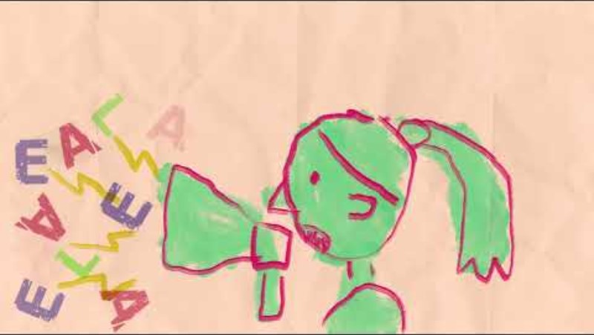
Hear Their Voice
2 min
46 sec
Film created by
Aberlour Children's Charity
If you are viewing this as a pdf use this link to access the film: https://www.youtube.com/watch?v=rijrj1Nlkv0
Notes:
When we start to consider how we can better support our care experienced children we need to first consider ‘what matters to them’ and then prioritise those things.
To know what matters to them we need to ask them first.
Some children are often considered harder to reach or engage with than others and are therefore not asked.
However we should never let age, ability or reluctance be a barrier to us trying to ensure all our children have a voice.
For example how would you include a non-speaking child or a very young child? Remember Realising the Ambition encourages us to use our eyes and our ears to ‘listen’ to children.
The following film helps us explore how this can be done.
Play the film

Slide 32
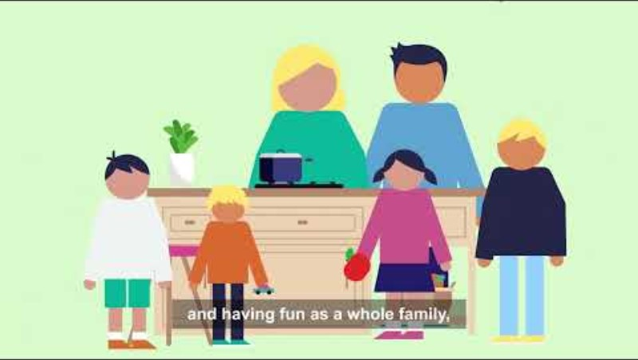
What can I do to support families?
4 min
39 sec
Film created by
The Promise Scotland
Use this link to learn more information about Family Learning
If you are viewing this as a pdf use this link to access the film: https://youtu.be/smgY0VC_QHE
Notes:
Play the film
When we talk about care experienced must consider the whole family.
In this video the parents are care experienced and may have trauma of the systems and services that impacted on their lives. This experience may have created barriers to their engaging with settings and services.
When we talk about supporting our children and young people it is vital we remember that one good, consistent, and trusting relationship (CONNECTION) can make a difference in their life and the life of their parents.
The impact of having a relationship with a keyworker, family champion or family learning worker can have lasting outcomes for the children and the families. It is important that practitioners working with families recognise the support that they can provide inhouse and also have knowledge of the wider services that can provide support e.g.) adult learning services.
Consider what opportunities you have to get to know parents, involve them in the life of the setting? How do you build those trusting relationships, learn what works for them and inform parents of the supports that are available. Some examples of this are stay and play sessions, family learning sessions where the parent and the children are learning together, drop in coffee mornings, meet and greet at drop off and pick up times, one to one support – parenting, signposting. Events like these can break down barriers and encourage parents to become involved in their child’s ELC setting, provide a friendly face for parents who are isolated, allow them to meet other parents and build their social network and support parents in their own learning and work. They can also support parents to more effectively engage in their child’s learning and support their child’s learning at home and in their local community.

Slide 33
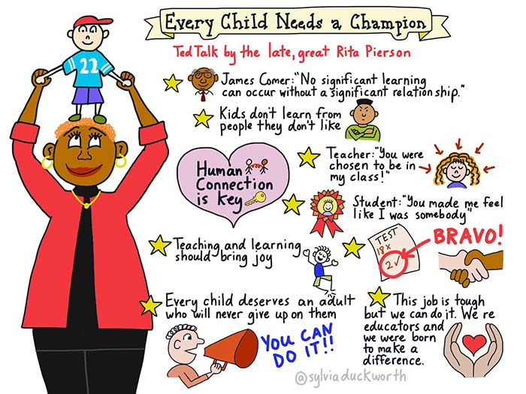
How can we be that good adult/champion?
Optional to view but it is an inspiring film
To access the film please follow this link and then return to the presentation:
https://youtu.be/SFnMTHhKdkw
7 min 48 sec
Created by TED Talk
Notes:
Optional to view but it is an inspiring film. To access the film please follow this link and then return to the presentation:
https://youtu.be/SFnMTHhKdkw
When we talk about supporting our children and young people it is vital we remember that one good, consistent, and trusting relationship (CONNECTION) can make a difference in their life. Some of our children and young people come from rather challenging backgrounds, and most remain within these. Having a good understanding of what has happened to them is beneficial in being able to make that connection, whilst appreciating how difficult this will be for them.
As people working in educational settings, no matter what role we have, it is important we recognise how we respond, react, and support our children and young people as this can have a profound impact on how they then perceive adults.
We must ensure we are consistent and relatable, allow yourself to be a human being so that our children and young people can build that relationship, and be shown that adults in their lives care about them, have aspiration, and hope for their futures.

Slide 34

Next Steps for Your Educational Setting?
So what will you do differently?
What will your setting do differently?
What will you help your learning community do differently?
Notes:
This activity can be done using menti, jamboard, or flipchart paper.
When responding to these questions think about The Promise foundations particularly:
Voice – Listen to our children, and involve them in decision making
People – Actively support our children in developing relationships
Family – Work together to support families and help them support their child
Scaffolding – When necessary support each other to be able to support our children and young people.
Ask the questions

Slide 35
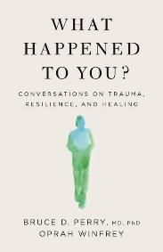

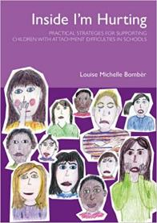
Further resources
Scottish Government Infant pledge: Voice of the Infant: best practice guidelines and infant pledge
Education Scotland: Realising the Ambition
Education Scotland - Improving relationships and behaviour
Education Scotland - CIRCLE resource to support Inclusive Learning and Collaborative Working
Beacon House - https://beaconhouse.org.uk/resources/
EP Insight website - https://www.epinsight.com/
Bruce Perry & Oprah Winfrey on Childhood Trauma: ACES Podcast - 40 Mins
NHS Education Service - How to be a good adult | The Knowledge and Skills Framework
NHS Education Service – One Good Adult Implementation Guidance
Building Resilience Through Positive Childhood Experiences
Bruce Perry books
Louise Bomber books
Dan Siegal books
Notes:
Refer to resources available
This is not an exhaustive list but may be a starting place for any further reading or professional learning.

Slide 36
The Personal e-Learning Module
Please complete the e-Learning module in your own time
when you have successfully completed the quiz at the end of the module – you will be sent a Keeping the Promise Badge
When 70% of all staff in our setting have completed the End of Module Quiz successfully the Setting will receive the Keeping the Promise Award Certificate
Thank you for your participation so far!!
Notes:
Well done! That’s the end of the formal presentations for this course and there is now only one more step to complete the Award. That’s the e-Learning Module that you will have to complete independently.
At the end of this presentation you will find a live link to the E-Learning Module or alternatively you can use the QR Code to access it.
At the end of the e-learning module there will be a short Quiz. The Quiz link will be provided to you by the person leading this professional learning via email.
On successful completion of the Quiz you will receive an ‘I Promise Award’. This will be in the form of a Digital Certificate and a Digital Badge’.
When you complete the Quiz the lead for this training is notified.
If you are in an ELC setting when 70% of everyone in the setting completes the Quiz the establishment will receive the ‘We Promise Award.
The digital badges could be used as part of your digital signature. The Formal We Promise Certificates could also be displayed in your establishments foyers or reception areas.
We hope that this professional learning will positively impact the care experienced children and young people you work with.
Thank you for your participation today.

Slide 37
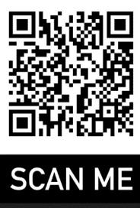
Access to the E-Learning Module
Please use the following weblink or QR code to access the E-Learning module
E-learning Module Link
On completion of the E-Learning Module please complete the Knowledge Check/Quiz (the person Leading this professional learning will be able to provide you with the link to access it)
Notes:
Link for E-Learning Module: https://rise.articulate.com/share/NI8Bga34ZBigMxlx7nP2HR51aYHT-_Y-
DO NOT READ THIS OUT – FOR INFORMATION ONLY
Quiz-Knowledge Check Instructions for ELC Setting Leads
ELC settings use this link to duplicate the Quiz- Knowledge Check ELC. Rename the Form – KTPA Add Your School Name
Independent childminders only can access the Quiz using the following link Quiz – Knowledge check Childminders
Click Collect responses (top right) and copy the link.
Give this link to participants who have completed the e-Learning Module
On your Master Form, in the Responses section, you will be able to see who has completed the Quiz and their score (the excel version is easier use for tracking purposes).
When 70% of all your staff have completed the full Programme and passed the Quiz-Knowledge check send the evidence (Excel Spreadsheet and full staff numbers) to IWE@educationscotland.gov.scot. You will let be sent the ‘We Promise’ Certificate.
Quiz-Knowledge Check Instructions for Independent Childminders
Independent childminders can access the Quiz using the following link Quiz – Knowledge check Childminders
Independent childminders who have completed all elements of the programme should email iwe@educationscotland.gov.scot and the coordinator will be able to check your quiz results and send you your I Promise badge.

