Slide 1



Supporting Young Carers in Education
‘There are an estimated 30,000 young carers in Scotland under the age of 18.
Three out of five of us will become carers at some stage in our lives.’
Carers Trust
For Scotland's learners, with Scotland's educators
Notes:
Welcome to the ‘Supporting Young Carers in Education’ Professional Learning Activity. This activity is designed for anyone working with young carers in an educational setting or context. This module of learning is part of a set of 4 modules. Each modules should take between 30 minutes and an hour depending on how it is undertaken. They can be studied as a group or as in-service activities with some discussion around the reflective questions or as an individual professional learning activity with written reflections in a log. Module one is designed specifically for all educational practitioners and should help them identify and support young carers. Module 2 is designed for anyone with leadership responsibility for organizing supports for young carers in their setting and includes their legal duties. Module 3 is designed for anyone hoping to develop a whole school approach towards supporting young carers. Module 4 addresses the specific challenges of transitions for young carers.
Welcome to this supported learning activity about young carers in education. Throughout this module and following the two other modules we often refer to young carers in school. However, we are very aware that young adult carers are in other types of education such as college or training provisions. They are supported by colleagues in youth or community services. This professional learning activity would equally apply to these young people.

Slide 2
Module 3: Ways to Support Young Carers in Education
Module 3A: Circles of Support
This module is suitable for everyone who works with children and young people and particularly those with specific responsibility for supporting young carers
For Scotland's learners, with Scotland's educators
Notes:
Module 3 Ways of supporting young carers through Circles of Support and in more practical ways.

Slide 3

Young carers describing themselves in education
Notes:
Young carers describing themselves in education

Slide 4

Young Carers need a ‘Circle of Support’ because:
Young Carers:
may not have spare time to play, socialise, or do sports &hobbies
can be hidden
can find it hard to make and maintain friends
can feel isolated
can feel no one understands
may not have an adult they can talk to
Notes:
Young Carers need a ‘Circle of Support’ because we’ve talked about why they can be hidden, why they can feel isolated, they feel no want understands. The feel they may not have an adult they can talk to. They find it hard to maintain friendships or even make friends, they talk about feeling isolated and lonely as part of their caring role. Many of them may not have spare time to play, socialise or do sports and hobbies that they enjoy. The may have outcomes that show they want to do these things but due to caring responsibilities they have been unable to.

Slide 5

Everyone who is connected to a Young Carer can play a part in their circle of support
How we work together is important!
The Potential Circle of Support around a Young Carer
Parent or Carer
Friends
Wider Family
Pupil Support Staff
Allied Health Professional
Head Teacher
Health Visitor
Early Years Worker
Class Teacher
Occupational Therapist
Family Doctor
Young Carer Coordinator
Registration Teacher
Mental Health Support Worker
School Nurse
Guidance Staff
Addiction Service Worker
Safeguarder
Youth Worker
Home School Link Worker
Advocacy Worker
Family Learning
Young
Carer Service
Community Support
Third sector partner
Social Worker
Family Support
Notes:
There is a massive ‘potential’ Circle of Support around a young carer who can come from parent's, carers, friends or wider family. It can also be from Allied Health Professionals, Occupational Therapists, Health Visitors, Mental Health Support Worker, it could be the family Doctor or an Addiction Service Worker. Then we look to other agencies is there a Safeguarder, Advocacy Worker, Third Sector Partner or Social Worker. Balancing the young carer is the Young Carers Service, there is a Young Carers Service in every local authority area and is this someone who can support the young carer. Is there Youth Workers, Family Learning, Community Learning or Family Support available. We also want to look at class teachers who sees the young person every day or registration teachers, Head Teacher, Guidance Staff, Young Carer Co-Ordinator in the school or is it a member of Pupil Support Staff, Early Years Worker or a School Nurse who the young person really trusts. Or is it the Home School Link Worker who has an idea of what is going on with home life.
Everyone who is connected to a Young Carer can play a part in their circle of support. How we work together is really important!

Slide 6
Support for young carers in education - happens at different levels and in different ways, for example:
Practitioner
Relationships
Compassion, connection and kindness
Day to day:
wellbeing support
learning support
practical support
Educational setting
Culture and ethos supports wellbeing and learning
Policies and procedures support inclusive practice
Leadership, professional learning, and staff support: if staff wellbeing is good it helps them to support their learners
Local Authority
Infrastructure support
Advice and guidance
Coordination of resourcing across services
Governance
Notes:
There are many ways we can support young carers in education and most of these will be at a universal level. So how can a classroom practitioner or someone who works with a young person around the school support a young carer? Well by building a relationship with them, by showing compassion, kindness and by connecting with that young person on a daily basis. So, what we can try to do is use that relationship to provide wellbeing support, learning support or actual practical support.
The whole school can also be doing things that can support young carers. They can be looking at the culture and ethos that support wellbeing and learning generally. They can make sure their policies and procedures support inclusive practice.
The leadership in the school can make sure there is professional learning like this learning available to staff and that’s all staff, teaching and support staff. But we also know that staff need to feel well themselves and if they do then they can support their learners including young carers.
There is also a responsibility on the local authority to provide infrastructure support and where needed advice and guidance for schools, for families and for young carers. They will be the people if more than one service so for example if education is needed, then they will coordinate resourcing across services and ultimately they will be the people responsible for making sure all this works for young carers.

Slide 7

Activity Reflection
What do you see in practice happening in your setting that supports Young Carers?
What don’t you see?
Notes:
In reflection to what you have just heard and seen what do you see in practice happening in your setting that supports Young Carers in these areas? And more importantly what don’t you see?
Please record your thoughts in the professional learning log.

Slide 8
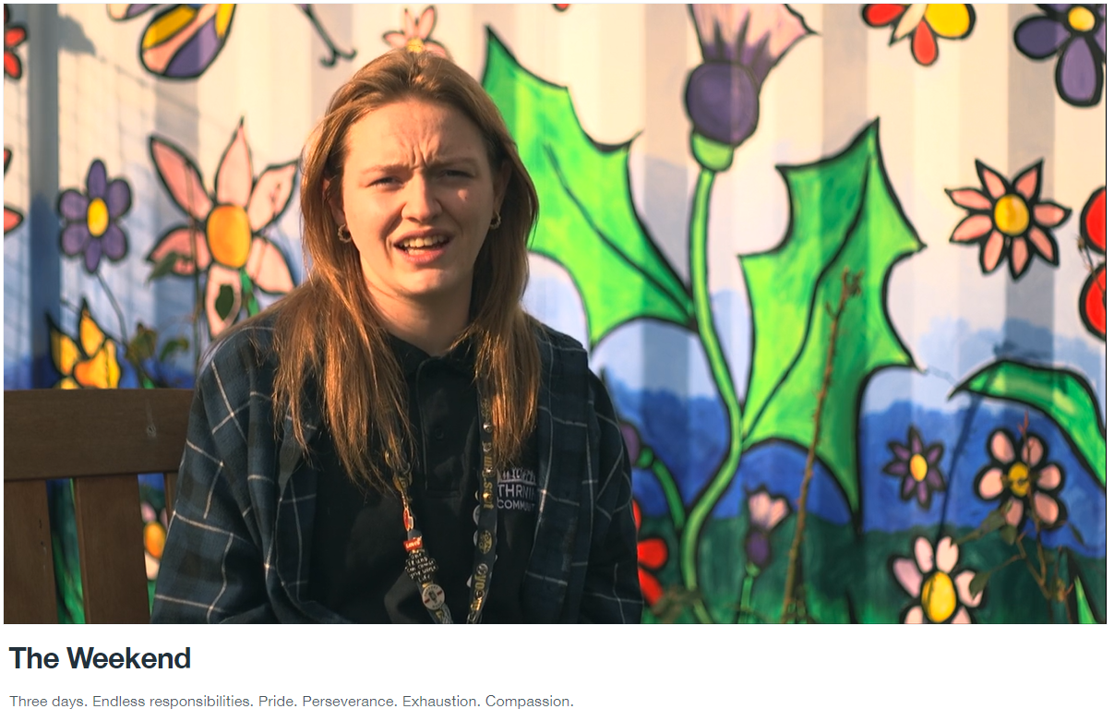
The reality of being a young or young carer
https://vimeo.com/801166050/90319e9829 (17 mins)
Notes:
What practical support can we offer Young Carers?

Slide 9
When we get it right
We make a big difference to young carers lives
“I no longer feel anxious about being a carer or feel nervous about being asked why I am late to school again, it has made my life so much easier at school which now makes it a happier place to be. By having my YC Statement in place it makes me feel settled and content within Education. The most challenging part of my Statement was having to detail any barriers I was experiencing in Education but now looking back this was the most meaningful part. Because of including this in my statement I know I have methods in place to support me.”
(Young Carer, Dundee)
“School is more welcoming; they understand me because I let them know I am a young carer. I think it helps because there is more of an awareness of young carers in school.”
(Young Carer Ambassador)
Quotes from Dundee Young Carers talking about their experience of school. Find out more here https://carersofdundee.org/carers/young-carers/
Notes:
Read slide notes

Slide 10
BE ALERT and BE AWARE
How can individual practitioners support young carers at a universal level
Notice Young Carers
Listen to them
Support them
Here are some examples of how some local authorities are raising awareness of Young Carers:
Carers of Dundee – Support in School
Things Teachers Should Know About Young Carers
Carers of Dundee – Support in School
You Tube: Perth and Kinross Young Carers Awareness Podcast 2020
You-tube: Echoes of Care – Being away from the person you care for
Education Scotland Professional Learning webpage – for practitioners, student teachers, and probationers
Notes:
How can individual practitioners support young carers at a universal level
BE ALERT and BE AWARE
Notice Young Carers
Listen to them
Support them
Here are examples of how some local authorities are raising awareness of Young Carers: Read slide

Slide 11
Top tips: once you know a child is a young carer you can support them by:
being emotionally available to them, being kind and being understanding
showing them that you genuinely care about them through what you say and what you do
proactively building and nurturing a relationship with them, being a mentor to them
listening (with purpose) and seeking to understand them and their needs (through what they say and how they behave)
prioritising learning and being educationally ambitious for them (even if they aren’t educationally motivated themselves at this moment in time)
proactively creating a safe and predictable learning environment
supporting transitions during the day (activity/person/place) and across the year (moving up/moving on)
if necessary seek out relevant professional learning to better understand and meet young carers needs
Notes:
Values and attitude – personal and professional commitment – linked to GTCS standards
Being rights based and using relational approaches – nurture, CCC, restorative values, thinking and language (link to SEBN)
Refreshing your knowledge ASN, PL and skills building - on the impact of trauma, childhood development, neuro-diversity, children’s rights and how to respond to these factors in their practice (attunement, de-escalation, co-regulation, and how to help children manage their own stress and anxiety).
Examining practice against the promise – language used - when writing reports/assessments/plans, or speaking to CYP and parents
Avoid imposing consequences that are restrictive, humiliating, or stigmatising such as seclusion or by using certain behaviour reward systems.
be inclusive and pro-actively promote engagement with learning by providing tolerance, understanding, care and protection rather than punishment. CYP hereafter implicitly includes those with care experience including those in residential schools or secure care

Slide 12
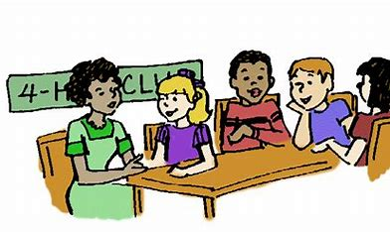


What can the establishment do?
Notes:
What can the establishment do?

Slide 13
Encourage Young Carers to tell a trusted adult
Use PSE classes or assemblies to raise awareness & encourage young carers to identify themselves
Listen
Stay connected
Plan ahead
Encourage young carers to have their say
Provide opportunities for young carers to influence decisions/change
For example:
Children’s Parliament Survey
Carers Trust Scotland Survey
Proactively engage young carers and parents through:
Participation activities
Surveys
Information/open nights
Invite local Young Carers Service to school to deliver training or have drop in sessions.
Know who is responsible for completing the Young Carer Statement and how to contact them.
Have Personalised Emergency Information to hand
Have Signposting information for young carers and their families readily available such as a Young Carer Service.
Notes:
Encourage Young Carers to tell a trusted adult
Use PSE classes or assemblies to raise awareness & encourage young carers to identify themselves
Listen
Encourage young carers to have their say
Provide opportunities for young carers to influence decisions/change
For example: surveys or focus groups
Stay connected
Proactively engage young carers and parents through:
Participation activities
Surveys
Information/open nights
Invite local Young Carers Service to school to deliver training or have drop in sessions.
Plan ahead
Know who is responsible for completing the Young Carer Statement and how to contact them.
Have Personalised Emergency Information to hand
Have Signposting information for young carers and their families readily available such as a Young Carer Service.

Slide 14

Change the narrative about having caring responsibilities
Celebrate Young Carers and value the care they provide – perhaps have a recognition award for young carers
Destigmatise ‘caring’ to reduce fear, bullying, or embarrassment
Normalise talking about ‘caring’ to encourage young carers to come forward
Recognise our role as part of the supportive scaffolding for young carers and be proud!
This film could be used in an Assembly 3 mins
Scottish Young Carer’s Festival 2024
Notes:
Change the narrative about having caring responsibilities:
Celebrate Young Carers and value the care they provide – perhaps have a recognition award for young carers
Destigmatise ‘caring’ to reduce fear, bullying, or embarrassment
Normalise talking about ‘caring’ to encourage young carers to come forward
Recognise our role as part of the supportive scaffolding for young carers and be proud!
Play the film (3 min) Explain this could be used in assemblies

Slide 15
Specifically for young carers educational establishments can:
Develop or update a Young Carer Policy or Charter
Work with colleagues and young carers to update or develop a specific young carer policy or charter for your education setting.
Create a Young Carer notice board
Work with young carers in your education setting to create a young carer notice board with information this will help destigmatise caring.
Nominate a Young Carer Champion
A Young Carers Champion is a member of staff who is the link between the education setting and young carer service, local authorities and other organisations.
Notes:
Specifically for young carers educational establishments can:
Develop or update a Young Carer Policy or Charter
Work with colleagues and young carers to update or develop a specific young carer policy or charter for your education setting.
Create a Young Carer notice board
Work with young carers in your education setting to create a young carer notice board with information this will help destigmatise caring.
Nominate a Young Carer Champion
A Young Carers Champion is a member of staff who is the link between the education setting and young carer service, local authorities and other organisations.

Slide 16
Other practical ideas:
Information leaflet about local young carer support available for young carers
Promote Young Carer Card
Promote Young Scot Young Carer Entitlement, Young Carer Wallet, Young Scot Card
Start a young carer group
Be flexible around deadlines for homework and lateness – provide guidelines for teachers
Provide a quiet area to study before and/or after school
Provide flexibility re location and timing of parent meetings where possible
Provide advice about transport to school if this is an issue
Use SQA exceptional circumstances requests if necessary
The school nurse service may be able to help with health and wellbeing issues
Notes:
Other practical ideas:
Information leaflet about local young carer support available for young carers
Promote Young Carer Card
Promote Young Scot Young Carer Entitlement, Young Carer Wallet, Young Scot Card
Start a young carer group
Be flexible around deadlines for homework and lateness – provide guidelines for teachers
Provide a quiet area to study before and/or after school
Provide flexibility re location and timing of parent meetings where possible
Provide advice about transport to school if this is an issue
Use SQA exceptional circumstances requests if necessary
The school nurse service may be able to help with health and wellbeing issues

Slide 17
Things that help ALL learners including young carers:
creating calm, safe learning environments where young carers rights are recognised and realised
providing staff with time, space and opportunity to develop kind, supportive relationships with young carers
prioritising and maximising effective universal supports and inclusive practice
recognising and addressing any and all additional support needs of their young carers
ensuring school policies and practice prioritise relationships and explicitly recognise young carers
recognising that young carers may need more support, for longer, and this might occasionally be intensive
engaging with other supporting services for universal family support potentially providing a place for this
be able to signpost young carers and their families to other appropriate services and organisations when more targeted support is needed
Notes:
NB When I refer to Schools I mean all settings were education happens.
Things that help ALL learners including young carers:
creating calm, safe learning environments where young carers rights are recognised and realised
providing staff with time, space and opportunity to develop kind, supportive relationships with young carers
prioritising and maximising effective universal supports and inclusive practice
recognising and addressing any and all additional support needs of their young carers
ensuring school policies and practice prioritise relationships and explicitly recognise young carers
recognising that young carers may need more support, for longer, and this might occasionally be intensive
engaging with other supporting services for universal family support potentially providing a place for this
be able to signpost young carers and their families to other appropriate services and organisations when more targeted support is needed

Slide 18

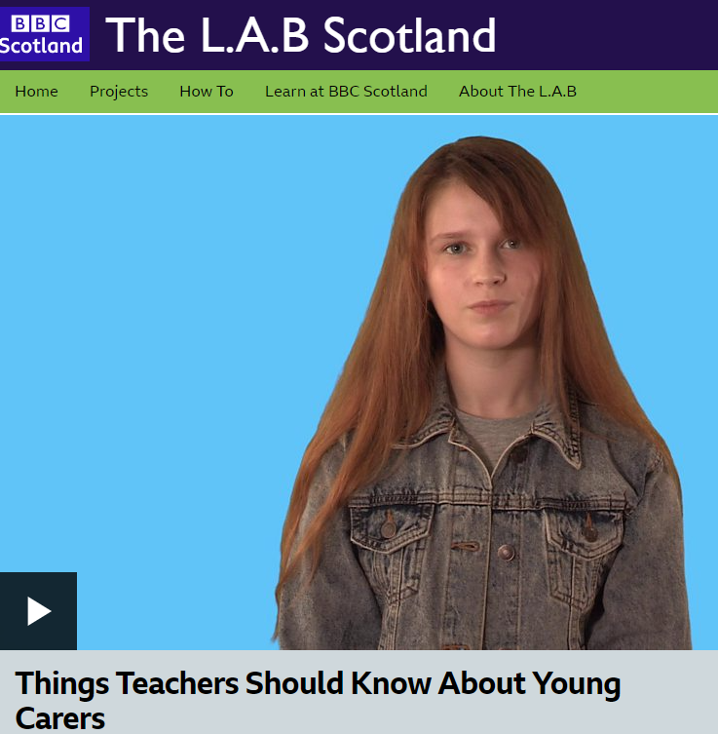
Remember we aren’t alone
Work in partnership with young carer services
Invite a local young carers service to the school for drop in or assemblies raise awareness
Raise awareness in the learning community
Build empathy and understanding by defining and explaining to learners, parents and partners exactly what young carers do
These two films are good for use in PSE lessons or assemblies
Many Young Carer Services offer to run an Assembly or support PSE classes
43 sec
https://www.youtube.com/watch?v=-qjjqhny8C0
I min 11 sec
https://www.bbc.co.uk/programmes/p07hst84
Notes:
Remember we aren’t alone
Work in partnership with young carer services
Invite a local young carers service to the school for drop in or assemblies raise awareness
Raise awareness in the learning community
Build empathy and understanding by defining and explaining to learners, parents and partners exactly what young carers do
These two films are good for use in PSE lessons or assemblies (No need to play unless you have time for them)
Many Young Carer Services offer to run an Assembly or support PSE classes

Slide 19

Activity Reflection
Do you know who/where your local Young Carers Service is?
Do you know how to access them?
Notes:
Ask the questions:
Do you know who/where your local Young Carers Service is?
Do you know how to access them?

Slide 20
And finally…..
Based on today’s professional learning:
What will you, as an individual, do differently?
What will your school do differently?
How will you help your learning community do things differently?
Notes:
Reflecting on what you have just heard and seen, in your educational or child care setting is there a process for identifying young carers? Record your thoughts in the professional learning log.

