Slide 1
Inclusion Wellbeing & Equalities Professional Learning Framework The Inclusive Scottish Context – An Introduction
Informed level
@ESInclusionTeam
For Scotland's learners, with Scotland's educators
Do luchd-ionnsachaidh na h-Alba, le luchd-foghlaim Alba
Notes:
Purpose of these Slides
Read title​
This professional learning is pitched at an informed level and suitable for anyone working with children and young people in an educational context.
How to use the slides:
To be used to facilitate professional learning in a group or whole-setting, or as a self-directed learning activity as an individual.
General Guidance
There is a requirement to cover all the slides.
Please do not change the provided slides.
Facilitators are welcome to add slides or activities relevant to your own setting, to support discussion and exploration of the topic. Facilitators will know their participants’ needs best.
Anyone who works in an educational setting can be a facilitator and use these slides.
It is important to establish a safe space which encourages respect and honesty to ensure that everyone is able to participate.

Slide 2
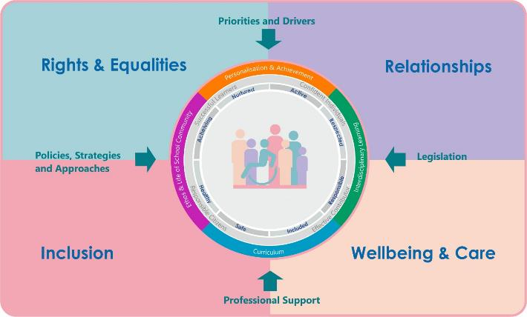
Interconnectivity
Notes:
All of the professional learning in the Framework fits into one of these four themes. The four themes are interconnected and interdependent.​
This activity forms part of the professional learning in the Inclusion theme.

Slide 3
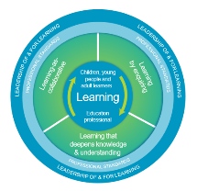
How to use this resource
These slides can be used to facilitate professional learning in a group or
whole-setting, or as a self-directed learning activity as an individual.
Facilitation notes are included at the bottom of each slide.
Please do not remove or change any of the slides included.
Facilitators are welcome to add slides or activities relevant to your own setting, to support discussion and exploration of the topic. Facilitators will know their participants’ needs best.
Anyone who works in an educational setting can be a facilitator and use these slides.
For reflection or discussion activities, it is important to establish a safe space which encourages respect and honesty to ensure that everyone is able to participate.
Notes:
Option to skip slide as these are instructions for facilitators only. No need to read to audience.

Slide 4
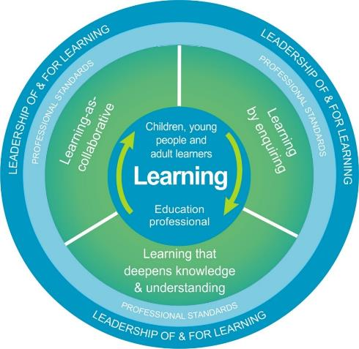
National Model for Professional Learning
This professional learning resource will support you to deepen your knowledge and understanding.
You will have the opportunity to consider how to take this learning forward on your own and with others.
The National Model of Professional Learning (education.gov.scot)
Notes:
This professional learning forms part of the national model for professional learning and is designed to help you gain more knowledge and have a deeper understanding of inclusion, wellbeing and equalities​​
On completion of this professional learning, you will be asked to consider what your next steps will be​​.
Please take some time to consider the reflection questions at the end

Slide 5
Welcome
Pause for Thought…
This session aims to provide an opportunity to reflect on:
What inclusion means to you.
The roles and responsibilities of all staff in supporting inclusive education.
Your next steps in developing a deeper understanding of inclusion.
Notes:
Link activity to national model

Slide 6
Scottish Context for Inclusion, Equality and Equity
Scottish education is based on the belief that education is a human right and that all children and young people should be supported to reach their fullest potential. Children’s rights and entitlements are fundamental to Scotland’s approach to inclusive education. It is supported by the legislative framework and key policy drivers
Scotland’s education system is designed to be an inclusive one for all children and young people in Scottish schools, with or without additional support needs.

Slide 7
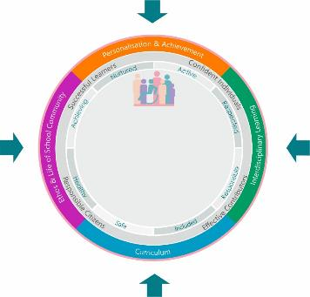
Scottish Context for Inclusion, Equality and Equity – Overview
Achievement, Attainment, Curriculum, Empowerment, Equity, Outcomes
Priorities and Drivers
Inclusive ELC/schools
Positive Relationships
Safeguarding
The GIRFEC approach
DYW
Additional Support
Accessibility
Equality
Inclusion
Learner Voice and Participation
Rights
Policies and
Guidance
Supporting All Learners:
Experiences
Achievements
Attainment
Outcomes
Legislation
Professional Support
Education Scotland
Professional Organisations and Standards
UNIONS

Slide 8
Supporting all learners
Support for all learners begins within the classroom and is provided by the classroom teacher who holds the main responsibility for nurturing, educating and meeting the needs of all learners in their class, working in partnership with support staff to plan, deliver and review curriculum programmes.
Learners can display a range of support needs which can result in significantly different profiles and requirements. It is important to realise that the issues children and young people may face do not always fit neatly into categories and it is likely that there are overlapping barriers which are experienced.
Parents, carers and children over 12 years old have the legal right to request an assessment and this should be started within 10 weeks of the request.

Slide 9
Inclusion
Inclusions means taking positive action and intervening in order to enable achievement for all by building and fulfilling the potential of every child, young person and adult.
Curriculum for Excellence was design to be an inclusive curriculum.

Slide 10
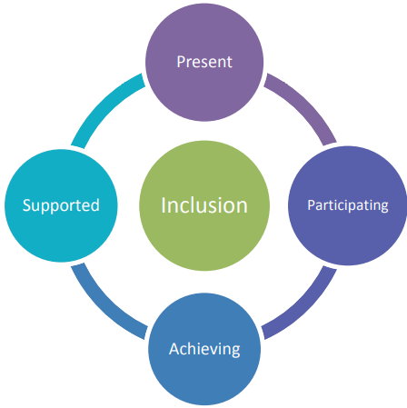
Inclusion
To be included all children and young people need to be and feel:
Present
Participating
Achieving
Supported.

Slide 11
Equality
Equality is described as the removal of discrimination, disadvantage, inequality and / or barriers which can affect people on the grounds of the protected characteristics set out in the Equality Act 2010: age, disability, gender, gender reassignment, pregnancy and maternity, race, religion or belief and sexual orientation.

Slide 12
Equity
Equity means treating people fairly, but not necessarily treating people the same.
Equity in education means that personal or social circumstances such as gender, ethnic origin or family background are not obstacles to achieving educational potential and that all our young people are well supported to secure wellbeing, skills for learning, life and work and the best possible post-school destination, HGIOS 4 (2016).
Equity is generally understood to refer to fairness and impartiality for people in general and sometimes especially relating to fairness for people facing socio-economic disadvantage.

Slide 13
Additional Support Needs
‘Additional Support Needs’ is the standard terminology used in Scotland when children and young people need more – or different - support to what is normally provided in schools or ELC to children of the same age.
Additional support is a broad and inclusive term which applies to children or young people who, for whatever reason, require additional support, long or short term, in order to help them make the most of their school education and to be included fully in their learning.

Slide 14
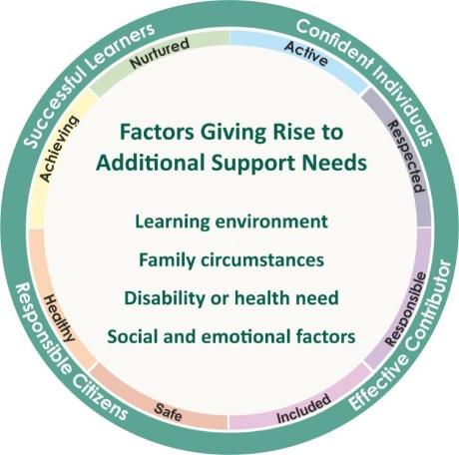
Barriers to Learning
Within Curriculum for Excellence, all children and young people are entitled
to support to enable them to achieve.
Education authorities are required to identify the additional support needs of each child or young person for whose school education they are responsible.
This can be achieved in a range of ways.
Any person working with the child, or the young person can raise a concern. For example, this may be the parent/carer, class teacher, pupil support staff , pupil support teacher, educational psychologist, social worker or any person who has been working with a child or young person.

Slide 15
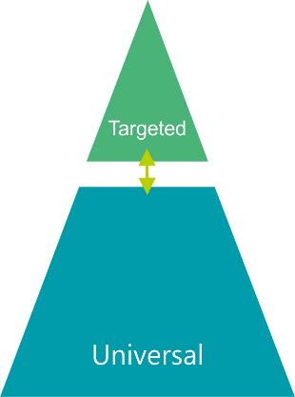
Staged Level of Intervention
Staged intervention a flexible approach used to identify, assess, plan, record and review to meet the needs of children and young people.
Targeted support
Usually, but not exclusively, co-ordinated and provided by specialist staff/partners. Targeted' support is any focused support which children or young people may require for short or longer periods of time to help them overcome barriers to learning or to ensure progress in learning.
Universal Support
The majority of learners are supported through Universal support which starts with the ethos, climate and relationships within every learning environment. It is the responsibility of all practitioners to take a child-centred approach which promotes and supports wellbeing, inclusion equality and fairness.

Slide 16
Curriculum for Excellence
“Curriculum for Excellence is an inclusive curriculum from 3 to 18 wherever learning is taking place”.
Curriculum for Excellence is a world-class example of universal design for learning. Its principles of curriculum design include relevance, personalisation and choice and challenge and enjoyment. At its development stage, special school head teachers and support for learning teachers advised on building experiential learning into the curriculum through experiences and outcomes across its levels.

Slide 17
What makes effective and inclusive learning and teaching that meets the needs of all learners – including those who require additional support?
Relationship based approaches
Child centred planning
Inclusive pedagogy - maximising universal support
Professional learning opportunities
Collaborative approaches - partnerships
No ‘one-size-fits-all’ approach
Progression pathways – flexible pathways – flexible curriculum*
Balance, progression and coherence
Tackling bureaucracy
Continuous cycle of improvement - effective use of reflection, self-evaluation robust data.

Slide 18
Reflection
From what you have learned so far, think about:
How has this made you feel?
What has this made you think about?
What one action would you like to take forward?
How can you link what you plan to do with others in your setting?
How you will know that this learning has made a difference?
Notes:
Facilitation notes:
You can do this in groups...
Encourage educators to take this forward in an enquiry
Consider impact of the actions / learning

Slide 19
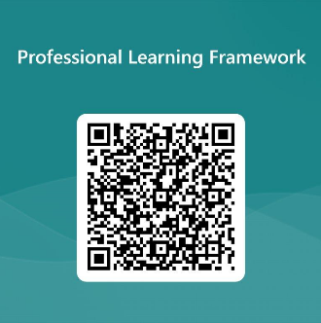
We value your feedback
From now until March 2024 we will be taking feedback on these resources so that we can make changes in advance of a formal launch of the Professional Learning Framework in June 2024
Your feedback could help us improve this resource
Please complete this short form, using the link or QR code, to let us know what you thought of it and any suggestions you have on how it could be improved
LINK: https://forms.office.com/e/b5PCpJJJ3P

Slide 20
For Scotland's learners, with Scotland's educators
Do luchd-ionnsachaidh na h-Alba, le luchd-foghlaim Alba
Education Scotland
Denholm House
Almondvale Business Park
Almondvale Way
Livingston EH54 6GA
T +44 (0)131 244 5000
E enquiries@educationscotland.gsi.gov.uk

