Slide 1
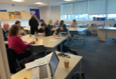
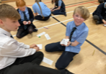
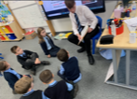
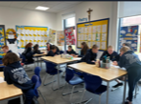
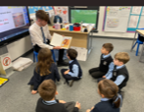
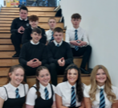
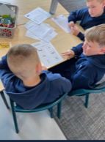
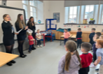
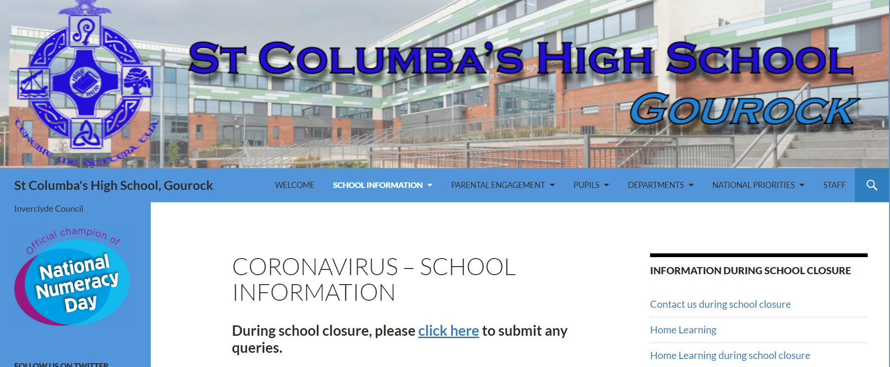
PRIMARY TRANSITION
Primary 6
Enhanced transition meetings with partners and Guidance staff begin.
School visits and meetings with ICOS established. Regular opportunities to visit St Columba’s and meet with supporting staff.
Lessons in Primary, delivered by secondary colleagues across a variety of subjects.
Cluster numeracy and literacy work, including moderation.
Family learning opportunities through STEM event.
P1-5
Primary 1-5
Visits by Literacy Leaders and visiting staff to engage in lessons around reading and literacy.
Families invited to STEM events.
Sports Leaders supporting at sports day.
Continued moderation events around literacy and numeracy.
P6
Primary 7
Full programme of transition events in place, including further opportunities for enhanced transition for those identified by primary colleagues.
Open Evening held in November for all prospective p7 and their parents.
STEM events and cluster work around literacy and numeracy including a full programme of input from Maths and English
Transition website and materials distributed aim to address pupil and parent questions. Website contains an interactive map of the school.
Induction visits in June to prepare pupils for the transition.
Nursery
Visits by Literacy Leaders to engage in reading activities.
STEM visits from Science and Technology to work alongside nursery children.
Visits by Language leaders and Modern Languages staff to introduce Modern foreign languages.
Early Years
P7

