Slide 1




1- Building strong Outcomes – Impact & Measures
2- School Improvement Planning,
Self-evaluation
& P.E.F.
Notes:
Discuss a case study and contribute towards the identification of expected impact of PEF interventions

Slide 2
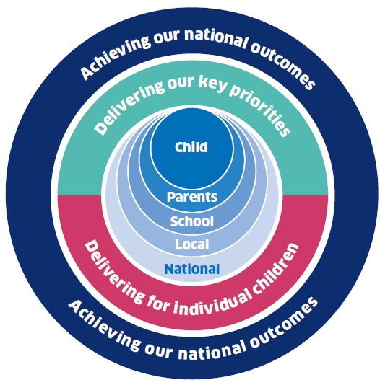
Aim –
Participants acquire the skills to clearly define outcomes in order to measure improvement and to raise attainment and are confident about the relationship between the positioning of PEF within whole school priorities.
Excellence through raising attainment: ensuring that every child achieves the highest standards in literacy and numeracy and the right range of skills, qualifications and achievements to allow them to succeed; and
Achieving equity: ensuring every child has the same opportunity to succeed. The Scottish Attainment Challenge will help to focus our efforts and deliver this ambition.
“Be rigorous about the gaps to be closed and pursue relentlessly “ closing the gap” and “raising the bar simultaneously” Improving Schools in Scotland: An OECD Perspective 2015

Slide 3
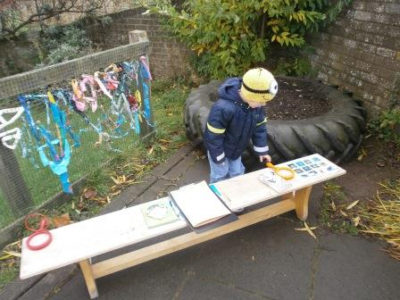
Case Study

Slide 4



Anywhere Primary School
Aequitas Pateremini
Roll : 200
SIMD 1&2 : 20%
FME : 28 pupil
PEF : £33,600
Transforming Lives Through Learning

Slide 5
The Big Picture
Standards & Quality Report
Highlighting Improvement Priorities
School Improvement Plans 2017/18
Focus on 3 or 4 for 2017/18
Literacy
Writing
Professional Learning
Opportunities for Leadership
Family Learning
Engaging parents in supporting the curriculum
Aequitas Pateremini
2.4
2.5
3.2
1.2
Transforming Lives Through Learning

Slide 6
The Improvement Process
1.1
Self-evaluation
1.5
3.2
Identify the gap
Improvement Planning
Interventions
1.3
Transforming Lives Through Learning

Slide 7
Identify the “gap”
Aequitas Pateremini
What are the gaps in your school / year groups / class and across the cluster?
What are the barriers associated with these gaps ?
What is going to change in the class / school / cluster to close the gap ?
Think about a 3 year plan – what will the difference be by 2020?
What is the rationale for your interventions?
A few targeted interventions within and beyond the classroom
Transforming Lives Through Learning

Slide 8
Where is the biggest poverty attainment gap?
Aequitas Pateremini
‘Data tells me that as a school, writing is the main area for improvement and the biggest dip in attainment appears at P4, however when I look at the performance of SIMD 1&2 pupils throughout the stages data suggests the biggest ‘gap’ actually begins in P3.’
2.3
I will therefore apply a key proportion of PEF with focus on writing interventions in P3.
1.5
Transforming Lives Through Learning

Slide 9
Anywhere primary
Aequitas Pateremini
1.1
3.2
Target Group
77 70 81 80 69 58 73 70 67 57 72 66

Slide 10
PEF additionality
S.I.P
2.2
SIMD 1&2 / Identified Group
Priorities
Attainment & Experiences in Writing
2.3
2.4
2. Staff leadership opportunities – Capacity building
1.1
1.4
3. Family learning to support literacy curriculum
2.5
Transforming Lives Through Learning

Slide 11
PEF additionality
Aequitas Pateremini
2.2
Identify resources for implementing in P3
Source Professional Learning opportunities
1.2
Consider support staff to assist progress
1.4
1.5
Consider availability of resources / opportunities for families to engage
2.5
Transforming Lives Through Learning

Slide 12
Outcome statement
Aequitas Pateremini
Improve the attainment & experience of the identified group of learners in writing during P3
Transforming Lives Through Learning

Slide 13
Interventions
Aequitas Pateremini
2.3
Develop writing Learning & Teaching strategies in P3 with supporting assessments which will demonstrate progress
3.2
Provide training for staff involved with the target group in P3 to support literacy and writing in particular
2.4
1.2
Help identify appropriate CPD literacy activities for staff
2.7
Provide Family Support Worker to engage with target families to encourage writing at home
1.4
Transforming Lives Through Learning

Slide 14
Expected Impact
Aequitas Pateremini
Develop Learning & Teaching strategies for Writing in P3 | Increased pupil engagement (75-87% by June ’18) and enjoyment in Writing activities (45%-62% by June ’18, 87% by June ’19) Identified resources for implementation in P3 by Dec’17 Supporting assessments demonstrating progress – Spring ‘18
Transforming Lives Through Learning

Slide 15
Aequitas Pateremini
Provide Professional Learning for staff involved with the target group in P3 to support literacy and writing in particular | Sourced PL opportunities leading to the training in pedagogy for staff 100% by June ‘18. Calendar of In-House CPD opportunities Oct ‘17 Understanding of standards between pupil, teacher and families of identified group by Spring ‘18 More engaging opportunities for learners by Nov’17 1:1 support from learning assistants for identified group by October ‘17
Transforming Lives Through Learning

Slide 16
Aequitas Pateremini
Provide Family Support Worker to engage with target families to encourage writing at home | Improved confidence and motivation in writing in pupils from 40% to 60% by Jun’18, 75% by Jun’19, 90% by Jun’20 More frequent engagement with family Increased level of support in learning at home from 32% to 50% Jun’18, 75% Jun’19
Transforming Lives Through Learning

Slide 17
Measures
Aequitas Pateremini
Develop Learning & Teaching strategies for Writing in P3 | Teacher judgement Writing comprehension scores Pre/post pupil surveys Standardised assessments Class formative assessments Levels of staff engagement with CLPL
Transforming Lives Through Learning

Slide 18
Aequitas Pateremini
Provide Professional Learning for staff involved with the target group in P3 to support literacy and writing in particular | Relevant programme assessment measures. L&T working group minutes Pre/post evaluations on staff confidence and understanding Professional tracking meetings with learning assistant and class teacher
Transforming Lives Through Learning

Slide 19
Aequitas Pateremini
Provide Family Support Worker to engage with target families to encourage writing at home | Learner feedback Writing records Use of library resources Pre/post child and family survey Standardised assessment at P4 Levels of parental engagement Attendance & Late-coming data
Transforming Lives Through Learning

Slide 20
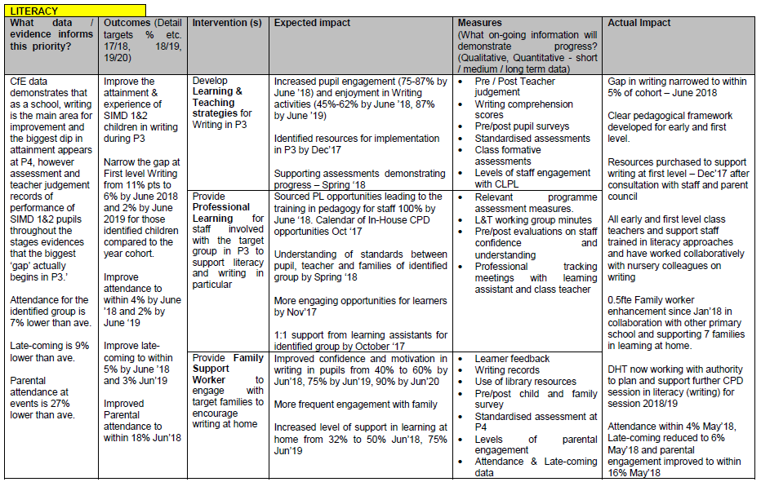

Slide 21
Interventions
Universal – will impact on all children eg Improving pedagogy / whole school literacy
Targeted – will impact on specific groups identified from self evaluation specifically data analysis
Transforming Lives Through Learning

Slide 22
Five key indicators in identifying and closing the poverty gap
Attainment
Attendance
Inclusion / Exclusion
Engagement - in every lesson and beyond school
Participation
Transforming Lives Through Learning
Transforming Lives Through Learning

Slide 23

Improvement Planning
All staff should contribute to the collection and collation of data at class, year group and school, level year on year.
Set and agree the targets to be achieved over the next three years across the five key indicators as appropriate.
Transforming Lives Through Learning

Slide 25

Planning for PEF
Be bold and courageous
Be ambitious
Believe in your ability to make a difference
Work together to make a difference
Get to grip with your ‘gaps’ and close them!

Slide 26
School Improvement Planning,
Self Evaluation
& P.E.F.

