Slide 1
Action Research
Jill Nixon, DEPS
June 10th 2016

Slide 2
What is Action Research?
Action research is a systematic study that combines action and reflection with the intention of improving practice (Ebbutt,1985)
Action research is an approach to improving education by changing it and learning from the consequences of changes (Kemmis and Mctaggart,1992)

Slide 3
Action Research
Involves individuals or groups researching some aspect of their own practice or environment in order to bring about improvement
It can support progress and deeper reflection and understanding at both practitioner and whole-provision levels

Slide 4
Collaborative Action Research (CAR) 3 step model
What are we trying to accomplish?
Clear vision of aims
What results would you like to get and how would you like things to be different
How will we know that a change is an improvement?
Agree what data you need to collect to measure whether there has been an improvement
What change can we then make that will result in improvement?
What do you and your team think is a good idea?
What evidence do you have from elsewhere about what is most likely to work?
What have other people done that you could try?
In order to establish
What works?
What needs to be changed now?
Notes:
Sometimes referred to as collaborative enquiry
CAR is a framework that can draw on a range of methods and accords well with some of the features of highly effective practice in HGIOS 4, the GTCS standards (practitioner enquiry) and Education Scotland
It is recommended by Education Scotland as a core element for working to improve education services
3 key questions to support the delivery of interventions
Each trio of steps can be viewed as one of a series- a single stage in a progressive cycle of change in which these three questions are repeatedly asked and for each revolution, reviewed in order to establish……

Slide 5
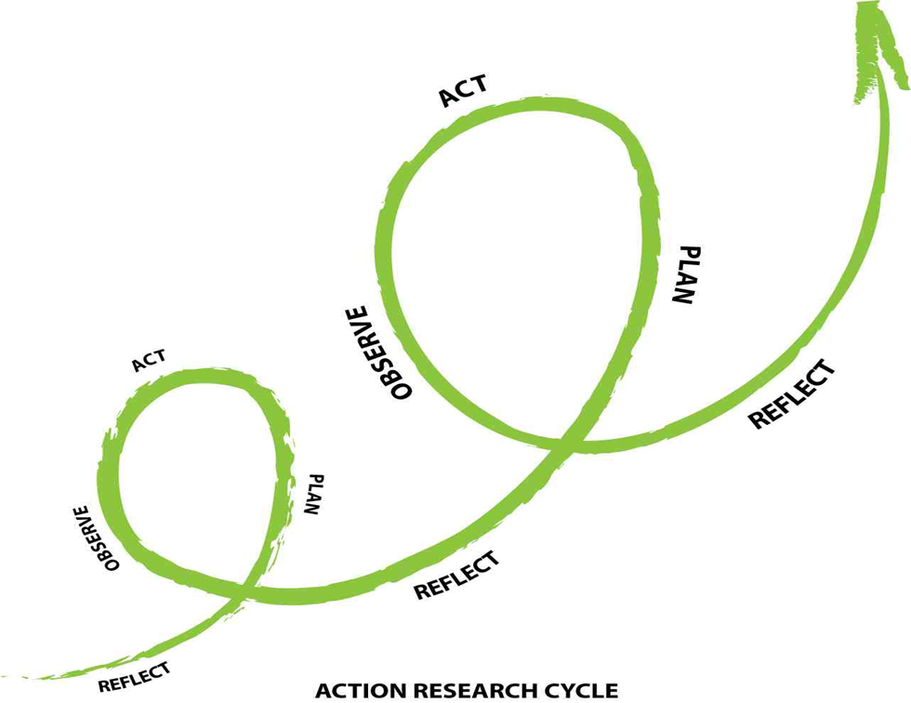

Slide 6
Six Key Questions (Education Scotland, 2015)
Is there an agreed AIM that is understood by everyone in the system?
Are we using all our knowledge to find the RIGHT CHANGES and prioritise those likely to have the biggest impact in relation to our aim?
Does everyone UNDERSTAND THE METHODS we will use to improve the system?
Can we MEASURE and report progress on our improvement aim?
Are PEOPLE and RESOURCES deployed in the best possible way to support improvement?
Do we have clear plans for INNOVATING, TESTING, IMPLEMENTING and SHARING LEARNING so we can translate and apply the improvement more widely?
Notes:
Six key questions that are crucial in the delivery of any change programme

Slide 7
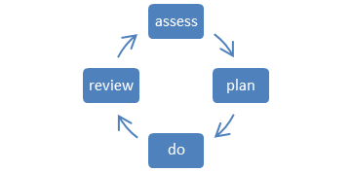
Collaborative Action Research
PDSA (Plan, Do, Study, Act)
Plan- the change to be tested or implemented
Do- carry out the test or change
Study- data before and after the change and reflect on what was learned
Act- plan the next change cycle or full implementation
APDR (Assess, Plan, Do, Review
Assess- in light of the existing data, what test or change are we going to implement and why
Plan- plan for carrying out the test or change
Do- carry out the test or change
Review- review the outcome in light of the main aim/question and begin next cycle
plan
do
study
act
Notes:
Two models of improvement methodology which provide a structure
Both are cyclical frameworks which support the process of improvement
PDSA is the framework used within improvement methodology- ‘small tests of change’. Data driven
APDR maybe more intuitive to educators- what we do on a day to day basis when we plan learning opportunities. GTCS practitioner enquiry. Triangulation of data- qualitative data (observations, discussion, professional judgement)
Both aim to start small, with the possibility of upscaling the improvements (small group> nursery)
I would argue that both can be boiled down to a straightforward cycle of identifying a problem, planning an intervention, implementing the intervention and evaluating the outcome

Slide 8
Box 1: Assess, Plan, Do, Review
Assess
What are our main questions/main aim and why?
What data/knowledge do we have and what does it tell us? (data gathered in school, research evidence e.g. Sutton Trust)
What else do we need to find out?
Plan
What is the intended outcome?
What sources of evidence will we gather in order to measure impact?
How do we plan to address the identified need – who, what, why, where, when, how?
Does everyone know what their role is?
Do
Implementation of the plan (amendments made as necessary)
Review
What happened during implementation?
What do all the sources of evidence gathered tell us about impact? (triangulation)
What do we need to do next (ongoing assess, plan, do, review cycle)?

Slide 9
Box 2: Plan, Do, Study, Act
Plan
Describe your first (or next) test of change: - what are we trying to accomplish?
What cycle number is this? Who, when, where?
List the tasks needed to set up this test of change - how will we do it?
Predict what will happen when the test is carried out – what do we think will happen?
What measures will help us to determine if our prediction has succeeded?
Do
What happened when you ran the test? Describe this.
Study
Describe the measured results - how do they compare to the prediction?
Act
What modifications will be made to the plan for the next cycle?

Slide 10
Task
Papers of different sorts of action research given to groups to read/discuss and put into one of the frameworks

Slide 11
Key Documents and websites

