Slide 1
Children/young people’s rights and equalities Our School : Our Rights
Notes:
Feel free to delete children or young people as appropriate

Slide 2
Safer Spaces
This is a safe space. It is important that we respect each other’s opinions and be mindful of our comments.
Notes:
All levels (amend language as needed)
To begin with, learners should be reminded of the importance of safe spaces and allowing everyone to participate. A safe space is created when everyone feels respected, that they can contribute, and opinions are listened to and acknowledged.
When establishing a safe space, it’s important to acknowledge that spaces such as classrooms and different groups can feel more unsafe for some learners, if they have experienced prejudice or discrimination. As such, to help create a safe space to have these discussions it’s important that we are respectful of our classmates. What does respect look like?
Listen and respond carefully to ideas and comments
Be aware and respectful of others’ backgrounds and experiences
Be mindful of sharing personal experiences – sharing sensitive, personal information in a group can mean that you lose control of that information, and it ends up shared with people that you don’t want it to be shared with
Support – if anything discussed today makes you feel uncomfortable, you can pop outside the classroom and the teacher will come and check on you – if you need support you can speak to an adult you trust in school, or you can use one of the numbers provided at the end of the slides.

Slide 3
“You don’t have to like me, agree with me or enjoy the same things I do, but you do have to respect me”.
Notes:
All levels

Slide 4
Ice Breaker
Turn to the person to your left. You have one minute to find out the answers to the following questions:
If there were 25 hours in a day, how would you spend your extra hour?
Why do you think children’s rights and equalities is important?
Notes:
All levels
OPTIONAL : Learners have two minutes total for this task (one minute each), both learners should answer the questions.

Slide 5
UN Rights of the child
The Convention has 54 ‘articles’ (Rights) these are rights that all children everywhere in the world are entitled to. It also explains how adults and governments must work together to make sure all children can enjoy all their rights.
Notes:
All levels
Explore with learners some human rights – what rights do they have? Ask the learners to share ideas.
You can explore some fundamental human rights such as the right to an education, the right to a religion, the right to a name and the right to freedom of expression and identity.

Slide 6
Insert setting name
Notes:
All levels
Settings may wish to use the following slides to insert information regards the settings vision, values and ethos. What does it mean to be a member of this particular school community?
Learners can discuss and put ideas on a post-it or jamboard.

Slide 7
Our vision, values and ethos
Please use this space to insert your settings vision, values and ethos.
Notes:
All levels

Slide 8
What is fairness?
Notes:
Early to second level:
Ask the learners to sit in pairs and talk about how they are similar to their partner. Then in the whole class talk about ways that people are different. This could include eye or hair colour, interests, favourite foods, etc.
- Then explore how it might feel to not be included because of these differences? Is this fair?
- Ask the learners what they think ‘fairness’ means. You may need to prompt them. E.g. fairness means that people get the same chances to try new things, have the same rights, etc. Then ask them to draw a picture that shows unfairness. This may be a situation where someone is not included or treated differently.
Third level to senior phase:
Ask learners to share their understanding of the word ‘fairness’
Then prompt thinking – does fairness mean giving everybody the same support and opportunities? Does each individual have the same needs or requirements?
Explore the concept of fairness being about allowing people to have the same access to opportunities. This may mean making adjustments for people who perhaps don’t have the same resources, or who face barriers to accessing these opportunities. For example, providing a sign language interpreter, translator, ensuring that there is wheelchair access, etc.
Fairness does not mean giving everybody the same treatment. Some people have more privilege than others, giving them an advantage in different situations. It’s important when thinking about what is ‘fair’ to consider advantages that people have or don’t have.

Slide 9
What is bullying?
Notes:
Second level to senior phase
Explore concept of bullying. What kind of behaviours are bullying behaviours? What is the impact of bullying?

Slide 10
What is bullying continued
Bullying is both behaviour and impact; what someone does and the impact it has on the other person’s capacity to feel in control of themselves.
Bullying behaviour can harm people physically or emotionally and, although the actual behaviour might not be repeated, the threat that it might can be sustained over time, typically by actions: looks, messages, confrontations, physical interventions, or the fear of these.
Notes:
Second level to senior phase
Read out definition

Slide 11
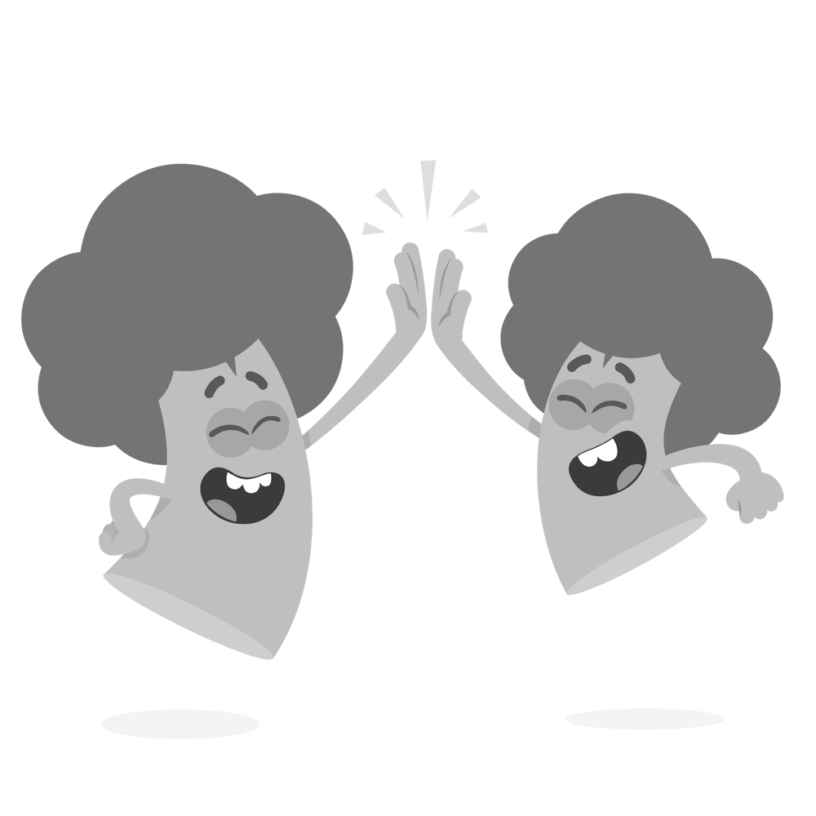
Being kind
Notes:
Early - first level
Ask the children to think of examples of how they could show kindness to others, and how others might show kindness to them. This might include, sharing toys, saying thank you when someone helps you, helping others with a task they are struggling with, remembering someone’s favourite snack and bringing it to them.
Explain that not everybody has the same things as others, and some people don’t have as many toys, clothes or food. A kind action is to share what you have with others.
You can illustrate kindness through stories such as:
ABCs of kindness
Have you filled your bucket today
Be Kind
https://parents.actionforchildren.org.uk/feelings-behaviour/wellbeing-activities/activities-teaching-kindness/

Slide 12
What is discrimination?
Notes:
For first and second level:
https://www.bbc.co.uk/bitesize/articles/z8yjdp3#zfnq7yc
Show BBC bitesize video and invite reflections
For third level – senior phase:
https://www.youtube.com/watch?v=T9jBRCJa_5Q

Slide 13
Definition of discrimination
Societal inequality
Mass discrimination, violence, economic and political inequality
Violence (physical and non-physical),
individual hate crimes
Harmful behaviour
Discrimination
Denying services, jobs, rights
Avoidance
Avoiding interaction with stereotyped groups
Antilocution
Stereotypes, bias, hate speech, propaganda
Notes:
Third level to senior phase:
Provide definition of discrimination and explain that it relates specifically to equalities – that some people are treated differently based on their race, ethnicity, gender, disability, sexual orientation, class or religion for example.
Introduce the Allports Scale on the slide. Explain that Gordon Allport, who was an American psychologist, created this image after the second world war to explain how the language we use and the stereotypes we hold can lead to avoidance, discrimination and then violence. ‘Antilocution’ is the word Gordon Allport used to define hate speech and propaganda, but it can refer to bias and stereotypes too.
What does discrimination look like? Ask learners to reflect on the video. It may be subtle (not inviting people to events), to overt (purposefully excluding people, not allowing access to service, not making events accessible for wheelchair users, not having an interpreter where needed, denying jobs or education). Discrimination can lead to even more harmful behaviours. These harmful behaviours are not the same as bullying, as they are using existing inequalities as a way to cause further harm and to deny rights to people facing these inequalities
Allowing discrimination to occur means that we are accepting that these people should have less rights which contributes to societal inequality and violence

Slide 14
Diversity
Linguistic
Religious
Ethnic/Cultural/Racial
Socioeconomic
Disability
Gender/Sex
Neurodiversity
Sexual Orientation
Age
Family
Notes:
Third level to senior phase
Put learners into pairs and ask them to think of their definition of the word diversity and write it down. Invite pairs to share their definition with the class.
Explain that diversity is a concept that has lots of definitions. For example, it can mean the act of making sure people of different backgrounds, characteristics and identities are included and represented equally. Diversity can also be the range of human differences, backgrounds, experiences, cultural practices, ethnic origins, sexual orientations and different people that make up our own varied culture.
Show the image on the PowerPoint and invite questions about any of the identities listed. Explain that most people will have more than one of the characteristics above, and their experiences will be shaped by these overlapping identities. This is called intersectionality.
Ask the learners why diversity is important? What would happen if we only spent time with people who had very similar experiences and backgrounds to us?

Slide 15
The Equality Act (2010)
=
Notes:
Third level to senior phase
The Equality Act provides a legal framework to protect the rights of individuals and advance equality of opportunity for all.

Slide 16
The Equality Act (2010) continued
Combines and replaces previous legislation (such as the Race Relations Act 1976 and the Disability Discrimination Act 1995). The Equality Act (2010) covers:
age
disability
gender reassignment
sex
race
religion or belief
sexual orientation
marriage and civil partnership
pregnancy and maternity
These are called ‘protected characteristics’. The Act extends some protections to characteristics that were not previously covered, and also strengthens particular aspects of equality law
Notes:
Third level to senior phase:
There are 9 protected characteristics listed in the Equality Act. This means that legally you should not be discriminated against on the basis of these characteristics.
The Equality Act was created in 2010, and some say that these protected characteristics should be updated to include the ones we saw on the diversity slide and to update the language. For example, gender reassignment is not really a term used now – those who identify as transgender or non-binary will not necessarily undergo the process of physical gender reassignment (e.g. hormone treatment, surgery), although are still at increased risk of discrimination.
Ask learners to discuss the questions from the video in pairs:
- What do you think of this law?
- Has anyone been left out from the protected characteristics?
- Do you think the language could be more inclusive?
- How would you feel if you were being treated unfairly?
- What more could be done to prevent discrimination in the UK and wider?
Additional resource/task: Exploring privilege. Who is at more risk of discrimination or has less opportunities/equality? This video from BBC bitesize is a good introduction to the concept:
https://www.bbc.co.uk/bitesize/articles/zrvkbqt

Slide 17
Support and accessibility
A list of support services will be provided at the end of the survey, you can also speak to a trusted adult in your school if you have experienced any of the behaviours talked about today
The survey is anonymous. No identifying information will be collected and results will only be used to help inform the development of an equalities policy
You can save and come back to your survey when signed into Google
Please try to answer all questions, but if you do not feel comfortable with any of the questions you can leave them out
Notes:
Outline school/setting child protection procedures and confidentiality if a disclosure is made.

Slide 18
Learner Survey
Notes:
At this point you would ask learners to complete the survey or complete together as a class if you choose to use the practitioner/learner led version

