Slide 1


Na Seumasaich – The Jacobites
Learning about Gaelic Language and Culture Resource
Lesson 4 – The Prince’s Campaign and Saying where you live in Gaelic.
For Scotland's learners, with Scotland's educators

Slide 2
Na Seumasaich – Lesson 4
In this Learning about Gaelic Language and Culture resource lesson we will learn:
about the Battle of Prestonpans
about a famous Jacobite woman, Jean Camerson of Glendessary
to say where we stay/live in Gaelic
to ask someone where they stay/live in Gaelic
to understand how to say this in contexts
about some Gaelic placenames for towns and areas
about the clan system in the Highlands of Scotland
to create short texts about ourselves and others in Gaelic

Slide 3
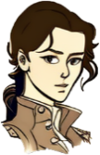
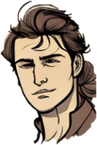
Màiri and Calum
Fàilte air ais a Chaluim
Welcome back.
Tapadh leat a Mhàiri
Càit a bheil thu a’ fuireach?
Tha mi a’ fuireach ann an Loch Abar

Slide 4
Màiri and Calum 2
So the Prince has landed in Glenfinnan.
Yes, he marched east through the Corriyairack Pass towards Perth. There more people joined him. They then took over Falkirk.
Why did the British Government not stop him?
Sir John Cope, the head of the British army, had taken his troops to Inverness and had let the South undefended.
Oh dear! That was a bit silly!

Slide 5
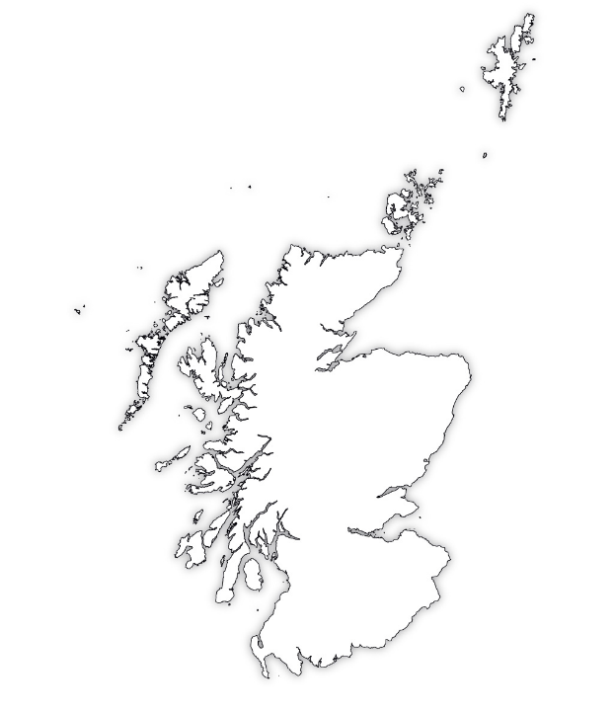




Càit an deach na Seumasach? Where did the Jacobites go?
The Prince raised his army first in Glenfinnan (Gleann Fhionnain) in Lochaber (Loch Abair). The then marched east through the Coireyirack Pass (Coire Ghearraig), where there was a military road. Follow the red line on the map.
They raised more soldiers in Perth (Peairt) then headed to Falkirk (An Eaglais Bhreac) before entering Edinburgh (Dùn Èideann).
They had managed to avoid the British Army who had gone to Inverness (Inbhir Nis) and had to jump boats in Aberdeen (Obar Dheathain) to sail South to catch the Prince. Follow the blue line on the map.
They would finally meet at Prestonpans. (Baile an t-Sagairt) in a famous battle.
Inbhir Nis
Obar Dheathain
Coire Ghearraig
Gleann Fhionnain
Peairt
Baile an t-Sagairt
An Eaglais
Bhreac
Creative Commons — Attribution-ShareAlike 3.0 Unported — CC BY-SA 3.0 MrPenguin20

Slide 6
Càit an deach na Seumasach? Where did the Jacobites go? - Questions
Q1 – Use a blank map of Scotland and mark the places the Prince and his Jacobite Army went. Write the names in Gaelic and English.
Q2 – Now add on the places where the British Army went using a different colour.
Q3 – Now add the place that you live and find out the Gaelic for it as well.

Slide 7

Màiri and Calum 3
What happened when they reached Edinburgh?
The Prince entered Edinburgh with 2400 men. His father was declared King, but they did not take Edinburgh Castle.
What about Sir John Cope?
He led his troops to an embarrassing defeat at Prestonpans near Edinburgh. The Highland Charge and inexperienced British Troops meant the Jacobites won in 30 minutes!
Wow! That is embarrassing. Next stop, England!

Slide 8
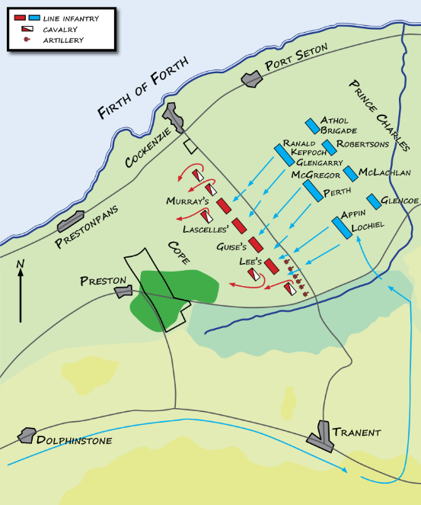
The Battle of Prestonpans
On the 21st of September, the first major battle of the 1745 Rebellion took place at Prestonpans to the east of Edinburgh.
Sir John Cope led the British troops. He was very confident his 2000 troops would beat the poorly armed Jacobites. He positioned them in behind a piece of marshy ground to the South but the Jacobites found a way through to the East thanks to a local farmer in the early hours of the morning.
Despite an argument between Prince Charlie and his general George Murray, the Highland Charge again won the day. The British Dragoons fled in terror and between 300-500 British soldiers were killed, and 500-600 captured. 450 soldiers under Cope reached Berwick upon Tweed the next day.
CC BY-SA 3.0 - Hoodinski

Slide 9

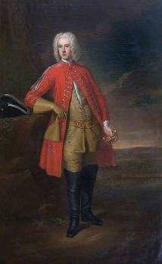
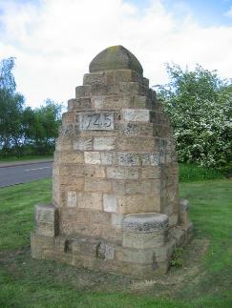
The Battle of Prestonpans
Questions
CC BY-SA 3.0 - Hoodinski
Q1 – What day did the Battle of Prestonpans happen?
Q2 – Why would Sir John Cope feel confident?
Q3 – What shows that not everything was good in the Jacobite camp?
Q4 – Many of the troops the Jacobites took prisoner were released – can you think why this might be?*
A - It would have been expensive to feed them!
B - The Jacobites felt sorry for them
C – They all agreed to fight for the Prince
CC BY-SA 2.0 – Renata Edge

Slide 10

Hey! Johnnie Cope!
Sir John Cope’s reputation never recovered from the loss at Prestonpans. A court-martial found him not guilty, and blamed a poor quality of soldier. However, the story of his defeat has become a legend. Mostly as he was the subject of a Scots language song called “Hey hey Johnnie Cope, Are ye waukin’ yet?” You could learn to sing the chorus of this song in Scots.
Hey! Johnnie Cope are ye waukin' yet?
Or are your drums a-beating yet?
If ye were waukin' I wad wait,
Tae gang tae the coals in the morning.
Hey Johnnie Cope (scotslanguage.com)
14 - Johnny Cope - YouTube
CC BY-SA 3.0 - Hoodinski

Slide 11
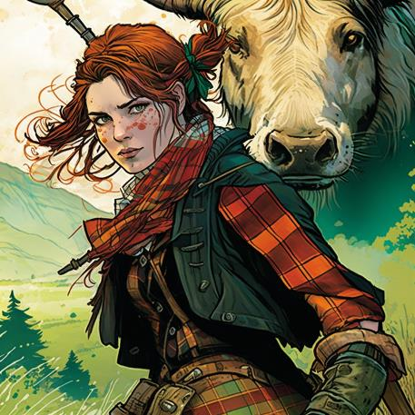
Jean Cameron of Glendessary
Wow! This woman looks cool! Cò i? Dè an t-ainm a th’ oirre?
Seo Sìne Chamshron. She is a one of the most famous Jacobite women, and she has a very interesting story.

Slide 12
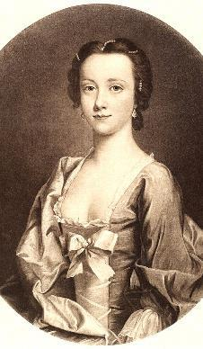
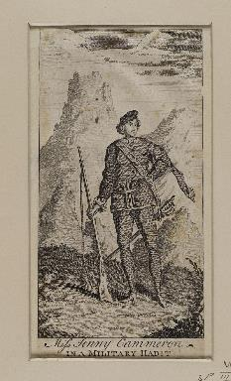
Jean Cameron of Glendessary 1
Tha mi a’ fuireach ann an Loch Abar
Jean Cameron was a member of the Clan Cameron. She looked after her brother’s land in Lochaber.
When Bonnie Prince Charlie landed at Glenfinnan, she raised over 200 men to go fight.
This was a scandal as many people did not believe a woman could do such things at the time.
The British press and the public spread nasty rumours that Jean travelled with the Prince, and that they were even in love. She was sometimes called “The First Lady of the Forty-Five” However, evidence suggests that Jean may never even have left home or even spoken to the Prince.
However, this didn’t stop Jean or Jenny as she also was known becoming an infamous character who even had the cheek to wear tartan trousers!
A British propaganda sheet showing “Jenny” as a soldier in trousers.

Slide 13
Jean Cameron of Glendessary 1
Questions
Tha mi a’ fuireach ann an Loch Abar
How many men did Jean Cameron raise for the Prince?
Why was this a scandal at the time?
Name at least two rumours that were made up about Jean Cameron.
A British propaganda sheet showing “Jenny” as a soldier in trousers.

Slide 14
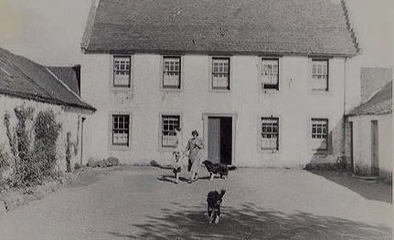
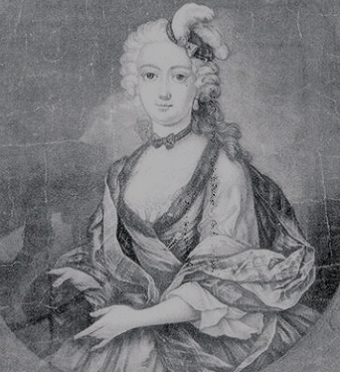
Jean Cameron of Glendessary 2
In the years after the ‘45 rebellion, with the Highlands raided and under army rule, Jean felt sad and left to start a new life in the Lowlands.
Jean made her home at farm called Blacklaw House where the town of East Kilbride (Cille Bhrìghde an Ear) is built today. Many Jacobites and other Highlanders would visit her there. It became known as Mount Cameron.
Even though the house was demolished in 1958, this area is still called Mount Cameron after her and many of the streets around it are named after areas of Lochaber.
There is a cairn and a chestnut tree marking her grave on a street called Glen Dessary. The local Mount Cameron Primary School has a Gaelic medium unit. Many of the children receive all their education in Gaelic, the language Jean would have spoken.
Tha mi a’ fuireach ann an Cille Bhrìghde an Ear
Photo of Blacklaw House, East Kilbride from Old Photographs, Bill Niven, 2016

Slide 15
Jean Cameron of Glendessary 2
Questions
Why did Jean move to the Lowlands?
Where did she move to, and what is it called today?
What marks the place where she is buried?
What other special connection does the area have to Jean to this day?
Tha mi a’ fuireach ann an Cille Bhrìghde an Ear
Photo of Blacklaw House, East Kilbride from Old Photographs, Bill Niven, 2016

Slide 16
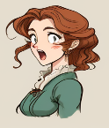
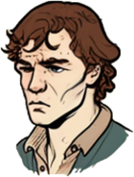
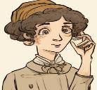
How to talk about where you are stay in Gaelic.
Càit a bheil sibh a’ fuireach?
To say I stay in Gaelic, you say Tha mi a’ fuireach… you then have to use ann an or ann am or anns depending on how the placename begins.
This is like how you have used à or às before, depending on how the place begins
To ask someone where they are from you, you ask
Càit a bheil thu a’ fuireach?
Or if they are older or there is more than one
Càit a bheil sibh a’ fuireach?
Tha mi a’ fuireach ann an Loch Abar
Tha mi a’ fuireach ann am Peairt
Tha mi a’ fuireach anns an Eilean Sgitheanach
Tha mi a’ fuireach anns a’ Ghearasdan

Slide 17
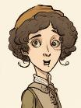
Saying where we stay in Gaelic
Why are there three different ways to say “in?
It’s all to do with how the placename starts.
In Gaelic we don’t say where we live we say where we stay
The Gaelic for stay is Fuirich! It changes to a’ fuireach when we use to for an action.
Fuirich mionaid! means Wait a minute!
To say I stay. We say Tha mi a’ fuireach
To say I stay in we say one of the following
Tha mi a’ fuireach ann an…
Tha mi a’ fuireach ann am…
Tha mi a’ fuireach anns…
A little like with à and às for “from”?
Exactly. We use ann an for almost all placenames but ann am for words beginning B, P, F or M.
And then we use “anns” with placenames that begin with A’, An, Am or Na, same way we use “às”

Slide 18
Scottish Placenames in Gaelic
In Lesson 2 we asked you to find out the Gaelic for these Scottish placenames. Now put the Gaelic names on a blank map of Scotland
Glasgow – Glaschu
Edinburgh – Dùn Èideann
Dundee – Dùn Deagh
Aberdeen – Obar Dheathain
Inverness – Inbhir Nis
Perth - Peairt
Stirling – Sruighlea
Paisley - Paislig
Fort William – An Gearasdan
Oban – An t-Òban
Dumfries – Dùn Phris
Orkney - Arcaibh
Shetland -Sealtainn
Elgin - Eilginn
Isle of Skye – An t-Eilean Sgitheanach
Isle of Lewis - Leòdhas
Notes:
You will need a blank map of Scotland – ask your teacher

Slide 19
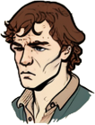
Placenames
You’ll see which places use ann an, which use ann am, and which use anns.
Tha mi a’ fuireach ann an…
Tha mi a’ fuireach ann am… (BPFM)
Tha mi a’ fuireach anns…
(An, An t-, A’, Am, Na)
Loch Abar - Lochaber
Cataibh - Sutherland
Earra-ghàidheal - Argyll
Glaschu - Glasgow
Arcaibh - Orkney
Dùn Èideann - Edinburgh
Comar nan Allt
- Cumbernauld
Cille Bhrìghde an Ear
– East Kilbride
Malaig - Mallaig
Muile - Mull
Fìobha - Fife
Fraochaidh - Freuchie
Peairt - Perth
Paislig - Paisley
Barraigh – Barra
Baile an t-Sagairt - Prestonpans
An Gearasdan (Fort William)
anns a’ Ghearasdan
An t-Eilean Sgitheanach (Skye)
anns an Eilean Sgitheanach
An Eaglais Bhreac (Falkirk)
anns an Eaglais Bhreac
Na Hearadh (Harris)
anns na Hearadh

Slide 20

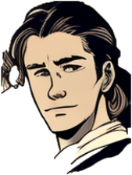
Task one – Asking and saying where we stay in Gaelic
Your teacher will ask you Càit a bheil thu a’ fuireach? Reply with Tha mi a’ fuireach ann an/ann am/anns (placename). Your teacher will give you the answer for your own local circumstance. See below for an example.
Caleb, Càit a bheil thu a’ fuireach?
Tha mi a’ fuireach ann an Obar Dheathain

Slide 21
Task Two – Sorting Exercise
Sort the following place names into the correct column according to whether they will use ann an, ann am or anns. Try and show how the ones after anns change.
Tha mi a’ fuireach ann an | Tha mi a’ fuireach ann am | Tha mi a’ fuireach anns
Sruighlea | Baile Iain | Am Ploc – a’ Phloc
Glaschu
Dùn Èideann
Dùn Deagh
An Eaglais Bhreac
Obar Dheathain
Baile Iain
Inbhir Nis
Peairt
An t-Eilean Sgitheanach
Muile
Leòdhas
Sruighlea
Paislig
Loch Abar
An Gearasdan
An t-Òban
Dùn Phris
Na Hearadh
Arcaibh
Sealtainn
Eilginn
Malaig
Am Ploc
Fìobha
Barraigh
Eirisgeigh
Gleann Fhionnain
Cille Bhrìghde an Ear

Slide 22

Task three - talking
Hai. Dè an t-ainm a th’ ort?
Go around the class and follow this example.
Greet each other with a simple Hai or Halò
Ask each other your name using Dè an t-ainm a th’ ort?
Then ask each other where you live Càit a bheil thu a’ fuireach?
Halò
’S mise Calum MacLeòid.?
Càit a bheil thu a’ fuireach?
Tha mi a’ fuireach ann an Loch Abar.

Slide 23


Task four - writing
You are going to add to your two profiles – one for yourself, and one for a Highlander boy or girl from the time of the Jacobites.
Write a sentence in Gaelic stating your first name and surname.
Write a sentence in Gaelic stating where you are from.
Write a sentence in Gaelic stating your age.
Write a sentence in Gaelic stating where you stay.
Then do the same for your Highlander.
Example
’S mise Ruairidh Caimbeul
Tha mi à Sasainn. Tha mi ceithir deug.
Tha mi a’ fuireach ann an Obar Dheathain
’S mise Raheem Alim
Tha mi à Alba. Tha mi deich.
Tha mi a’ fuireach ann am Paislig
’S mise Iseabail Stiùbhart
Tha mi à Alba. Tha mi sia.
Tha mi a’ fuireach anns an Eilean Sgitheanach

Slide 24

Task five - talk
Halò. ’S mise Seumas. Tha mi a’ fuireach ann an Arcaibh.
Choose a town, island or area that you don’t live in
Go round the class and introduce yourself and then state where you stay.
Halò ’S mise Calum! Tha mi a’ fuireach ann am Fiobha.
Hai ’s mise Anna. Tha mi a’ fuireach anns a’ Ghearasdan.

Slide 25
Task six - Art
Draw a picture of Jean Cameron of Glendessary
Think about all the different stories about Jean Cameron of Glendessary
How will you draw her in your picture? Why? Be prepared to explain your answer.

Slide 26

For Scotland's learners, with Scotland's educators
Education Scotland
Denholm House
Almondvale Business Park
Almondvale Way
Livingston EH54 6GA
T +44 (0)131 244 5000
E enquiries@educationscotland.gsi.gov.uk

