Slide 1
Inclusion Wellbeing & Equalities Professional Learning Framework Active Listening Level – Informed
@ESInclusionTeam
For Scotland's learners, with Scotland's educators
Do luchd-ionnsachaidh na h-Alba, le luchd-foghlaim Alba
Notes:
Purpose of these Slides
Read title​
This professional learning is pitched at an informed level and suitable for anyone working with children and young people in an educational context.
How to use the slides:
To be used to facilitate professional learning in a group or whole-setting, or as a self-directed learning activity as an individual.
General Guidance
There is a requirement to cover all the slides.
Please do not change the provided slides.
Facilitators are welcome to add slides or activities relevant to your own setting, to support discussion and exploration of the topic. Facilitators will know their participants’ needs best.
Anyone who works in an educational setting can be a facilitator and use these slides.
It is important to establish a safe space which encourages respect and honesty to ensure that everyone is able to participate.

Slide 2
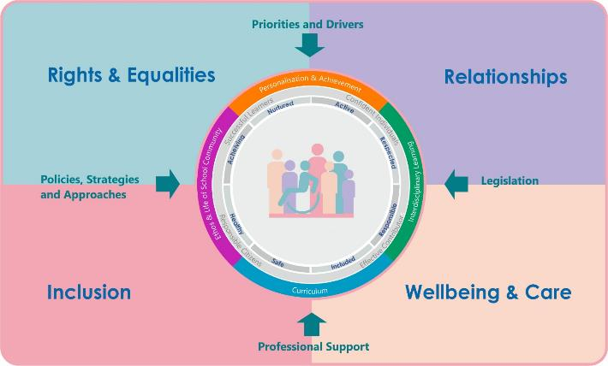
Interconnectivity
Notes:
All of the professional learning in the Framework fits into one of these four themes. The four themes are interconnected and interdependent.​
This activity forms part of the professional learning in the Relationships theme.

Slide 3
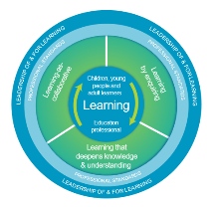
How to use this resource
These slides can be used to facilitate professional learning in a group or
whole-setting, or as a self-directed learning activity as an individual.
Facilitation notes are included at the bottom of each slide.
Please do not remove or change any of the slides included.
Facilitators are welcome to add slides or activities relevant to your own setting, to support discussion and exploration of the topic. Facilitators will know their participants’ needs best.
Anyone who works in an educational setting can be a facilitator and use these slides.
For reflection or discussion activities, it is important to establish a safe space which encourages respect and honesty to ensure that everyone is able to participate.
Notes:
Option to skip slide as these are instructions for facilitators only. No need to read to audience.

Slide 4
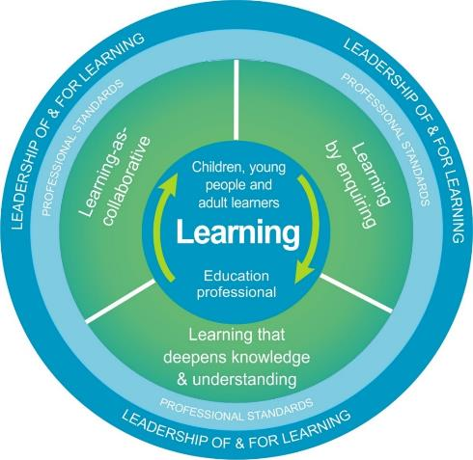
National Model for Professional Learning
This professional learning resource will support you to deepen your knowledge and understanding.
You will have the opportunity to consider how to take this learning forward on your own and with others.
The National Model of Professional Learning (education.gov.scot)
Notes:
This professional learning forms part of the national model for professional learning and is designed to help you gain more knowledge and have a deeper understanding of inclusion, wellbeing and equalities​​
On completion of this professional learning, you will be asked to consider what your next steps will be​​.
Please take some time to consider the reflection questions at the end

Slide 5
Welcome
This session provides an opportunity to:
To understand why active listening is important
To learn more about active listening skills to build trusting relationships and support regulation
To reflect on our own practice and explore our next steps in learning

Slide 6
Listening A skill for life!
1 min 40 sec
If viewing as a PDF please click this link to watch the film https://youtu.be/h5sMwHk63OQ?t=2
Video by www.scouts.org.uk
How well do you listen?

Slide 7
What is Active Listening?
‘Active listening is a communication skill that involves going beyond simply hearing the words that another person speaks but also seeking to understand the meaning and intent behind them. It requires being an active participant in the communication process.’ (Verywellmind)
It includes:
the non-verbal and verbal messages that a listener sends back to a speaker to show them that they are listening
the ability to reflect back to the speaker what has been received – not just the words but an understanding of what has been said

Slide 8
Why is active listening important?
It is vital for effective communication
It forces us to slow down communication (providing time to calm if needed)
It helps prevent miscommunication and misunderstandings
It can reduce stress and frustration
It can take the ‘heat’ out of situations that has, or could, escalate into conflict
It helps the person speaking feel seen, heard, valued, and validated
It fosters collaboration
It breaks down defensiveness and encourages connection

Slide 9
Non-Verbal and Verbal strategies for Listening and Responding

Slide 10
Fundamental elements of active listening
Giving your full attention and being fully present in the conversation
Being patient
Withholding judgment and advice
The skills explored in the following slides will be ineffective if these fundamental elements are not obvious to the speaker

Slide 11
What to look for? (non-verbal cues)
Their facial expressions, tone of voice, and gestures can tell you more about how they are feeling than the words they use:
are they smiling, are their arms crossed defensively, or are they rubbing their eyes as if they're tired or upset, or are their feet pointed towards the door
is their voice subdued or upbeat, high pitched or flat, quick or slow?
Body language doesn’t lie so pay attention to what they are saying with their non-verbal cues

Slide 12
What to do?
Use eye contact and body language to connect:
Eye contact is important in conveying your interest, but it should be used wisely:
Too much eye contact can be intimidating so remember to blink and break eye contact
When looking away, look to the side or up, looking down can look like disinterest
Keep your body language open
Avoid crossed arms or legs, this can come across as being ‘closed’ or defensive
Leaning forward, tilting your head, or resting your head on your hand can all convey your interest
Show empathy and that you’re listening through
Facial expressions, smiling, nodding your head, and making noises like “yes”, “uh huh”

Slide 13
What not to do?
✗
Don’t interrupt
Letting them speak will make it easier for you to understand their message
Interruptions can cause them to stop speaking or sidetrack the conversation
Don’t react physically, in a way that may convey judgement
They’ll be attuned to your body language and facial expressions
Don’t jump to conclusions
Don’t assume that you know what’s going to be said next
Don’t start planning what you are going to say next
Don’t look at your watch or fidget

Slide 14
What to say?
Active listening also includes replying verbally to the speaker to convey to them that you have listened to them and understood what they have said
The following 2 slides provide some strategies to try when responding verbally:
Each strategy includes:
the purpose of the strategy
what the strategy involves
a brief example

Slide 15
Verbal strategies to try
Purpose
To achieve it
Example
Ask questions
To get more information
Ask closed and open questions
Can you tell me what happened?
What did you do, or say, when Mrs C stopped you in the corridor?
Focus on emotions
Shows you’ve understood how they’ve felt
Helps them think about their feelings and more able to name them in the future
Reflect back accurately their feelings and emotions
So you were angry when you were stopped in the corridor by Mrs C
Reflect back
Conveys interest
Shows you are paying attention
Encourages them to keep talking
Restate the information they’ve told you in your own words – they know you have listened and understood what they’ve said
So you spoke to Mr A at the end of your last class about the homework and then you had to run to get to your next class on time

Slide 16
Verbal strategies to try
Purpose
To achieve it
Example
Encourage
Shows interest
Encourages them to keep talking, expand on their explanation or story
Use verbal and non-verbal prompts
Verbally use expressions such as: ‘Uh huh, yes, tell me more about that, and then what, ...
Non-verbally: nod, use eye contact, lean forward, …
Summarise
Review all that’s been said
Pulls together key points
Set the scene for a further discussion – potentially a restorative one
Restate main themes including feelings and actions
So let me just check that I’ve got everything and that I’ve got it right ….………
Clarify
Clarify what’s been said
Help them see other points of view
Ask more about anything that is vague, unclear, or is inaccurate
Restate inaccuracies, misconceptions, and explore further
Remind me, was that before or after Mrs C stopped you
Can I just check who said that?
Did you mean ….or ….?

Slide 17
Practice
Old habits are hard to break
Becoming an active listener requires a conscious effort
Active listening is for LIFE not just for education so you can practice anywhere (at work, at home, elsewhere) and with anyone (your partner, children, colleagues, or friends)!

Slide 18
If viewing as a PDF please click this link to watch the film https://www.youtube.com/watch?v=4VOubVB4CTU
Video from
Gordon Training International
2 min 58 sec

Slide 19
Reflection Time
Based on what you’ve learned about active listening, in the film:
What does Raymond do well?
What could he improve on?

Slide 20
Remember: when we actively listen -
We don’t:
check our phone, emails, ….
daydream, look out the window, ….
interrupt
jump to conclusions
focus on what we are going to say next instead of listening
We do:
give the speaker our full attention
show them we are interested
show that we are open to what is being said
show empathy
show patience

Slide 21
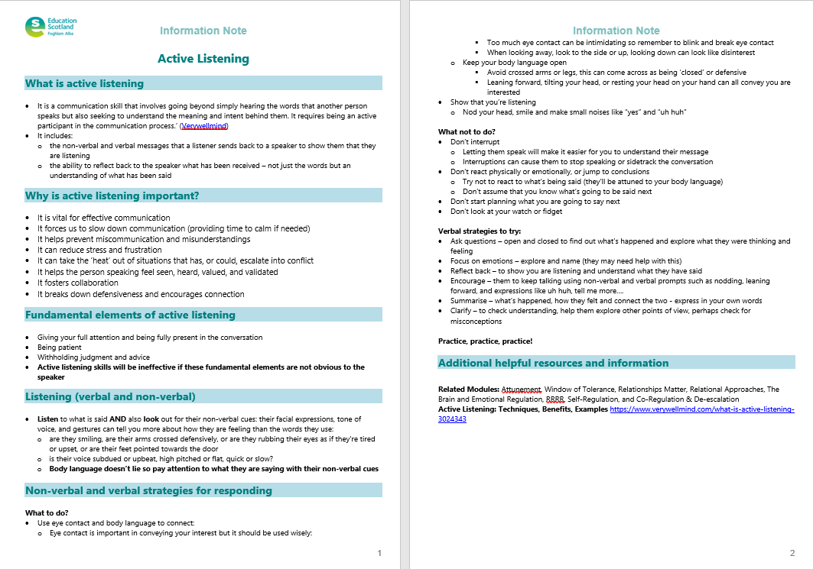
Resources and Information to help

Slide 22
Reflection
From what you have learned so far, think about:
How has this made you feel?
What has this made you think about?
What one action would you like to take forward?
How can you link what you plan to do with others in your setting?
How you will know that this learning has made a difference?
Notes:
Facilitation notes:
You can do this in groups...
Encourage educators to take this forward in an enquiry
Consider impact of the actions / learning

Slide 23
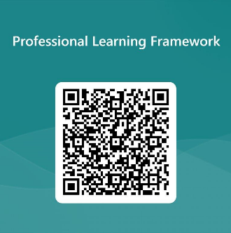
We value your feedback
From now until March 2024 we will be taking feedback on these resources so that we can make changes in advance of a formal launch of the Professional Learning Framework in June 2024
Your feedback could help us improve this resource
Please complete this short form, using the link or QR code, to let us know what you thought of it and any suggestions you have on how it could be improved
LINK: https://forms.office.com/e/b5PCpJJJ3P

Slide 24
For Scotland's learners, with Scotland's educators
Do luchd-ionnsachaidh na h-Alba, le luchd-foghlaim Alba
Education Scotland
Denholm House
Almondvale Business Park
Almondvale Way
Livingston EH54 6GA
T +44 (0)131 244 5000
E enquiries@educationscotland.gsi.gov.uk

