Slide 1







Inclusion Wellbeing & Equalities Professional Learning Framework
Regulate-Relate-Reason-Restore:
The Sequence of Engagement
Informed Level
@ESInclusionTeam
For Scotland's learners, with Scotland's educators
Do luchd-ionnsachaidh na h-Alba, le luchd-foghlaim Alba
Notes:
Purpose of these Slides
Read title​
This professional learning is pitched at an informed level and suitable for anyone working with children and young people in an educational context.
How to use the slides:
To be used to facilitate professional learning in a group or whole-setting, or as a self-directed learning activity as an individual.
General Guidance
There is a requirement to cover all the slides.
Please do not change the provided slides.
Facilitators are welcome to add slides or activities relevant to your own setting, to support discussion and exploration of the topic. Facilitators will know their participants’ needs best.
Anyone who works in an educational setting can be a facilitator and use these slides.
It is important to establish a safe space which encourages respect and honesty to ensure that everyone is able to participate.

Slide 2

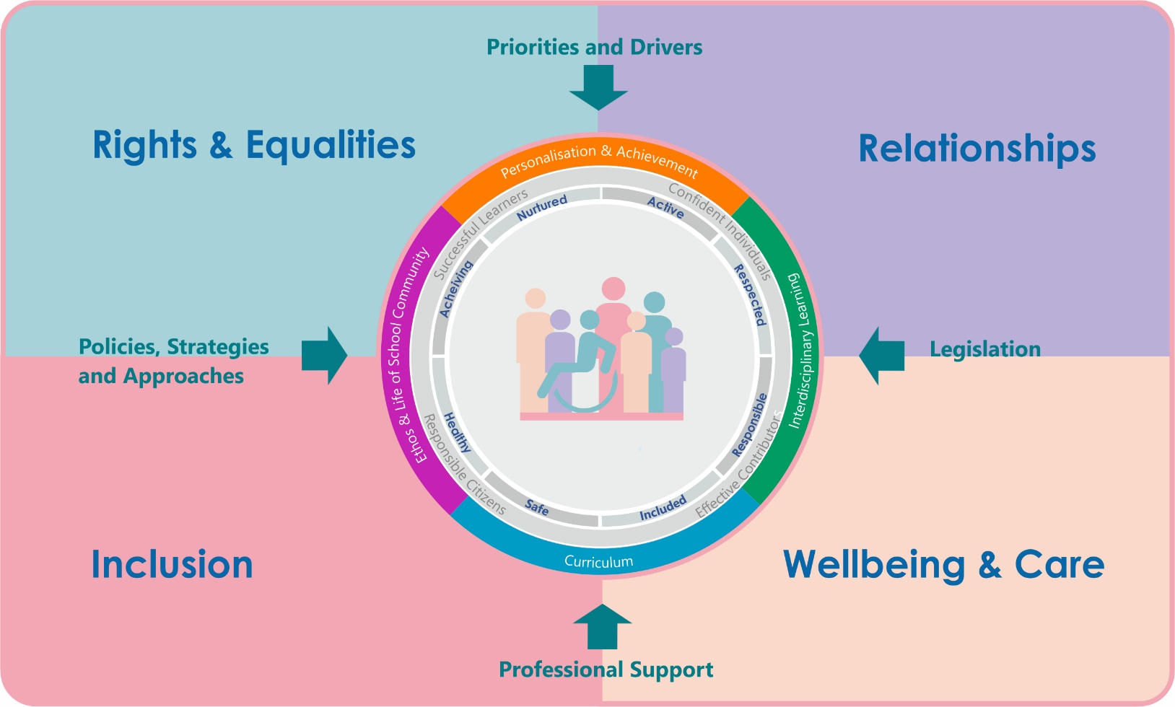





Interconnectivity
Notes:
All of the professional learning in the Framework fits into one of these four themes. The four themes are interconnected and interdependent.​
This activity forms part of the professional learning in the Relationship theme.

Slide 3
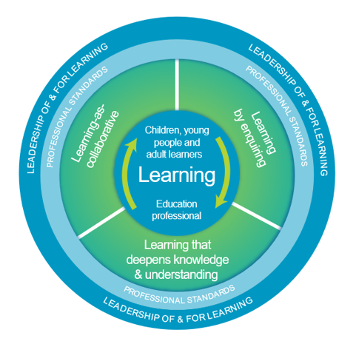
How to use this resource
These slides can be used to facilitate professional learning in a group or
whole-setting, or as a self-directed learning activity as an individual.
Facilitation notes are included at the bottom of each slide.
Please do not remove or change any of the slides included.
Facilitators are welcome to add slides or activities relevant to your own setting, to support discussion and exploration of the topic. Facilitators will know their participants’ needs best.
Anyone who works in an educational setting can be a facilitator and use these slides.
For reflection or discussion activities, it is important to establish a safe space which encourages respect and honesty to ensure that everyone is able to participate.
Notes:
Option to skip slide as these are instructions for facilitators only. No need to read to audience.

Slide 4
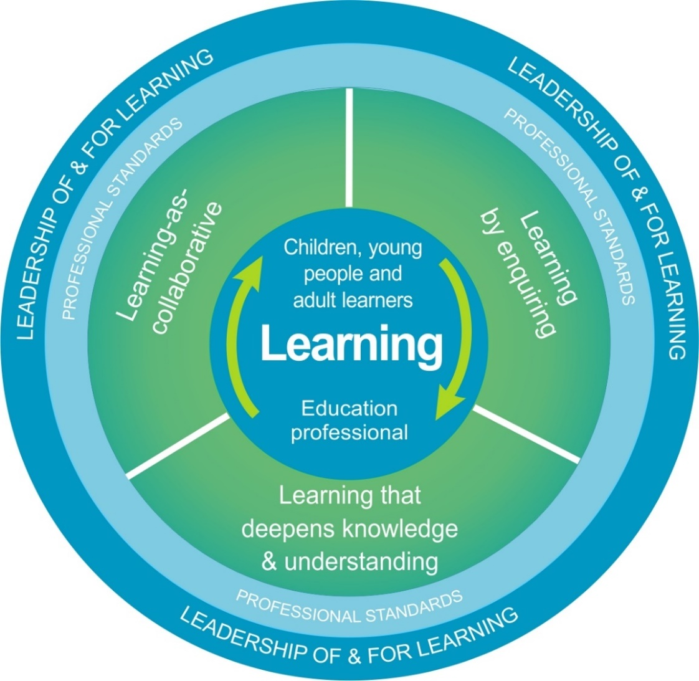
National Model for Professional Learning
This professional learning resource will support you to deepen your knowledge and understanding.
You will have the opportunity to consider how to take this learning forward on your own and with others.
The National Model of Professional Learning (education.gov.scot)
Notes:
This professional learning forms part of the national model for professional learning and is designed to help you gain more knowledge and have a deeper understanding of inclusion, wellbeing and equalities​​
On completion of this professional learning, you will be asked to consider what your next steps will be​​.
Please take some time to consider the reflection questions at the end

Slide 5
Welcome
This session provides an opportunity to:
To explore The Neurosequential Model & The Sequence of Engagement (RRR)
To consider a 4th R – Restore
To understand the ‘why’ and the ‘how’ behind Regulate, Relate, Reason and Restore
Notes:
Link activity to national model

Slide 6
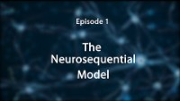
The Sequence of Engagement (The Neurosequential Model)
6:39 min
From
The Neurosequential Network
If viewing as a PDF please click this link to watch the film https://youtu.be/_3is_3XHKKs
Notes:
The Sequence of Engagement is based on Dr Bruce Perry’s Neurosequential Model in Education. It helps us understand dysregulated behaviour through the lens of ‘brain’ science and gives us a simple but effective approach for working with learners who struggle to regulate their emotions. The model helps us respond in a way that is non-judgemental and relationship based.
It is based around the 3 R’s: Regulate, Relate and Reason. Due to the way our brains work to get back to a regulated state we need to process through the R’s in this sequence.

Slide 7
The Sequence of Engagement – The 3 R’s plus 1
Regulate
Relate
Reason
Restore
Based on Bruce Perry’s 3 R’s: Reaching the Learning brain
and
Louise Bomber’s
4th R
Notes:
The Sequence of Engagement is based on Dr Bruce Perry’s Neurosequential Model in Education. It helps us understand dysregulated behaviour through the lens of ‘brain’ science and gives us a simple but effective approach for working with learners who struggle to regulate their emotions. The model helps us respond in a way that is non-judgemental and relationship based.
It is based around the 3 R’s: Regulate, Relate and Reason. Due to the way our brains work to get back to a regulated state we need to process through the R’s in this sequence.
In the context of Relational Practice Louise Bomber has added a fourth R: Restore. Why? When we are distressed or dysregulated we can say or do things that cause harm. When this happens it’s necessary to try to repair or restore the situation or relationship in order to return to normality and get on with learning.

Slide 8
1. Regulate (sensory brain) - through co-regulation
Why do we need to help a learner regulate?
They can’t learn or reflect when they are in fight/flight/freeze/fawn mode, so their psychological stress responses need to be calmed FIRST.
Stress brings on a pattern of psychological responses: hyper-arousal (jumpy, agitated, explosive) or hypo-arousal (depressed, withdrawn, frozen). See Window of Tolerance Module
How do we help a learner regulate?
Offer soothing but limited words to comfort and re-assure
Provide or create a safe space for them
Allow them time to process and recover
Use quiet tones
Make sure they’re comfortable (think sensory tolerances and physical needs )
Ensure they are with a trusted regulated adult
See Co-regulation & Calming Together
Notes:
Regulate Why?
Why? They can’t learn or reflect when they are in fight/flight/freeze/fawn mode, so their psychological stress responses need to be calmed FIRST.
Stress brings on a pattern of psychological responses: hyper-arousal (jumpy, agitated, explosive) or hypo-arousal (depressed, withdrawn, frozen). See Window of Tolerance Module
Regulate How?
Help them calm their fight/flight/freeze response (see Window of Tolerance Module).
In other words help them gain control over their emotions.
You need to be regulated yourself (be calm, alert, steady, grounded, empathic, mindful).
You become the stress regulator for the child. See Co-regulation & Calming Together
Offer soothing but limited words to comfort and re-assure
Provide or create a safe space for them
Allow them time to process and recover
Use quiet tones
Make sure they’re comfortable (think sensory tolerances and physical needs )
It may be a time to use playful approaches to bring down emotional temperature.
Use safety cues and reduce or remove stress triggers, for example, if the child is distressed you could move their work out of their line of sight, stand between them and another child, or try to remove them from any “audience”.
If possible use “Time in” rather than “Time out” to avoid triggering further feelings of rejection.

Slide 9
2. Relate (emotional brain) - through connection
Why do we need to relate to a learner?
This connection will help to calm their nervous system.
When we are around people we care about & trust, our bodies produce oxytocin, the hormone responsible for calming our nervous system after stress.
See The 3 Brains & The Cranial Cocktail
How do we relate to a learner?
Use calm sensitive dialogue
Help them name their emotions
Acknowledge and validate how they feel
Connect with them - attune and empathise (see Attunement Module)
Share your own experiences of that emotion (only share what is safe to share)
‘Empathy is a quality in which one person understands the perspective of another, accepts this perspective as belonging to the other person and conveys this understanding and acceptance back to the person …. Sometimes empathic communication can pave the way for some joint problem solving.’ Golding 2006: 102
Notes:
Relate Why?
Connection will help to calm their nervous system.
When we are around people we care about & trust, our bodies produce oxytocin, the hormone responsible for calming our nervous system after stress. See The 3 Brains & The Cranial Cocktail
Relate How?
Use your relationship to help them feel safe and connected - be attuned to them emotionally.
Use the power of ‘noticing’ i.e notice and name the emotion, for example, I can see you are frustrated, upset, angry, worried, sad……
Validate their feelings but not the behaviour. This step in the sequence is supported by building trust with the child during the periods when they are regulated, creating an ethos which recognises the importance of mistakes for learning, and modelling self-compassion.
If it’s safe to do so share some of your experiences of times you have felt that emotion.

Slide 10
3. Reason (thinking brain) - through learning
Why do we need to help a learner reason?
Now they are calm, they are in a mindset to learn
Support them to explore strategies that help them to find calm (even practice some of the strategies)
Hopefully next time they feel this emotion they will have helpful strategies to rely on.
How do we help a learner reason?
Now:
Support them to remember and reflect
Actively listen
Help them to understand their feelings and that they are normal
Help them reframe the situation if necessary
Long-term:
Teach them the language of emotions
Talk about regulation techniques
Remind them about safe places & people
Notes:
Right now:
Support the child to remember, reflect, articulate and learn.
Actively (empathically) listen to the young person.
Help them to understand their feelings and behaviour in a non-judgemental way.
Help them know that negative emotions are normal and that there are ways of expressing them that don’t harm others or themselves.
If necessary help them to re-interpret the situation or reframe it.
Longer term:
Teach them the language of emotions (See The Ring of Emotions Framework)
Talk about regulation techniques (See Self-Soothing Techniques & Emotional Regulation Skills)
Remind them about safe places & people (See Creating Safe Spaces in Schools)

Slide 11
4. Repair and Restore – through relationships & reflection
Why bother?
To repair relationships, rebuild trust, and/or open the lines of communication again if they have been damaged
Allows them to tell their story, feel heard, and encourages them to be responsible and take ownership of resolving the situation
Allows them, and others affected, to get back into their routine and to be ready to learn again
How do we help a learner go about this?
‘Think together’ to explore:
What happened (including thoughts and feelings)?
How have others been affected?
What needs to happen now to fix things?
How can we help them repair the situation?
See Relational Approaches Module
Notes:
Repair – Why?
To repair relationships, rebuild trust, and/or open the lines of communication again if they have been damaged
Encourages them to be responsible and take ownership of resolving the situation
Allows them, and others affected, to get back into their routine and to be ready to learn again
Repair – How?
‘Think together’ to help the child to find a way to repair and restore the situation and re-connect with others.
Use restorative language and nurturing approaches.
Use the five questions: What happened (including thoughts and feelings)? How have others been affected? What needs to happen now to fix things? How can we help them repair the situation?
This does not mean being permissive.

Slide 12
How do we help someone who is dysregulated?
Reflection Activity (individually or as a group):
What can we do help someone to regulate?
What can we relate to someone?
What do we need to consider when reasoning with someone who has been dysregulated?
What do we need to do next?

Slide 13

Reflection
From what you have learned so far, think about:
How has this made you feel?
What has this made you think about?
What one action would you like to take forward?
How can you link what you plan to do with others in your setting?
How you will know that this learning has made a difference?
Notes:
Facilitation notes:
You can do this in groups...
Encourage educators to take this forward in an enquiry
Consider impact of the actions / learning

Slide 14
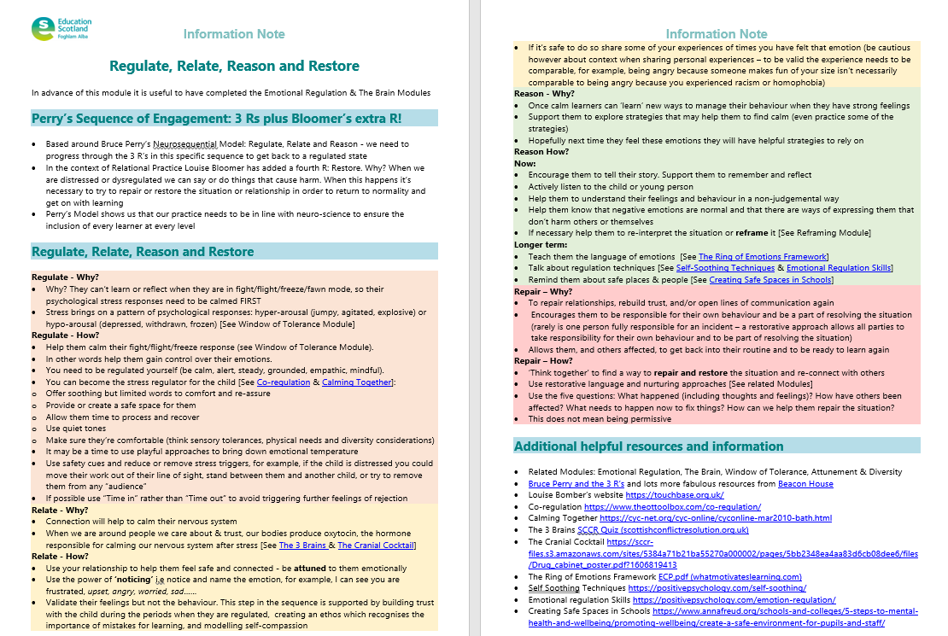
Resources and Information to help

Slide 15
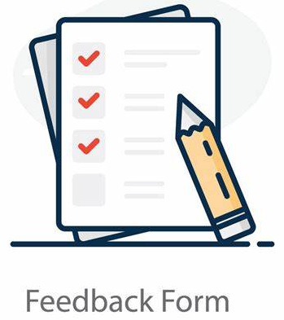
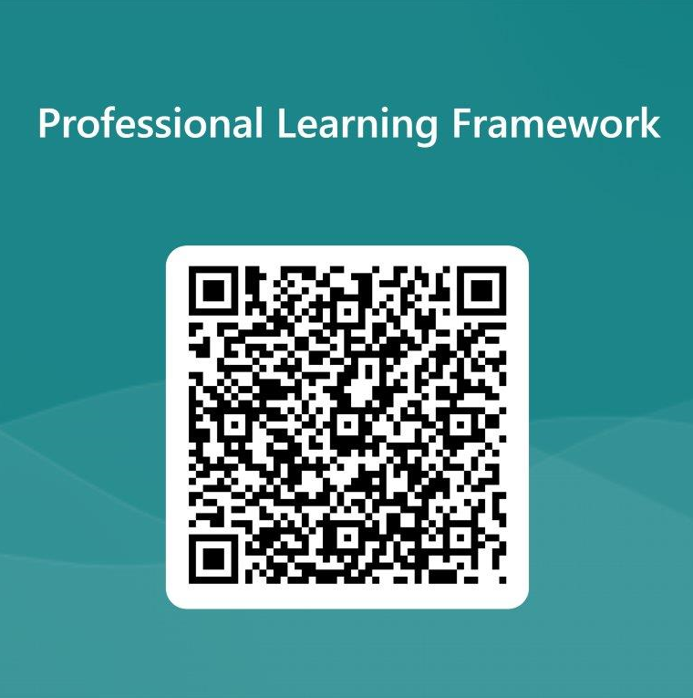
We value your feedback
From now until March 2024 we will be taking feedback on these resources so that we can make changes in advance of a formal launch of the Professional Learning Framework in June 2024
Your feedback could help us improve this resource
Please complete this short form, using the link or QR code, to let us know what you thought of it and any suggestions you have on how it could be improved
LINK: https://forms.office.com/e/b5PCpJJJ3P

Slide 16
For Scotland's learners, with Scotland's educators
Do luchd-ionnsachaidh na h-Alba, le luchd-foghlaim Alba
Education Scotland
Denholm House
Almondvale Business Park
Almondvale Way
Livingston EH54 6GA
T +44 (0)131 244 5000
E enquiries@educationscotland.gsi.gov.uk

