Slide 1


The Additional Support for Learning Engagement Event 2026
Sharing What Works: Improving ASN Together
12 March 2026

Slide 2


Session 2:
Achieving Excellence in Learning and Teaching Through Effective Inclusion at
Glencoats Primary School

Slide 3
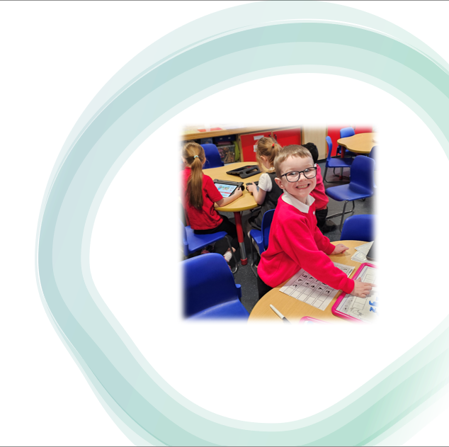
Our School Context
173 children
Ferguslie Park area of Paisley
87% children in SIMD 1 & 2
47% children with recorded ASN
High level of ‘hidden’ ASN

Slide 4

Glencoats Primary 2020
  High level of dysregulated behaviour across the school
  A focus on ‘behaviour challenges’ rather than ‘wellbeing’ – negative school reputation
  Low staff morale
  Low expectations
  Unmet needs – children & staff
  Pedagogy development at a stand still
  Low levels of attainment and achievement

Slide 5
Key priorities for school improvement
To understand our school context and the needs of our children and families to inform effective personalised support
To recognise that supporting wellbeing, equality and inclusion was fundamental to raising attainment and achievement
To develop a relevant curriculum that provided high quality, progressive experiences to develop skills for LLW
To develop consistent approaches to high quality learning and teaching that supported pupil engagement and inclusion

Slide 6

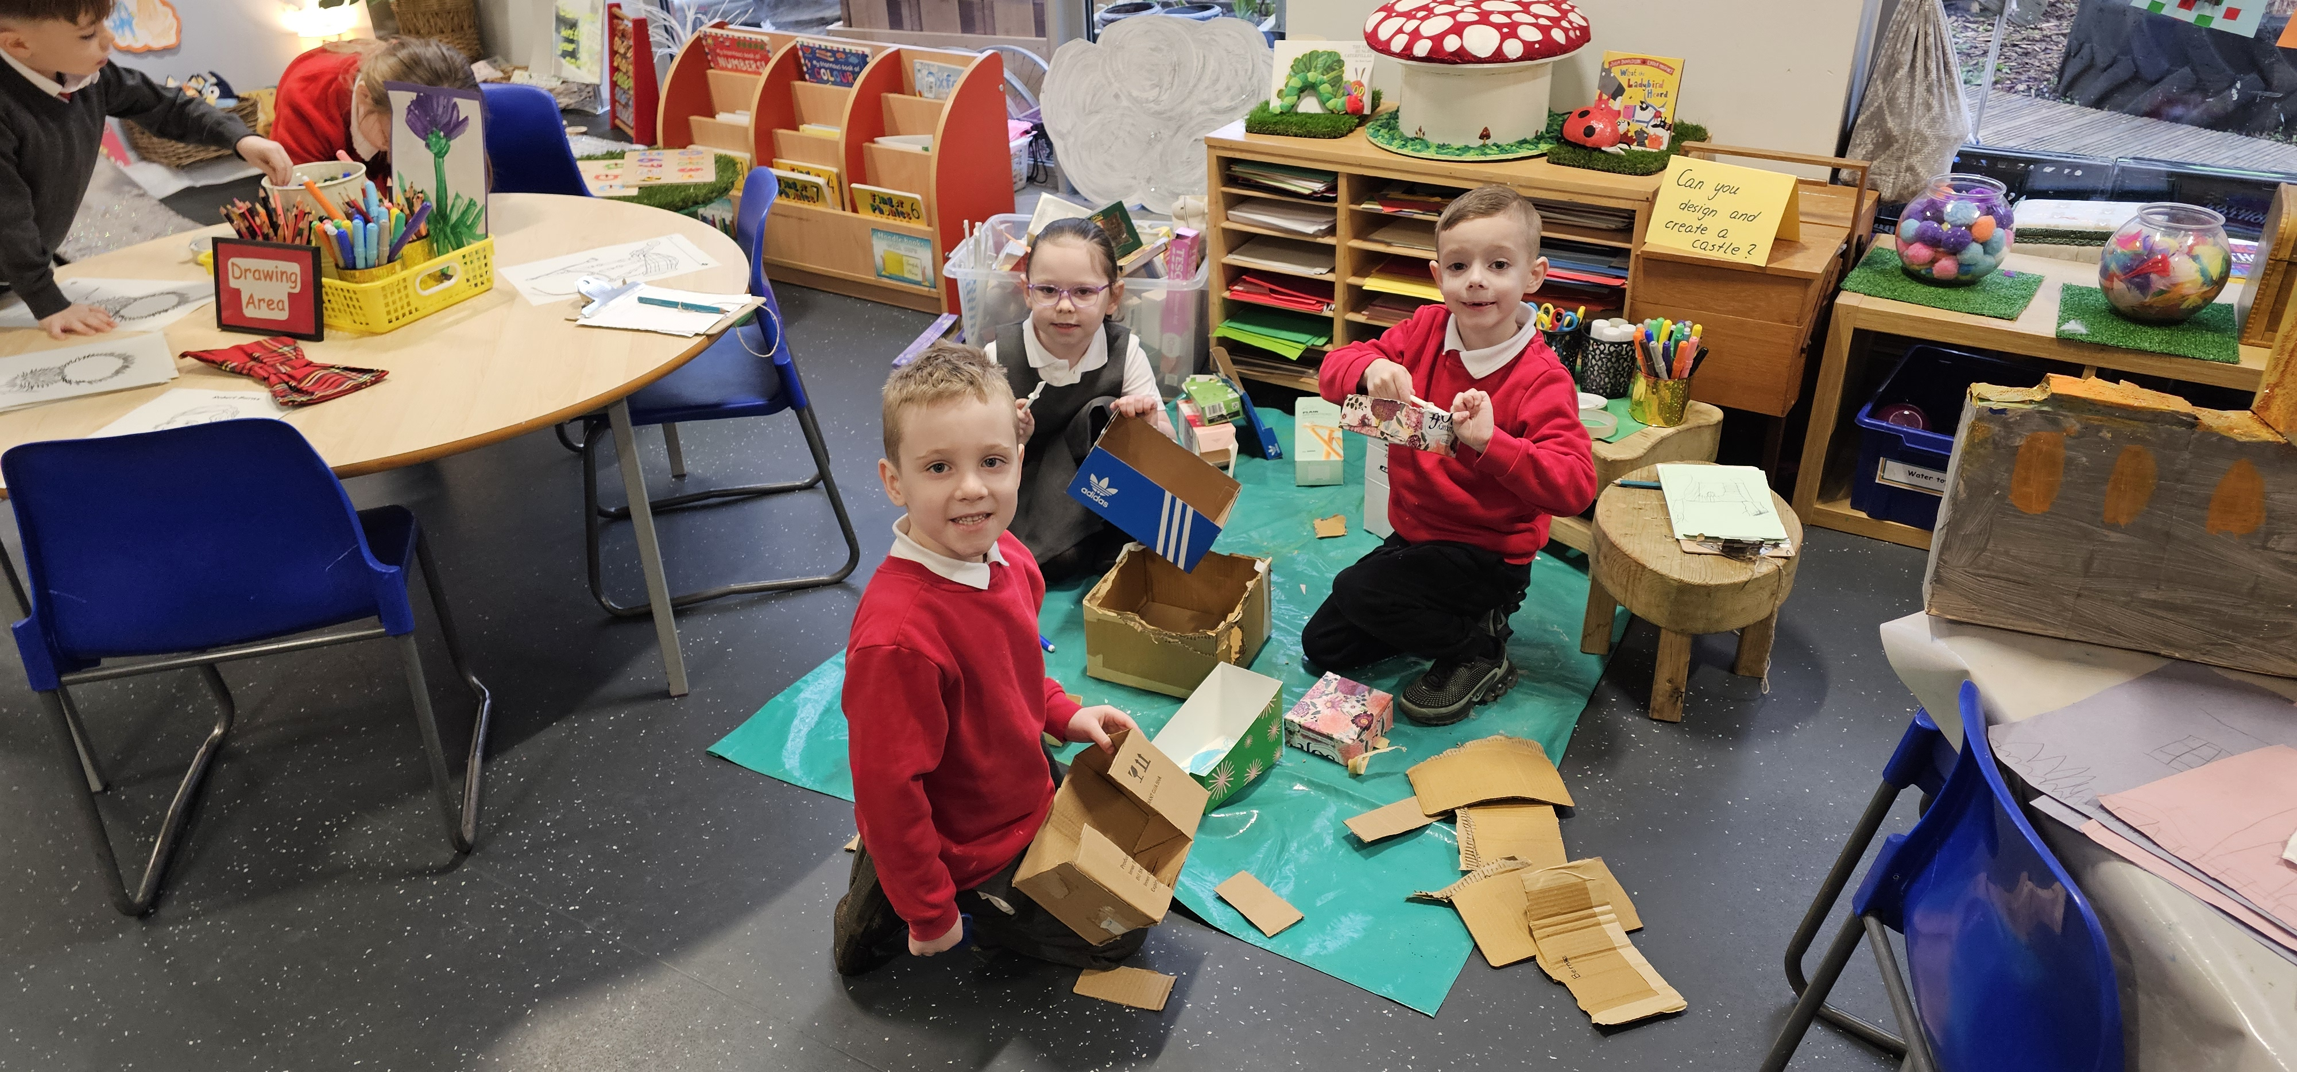
Putting priorities into action
Challenge our own mindsets
Pace of change
Time to talk, reflect, plan next steps
Looking after ourselves and each other – staff wellbeing
Visible leadership

Slide 7
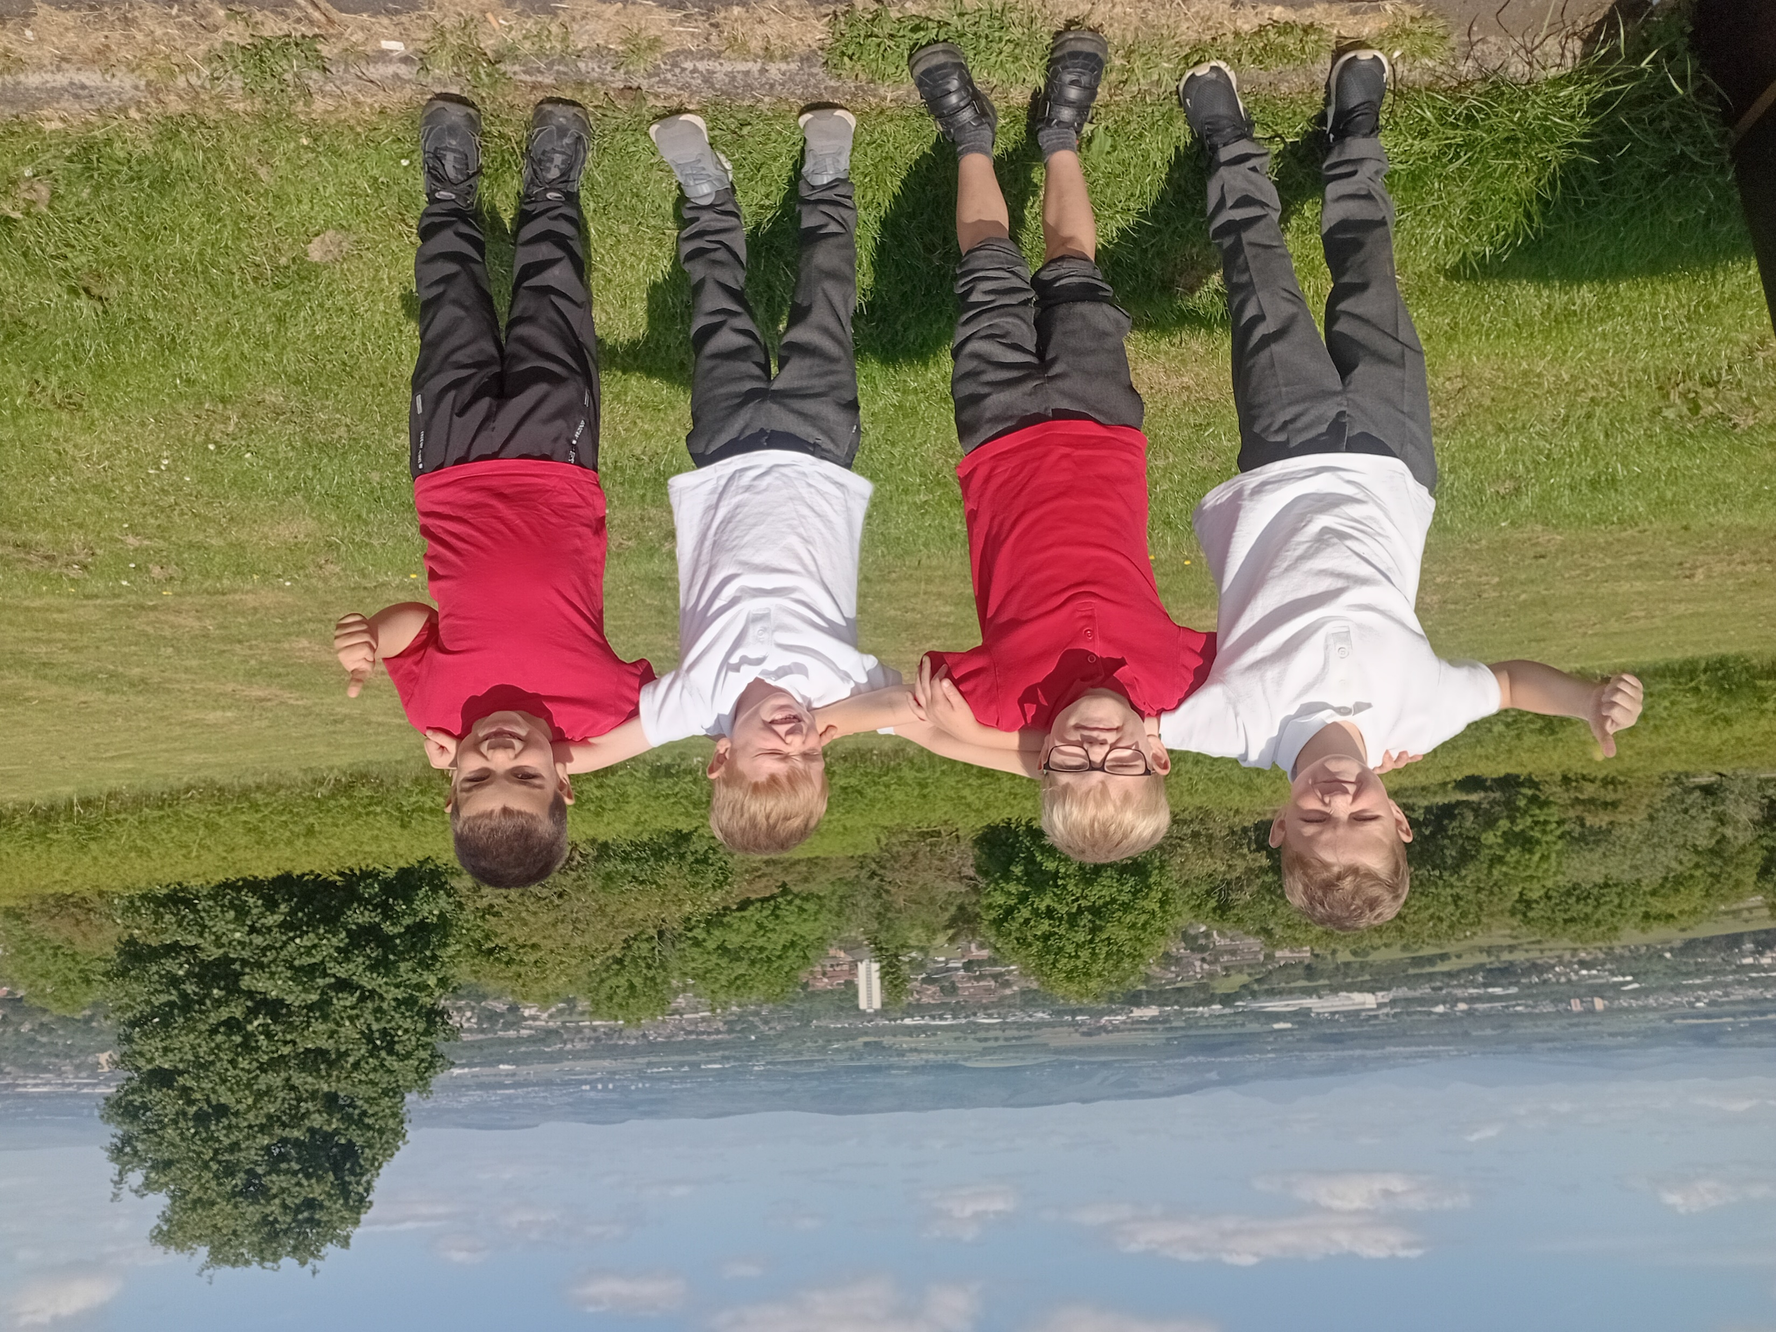
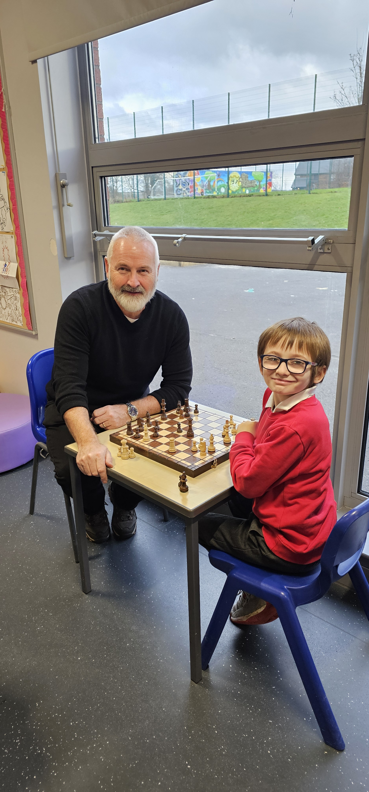
Inclusion
Inclusion is not simply about physical proximity.
It is about intentionally planning for the success of all pupils.
Thinkinclusive.us

Slide 8
Inclusion in Glencoats – Our School Ethos
ALL staff have a role to play in supporting our children
High expectations of and high aspirations for all children
Consistent approaches to wellbeing across all classes
Transition support and planned alternatives to the playground supported by leadership team
Development of spaces across school to support wellbeing & learning

Slide 9
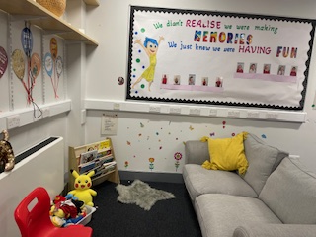
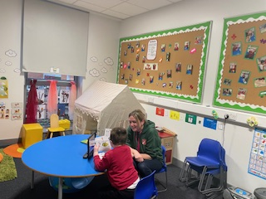
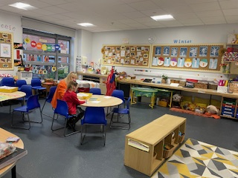
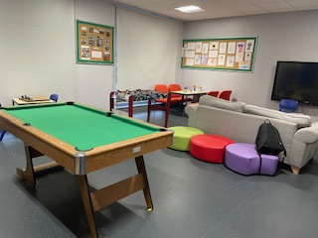
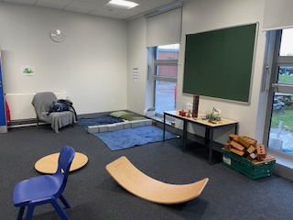
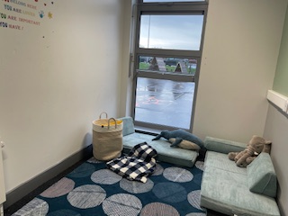
Types of rooms
Oscar’s Den
The Cloud
The Sunshine Room
Key Worker Room
Flexible Learning Space
The Rainbow Room

Slide 10
Inclusion in Glencoats – Universal approaches
Whole School progressive ‘Super Skills’ programme with focus on wider achievement and skills development for all children
Key Worker – universal programme ‘Swim to Success’ for all P7 pupils
Whole School ‘Turbo Topics’ – relevant and progressive IDL experiences
Pupil Led Learning approaches across all stages with visible and meaningful connections to skills for learning, life and work.

Slide 11
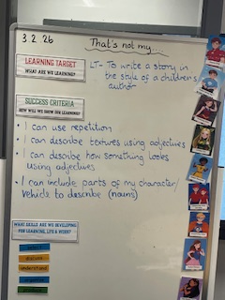
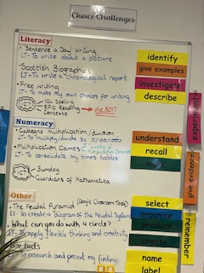
Pupil led learning
Learning Boards
Choice Challenge

Slide 12
Inclusion in Glencoats – Targeted Interventions
Flexi Skills groups – targeted sessions for P1 & 2 focusing on life and social skills
Skills Academy – targeted sessions for first level and second level groups focusing on attainment, achievement and self-esteem
Key Worker – targeted sessions to develop social skills and support emotional and mental wellbeing
Targeted attainment interventions based on robust data

Slide 13
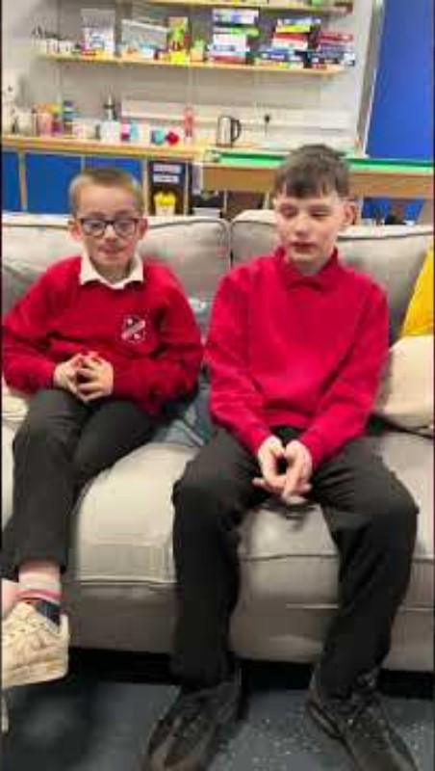
Key worker support Pupil Voice

Slide 14

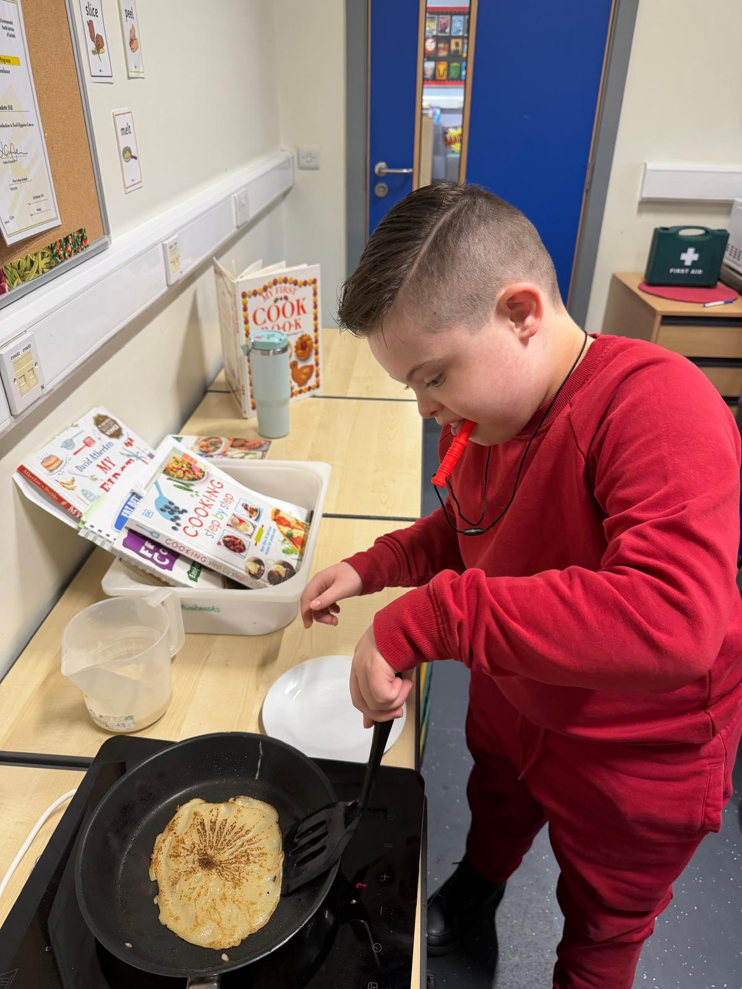
Impact of our inclusive practice…
In the school and Flexible Learning Resource, children are very happy, motivated and well-behaved across the day. They are thriving as a result of highly positive relationships with staff and outstanding nurturing personalised support. All children feel valued, included and ready to learn each day.

Slide 15
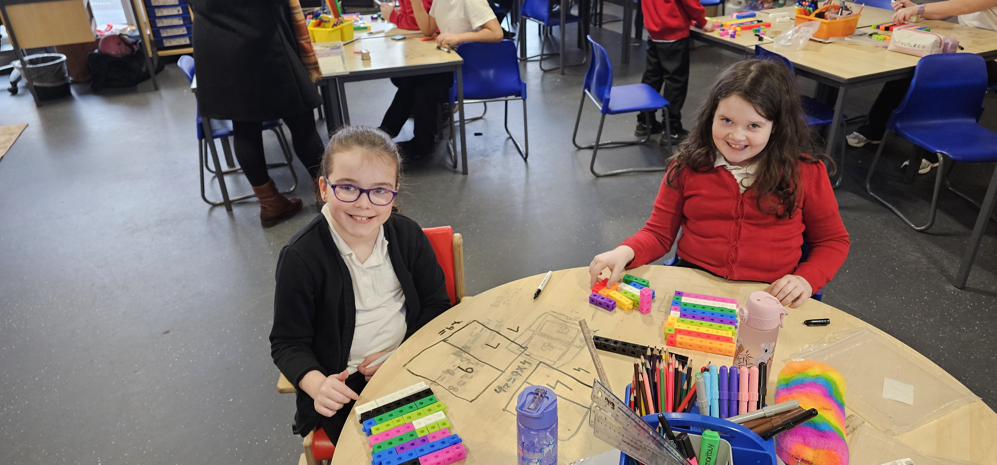
Impact of our inclusive practice.
In the school, teaching and support staff deliver very high-quality focused and targeted work in literacy, numeracy and health and wellbeing.
This is raising attainment and accelerating progress in learning significantly for all children across the curriculum.

Slide 16
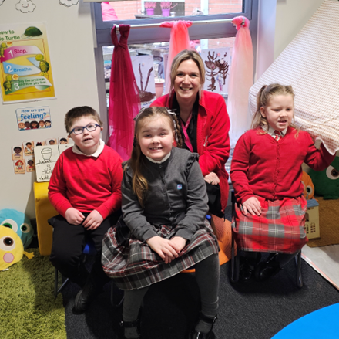
Impact of our inclusive practice..
Highly inclusive approaches to learning and teaching are an outstanding strength of the school.
All staff have high aspirations and expectations for every child’s progress and attainment. They ensure that any barriers to learning are minimised.
Staff know and respond very well to the individual needs of children.

Slide 17
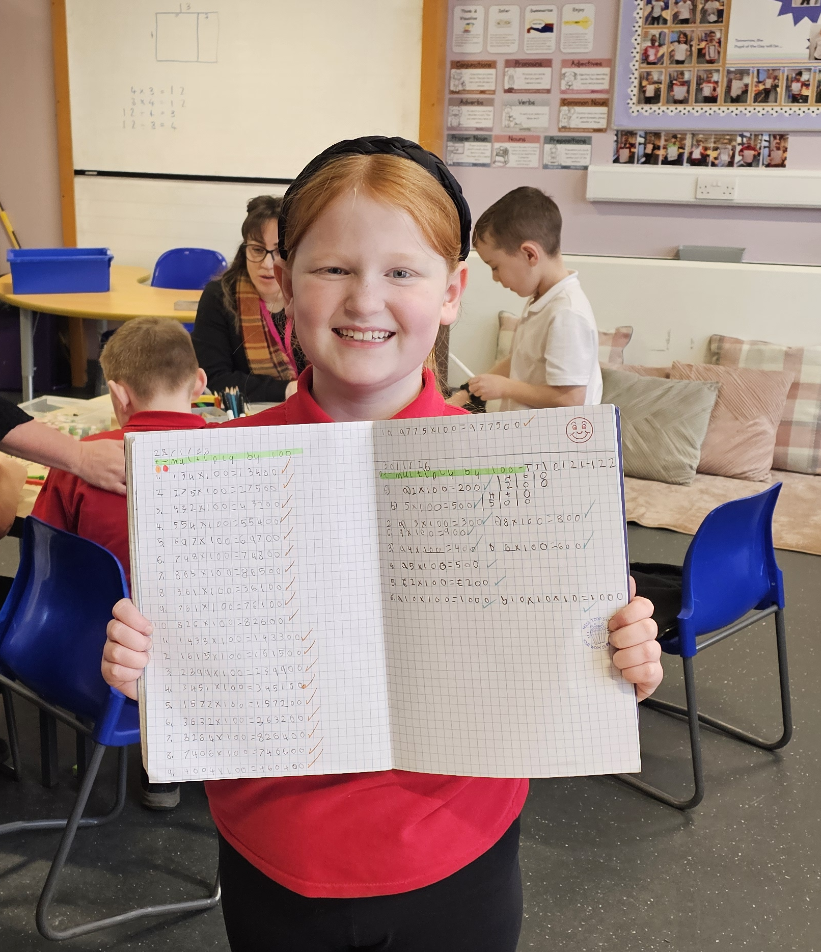
Impact of our inclusive practice….
Attainment has improved consistently over recent years.
Senior leaders, teaching and support staff skillfully to plan and deliver highly effective, well-planned universal and targeted interventions. As a result, there has been a significant increase in the number of children achieving nationally expected CfE levels.

Slide 18
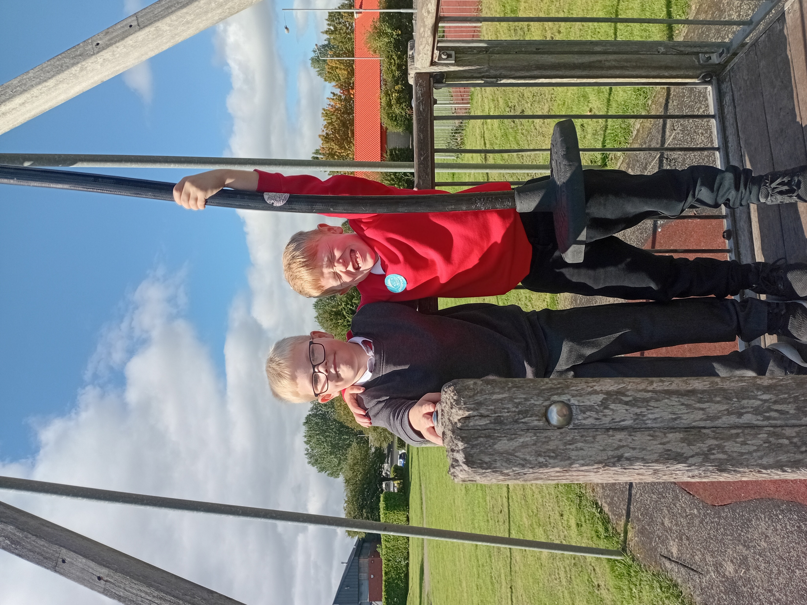
When everyone is included, everyone wins.
Jesse Jackson

Slide 19
Education Scotland logo: white on teal background

