Slide 1

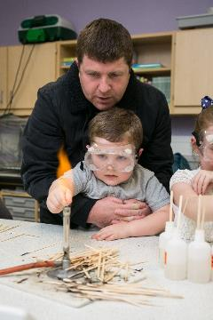
Re/aligning Beliefs
For Scotland’s learners with Scotland’s educators

Slide 2

Different Agendas?
How can we get parents and families involved and engaged in our setting/school?
Involving parents and families in improvement planning would make a huge difference
I wonder if parents and families would like to help revise some of our policies?
Parents and families have so many skills that would enhance learning and teaching in the school
How can we get parents interested and involved in the Parent Council or Parent Teacher Association?
It would be good to have more parents coming in on Parents Evenings
For Scotland’s learners with Scotland’s educators

Slide 3
Different Agendas?
Will I get money to
pay the bills?
Will we live if we are
made homeless?
Where:
Are things going
to change?
When:
Can I ask to help?
Who:
Will I wash the
children's clothes
without money
for electricity?
How:
Am I working two jobs
and still can't provide
for my family?
Am I going to do
to keep the
children warm
without heating?
Why:
What:
For Scotland’s learners with Scotland’s educators

Slide 4
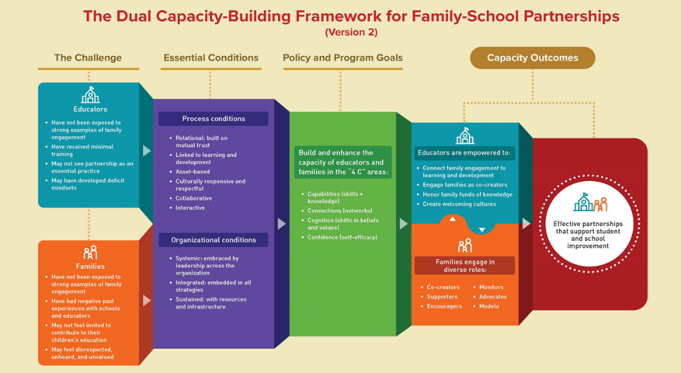
The Dual Capacity-Building Framework for Family School Partnership
Further information and a video guide showing how educators and practitioners can use the Framework to build trust with families can be found on Harvard Graduate School of Education’s website. As per the legislative requirements in Scotland, parents and families should be encouraged to be part of the process to develop and review Parental Involvement and Engagement strategies.

Slide 5
Comments about what did or would help
Teachers who were beacons of stability in a chaotic childhood – they planted seeds of self-belief
Mentors whose encouragement revived that self-belief
Looking out for children, giving them hope, practical support and meaningful opportunities
Upholding the unequal structures in society
Unending motivation
Gift of music and books
Encouragement every day to get up, to get on and to believe in yourself
Opportunity, money and support
Don’t lose some of the ‘brilliant minds in the trenches of poverty’
Stepping stones at the right time, in the right place
Don’t regard anyone in poverty with pity. Don’t ignore the value of diversity – diversity brings power.
When there are barriers – finances, transport, attendance problems, caring responsibilities, complicated home lives – the challenge is to come up with solutions
Need equity in education not equality
If someone can’t see straight because the world is falling in around them, we need to raise them up to clearer skies
(O’Sullivan, K. (2023), 'Poor'. Dublin. Sandycove.
For Scotland’s learners with Scotland’s educators

Slide 6
Comments from research about what works
‘Social inclusion became a key mantra in the nineties, giving rise to a great deal of attention by policymakers, researchers and practitioners to countering the incident of social and educational disadvantage in society. It has been learned that the elimination of such disadvantage is a complex and multi-layered problem. It does not yield to single-focused initiatives, or to short-term interventions. It has been recognised that while schools have a role to play in the alleviation of the problem, to make real progress their efforts need to be supplemented by multi-faceted social interventions within the family and deprived local communities’ (Conaty, 2002, p7-8).
‘…educational initiatives based in schools can raise the educational levels of the adults involved, and result in a general sense of empowerment in the local community. Parental involvement [engagement], especially in areas of socio-economic deprivation, does not just benefit the children and the school – it is a crucial aspect of lifelong learning’ (Conaty, 2002, p9).
‘It is a widely held fact that schools cannot address the multi-faceted nature of educational disadvantage on their own. Undoubtedly, the education system has a vital role to play. However, the school must incorporate the home in a partnership process within the wider context of community, including statutory and voluntary agencies’ (Conaty, 2002, p18).
For Scotland’s learners with Scotland’s educators

