Slide 1
Scottish Attainment Challenge Pupil Equity Funding: Head Teacher Event February 2017
Reflections of a HT
Tackling the Poverty Related Attainment Gap
Steve Ross
Headteacher
Craigroyston Community High School Edinburgh
Notes:
Set up watch – 15mins
Good morning
At Craigroyston we are a Scottish Attainment Challenge school – I am able to share with you some of the approaches we have taken with that ‘ring-fenced’ resource
This should help with your planning for the effective use of the PUPIL EQUITY FUNDING resource

Slide 2
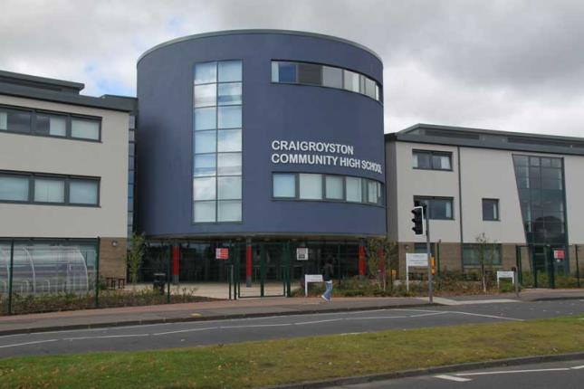
Craigroyston Community High School Edinburgh
Notes:
Craigroyston Community High School is a school in the NW of Edinburgh serving the areas of Muirhouse and Pilton
In case you don’t know the area, Muirhouse is where Irvine Welsh grew up…setting some of grittier scenes from Trainspotting there…
I’ll set out the context of our school with some facts:

Slide 3
School Context
Catchment within a designated area of high deprivation
40% FME
50% of pupils in SIMD 1
75% of pupils in SIMD 1 +2
1 in 4 pupils has recognised additional support need
10% of roll are LAC/LAAC
S4 into S5 staying on rate August 2013 – 54%
Unemployment high and generational in community
Small, but influential, minority of young people drifting into crime
Notes:
Give a bit of time
So – a high level of need, but also a fantastic opportunity for education to have a real positive impact…

Slide 4
Nurturing and Inclusive school approaches
All young people strongly encouraged to stay on until the end of S6
Exclusion rarely used
Curriculum designed to meet the needs of all
Flexible approaches that treat pupils as individuals
Employment an overarching theme of curriculum
Notes:
These are the approaches we have used since 2014 to ensure all young people can flourish in our school
Give some time to let audience read points
These are a response to the school context

Slide 5
Culture of high aspirations and expectations
All staff see themselves as responsible for every young person’s welfare
Communications go beyond what’s just necessary or ‘professional’
Young people often live in a chaotic home environment but school is seen as a consistent positive in their life
Constantly challenge the stereotype that they are ‘not good enough’ or ‘I can’t do that’
Recruitment of staff that share this ethos is essential
Notes:
In our school it is absolutely essential that you think positively and have high expectations for every child
Not interested in the line of thinking that ‘their home life is so bad – as long as they get in through the door’
Often it’s not just the effects of poverty we need to tackle… it’s the ‘POVERTY OF ASPIRATION’ that we need to challenge and change
Here’s the vision for our school:

Slide 6
Our School Vision:
Every young person, without exception, receives excellent quality learning and teaching in a safe, welcoming, nurturing, happy and inclusive environment – so they are able and encouraged to achieve their potential.
The school will ensure every young person leaves Craigroyston at the end of S6 with a portfolio of qualifications, skills, experiences and a knowledge of the job market so that they can enter a sustained, positive destination of further/higher education, apprenticeship or employment.
Notes:
Give time for audience to read
First bit – most schools would aspire to this
Bit in bold - this is a direct response to the context of our community – we are focusing on the outcome
That is my fundamental belief – to combat poverty you must provide the young person with the means to be employed

Slide 7
A curriculum designed for all
Innovative, aspirational Senior Phase curriculum offering exciting vocational courses as well as traditional subject provision: parity of esteem
S4/5/6 is treated as a 3 year path to employment with S4 not being an exit point
High attaining pupils supported and challenged to prepare for University
S2/3 employment electives
S1 STEM – 1 period per week
Notes:
The curriculum can be the key driver of equity
As S4 is no longer an exit point we have courses that appeal to all young people – not just those interested in Highers
Parity of esteem: Pupils following 2 Nat5s, a city and guilds and a pre- apprenticeship are as valued as those doing 5Hs
Employability skills are embedded throughout the curriculum
So – the scene is set – we now have our additional PUPIL EQUITY funding – what’s next?

Slide 8
Advice on Improvement Planning
Keep it simple: one plan is enough
Notes:
As a Scottish Attainment Challenge school we have a plan that is linked to that resource
However – we have only ONE whole school improvement plan for this session
The whole school plan incorporates the attainment challenge plan
My advice?
Keep your plan simple, concise and outcome based

Slide 9
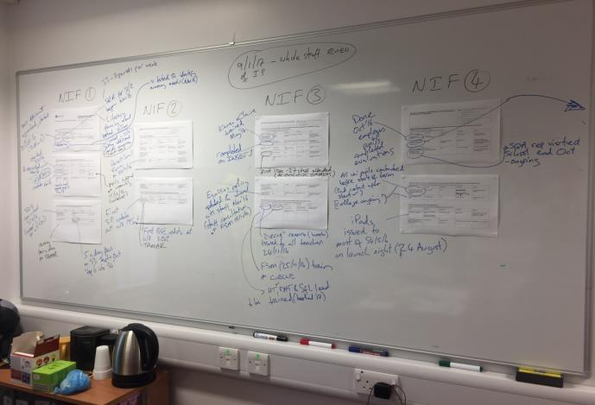
Advice on Improvement Planning
Notes:
This is our whole school plan – and…I see, my kettle!
Keep your IP current and live by having it up in a place you can regularly update it

Slide 10
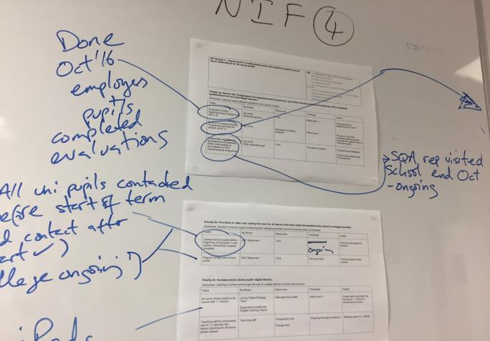
Advice on Improvement Planning
Notes:
Every week or so myself and senior team gather round the plan and discuss updates and progress
This approach is straightforward and works – prevents slippage

Slide 11
How do we know we are making a difference?
Hard and soft data (quantitative & qualitative)
HARD: positive destination figures, attendance figures, key attainment measures (literacy/numeracy/5@s)
SOFT: pupil voice, parent/carer views, ethos and culture in school
Individual case studies where success can be tracked to planned interventions
Notes:
As part of improvement planning, consider how you will be able to evidence progress
All of these are good measures that we have used in Craigroyston
I’ll share some key figures with you:

Slide 12
How do we know we are making a difference?
Some hard data:
2013 2016
Staying on rate S4 to S5 54% 94%
Positive destinations 74% 93%
5@level 5 23% 35%
3@ level 6 7% 21%
Number of exclusions 47 3
Notes:
Improvements clearly linked to our vision
These figures are positive and the whole school is very proud of them – quite rightly (as it takes a lot of work)
But – I prefer the stories:
The young people who did our pre-apprenticeship programme and are now in full time employment on a MA earning 16 grand – and the first in their family to work.
The kids we got off to Uni – again the first in their family to do that
Could share literacy and numeracy interventions but I’ll share with you a few different approaches from our Attainment Challenge work…

Slide 13
2 examples from our Scottish Attainment Challenge:
After Care for former pupils now at university
Attainment Champions
Notes:
After care… We work so hard to get pupils to University – only to hear that many of them drop out in the first year
We believe this is due to a lack of resilience, support, funding and the fact that it is so different for them (almost all are the first in their family to go)
Our additional DHT now keeps in touch with former pupils – the students know how and when to seek support
To date all are still attending uni – and all have used the support offered in a variety of ways
I believe this approach will be mainstreamed as we work towards the SG aspirational target of 20% of uni students coming from areas of poverty
The attainment champions initiative is our take on mentoring + coaching
I’ve stolen 3 quick slides from a colleague's presentation that will give you the gist of it…

Slide 14
Who are these pupils?
Pupils allocated an Attainment Champion are:
the middle 60%
pupils who are at risk of underachieving
our ‘invisible’ pupils
pupils who may need extra support to reach their full potential
Notes:
We support our top end and bottom end very well – this is a direct target on the middle 60%
When the pupils were told about this it was quite clear that many of them were well chuffed to be recognised

Slide 15
What do these pupils need?
Motivation
Support
Challenge
Nurturing
Coaching
Mentoring
Direction
Improved self-esteem
A friendly face
Notes:
Don’t speak

Slide 16
What do these pupils not need?
A counselling session – this is really important!
Inspirational speeches about yourself – it needs to be about them
Sessions where the real issues aren’t tackled or are avoided
Inconsistency
Notes:
Don’t speak

Slide 17
Attainment Champion Intervention - Progress to date:
Significant number of the 76 pupils have increased their attendance since being allocated an Attainment Champion
Pupils state they feel more supported and aware of their levels and targets
We await SQA results in August with cautious optimism…
Notes:
This is just a quick update on progress to give you a feel for something that has been ‘live’ for around 6 weeks
I’ll now finish with a few pointers for you to consider…

Slide 18
Advice on how to use Pupil Equity Fund
Don’t expect staff (who are probably already at capacity) to do more – this is additional funding
Think of outcomes and be solution focussed – plan for what will actually work
Positively discriminate for those young people who are most in need
What is the true context of your community – looking through the lens of those young people living in poverty?
Notes:
Be aware of the issue of workload
Pupil Equity Fund is additional resource – use it in that manner – for example, using our Attainment Challenge funding we employed an additional Depute to take the operational lead on the challenge – rather than me asking more of my 2 existing DHTs
The Attainment Champions are teachers who meet with their 5 pupils in their own time every week – and are paid £1000 for that additional workload
This approach gives time, space and strategic thought to allow real interventions to happen – rather than adding to an already full remit
Don’t factor in a maths teacher in your plan – if you know there are no maths teachers out there!
Read the last 2 bullet points

