Slide 1

Empowering Youth Voice
Contents – Part 2
Section 4 – Identifying a theme and research tools
Section 5 – Undertaking research
Section 6 – Analysing results and next steps

Slide 2
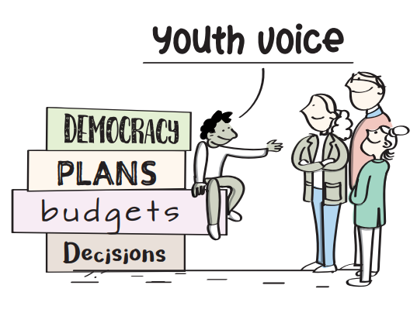
Identifying a research theme
There may already be an identified theme that children and young people will be undertaking research on. If you do not have a research theme identified, please use the next few slides to consider what the children and young people would like to do peer research on.
Before starting this part, please refer to how to make a theme understandable for children and young people.
It is important practitioners follow this guidance to help break down information into formats and language that is easily understood.
For Practitioners
Notes:
Facilitator Notes: Identifying a research theme.
If the group have an identified area/theme for carrying out the research please ensure that they are well informed of the topic before undertaking the research.
Please refer to Guidance on How to Make a Theme understandable for children and young people on the webpage.
For example, if the group are undertaking research on poverty, you may wish to share geographical poverty data, budget information, school attainment data etc to give the group an informed view of the topic.

Slide 3

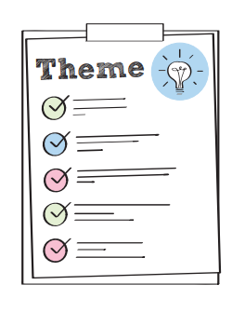
Section 4
Identifying a theme
and research tools
This section you will identify a theme for the research, cover different research tools and techniques.
Please note - With any new theme, Powerpoint 2 should be undertaken
Notes:
Section 4: Identifying a theme and research tools
This section will identify a theme for the research and cover different research tools and techniques.
Explain to the group that a theme is like a topic or subject, and either the group will decide the theme, or it will already have been chosen.
With any new theme this powerpoint should be completed

Slide 4
Identifying a theme
Groups or clubs?
These are some research theme ideas:
Mental health?
Future dreams?
Accessing education?
Opportunities available after school?
Help with learning or exams?
Places to meet up or play?
Notes:
Facilitator Notes: Identifying a Theme
If the group do not have a research theme already identified, you may wish to use these slides to help identify one.
The selection of headings here should be talked through and examples of how these are important should be shared from the perspective of the setting.
You may wish to ask your youth voice structure if these themes are important in their setting
You may wish to refer back to section 1 and 2, talking about children and young people's right to be heard on matters that affect them to help decide on a topic.

Slide 5
Identifying a theme
Activity
Think of things that are important to children, young people in your community and/or school. These could be ideas for research themes:
Notes:
Facilitator Notes
Ask the group to think about what they would like to consult other children and young people on. They can do this in one groups or smaller groups and present an option of ideas
If you already have a theme, this is the opportunity to present it to your youth voice structure so that they can become aware of what you are asking of them

Slide 6
Confirm the theme
Discuss
Does everyone understand the theme?
Now it is time to pick the theme of what you want to research.
You might already have an idea of what you want to research, or there might be something that is bigger than your school/group/community.
What is the research theme going to be?
Our research theme is:
Notes:
Facilitator Notes: Confirm the Theme
If there is not already a clear theme identified based on the previous discussions about Themes, support the group to select one theme that they are going to conduct research on.
If there is a theme already agreed, or there is a larger theme that is the focus of this group, make sure the young people are aware of what it is and why it is being selected.
It is very important that the young people feel informed about the theme, so the next slide encourages them to find out more.
Note: Do the children and young people understand the theme? Please refer to the “How to make a particular theme easily understandable for children and young people “ within the Empowering Youth Voices Resource Pack web page
https://education.gov.scot/resources/youth-voice-toolkit/support-materials/how-to-make-a-theme-understandable-for-children-and-young-people/

Slide 7




Research tools
Discuss
Before finding out more about the theme, we need to learn about research.
Being a researcher is like being a detective, what tools could you use to find out more about the research theme?
But remember you also have to work out how valid each piece of evidence is!
Notes:
Facilitator Notes: Research Tools
Explore different research tools and discuss with the group why researchers need different pieces of evidence to help inform them.
When undertaking a piece of research, we need to think about how valid and truthful our evidence sources are.
Valid means when an idea is tested and proven, it is not just a person’s opinion and remind young people that everything on the internet is not always true or fact!
You might want to talk about times when people have read something and believed it to be true and ask the group if they have examples of this.
Explore with the group the pros/cons, and how valid each one of these examples are:
Books?
Research in books?
Search engines eg google?
Newspapers? Is there a difference across different newspapers?
YouTube?
Hearing from something from someone else?
Watching a video
Discuss what might be the best research tools for using with your identified theme and why?

Slide 8

Research techniques
Activity
Methods of research
Interviews
Surveys
Observations
Focus groups
Questionnaires
What approaches do you like best and why?
Notes:
Facilitator Notes: Researcher Techniques
Read the following types of techniques out and explain what they are
In pairs or small groups, get your youth voice structure to do some thinking or online research about the different techniques.
Ask them to think about which approaches they like best and why.
Pick out the ones which you think you the group could use to help carry out their research on their theme/ question.
Further information:
Questionnaires are frequently distributed via email, in-person, or post. This method of research works well when researchers already have some knowledge (and they might want to explore further) or they want to ask a more specific set of questions. They could ask open-ended questions which allow people to express their full ideas or closed questions that are questions with limited answers.
Interviews are one of the most popular primary research methods of gathering information. Respondents are invited to share their opinions on questions, ideas, products, etc. They can be one-on-one or small group interviews.
Surveys allow researchers to gather primary data from a large number of people all at once. They can be conducted through online, paper-based questionnaires, interviews, and focus groups.
Focus groups can also be likened to a group interview where one person leads the questions, and a few people are express their thoughts and opinions openly. When doing focus groups, the researcher needs to think about the diversity and experience of people involved in the group.
Observations are be done by watching people complete an activity, speaking with them about their experiences, or conducting interviews to obtain more relevant data. The reserachers don’t ask questions, they just observe what’s going on around them and record this.

Slide 9

Keeping research safe: What not to ask!
To keep everyone safe – it is important not to ask any personal information when doing research.
This includes not asking anyone’s:
Names
Ages
Addresses
Any identifiable information
Notes:
Facilitator Notes: Keeping research safe
This slide intends to support discussion about safe research, it is important that the group know not to collect any identifiable information to maintain anonymity.

Slide 10
The power of questions
Activity or Discussion
Asking the right question can be tricky
Activity: What makes a good question?
Look at the 3 questions below
Read them aloud, within your group.
As a group decide what is the best question? And why?
Remember about ethics, why are you asking this and is it safe for someone to answer?
Do you think there should be school?
Describe what school is?
What is your experience of school?
Notes:
Facilitator Notes: The power of questions
Follow the activity on the slide – young people should decide which question they like the best and why
Depending on the size of your group, you could split them into smaller groups for discussions.
Try and get them to explore what types of answers they could get from the questions.
Another question to ask to illustrate the difference between the questions being asked is ‘how would they answer each of the questions?’. How did each question feel?
Question 3 “What is your experience of school?” would generate the best responses as It allows for a range of answers. Question 1 and 2 either give only Yes/No answers or a very factual statement.
Discussion points - how important a question wording can be and the need to be clear. People can take lots of different meanings from the same question if it is not asked in the right way.
You should always be considering what is it you are trying to find out from your questions and does everyone understand the question in the same way
Consider if the questions ethical and whether people are able to answer them using the approach you are using to ask the questions?
For example someone might answer differently in a focus group with their HT or family compared to answering using an anonymous questionnaire.

Slide 11


Styles of questions
?
Closed question
A question that only allows people to answer yes or no
Open question
Allows people to answer in
their own words
Notes:
Facilitator Notes: open and closed questions
Explain the concepts of an open and closed question.
Now consider the questions on the previous slide and decide if they are open or closed questions. Which did you pick as the best question?
Explain to the group that closed and open ended questions can both be useful depending on what information they are looking to explore because they each have different purposes.
Closed-ended questions are appropriate in situations where you're looking for a quick, definitive answer, but they're not conversation starters.
When you're looking for an explanation or a rich level of detail, you'll want to use questions that are open-ended.

Slide 12


The difference between open & closed questions
GOOD OPEN QUESTION
BAD OPEN QUESTION
GOOD CLOSED QUESTION
BAD CLOSED QUESTION
Notes:
Facilitator Notes: The difference between open and closed questions
Discuss aspects of good open and closed questions as well as bad open and closed questions and write them on slide above.
There is information below which will help you with this.
If appropriate, you could ask your group to come up with good and bad closed/ open questions.
Further Information:
Good research questions should:
Be natural and make sense to the people being asked
Be focused on a single topic or very closely related topics
Keep language simple and questions short. If you need to explain anything, avoiding leading the respondent to any particular answer.
Avoid using jargon, acronyms, abbreviations and specialist terms.
Be specific when you ask about factors like frequency, so saying “daily”, “more than once a week” and so on, rather than “regularly”.
Test understanding and clarity of the questions on someone who is not involved in the research and who can look at it with fresh eyes. Try to ensure that you seek views from a mixed group of people of the kind you will be inviting to take part in the research so that you can find out early which questions work as you intended and which need revision. For example, ask some people in your class what they think of the questions.
Make your method of research accessible for everyone. How can you make sure everyone has the opportunity to answer your questions if they want to?
However you need to avoid:
Avoid double barrelled questions – questions which have two questions within them! Eg Do you think school is exciting and worthwhile? This is asking if the person thinks school is exciting but it is also asking if the person thinks school is worthwhile. The person could have two different answers to each of them
Avoid leading questions: Eg people can be drawn towards something that looks like the “right” answer. For this reason it is important to avoid suggesting one response is more desirable than another. Do not lead them by descriptions such as “People at this school love it, how much do you love it?”
Avoid asking too many questions as people get bored and then stop responding truthfully or at all

Slide 13
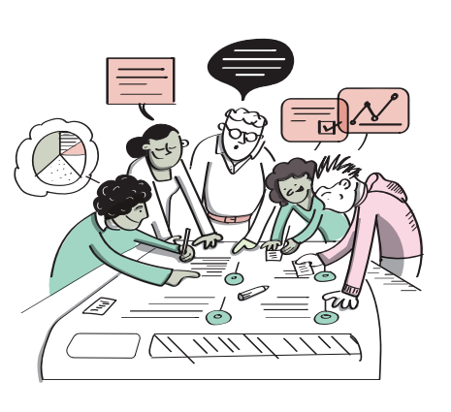
Section 5
Undertaking research
In this section you will plan the research,
and then do it!
Notes:
Section 5: Undertaking Research
In this section we will use our skills as a team to plan the research, then do it!

Slide 14
Thinking about the theme
Activity
Now you have picked the theme and understand research, go and find out some things about it!
Does everyone understand the theme?
What did you find out about your theme and what has STUCK with you most?
Name at least 1 thing you want to know more about with this theme
Why?
Notes:
Facilitator Notes: Thinking about a theme
In this activity as the group to spend some time doing some research on the theme - encourage the group to find out what information already exists on the topic.
The group can do this by using digital devices, asking adults, doing some reading or a having a look online.
After they have done some research, support the group to take some notes and then answer the boxes above based on what they found out.
You may also wish to share local information - for example if the theme is PEF spend, you may wish to share geographical poverty data, budget information and school attendance/attainment data with the group.
Note: Do the children and young people understand the theme? Please refer to the “How to make a particular theme easily understandable for children and young people “ within the Empowering Youth Voices Resource Pack web page - https://education.gov.scot/resources/youth-voice-toolkit/support-materials/how-to-make-a-theme-understandable-for-children-and-young-people/

Slide 15
Thinking about the research
Discuss
How many people would you like to speak to?
How would you like to speak to them?
What help do you think you might need?
Notes:
Facilitator Notes: Thinking about the research
Discuss these questions with the group:
How many people should we speak to?
In what ways do we need to speak to them? E.g. in groups, individually, as a whole class, through a survey on paper or online,
What help do you need to do this and make it easier?
Write answers from the group on a board or piece of large paper.
Highlight that research works best when a wide range of views are gathered and there are inclusive ways in which this is done.
Also research works best when not done alone, doing research with others makes it faster and more likely to be successful.

Slide 16
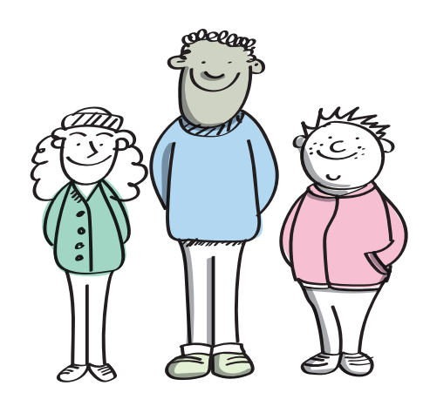
Who do you want to ask?
Discuss
It is important to think about the audience for the research.
Who do you want to ask the research questions?
Specific classes across the school?
Youth groups in the community?
A selection of young people across the whole school?
Notes:
Facilitator Notes: Who do you want to ask?
This slide aims to support the group to consider the audience for the research and agree who they want to ask.
Encourage the group to consider their school / community, and think about who they would like to ask their research questions to.
You may wish to support the group to map out the opportunities for youth voice across the school or community setting.

Slide 17
Mind map the research
Activity
What do we know already about the theme?
Questions we want to ask others?
Theme
What research tools will we use?
Survey?
What ways are we going to involve others in our research?
Group?
Form?
Online?
Notes:
Facilitator Notes: Mind map the ideas
Support the group to create a mindmap pulling the ideas together. You may wish to use information from previous slides as visual aids to make this easier e.g. Types of questions, methods of research etc.
Remember this is about asking questions on this theme, and what children and young people could do to improve this.
You may wish to refer back to the team plan, and now consider:
Who is doing what?
When is the best time to do it?
What is the best tool? Focus groups? Questionnaire on paper or using Google Forms?
When do we want it finished by?
Who and how are we going to collate the results?

Slide 18
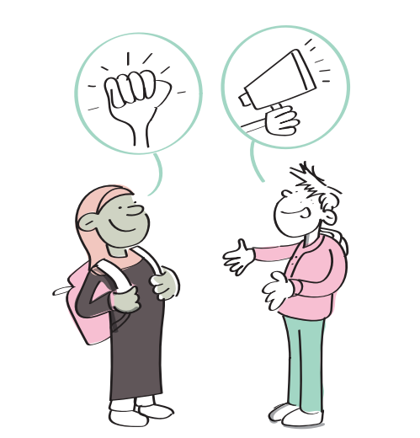
Creating questions for the theme
Activity
Think about what kind of questions you would ask about the theme,
and check if they make sense to others.
Check that the questions give you mix of open & closed replies.
Yes/No
I think...
Notes:
Facilitator Notes: Creating Questions
Based on the theme, support the group to come up with some questions that they would like to ask to undertake the research.
Ask the group to think about if the questions make sense and what type of questions they are.
Can everyone easily understand and answer them?

Slide 19
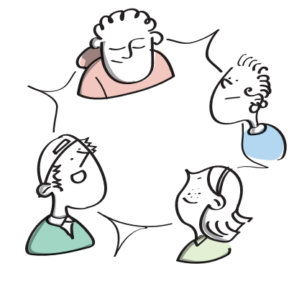
Testing the questions…
Discuss
Think about the target audience and identify who you would like to test your questions with.
The best way to check if a question makes sense is to ask someone who isn’t in your group.
If you ask someone within your group, they already know the things you are hoping to hear...
Notes:
Facilitator Notes: Testing the questions
If possible, support the group to test these questions out on other children and young people who aren’t involved in the group.
Do the questions work? Do you get answers that help your research?
Ask the group to come back and feedback to everyone on the results they got.
If this isn’t possible then move to the next slide and as the children and young people to test the final questions at another point

Slide 20
Confirm the final questions
Now it’s time to confirm your final questions and research methods.
Notes:
Facilitator Notes: Confirm the final questions
Write down the questions the group have agreed that they want to ask others based on the theme.
Discuss with the group do they need to edit any questions based on feedback?
Do the group wish to use any other methods to ensure they are getting all the information they need?

Slide 21
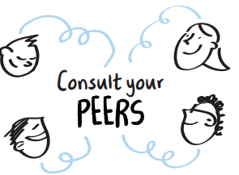
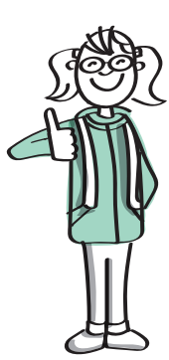
It’s time to do the research!
You’ve identified the topic,
decided on the research methods,
and the questions you want to ask…
Now go ahead and carry it out!
Notes:
Facilitator Notes: Do the research!
Now it’s time to put being a researcher into practice! Support the group in carrying out research on their identified theme.
Give the group the opportunity to ask their peers the questions they created to collect information on this theme.
As this requires the group to go and conduct this work we advise that you allow some time between this session and the next session for research to take place.
Consider how the children and young people are capturing answers to questions. Are they writing answers down? Do they have a form people can in on their phone via a QR code? Are they handing the questions out and giving their peers the time to fill their answers in?
NOTE: Digital tools (forms/surveys) can make gathering and analysing this information more seamless however this also may not be suitable for specific settings.

Slide 22
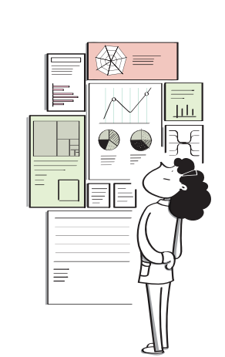

Section 6
Analysing results and next steps
​In this section you will learn how to analyse the results of the research, decide what to do next, and create an action plan.
Notes:
Section 6: Analysing results and next steps
The goal of this section is to help the children and young people understand the information they have gathered and putting this into actions they want to take forward.
This section will help them understand common themes they have discovered, the different kinds of data gathered and putting this into action plan!
It is really important in this section that young people agree on what happens next with their findings.
Learning how to analyse the results of your research
Problem solving ways to put the results of the research into action
Practitioners should have the direct results gathered from the research and have this ready to share with the group of children and young people

Slide 23

Looking at qualitative & quantitative results
Look at the information and decide what is qualitative and what is quantitative
Qualitative means results are people's thoughts, views, suggestions and ideas.
Example - What did people say needs to change to make something better?
Quantitative means results that can be counted, measured and added up.
Example - How many people said Yes or No to a question?
How many people agreed or disagreed with what you asked them?
Notes:
Facilitator Notes: Introducing qualitative & quantitative results
Follow this slide and describe to the group the difference between qualitative & quantitative results.
Explain that the data they gathered is made up of specific numerical answers while other parts of the data focus on the views from people.

Slide 24
An example…
qualitative or quantitative
Questions
200 children and young people were asked some questions about their community:
Do you like where you live? (A lot, a little, not much, not at all)
What is the best bits about where you live?
What could make it better?
Answers
75% or 150 said they liked where they live, either a lot or a little.
100 said the best bits were the park and the sports centre.
150 said that it would be better if there were more things to do.
Notes:
Facilitator Notes: Example of research
Take the group through the example showing where there is qualitative and quantitative research.
Show how the results of the example could help adults who make decisions make better decisions.

Slide 25
Looking at qualitative results
Activity
First things first, look at the research and do the following steps…
In the answers, look for things that are ‘similar’ comments.
It might be helpful to colour code these.
Now count how often the ‘similar comments’ are made.
The more times it’s said, the more important or popular it is.
This means it should be more noticeable within the results.
Can you find the key similarities in the results?
Notes:
Facilitator Notes: Qualitative Results
Follow this slide and support the group to look at the qualitative results and identify any similarities in the research.
You may wish to give the group an example of what this might look like (see slide 25)
e.g. We asked 100 children and young people what they thought were the most enjoyable parts of lessons in a class or the most enjoyable parts of a group. 70 of those asked said that they enjoyed it when the lesson/group was interactive and engaging with some saying “I like it when we use different objects to help us learn”, “I like when we move around”, “I think its better when we are outside”. With this we can see there is a similarity stating that those asked feel they enjoy the lesson/group more when it is interactive and hands on. This helps put a value on statements

Slide 26
Looking at quantitative results
Activity
Now we look at the questions that are easy to add up and see what they tell us…
Count how many times ‘yes’ or ‘no’ were said to answer a question.
How many people agreed or disagreed with something you asked them?
Now look at the total participants and write out the information for each answer. Example - 50 people were asked, 40 said yes and 10 said no.
You can also make this into a percentage.
How many answered yes/no or agree/disagree?
Notes:
Facilitator Notes: Quantitative Results
Support the group to look at the quantitative results and identify any similarities and themes.
If they are able, encourage them to make these numbers into percentages as it is easier to understand for those reading the results.
Make into a percentage by taking the total participants answering ‘yes’ divided by the overall total number of participants, then times that number by 100. e.g. 40/50 X 100 = 80%
Discuss if there are any results that surprise the group?

Slide 27
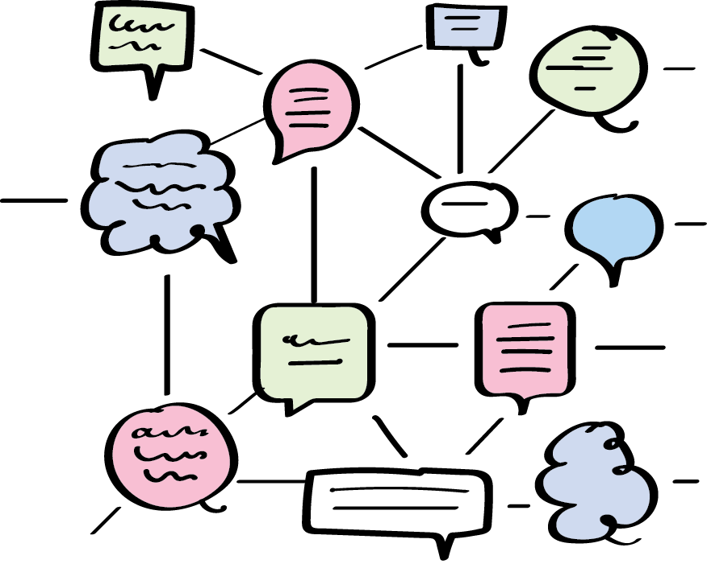
Looking at the results
Activity
Answer the following questions from the research results:
How many people took part in the research?
Did you find any big ideas in the results?
Would it be helpful to use any graphs to show the results, particularly for any closed questions?
Look to find any differences in how people answered the questions?
Notes:
Facilitator Notes: Analysing your results
Support the group to consider how they are going to analyse the results - this could be on paper, or by using an online tool to collate the results.
It could be that some people would like to look at the numerical data and draw graphs, and others might like to look at the answers to the open ended questions and pull out any themes.
Encourage the team to work together and share out the roles as required.

Slide 28
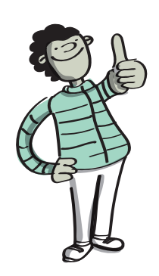

What next?
Discuss
Now we have the research results, what next?
Notes:
Facilitator Notes: Agreeing next steps
This slide gives time to open up discussion with the group on how they can use the research to make things better at school and/or in the community.
The next few slides allow you to support the group in how they create an action plan and start to think about ways they can start to do something about what the research has told them.
The slides also give guidance on how to keep other children and young people informed while also presenting the research to leaders and decision makers
These remaining slides mark the end of the resource pack and it’s up to practitioners, children and young people on what they do with the information they have found on their chosen theme.

Slide 29
Let's make an Action Plan!
Question | Answers
What did you find out?
What do you want to change?
Why is it important to change this?
How will you know the change has been a success?
Actions needed to get there:
Support we need to make it successful:
Notes:
Facilitator Notes: Make an action plan
This activity gives space to create the final plan on what you are going to do. Creating an action plan helps children and young people hold adults accountable.
Young people could draw out a table like this one and work together to answer the questions.
In all consultation activities, it is essential that children and young people are informed of what has happened as a result of their involvement. Even when ideas cannot be implemented, it is vital to explain clearly what actions have or have not been taken, and why. This helps close the feedback loop and ensures young people feel heard and respected.
For the action plan it may be useful to think about:
The aim – what are you wanting to change?
Why this is important?
How will we know it's been a success?
Actions to get there?
Support needed to make it successful?

Slide 30

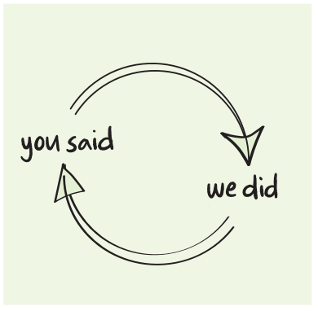
Keeping people informed
Discuss
After doing research it is important to keep people involved and let them know what happens next.
Who do you want to tell?
Why is feedback important?
Remember to share the findings with the people who took part in the research!
Notes:
Facilitator Notes: Keeping People Informed
Explain to the group it is important to have a feedback loop with those they have consulted. The should group speak to/share with the people involved in the research and tell them what they are going to do as a result of the research.
This is important because it means that people will feel their opinions are valued, they will feel a sense of belonging in terms of what happens next and they are more likely to participate in more research again.
They will also be more likely to want to be involved in anything the group are doing next because they have a sense of ownership because they have been included in the decision making.
Discussion Activity:
Explain to the group why it is important to feedback to people on what you have found out and what you are going to do about it.
ask why they think it is important to do this?
who do they think they need to feedback to? And what is the best way to do this?
do you need to consider how often you will feedback on the action plan/ project work?

Slide 31
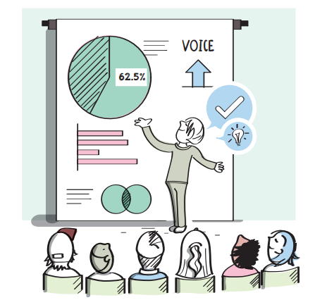
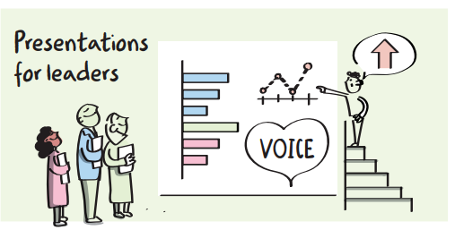
Presenting the research results
Consider how the group would like to present the results of the research - this could be a presentation, a poster, writing a report or making a video.
Notes:
Facilitator Notes: Presenting the Research Results
Now you have reached the end of this resource - Depending on the topic, the group may have different ways that they wish to present their findings.
This may be by hosting an event, speaking to local authority officers or heads of establishments, writing a report, making a presentation or poster.
Agree with the group how they would like to present their findings and who they would like to share them with – this may be a good opportunity to link with any local authority/regional youth voice networks.

Slide 32
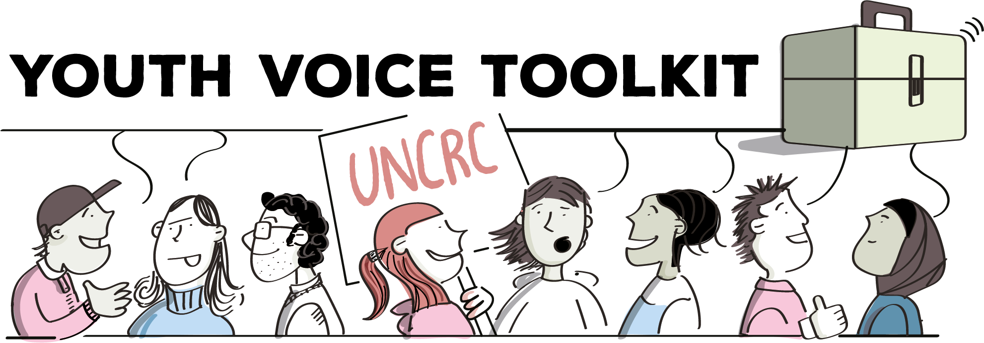
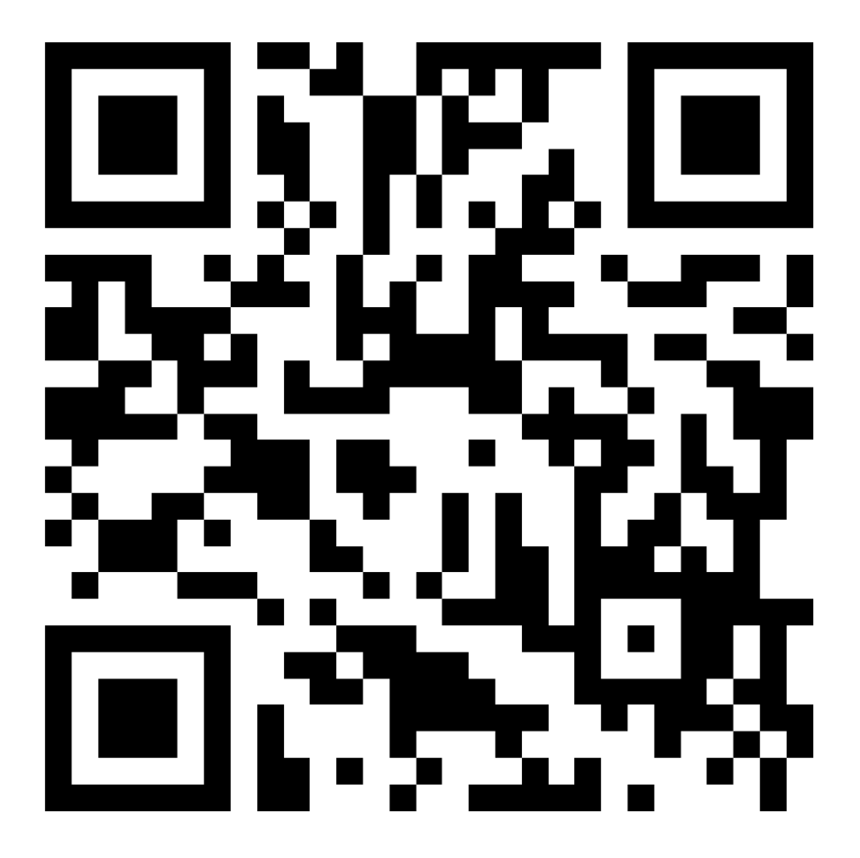
Let Education Scotland know!
Thank you for using the Youth Voice Toolkit. If you haven’t already done so, please make sure to complete our toolkit contact form
You can also email us at youthvoice@educationscotland.gov.scot

Slide 33
Finished?
Now the group are trained in peer-research, you may wish to do consultation on a different theme. Use this Powerpoint (Part 2) again to identify a different theme when ready.
Notes:
Facilitator Notes: Finished
This PowerPoint can be used again to consult on a different theme when suitable.
Part 1 of the resource pack should only be done again when the youth voice structure significantly changes or you plan to use the resource pack with a new youth voice structure.

