Slide 1
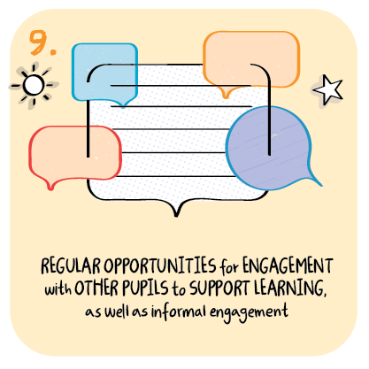
Adapting the curriculum to motivate and engage learners Thomas Muir Primary School, East Dunbartonshire Council
>National overviews of practice<

Slide 2
Thomas Muir Primary School – case study
A main challenge has been providing a curriculum that is balanced to encourage and motivate children’s learning. Staff wanted to ensure that the curriculum is enjoyable and where appropriate, an element of fun is added to enthuse children and help them engage fully with their learning. Different approaches from a variety of teachers is leading to creativity and children benefit from this.
The senior leadership team maintains a whole school focus on planning for remote learning. Children’s mental health is seen as a priority across the school and is a strong component of each school activity. Successful whole-school interdisciplinary learning has included activities around ‘Winter Photography’ and ‘Fair Trade.’
These themes generated a positive response from the school community and allowed children to celebrate their successes online, sharing the information and learning from these activities. Many interesting photographs and written work by children were circulated across the school community and the content enjoyed and appreciated by all. This type of approach is having a positive impact in helping the school community, across the ages and stages, to stay connected and in touch with each other. A very popular series of lessons looking at ‘how to draw comics’ has been put together in partnership between the school and a local artist to encourage children to engage in a fun and purposeful learning in art and design. This is proving very motivational for many children, including a number who may normally feel reluctant to engage in remote learning activities.

