Slide 1


An Introduction to Learner Participation in Educational Settings

Slide 2
Where, after all, do universal human rights begin? In
small places, close to home - so close and so small that
they cannot be seen on any maps of the world. Yet they
are the world of the individual person; the
neighbourhood he lives in; the school or college he
attends; the factory, farm, or office where he works...
Unless these rights have meaning there, they have little
meaning anywhere.”
- Eleanor Roosevelt
Notes:
Learner participation is part of the wider rights agenda and should be seen as such – it may be helpful to refer to the professional learning materials ‘Recognising and Realising Children’s Rights’ found on the National Improvement Hub. See below.
https://education.gov.scot/improvement/learning-resources/Recognising%20and%20realising%20children’s%20rights:%20A%20professional%20learning%20resource%20to%20promote%20self-evaluation%20and%20improvement%20planning

Slide 3

Where has this resource come from?
Based on the research ‘How young peoples participation in schools supports attainment and achievement’ (Children and Young People’s Commissioner Scotland)
Seven schools with better than expected exam results for their catchment took part.
The goal of the research was to find out if these schools were addressing pupils’ participation and rights in ways that were distinctively supportive of pupil achievement and attainment.
In all seven schools, pupils had opportunities to take part in meaningful activities which helped to make contributions to schools life and had their views considered in matters that affect them.
Participation was identified as taking place in 4 main arenas identified in the research as: Formal curriculum; extended curriculum; decision making groups and other informal contact between peers and adults.
Notes:
A number of secondary schools with catchments in more deprived areas of Scotland were identified as having higher than expected exam results. 7 were invited to take part.
The goal of the research was to find out if these schools were addressing pupils’ participation and rights in ways that were distinctively supportive of pupil achievement and attainment.
Participation in school life was seen to be all of those times and places when pupils have a chance to influence decision making and bring about smaller or more significant change
In all seven school, pupils had substantial opportunities to formally and informally taking part in a variety of meaningful activities, eg. to take responsibility for events, make contributions to school life, and have their views considered in matters that affected them.
Young people saw a good education as one that allowed many rights based experiences.
There were still limits to participation in these schools, eg. what children and young people could make decisions about, who could participate in power sharing and in how schools linked to their communities.
Participation was found in 4 main arenas:
Formal curriculum (eg. in class or other areas of learning)
Extended curriculum (eg. clubs, trips, voluntary activities)
Decision making (eg. pupil councils, eco committees, etc.)
Other areas of informal contact between peers and adults (eg. canteen, playground, wider community)

Slide 4
Article 12 of the UNCRC Provides:
“1. States Parties shall assure to the child who is capable of forming his or her own views the right to express those views freely in all matters affecting the child, the views of the child being given due weight in accordance with the age and maturity of the child.
2. For this purpose the child shall in particular be provided the opportunity to be heard in any judicial and administrative proceedings affecting the child, either directly, or through a representative or an appropriate body, in a manner consistent with the procedural rules of national law.”
Notes:
Refer to the articles here and the Recognising and realising children’s rights professional learning resource. Also that the articles can be found in a child friendly format at www.unicef.org

Slide 5
What is participation? – Principles of the UNCRC
Survival
Non-
Discrimination
Survival
& Development
Best Interests
Being heard
Notes:
This outlines the 4 principles of the UNCRC – one of which is being heard taken from article 12 – being heard or the views of the child. These general principles help in the interpretation of the UNCRC

Slide 6
What is participation? – UN General Comments
We must ensure that:
children are supported to form a free view;
an environment that enables the child to exercise her or his right to be heard (is provided);
(children’s views can) add relevant perspectives and experience
(children’s views are) considered in decision-making, policymaking and preparation of laws and/or measures as well as their evaluation
The concept of participation emphasizes that including children should not only be a momentary act, but the starting point for an intense exchange between children and adults on the development of policies, programmes and measures in all relevant contexts of children’s lives.
Article 12 stipulates that simply listening to the child is insufficient; the views of the child have to be seriously considered when the child is capable of forming her or his own views.
Notes:
This adds further detail on what participation involves according to the UN. A model by Laura Lundy of participation may also be helpful to put this into practice and demonstrate key aspects that need to be taken forward to realise participation fully.
Her views on this can be found in: ‘Voice’ is not enough: conceptualising
Article 12 of the United Nations Convention on the Rights of the Child’ – Laura Lundy, British Educational Research Journal
Vol. 33, No. 6, December 2007, pp. 927–942. This outlines Article 12 as the need for space to participate; the need for a voice to be heard; the need for children and young people to have influence when they do participate; and finally the need for an audience to hear them. This helps realise both aspects of Article 12 which outline the need to have a voice but also for that voice to be given due weight.

Slide 7
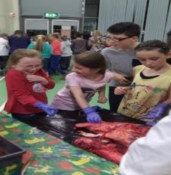
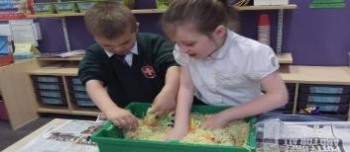
Where and when does participation happen?
Discussion
Notes:
Spend some time in small groups discussing where and when you think participation might happen in a school or early years context?
What does it look like? What does it involve? How do you ensure it is authentic participation? What might it be called?

Slide 8
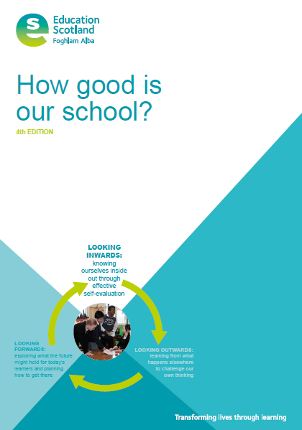
QI 1.1 – Self-Evaluation
Pupil participation is a strong feature of our approach to self-evaluation and continuous improvement. Through regular and effective collaboration our community has a shared understanding of the school’s strengths and improvement needs. We have developed very effective mechanisms to consult with stakeholders and can show how their views inform change and improvement.
Notes:
Participation runs throughout HGIOS 4 and is mentioned throughout the document as a key feature of school improvement. It states that: “Children and young people’s active participation in self-evaluation is an important factor.”
In QI 2.2 for example it states that: Learners are fully involved in planning learning.

Slide 9


Notes:
How good is OUR school has recently been produced as a resource to support children and young people’s participation in self-evaluation and school improvement. A strong, inclusive school ethos and a community that actively listens to children’s and young people’s views underpins effective learner participation. This resource is in two parts:
Part One: A guide for staff and partners working with children and young people will support self-evaluation of your current approaches to learner participation. It is intended to be used by school staff and partners working collaboratively with
children and young people to evaluate what is working well and consider what would support increased learner participation.
Part Two: A self-evaluation framework for use by children and young people includes some suggested activities to support children and young people to evaluate the quality of relationships, learning and teaching, school and community, health and wellbeing and successes and achievements. It is hoped that as their skills and confidence increase, children and young people will grow their self-evaluation activity in ways which work best for them in their own school context.

Slide 10

What is this resource?
A guide for schools and early years settings to
take forward participation
Developed in a partnership between Education Scotland and the University of Stirling. Followed by consultation with children and young people and key stakeholders. A pilot also took place with a number of early years and school settings.
Notes:
This guidance was developed to support schools and early years settings and give them clearer guidance on what is involved in participation and how it can be taken forward. It takes into account academic research in the area including the Children and young people’s commissioner research but also other academic research which outlines the benefits of participation. It is also intended as a means of stimulating discussion and helping schools to reflect on what they are currently doing to support participation and how this can be taken forward.
The pilot helped update the resource to ensure it was accessible. Schools which took part included Newtongrange Primary in Midlothian; St.Mungo’s Academy in Glasgow; New Cumnock Early Childhood Centre in East Ayrshire; Glendee Pre-5 Centre in Renfrewshire; Rothesay Joint Campus in Argyll and Bute and Whinhill Primary, Inverclyde.

Slide 11
Definition
Learner participation in schools and early years
settings includes all the ways in which children
and young people engage in practices and
dialogue with educational staff, parents, carers,
and community members to create positive
outcomes and changes
Notes:
Note that participation is not just dialogue but involves activities which children and young people may become involved in – but dialogue, particularly authentic intergenerational dialogue is an important aspect of participation.

Slide 12
Benefits and rationale
Improved pupil-teacher relations
Improved peer relations across the school age ranges
Improved teaching and learning
Improved guidance and support
A better school ethos and a greater sense of shared community
A reciprocal sense of feeling valued, trusted and respected
Life skills such as teamwork, problem-solving and citizenship
Improved engagement, empowerment, and commitment to education
Improved achievement and attainment
An addressing of the ‘attainment gap’ between learners from different backgrounds
Notes:
A number of key references are provided in the guidance which outline the benefits that it can bring – schools may choose to access this research to help promote discussion. Schools may choose to take forward participation for a number of different reasons and it can be helpful to have some discussion about what you are trying to achieve by taking this forward.

Slide 13
Principles of Participation
equal opportunities for inclusive, voluntary participation
respect for children and young people’s rights and differences
transparency and accountability in decision making
intergenerational power sharing
relevance of content, purpose and outcome
Notes:
Inclusion should be open to all children and young people and not just those who are able to easily express their views – schools and early years settings should think about practices that encourage all ch/yp to get involved – however it should be voluntary and not enforced. It also should not be seen as something that is earned or a reward.
Educators should recognise children and young people’s capacity to participate and see that children can bring an equally valuable point of view to discussions that should be considered and acted upon where appropriate. This intergenerational power sharing between adults and children may need to be worked on in schools to ensure that staff have the values and attitudes that help to promote this.
Participation practices should clearly articulate what they aim to achieve and this should be shared with children and young people – everyone involved should also be accountable for any actions that are taken. Adults should listen authentically to the voices of children and young people but make it clear that it may not always be possible to always take every action that is suggested forward just as all adults ideas may not always be taken forward.
Any participation should be about matters that affect children and young people so that they see the relevance and they should also feel that it is not tokenistic but has a purpose and that they will be listened to.

Slide 14





Notes:
The four arenas of participation which are drawn from the initial children’s commissioner research are outlined in this guidance for this first time. These arenas outline all the places that participation can take place and extend it beyond the scope of decision making groups. For example, children might participate in giving their opinions on aspects of lessons including the content and delivery. Some aspects of assessment is for learning would be helpful in this arena.
Opportunities for personal achievement include ch/yp being included in all those wider areas in school such as volunteering, award schemes, visits, etc. It can be helpful to get the children involved in

Slide 15
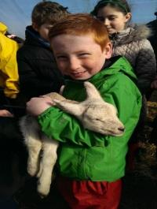
What helps participation to happen?
What stops it from happening?
Discussion Point
Notes:
Implementing participation fully can be a challenge. Take some time to think about what factors might facilitate effective participation and what might hinder it in your setting?

Slide 16
Materials and Links to support you
Learner participation resource
7 Golden rules
Implementation framework
Readiness Checklist
Introductory Power point
Film case Studies
Participation Mapping Tool
Additional models of participation
https://www.cypcs.org.uk/education
http://www.participationworks.org.uk/
https://www.unicef.org.uk/rights-respecting-schools/the-right-to-participation/
Laying the groundwork
(where are we now?)
Notes:
There are many supports and resources that can help you with participation. Some schools might already be part of the Rights Respecting schools award process and have done work in participation through this. Alternatively the Education Scotland professional learning resource – ‘Realising and Recognising Children’s Rights’ can help to understand participation in the wider sense. There are also support materials provided with the guidance which can support implementation and self-evaluation including the participation mapping tool and the implementation framework. Additional models of participation also exist which can support implementation including Tresseder – outlined in a later slide and Lundy, previously mentioned.

Slide 17

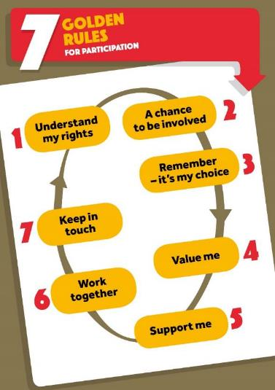
https://www.cypcs.org.uk/get-help/teachers/golden-rules/
Notes:
The children’s commissioner has produced the 7 golden rules for participation and booklets which support this – these can be really helpful to guide work around participation.

Slide 18
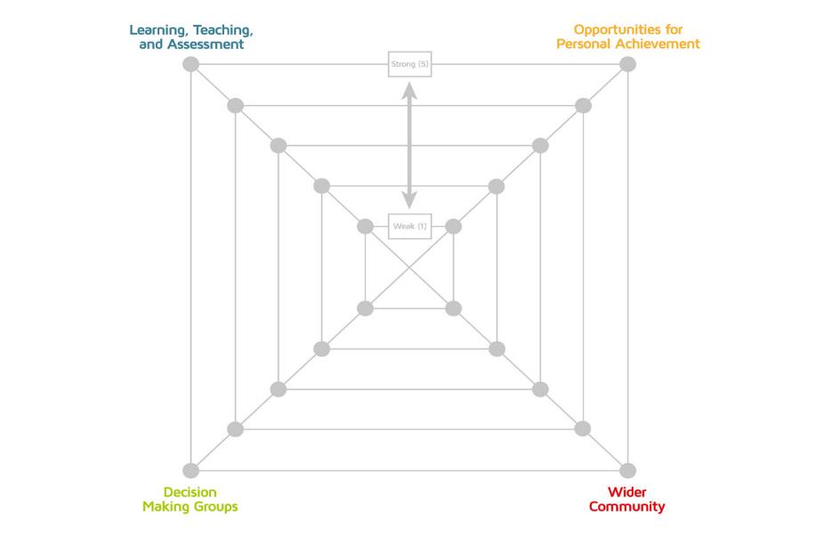
Participation
Mapping Tool
Notes:
Helps schools to have dialogue and consider where they may be across the 4 arenas

Slide 19




The 4 Arenas
Notes:
This planning tool is useful to help schools to outline briefly what they are doing in each arena and what they might intend to do and can be further subdivided into this.

Slide 20
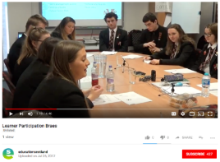
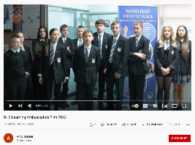
Films – Exemplifying practice
Notes:
The 4 video exemplars are provided to help give schools some examples of how the arenas might look in practice – further information on each exemplar and each film clip can be found on the Hub.

Slide 21
Implementation framework
Laying the groundwork
(where are we now?)
Establishing priorities
(where do we want to go??
Taking it forward
(How will we get there?)
Establishing it across school
(How do we build it into wider systems?)
Evaluating and sharing practice
(What has the impact been?)
Laying the groundwork
(where are we now?)
Notes:
These stages of implementation are supported by an implementation framework which accompanies the guidance.
Activities around Laying the groundwork might include doing initial questionnaires and interviews, gathering data, developing a vision.
Activities around Establishing our priorities might include analysing your data and information, looking at where you are in terms of current evaluation activity, choosing arenas to focus on, etc.

Slide 22
Model of
participation
Assigned but informed
Adults decide on the project and young people volunteer for it. The young people understand the project, and they know who decides to involve them and why. Adults respect young people’s views.
Consulted and informed
The project is designed and run
by adults, but young people
are consulted. They have a full
understanding of the process and
their opinions are taken seriously.
Adult-initiated, shared decisions with young people
Adults have the initial idea but young
people are involved in every step of
the planning and implementation.
Not only are their views considered,
but young people are also involved
in taking decisions..
Degrees of
participation
Young people-initiated, shared
decisions with adults
Young people have the ideas, set
up projects and come to adults for
advice, discussion and support.
The adults do not direct but offer
their expertise for young people to
consider.
Young people-initiated
and directed
Young people have the initial idea
and decide how the project is to be
carried out. Adults are available but
do not take charge.
Based on Treseder P Empowering Children and Young People (Save the Children 1997)
Notes:
This model is not provided as an alternative to the arenas but might help schools and early years settings to think about what degree of participation might be appropriate for each activity. It might be appropriate in some instance for adults to decide on projects for young people and invite them along to these or to have something that they want some ideas or consultation from the young people, but in many instances it will be more appropriate for the young people to have more of a say in projects they want to take forward and in how they want to go about this.

Slide 23

Education Scotland
Denholm House
Almondvale Business Park
Almondvale Way
Livingston EH54 6GA
T +44 (0)141 282 5000
E enquiries@educationscotland.gov.uk
www.educationscotland.gov.uk

