Slide 1

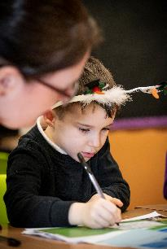
Legislation, policies, strategies and frameworks across Scotland on Parental Involvement, Parental Engagement, Family Learning and Learning at Home
Legislation, policies, strategies and frameworks across Scotland on Parental Involvement, Parental Engagement, Family Learning and Learning at Home
For Scotland’s learners with Scotland’s educators

Slide 2
Why is legislation on involving and engaging parents and family is important?
Parental/family engagement benefits learners
Start early for long-term gains
Engaging families strengthens families
Frequent programmes with diverse and active roles for families linked to learning are more effective
Higher performing schools foster welcoming cultures and collaborative relationships
Support parents and families to advocate for their children
Working with parent and family leaders and communities can transform settings and schools
Educators and practitioners benefit from working closely with parents and families
Settings and schools improve when they engage parents and families
Local authorities and communities improve
Adapted from:
Henderson, A.T. (2023) ‘It’s Not Another Thing to Do, it’s Another Way to Be’. In Caspe, M. and Hernandez, R. ‘Family and Community Partnerships’. Charlotte NC. Information Age Publishing Inc. pp25-29
For Scotland’s learners with Scotland’s educators

Slide 3
Legislation, Strategies, Policies, Frameworks and national key documents
Professional Learning Guide for Practitioners and Educators
United Nations Convention on the Rights of the Child (UNCRC)
Engaging families in learning: A Thematic Inspection of Family Learning
2022
2024
An Empowered System
Empowerment for parent and pupil participation: National Thematic inspection
Strategic Framework for PI/PE/FL/LAH
Parent Council Resource
Adult Learning Strategy
British Sign Language Toolkit
2021
2020
Realising the Ambition
Review of the Impact of the Parental Involvement Act
Pupil Equity Funding
Research Strategy for Scottish Education
2019
2018
'How good is our....' frameworks
Scottish Attainment Challenge
National Improvement Framework
Family Learning Framework
Review of Learning at Home
Learning Together National Action Plan
Engaging parents and families: A toolkit for practitioners
2017
2016
Family Learning Review
National Improvement Framework Parent Communication Plan
National Standards for Community Engagement
2012
Schools (Consultation) (Scotland) Act
Equality Act
2015
National Parenting Strategy
School Handbook Guidance
Scottish Schools (Parental Involvement) Act
Statutory Guidance
GIRFEC
2007
2010
Parental Involvement in Headteacher and Depute HT appointments (Scotland) Regulations
2000
2006
Standards in Scotland’s Schools etc Act
See notes below for hyperlinks to documents
For Scotland’s learners with Scotland’s educators
Notes:
2000
Standards in Scotland’s School etc Act - https://www.legislation.gov.uk/asp/2000/6/contents
2006
Scottish Schools (Parental Involvement) Act – https://www.legislation.gov.uk/asp/2006/8/contents
Statutory Guidance - https://www.gov.scot/publications/guidance-scottish-schools-parental-involvement-act-2006/
Getting it right for every child (GIRFEC) - https://www2.gov.scot/Topics/People/Young-People/gettingitright
2007
Parental Involvement in Headteacher and Depute HT appointments (Scotland) Regulations- https://www.legislation.gov.uk/ssi/2007/132/made
2010
Schools (Consultation) (Scotland) Act 2010 - https://www.legislation.gov.uk/asp/2010/2/contents
Equality Act - https://www.legislation.gov.uk/ukpga/2010/15/contents
2012
National Parenting Strategy - https://www.gov.scot/publications/national-parenting-strategy-making-positive-difference-children-young-people-through/
School Handbook Guidance - https://www.gov.scot/publications/school-handbook-guidance/
2015
‘How Good is our…’ Frameworks - https://education.gov.scot/inspection-and-review/inspection-frameworks/
Scottish Attainment Challenge - https://education.gov.scot/learning-in-scotland/programmes/scottish-attainment-challenge/
National Improvement Framework - https://www.gov.scot/policies/schools/national-improvement-framework/
2016
Family Learning Review - https://education.gov.scot/resources/review-of-family-learning/
National Improvement Framework Parent Communication Plan - https://www.gov.scot/publications/national-improvement-framework-parent-communication-plan/pages/1/
National Standards for Community Engagement - https://www.voicescotland.org.uk/
2017
Review of the Impact of the Parental Involvement Act - https://www.npfs.org.uk/downloads/review-of-the-impact-of-the-2009-parental-involvement-act/
https://www.npfs.org.uk/downloads/ipsos-mori-research/
Pupil Equity Funding - https://www.gov.scot/publications/pupil-equity-fund-national-operational-guidance-2022/
Research Strategy for Scottish Education - https://www.gov.scot/publications/research-strategy-scottish-education/documents/
2018
Family Learning Framework - https://education.gov.scot/resources/family-learning-framework/
Review of Learning at Home - https://education.gov.scot/resources/review-of-learning-at-home/
Learning Together National Action Plan - https://www.gov.scot/publications/learning-together-scotlands-national-action-plan-parental-involvement-parental-engagement/
Engaging parents and families: A toolkit for practitioners - https://education.gov.scot/resources/engaging-parents-and-families-a-toolkit-for-practitioners/
2019
An empowered system - https://education.gov.scot/resources/an-empowered-system/
Empowerment for parent and pupil participation: National Thematic inspection - https://education.gov.scot/inspection-and-review/hm-chief-inspector-reports-and-guidance/national-thematic-inspections/thematic-reports-up-to-and-including-june-2019/national-thematic-inspection-empowerment-for-parent-and-pupil-participation/
2020
Realising the Ambition - https://education.gov.scot/resources/realising-the-ambition/
2021
Engaging families in learning: A Thematic Inspection of Family Learning - https://education.gov.scot/inspection-and-review/hm-chief-inspector-reports-and-guidance/national-thematic-inspections/engaging-families-in-learning-a-thematic-inspection-of-family-learning/
2022
Strategic Framework for PI/PE/FL/LAH - https://education.gov.scot/resources/strategic-framework-for-parental-involvement/
Parent Council Resource - https://education.gov.scot/parentzone/getting-involved/parent-councils/about-parent-councils/
Adult Learning Strategy - https://www.gov.scot/publications/adult-learning-strategy-scotland-2022-27/
British Sign Language Toolkit - https://education.gov.scot/resources/bsl-toolkit-for-practitioners/
2024
Professional Learning Guide for Practitioners and Educators - https://education.gov.scot/resources/professional-learning-guide-involving-and-engaging-parents-and-families/
United Nations Convention on the Rights of the Child
https://www.gov.scot/publications/united-nations-convention-rights-child-incorporation-scotland-bill-leaflet/
https://education.gov.scot/resources/united-nations-convention-on-the-rights-of-the-child/

Slide 4
Key Documents – Local
Parental Engagement Strategies
https://education.gov.scot/resources/local-authority-parental-involvement-and-engagement-strategies/
Family Learning Strategies
Sometimes contained within Parental Engagement Strategies
For Scotland’s learners with Scotland’s educators

Slide 5
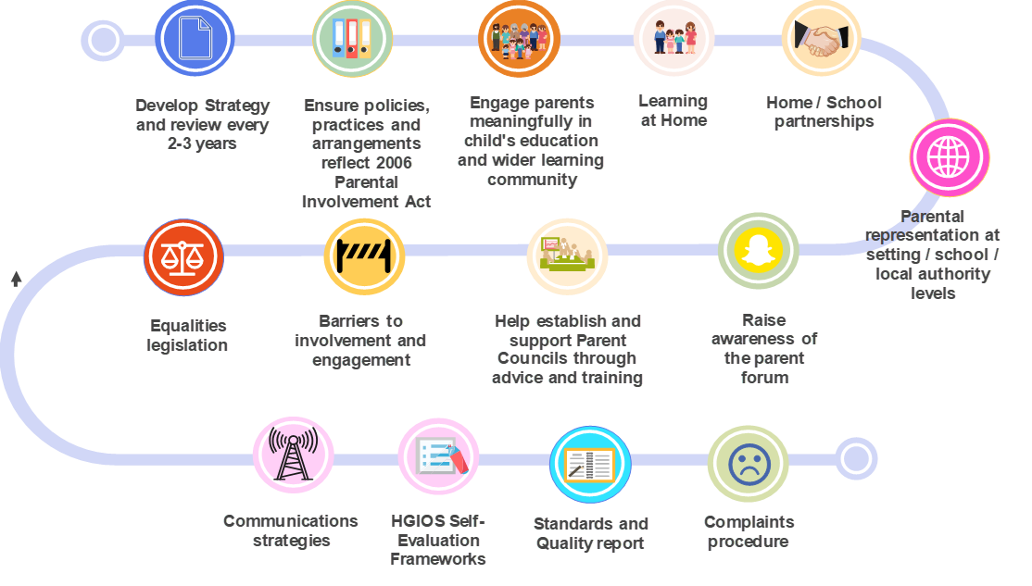
Back to Basics - Legislative
For Scotland’s learners with Scotland’s educators
Notes:
The approaches to involving and engaging parents in their children’s and their own learning requires to be regularly reviewed and adapted to ensure they meet the individual needs of families taking account of different demographics. Communications and relationships based on trust, mutual respect and collaboration are, and will continue to remain an important lever of change and improvement which lies at the heart of all our work with children and families. Having the voice of parents represented will not only influence these approaches and communication methods, it will also help to re-shape the future direction of engaging parents and families in their child’s and their own learning.
There is a need to provide the right support, conditions and opportunities to help parents feel empowered to engage in their child’s and their own learning. Recognising and reducing barriers and/or previous negative or false beliefs, attitudes or mindsets which are preventing parents from engaging in their child’s and their own learning require to be a key focus for local parental involvement and engagement strategies.

Slide 6
Back to Basics - Current
For Scotland’s learners with Scotland’s educators

