Slide 1
Autism & Inclusive Practice
Professional Learning Module
Session 7. Transitions and Module Completion
For Scotland's learners, with Scotland's educators
Do luchd-ionnsachaidh na h-Alba, le luchd-foghlaim Alba
Notes:
The module An Introduction to Autism and Inclusive Practice is designed to provide an introduction for educational staff and anyone with an interest in supporting autistic learners in the settings that they work and support. This introductory module aims to help you develop an awareness of what autism is, its impact and how it can be supported within an inclusive school community. It may also be of interest if you work in the voluntary sector or simply have an interest in autism and inclusive practice.

Slide 2
This week’s session
Terminology
The Scottish context for autism and inclusion
Understanding Autism
Assessment and Monitoring
Supporting Learners and Families
Social and Emotional Wellbeing
Transitions
Notes:
The module and this supporting programme for reflection is split into seven sections:
Terminology
The Scottish context for autism and inclusion
Understanding Autism
Assessment and Monitoring
Supporting Learners and Families
Social and Emotional Wellbeing
Transitions
Today we will explore the seventh and last section of the module, Transitions.

Slide 3
Recap of Section 7 Transitions
7.1 | Transitions and autism
7.2 | Supporting transitions for autistic learners
7.3 | Transition planning to support a school move
Notes:
These are the subsections, included within the section on Transitions:
7.1 Transitions and autism
7.2 Supporting transitions for autistic learners
7.3 Transition planning to support a school move

Slide 4
7.1 Transitions and autism
Notes:
Notes from module:
Transition is not a single event, such as leaving school, but a process that unfolds over many years and involves significant emotional, physical, intellectual and physiological changes. During this journey, most autistic learners progressively assume greater autonomy in many diﬀerent areas of their lives and are required to adjust to diﬀerent experiences, expectations, processes, places and routines.
Whatever the form of change and transition, all children and young people are entitled to support to enable them to gain as much as possible from the opportunities which Curriculum for Excellence can provide, and also support in moving into positive and sustained destinations beyond school.
Transitions also impact on the family or on those who care for the child or young person. There are numerous types of transition that occur throughout the day, the school term, the year and across the lifespan as highlighted in Figure 17. It is not always the major (macro) transitions that have the most impact on autistic learners, but all need to be considered and planned for where possible. At the very least, coping with transition needs to be recognised as a potential for increase in stress for learners and their families. In line with legislation, transitions should be planned well in advance.
The extent of any impact from transitions will vary considerably for every autistic learner. This may be due to the levels of understanding, planning and supports in place, as well as the learner’s profile of strengths, skills and areas of difficulty.

Slide 5
7.2 Supporting transitions for autistic learners
Notes:
Notes from module:
When supporting transitions, large (macro) and small (micro) anticipate the support required for coping with change or with new experiences. Visuals can help prepare the learner for new places or unfamiliar experiences e.g. photos of the museum you are planning to visit or of their new classroom. At a calm time, support the learner to plan for upcoming events, helping them to anticipate what could happen and what strategy they could use to cope, for example:
If you know that they will have to wait an unspecified amount of time for a turn, plan what could they do while they are waiting (a visual support could help to remind the child in the moment).
If you are going to the theatre, plan for the child to sit on an end of aisle seat and have a plan for where they could go if they feel they need to leave during the performance.
Try to change only one thing at a time. If there is to be an unfamiliar adult taking the class, try to ensure that the lesson content and room are familiar. If the lesson is to be in an unfamiliar place, try to ensure that the people and resources are familiar.

Slide 6
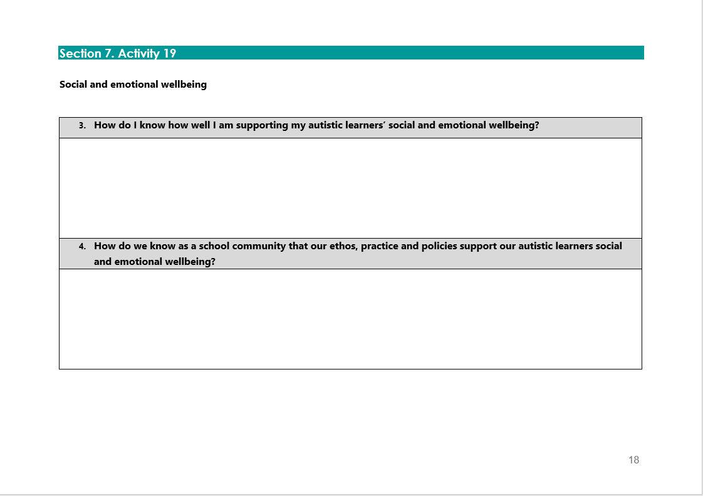
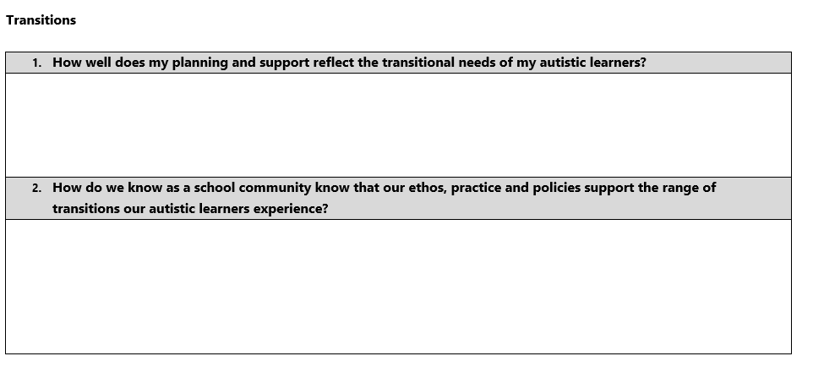
Activity 19
Notes:
Reflective log, page 18 and 19

Slide 7
7.3 Transition planning to support a school move
A range of helpful downloadable resources have been shared by NAIT and some local authorities and are available on the Toolbox to support transitions. You can access them on the Forms and Resources section. http://www.autismtoolbox.co.uk/templates-and-resources
Notes:
Notes from module:
Moving to a new school is a big event in any young person’s life. For autistic learners, transferring to another school can cause fear or anxiety for the young person. Working together, parents and staff can help make this move a successful one by keeping in mind that the autistic young person needs predictability. Creating predictability about the school day will lessen anxiety and fear. There will be new challenges to face in a new school, but a solid support system and appropriate coping strategies will make the transition to a new school easier. Parents/carers and autistic learners need to know what support system the new school has and know who the key people in the school who can help when needed such as the head teacher, deputy head, support teacher, secretary, early years’ worker, support assistant.
It is important to share and discuss with an autistic learner, in a way that is appropriate to their developmental level, why they are moving to a new school. The reasons will vary e.g. it may be due to a move from primary to secondary school or a family house move. The autistic learner may not understand or appreciate the reasons for a change of school but try and talk about the positive aspects of attending a different school. During the discussions with the parents/carers, establish if these discussions have taken place prior to the move. School staff may need to be prepared to discuss feelings around the move with the learner and the learner's perceptions of the move.
When changing school, plan extra visits, starting when the school or classrooms are empty and quiet.
‘All about me’ profiles can be very helpful as it provides an opportunity for the autistic learner to share their strengths, likes, dislikes, adjustments which help them access their learning, etc.

Slide 8
Activity 20

Slide 9
Reflections:Transitions
How well does my planning and support reflect the transitional needs of my autistic learners?
How do we as a school community know that our ethos, practice and policies support the range of transitions our autisitc learners experience?

Slide 10
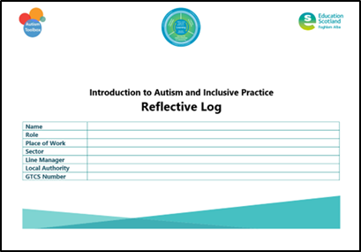
Final reflections
Notes:
Reflective log, page 20

Slide 11
Module Completion and Next Steps
Reflective Log:
Activity 19, page 18 and 19
Module quiz
GTCS Professional Recognition application
Notes:
Final tasks to be completed.

Slide 12
Notes:
Reflective log, page 21

Slide 13
Applying for GTCS Professional Recognition
Apply for Professional Recognition - The General Teaching Council for Scotland (gtcs.org.uk)
Notes:
Use the link for further information from the GTCS on applying for Professional Recognition
Reflective log is key as this provides evidence of your professional learning

Slide 14
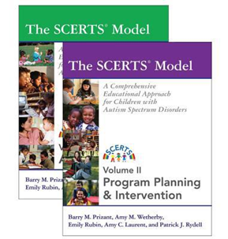
Signposting: Staged Level of Intervention
Targeted support
Universal support
Notes:
Notes from module:
Staged intervention is designed to be flexible and allows for movement between stages depending on progress. Built on a foundation of inclusive practice and the value of ‘we were expecting you’
There are variations between local authorities regarding the number of stages within their process.
Staged intervention is used as a means of identification, assessment, planning, recording and review to meet the learning needs of children and young people.
Provides a solution-focused approach to meeting needs at the earliest opportunity and with the least intrusive level of intervention.
Involves the child, parents/carers, school staff and, at some levels, other professionals. All working in partnership to get it right for every child.
Universal support starts with the ethos, climate and relationships within every learning environment. It is the responsibility of all practitioners to take a child-centred approach which promotes and supports wellbeing, inclusion equality and fairness
Targeted support is usually, but not exclusively, co-ordinated and provided by staff with additional training and expertise through a staged intervention process. This may be by staff other than the class teacher and outwith the pre-school or school setting but within education services
Targeted' support is any focused support which children or young people may require for short or longer periods of time to help them overcome barriers to learning or to ensure progress in learning.
How this support can be planned for and delivered – universal and targeted support – Circle and SCERTS are complementary approaches
When a child’s needs have first been recognised and are being met, (in class and in the school), staff in schools look to CIRCLE for guidance.
When a child’s needs have reached a level that they require support whether from specialized education staff, psychologists, AHPs and services or placement in Special Schools or classes- the multi-disciplinary team should be looking to SCERTS as their guidance.
Staff working in mainstream schools have a growing awareness of SCERTS and are beginning to work together on implementing SCERTS plans, however there is no expectation that they will be trained in or lead on this as CIRCLE will remain their key guidance – usually

Slide 15
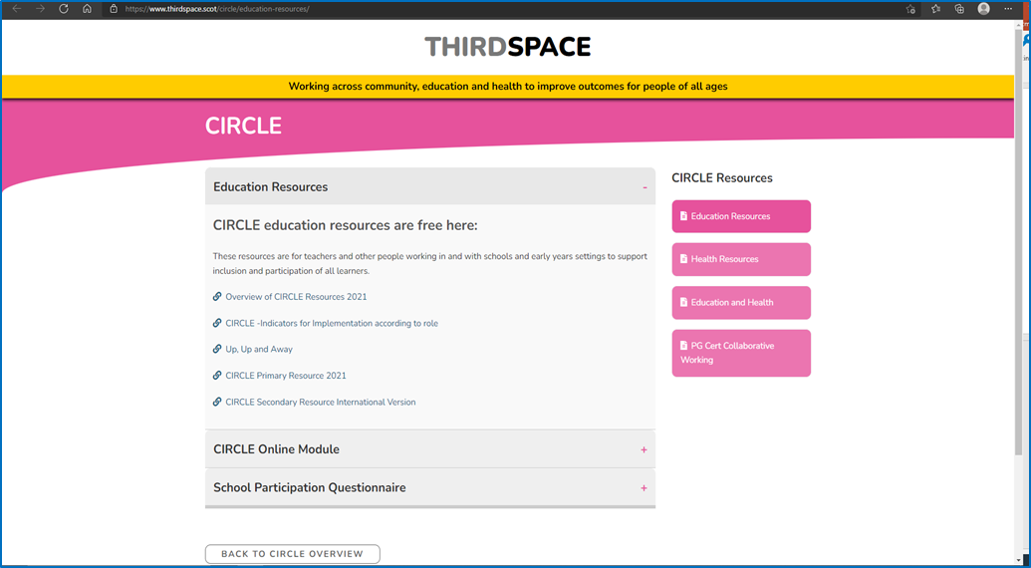
Signposting: Circle
Education Resources | ThirdSpace
Overview-of-CIRCLE-Resources-2021.pdf (thirdspace.scot)
NAIT-CIRCLE-Implementation-Guidance-2021-Final.pdf (thirdspace.scot)
Notes:
Primary, Secondary mainstream:
Inclusive Classroom Scale
Participation Scale
Early Years:
Up Up and Away (individual profile and strategies)
Link to module on this site to free online learning module on Autism Toolbox

Slide 16
Signposting: Collaborative Partnership - Inclusion in Practice: The CIRCLE Framework Modules
The CIRCLE Framework of Inclusion materials have been adapted by Education Scotland in consultation with Edinburgh City and Queen Margaret University to develop the free online modules ‘Inclusion in Practice: The CIRCLE Framework’ Primary and Secondary modules.
OLCreate: Education Scotland - Inclusion and Equalities (open.edu)

Slide 17
Signposting: SCERTS Model
Evidence-based practice
http://www.thirdspace.scot//wp-content/uploads/2019/09/NAIT-Evidence-Based-Toolkit-V-1.1-2019.pdf
Notes:
SCERTS – Targeted Support – not a universal approach
Emphasis on the importance of the adult’s role through Transactional Supports
Emphasis on selecting approaches to supporting goals which are based on quality evidence – not just because we’ve always done things that way or because we’ve tried something before for one child and it appeared to work
Assessment process supports team to drill down into appropriate goals relevant to the individual learner

Slide 18
Signposting: GTCS Key messages
Difference not deficit
Environment first
Provide predictability
Make learning meaningful
Seek to understand distressed behaviour
Ensure adjustments are participatory
We were expecting you!
professional-guide-meeting-needs-autistic-learners.pdf (gtcs.org.uk)
Notes:
Revised standards published August 2021
Summarises the promoted ethos
Considerations for teachers working in ALL roles – we need to all be singing from the same hymn sheet
PRD conversations and standards

Slide 19
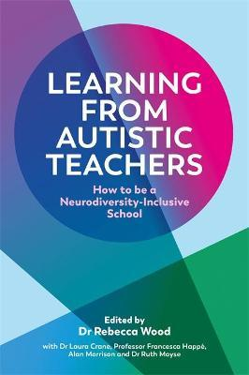
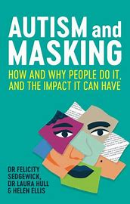
Signposting: Find out more
Uniquely Human: The Podcast – Be Informed. Be Inspired.
Amy Laurent: Compliance is Not the Goal: Letting Go of Control and Rethinking Support for Autistic Individuals | TED Talk

Slide 20
Useful links
Autism Toolbox
Home | Autism Toolbox
Education Scotland free online modules
OLCreate: Education Scotland - Inclusion and Equalities (open.edu)
Education Scotland Professional learning framework
Pupil Support Staff - PL Framework | National Improvement Hub (education.gov.scot)
GTCS professional learning guide for teachers (professional learning and discussion tool
https://www.gtcs.org.uk/web/FILES/professional-guides/Professional-Guide-Autism.pdf
National Autism Implementation Team (NAIT): Evidence-based toolkit:
An Autism Evidence Based Practice Toolkit for use with the SCERTS™ Assessment and Planning Framework (thirdspace.scot)
Notes:
More detailed signposting is included within the final section of the online module

Slide 21
Education Scotland
Denholm House
Almondvale Business Park
Almondvale Way
Livingston EH54 6GA
T +44 (0)131 244 5000
E enquiries@educationscotland.gsi.gov.uk
For Scotland's learners, with Scotland's educators
Notes:
This is a back cover page in blue. You may edit the address if needed only. It can only be once and at the end of the PowerPoint presentation. Use the corresponding blue internal and back pages if you are using this page.

