Slide 1


Children’s Rights and the Current Context
What are they? Why do they matter? How do we embed them?
Part 1 – What are they?
For Scotland's learners, with Scotland's educators
Do luchd-ionnsachaidh na h-Alba, le luchd-foghlaim Alba
Notes:
Hi, I’m … and welcome to the 3 session course on Children’s rights and the current context. This is Part 1 – What are Rights?

Slide 2
Protocols
• Turn off your camera
• Mute your microphone
• Post comments, questions and thoughts into the chat window
• The chat will be facilitated by one of our team
• If you would like to speak type SPEAK in chat window or use RAISE HAND facility
• The event will not be recorded
Please introduce yourself in the chat!
For Scotland's learners, with Scotland's educators
Do luchd-ionnsachaidh na h-Alba, le luchd-foghlaim Alba
Notes:
Trainer Tip: Different sessions may have slightly different protocols based on the platform you are delivering the session through or who has asked you to run the session, so it’s worth double checking beforehand if your protocols match the expectations of the people who have asked you to run the sessions, in particular around recording the session.
Please take a moment to read through the protocols of this session.
Please take a moment to introduce yourselves in the chat!

Slide 3
Children’s Rights – What? Why? How?
Aims of professional learning resource (all 3 sessions):
To raise practitioner’s awareness and develop their knowledge/understanding of the United Nations Convention of the Rights of the Child (UNCRC)
To support rights-based practice across schools and other organisations
To link rights-based practice to the Scottish legislation and policy context
To support individuals, establishments and organisations to begin to reflect on and self-evaluate their current practice in light of the UNCRC
(To enable children to know, understand and claim their rights)
For Scotland's learners, with Scotland's educators
Do luchd-ionnsachaidh na h-Alba, le luchd-foghlaim Alba
Notes:
This training is intended to support practitioners knowledge but should also be delivered by those attending the training to other practitioners, so although it can be a stand-alone training, it can also be a training for trainers.
These are the aims for all 3 of the sessions connected with this 3-session course:
- To raise practitioner’s awareness and develop their knowledge/understanding of the United Nations Convention of the Rights of the Child (UNCRC). Through promoting practitioners understanding and knowledge, we want to support children and young people to recognise and realise their rights.
- To support rights-based practice across schools and other organisations.
- To link rights-based practice to the Scottish legislation and policy context.
- To support individuals, establishments and organisations to begin to reflect on and self-evaluate their current practice in light of the UNCRC.
- The final aim (To enable children to know, understand and claim their rights) is in brackets since this highlights the intended impact from the training rather than suggesting that the pack is directly for children or young people.

Slide 4
Session One - What
This session aims to:
Introduce the UNCRC
Reflect on it’s history
Explore some of the articles
For Scotland's learners, with Scotland's educators
Do luchd-ionnsachaidh na h-Alba, le luchd-foghlaim Alba
Notes:
This session aims to:
- Introduce the UNCRC.
- Reflect on it’s history.
- Explore some of the articles.

Slide 5

The United Nation Convention of the Rights of the Child (UNCRC)
This professional learning is about the United Nations Convention on the Rights of the Child, or UNCRC for short.
It is also about how the values, principles and practices of education including CLD can support the UNCRC.
Throughout this professional learning, the term ‘child’ is used as defined by the UNCRC. Please note that this should be understood as meaning ‘children and young people’ as is commonly used in Scotland.
For Scotland's learners, with Scotland's educators
Do luchd-ionnsachaidh na h-Alba, le luchd-foghlaim Alba
Notes:
This professional learning is about the United Nations. Convention on the Rights of the Child, or UNCRC for short.
This PL is also about how the values, principles and practices of education including CLD can support the UNCRC.
Throughout this professional learning, the term ‘child’ is used as defined by the UNCRC. Please note that this should be understood as meaning ‘children and young people’ as is commonly used in Scotland.

Slide 6
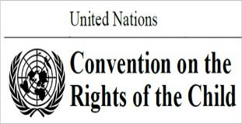
What is the UNCRC?
Every child has the right to survival, protection and education. The United Nations Convention on the Rights of the Child (UNCRC) is a legally-binding international agreement setting out the civil, political, economic, social and cultural rights of every child, regardless of their race, religion or abilities.
For Scotland's learners, with Scotland's educators
Do luchd-ionnsachaidh na h-Alba, le luchd-foghlaim Alba
Notes:
Every child has the right to survival, protection and education. The United Nations Convention on the Rights of the Child (UNCRC) is a legally-binding international agreement setting out the civil, political, economic, social and cultural rights of every child, regardless of their race, religion or abilities. Nations that ratify this convention are bound to it by international law.

Slide 7



What are rights?
Type up to three word that you associate with children’s rights - this will be used to create a wordle for children’s rights
Or open a new browser using: insert link
If you have a smartphone, please go to
www.menti.com
Use the code
For Scotland's learners, with Scotland's educators
Do luchd-ionnsachaidh na h-Alba, le luchd-foghlaim Alba
Notes:
What are rights?
You should all have received a participant pack in advance of the session and will hopefully have had a look through it. The pack was to give you a bit about the background of rights and what they are. If you haven’t had a chance to look at it, it would be worth finding time to look at it after the session.
To begin this session, I thought it would be a good to get an idea about your answers to the question ‘what are rights’.
Activity: Please take a moment to consider what three words you might associate with Children’s Rights.
Trainer Tip: You can do this activity in any way you like. We have found that using Mentimetre to create a wordle is a great way to get quick participant engagement with the output of a lovely visual which can be exported and emailed to all participants after the session.
Talk through any commonalities in the words coming through. If there are some unusual words, you might want to ask the person or people who put it down to unmute and talk through why they contributed that word.

Slide 8
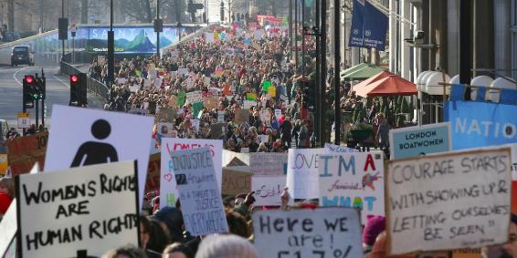
Activity
If you feel comfortable, share a time when you were aware of your own or someone else’s human rights being infringed in some way.
- What were the circumstances around this?
- What was the impact?
If you would like to speak,
raise hand.
For Scotland's learners, with Scotland's educators
Do luchd-ionnsachaidh na h-Alba, le luchd-foghlaim Alba
Notes:
If you feel comfortable, share a time when you were aware of your own or someone else’s human rights being infringed in some way.
- What were the circumstances around this?
- What was the impact?
If you would like to speak, please raise your hand.
Leave time to allow people to reflect and type in the chat pane, or raise their hand.
It’s important to begin learning about what children’s rights are so that we can be aware of when they might be being infringed on and then we can rectify the situation, as the impact of infringing on a child’s rights can be negative and has the potential to be long lasting.

Slide 9

The Articles
54 Articles:
Part 1 (1-42): Provisions
Part 2 (42-45): Implementation and monitoring
Part 3 (46-54): Final clauses
UNIVERSAL
UNCONDITIONAL
INALIENABLE
INHERENT
INDIVISIBLE
For Scotland's learners, with Scotland's educators
Do luchd-ionnsachaidh na h-Alba, le luchd-foghlaim Alba
Notes:
The UNCRC has 54 articles in total:
- 1 to 41 are substantive articles describing specific rights, the majority of which impact on services provided by Local Authorities.
- 42-54 talk about how the UN and National Governments work to ensure those rights.
Key Points:
- The UNCRC is Universal and applies to ALL children, regardless of race, religion, abilities or family circumstances.
- Rights are Unconditional: All children everywhere in the world are entitled to rights, they do not have to be earned
and they are not dependant on responsibilities – children have them regardless.
- Human rights are Inalienable: They cannot be given or taken away.
- They are Inherent: They are permanent and cannot be separated from the individual.
- Human rights are Indivisible: Rights are completely interdependent and depend on each other for their effectiveness. So for example children have the right to relax and play and they also have the right of free assembly. They need to exercise both these rights for either one to work properly.
It’s important we know the 2 U’s and the 3 I’s so that we fully understand how essential getting this right in schools is.

Slide 10

Article Activity
54 Articles:
3 domains/themes:
  PROVISION
  PROTECTION
  PARTICIPATION
  Sorting activity – padlet
For Scotland's learners, with Scotland's educators
Do luchd-ionnsachaidh na h-Alba, le luchd-foghlaim Alba
Notes:
The rights can be organised around 3 domains, often referred to as the 3 Ps:
- Provision of services, such as education or healthcare.
- Protection of children and young people from abuse or from dangerous drugs (for example).
- Promoting the Participation of children and young people so that their views are sought, heard and actively influence decisions or outcomes.

Slide 11


Articles Activity:
Provision; Protection; Participation
Sort the rights into the three domains of the 3 P’s
Please open a new browser tab and go to: (Insert link)
For Scotland's learners, with Scotland's educators
Do luchd-ionnsachaidh na h-Alba, le luchd-foghlaim Alba
Notes:
Activity: To start getting to know the articles, consider which articles you would consider to fall under each of the 3 P’s
Trainer Tip: You can do this activity in any way you like. We have found that sending out a link to a summary of the UNCRC articles: https://bit.ly/2ZkLhES and then using Padlet to display the three headings and allow participants to decided which article to put under each heading is a great way to get quick participant engagement. This can also be done on Jamboard or traditional way with flip chart and post its
Talk through any commonalities coming through. There may be some articles that fall under more than one heading, which is fine. You may want to highlight that to the participants.
It’s important to be aware of the three P’s of provision, protection and participation so that we can begin to recognise our own role in ensuring that children and young people have these aspects realised within our settings.

Slide 12
Agree / Disagree Activity
Agree / Disagree Activity –
SOMEWHERE
IN THE
MIDDLE
AGREE
DISAGREE
For Scotland's learners, with Scotland's educators
Do luchd-ionnsachaidh na h-Alba, le luchd-foghlaim Alba
Notes:
Trainer Tip: We have found that this next activity has the best engagement within the session, and we would recommend that you facilitate it in the way detailed in the script. As you become more confident, you may choose to adapt the way it’s facilitated, however the prompt statements MUST remain the same.
This next activity is about reflecting on our own thoughts around what is involved in Children’s Rights education.
I am going to read some statements out to you and you are going to consider whether you strongly agree, agree, neither agree nor disagree, disagree or strongly disagree with each statement.
To do this, we are going to use menti.

Slide 13
Activity Agree/Disagree
Or open a new browser using: insert link
If you have a smartphone, please go to
www.menti.com
Use the code
For Scotland's learners, with Scotland's educators
Do luchd-ionnsachaidh na h-Alba, le luchd-foghlaim Alba
Notes:
After each statement you will have a chance to vote and a bar chart will be created reflecting our group results for each statement. After you have had a chance at voting on each statement, we’ll then go back and discuss them:
After each statement you will have a chance to vote and a bar chart will be created reflecting our group results for each statement. After you have had a chance at voting on each statement, we’ll then go back and discuss them:
1. Children and young people need to be taught about their responsibilities when learning about their rights.
2. Children and young people already know enough about their rights.
3. Promoting children’s rights endangers the rights of the adults looking after the children.
4. Giving children and young people a voice can make their behaviour more challenging for adults sometimes.
5. Children and young people from disadvantaged backgrounds should be given greater support to realise their rights.
6. Children and young people should be seen as active partners in their education rather than service users.
For statement 1, Children and young people do not need to be taught about their responsibilities when learning about their rights. Different people may have different ideas around what it is to be responsible, but rights are inalienable, and cannot be taken away based on whether we deem a child responsible or not. This is very clear in the UNCRC preamble, and will be enshrined in law. If we get in the habit of teaching rights along with responsibilities, it might even become a child protection issue, as children may think they have to act in a certain way in order to be allowed a right. When teaching about rights, we might want to consider changing our language away from ‘responsibilities’ to ‘respecting’ instead. All children have rights and it’s important to respect rights so that everyone is able to maintain those rights. It may help to discuss human rights more generally, and look at the UDHR alongside the UNCRC. Remember that children are also entitled to the rights set out in the UDHR – but they have additional rights because of their vulnerability as children.
Trainer Tip: At this point participants may have questions as traditionally the word ‘responsibility’ has been used to help teach children’s rights. Some practitioners can find it very difficult to accept the separation of rights and responsibilities – either because of their own values and/or due to the content in some of the Es and Os. It is worth reminding them that CfE is guidance and not mandatory, whereas UNCRC is statutory. In sessions there have been questions around the phrase ‘rights and responsibilities’ within the social subjects and HWB E’s and O’s and the phrase ‘Responsible Citizen’ from the four capacities. If this comes up, it might be worth mentioning that there is a working group in place and one of the things they are looking at is the wording around this. If discussing with children the idea of being a ‘responsible citizen’ it might be an idea to ask children to consider how we respect other people’s rights and then discussing what they would consider to be responsible behaviour, while bearing in mind that responsibility is subjective, and as long as rights are being respected, there isn’t really a wrong answer to what it is to be responsible.
For statement 2, it has been revealed that both adults and children don’t generally know enough about their rights, so it’s important to ensure staff in settings get regular professional learning opportunities so that they are able to talk about children’s rights with their learners more confidently and consistently.
For statement 3, some adults do feel that teaching children about their rights infringes on adults rights, which is simply not true. Parents and carers have their thoughts and opinions considered as part of their children’s rights as well.
For statement 4, how you answered may depend on your interpretation of the question.
If children and young people have a good understanding of their rights they may feel enabled to respectfully challenging practitioners when they feel their rights aren’t being fully respected, or if they have ideas to share. If we’re not used to facilitating this level of participatory planning within learning and teaching, it might sometimes feel like a challenge to our teaching practice. However, if we fully embrace that participatory process of children feeling able to respectfully challenge moments within lessons, or within the wider school setting, then it might lead to really exciting thinking and progress.
The other way to interpret this question might be if children don’t understand rights and then begin to challenge in a disrespectful way, causing disruptions in the lessons. This may stem from children and potentially teaching staff not understanding how rights can be considered and then embedded within practice. The solution is to ensure a well-developed understanding of rights-based practice so that disrespectful challenging is mainly avoided, and if it does persist, practitioners will have the tools to be able to handle the situation well.
For statement 5, it is generally agreed that children from disadvantaged backgrounds do sometimes need more help to realise their rights. And potentially with the wording of this question we need to challenge ourselves to consider what the word ‘disadvantage’ might mean in different contexts, and who might experience disadvantage around different rights. For example, in a rural context a young person may be disadvantaged if members of their family can’t drive or don’t have access to transport, therefore that young person may need greater support to realise article 31, the right to play and relax by doing things like sport, music and drama, and Article 15, having the right to be with friends and join or set up clubs.
For statement 6, it is generally agreed that Children and young people should be seen as active partners in their education rather than service users, especially as the underpinning rights of article 12 and 3 are that children have the right to an opinion and for it to be listened to and taken seriously, and adults should act in the best interest of the child, and that might include finding out from the child what their thoughts are.
Hopefully that activity has enabled you to reflect on your own thoughts around children’s right practice and helped give you some food for thought.

Slide 14
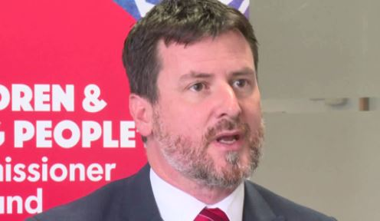
Film – Children and their rights
View video on ES YouTube channel: https://youtu.be/4znwLrvVkMU
For Scotland's learners, with Scotland's educators
Do luchd-ionnsachaidh na h-Alba, le luchd-foghlaim Alba
Notes:
Trainer Tip: It’s worth having the link for this next clip ready to paste into the chat pane in case the embedded link doesn’t work. That way, participants can play the clip on their own devices and let you know when it’s finished for you to resume the presentation.
This is a film clip of Scotland’s Children’s Commissioner explaining why rights are so important along with children from Longniddry giving their interpretation of why rights are important.

Slide 15


NEEDS
Body of Rights
A - Adults
B - Children
For Scotland's learners, with Scotland's educators
Do luchd-ionnsachaidh na h-Alba, le luchd-foghlaim Alba
Notes:
Activity: Consider what the wants and needs are of adults and children
Trainer Tip: You can do this activity any way you like. We have found that this activity is best done on padlet where there are four headings of Wants (Adult); Needs (Adults); Wants (Children); Needs (Children), so that practitioners have the chance to choose which headings they feel most able to input under. This is a good way of getting quick engagement from practitioners.

Slide 16
Activity - Body of Rights
Suggest what you consider to be wants and needs of adults and wants and needs of children
Please open a new browser tab and go to: insert link
For Scotland's learners, with Scotland's educators
Do luchd-ionnsachaidh na h-Alba, le luchd-foghlaim Alba
Notes:
Once practitioners have inputted, it would be good to comment on commonalities between adult and children needs, adult and children wants, whether there are things people considered to be a want and a need, and whether practitioners could identify things that are clearly wants and clearly needs.
This can also be done using jamboard

Slide 17

Body of Rights
What is a Right?
For Scotland's learners, with Scotland's educators
Do luchd-ionnsachaidh na h-Alba, le luchd-foghlaim Alba
Notes:
Activity: Pose the questions:
- What is a right?
- What is the difference between a right, a want and a need?
Trainer Tip: You can do this activity in any way you like. We have found that posing the questions and getting people to answer in the chat pane is a great way to get quick participant engagement. If no one engages, just go to the next slide.

Slide 18

Body of Rights – Wants, needs and rights
Want - a desire for something
Need - the state of requiring help, or of lacking basic necessities such as food
Right - a moral or legal entitlement to have or do something
For Scotland's learners, with Scotland's educators
Do luchd-ionnsachaidh na h-Alba, le luchd-foghlaim Alba
Notes:
Nailing down the differences between these things can actually be quite challenging for both adults and children and young people to do. Understanding what rights really are is an essential part of leading colleagues through this professional learning experience; it is quite easy for wants, needs and rights to become confused when talking about children’s rights.
Wants refers to something you don’t need but would like to have. A good example of this wanting to have expensive toys to play with. Children have a right to play, but it is only a want to have an expensive toy to play with.
A need is an aspiration that can be quite legitimate, but it is not necessarily associated with an obligation to cater for it; satisfaction of a need cannot be enforced. Quite often a need may come about if there is a lack of something. For example, if we’ve spent a lot of time feeling isolated and lonely, and lacking in social contact, a need might be to have social contact with a friend or family member.
A want or a need also has the capacity to change based on how a personal feels at a specific moment, or on the context they are in. For example, if we haven’t been feeling isolated or lonely, that social contact with family or friends might then become a want rather than a need.
Rights come from needs, but not all needs have rights associated with them. A human right is something to which someone is entitled solely by virtue of being alive; it is something which enables a person to live with dignity. A right can be enforced before the government and entails an obligation on the part of the government. Looking at something from a perspective of rights puts the person with that right in a position of strength: it protects their core entitlements.

Slide 19


What are rights?
Human rights are the basic rights and freedoms which everyone is entitled to. We are all entitled to human rights in order to live with dignity.
Human rights are rights inherent to all human beings, whatever our nationality, place of residence, sex, national or ethnic origin, colour, religion, language, or any other status. We are all equally entitled to our human rights without discrimination. These rights are all interrelated, interdependent and indivisible.
Oxford Online Dictionary:
A moral or legal entitlement to have or do something
For Scotland's learners, with Scotland's educators
Do luchd-ionnsachaidh na h-Alba, le luchd-foghlaim Alba
Notes:
Activity: Consider what the definitions might be for the terms ‘right’ and ‘human right’.
Trainer Tip: You can do this activity in any way you like. We have found that posing the questions and getting people to answer in the chat pane is a great way to get quick participant engagement.
Here are a couple of definitions:
- “Human rights are rights inherent to all human beings, whatever our nationality, place of residence, sex, national or ethnic origin, colour, religion, language, or any other status. We are all equally entitled to our human rights without discrimination. These rights are all interrelated, interdependent and indivisible” – United Nations of Human Rights: Office of the High Commissioner.
- “Human rights are the basic rights and freedoms which everyone is entitled to. We are all entitled to human rights in order to live with dignity” – Scottish Human Rights Commission
- “A moral or legal entitlement to have or do something” – Oxford Online Dictionary.
The term ‘right’ may conjure up images of compensation-claim lawyers’ adverts, but it is important that the vision of dignity and respect, which rights seek to protect, is not lost.
‘Rights’ can be seen from the perspective of the bearer, but much of the work undertaken to bring about the protection of children’s rights has come about from experiences of atrocity, poverty and abuse; it is in this context that children’s rights can be seen from the perspective of the adults, the duty-bearers, in ensuring that the dignity, respect and basic requirements for development of children are all protected and promoted.

Slide 20
Body of rights – Do children need separate rights?
Do children need separate rights?
Maturity
Voiceless &
invisible
Possessions
For Scotland's learners, with Scotland's educators
Do luchd-ionnsachaidh na h-Alba, le luchd-foghlaim Alba
Notes:
Activity: Consider, do children need separate rights? Justify your answer.
Trainer Tip: You can do this activity in any way you like. We have found that posing the questions and getting people to answer in the chat pane is a great way to get quick participant engagement.
Children have the same human rights as adults, but because they are more vulnerable, they need extra protection.

Slide 21

Activity – Review of pre-course learning
In the chat, highlight anything of interest that you learned about the history of rights. Did anything surprise you?
Additional discussion points:
Who were some of the key players in taking forward children’s rights?
What are some of the key messages in the Universal declaration of human rights?
What are some of the key reasons given for the need to have specific children’s rights?
For Scotland's learners, with Scotland's educators
Do luchd-ionnsachaidh na h-Alba, le luchd-foghlaim Alba
Notes:
Activity: Highlight anything of interest that you learned about the history of rights. Did anything surprise you? Consider:
Who were some of the key players in taking forward children’s rights?
What are some of the key messages in the Universal declaration of human rights?
What are some of the key reasons given for the need to have specific children’s rights?
Trainer Tip: You can do this activity in any way you like. We have found that posing the questions and getting people to answer in the chat pane is a great way to get quick participant engagement.
Once practitioners have inputted, it would be good to comment on commonalities.

Slide 22

Context – Universal declaration of Human Rights
WWII Context: atrocities and human suffering
World leaders agreed to protect the rights and dignity of every human person
Introduced in 1946
Commission on Human Rights (1947)
    Proposed Sept 1948;
    adopted 10 Dec 1948
For Scotland's learners, with Scotland's educators
Do luchd-ionnsachaidh na h-Alba, le luchd-foghlaim Alba
Notes:
These are a couple of moments that we found interesting:
- 1917 – Declaration of Children’s Rights produced by Proletkult following Russian Revolution.
- 1919 – Polish paediatrician and educationalist Janusz Korcak wrote about children’s rights in his book ‘How to Love a Child’.
- 1924 – Declaration of the Rights of the Child (Declaration of Geneva) adopted by League of Nations in 1924 (focus=care & protection).
- 1945 – 50 nations form the UN following the war.

Slide 23
Context – Putting the World to Rights
UNCRC
Need to see Children’s Rights differently
1948 – UDHR
1959 – Special provision for children
1978 – 34th Session of UN Commission
1989 – CRC Ratified by UN
1990 – CRC brought into force
    1991 – CRC ratified by UK
    54 Articles (42 about CYP)
    Applicable from birth to 18*
    3 Optional Protocols
UN Convention on the Rights
of the Child
For Scotland's learners, with Scotland's educators
Do luchd-ionnsachaidh na h-Alba, le luchd-foghlaim Alba
Notes:
To continue:
- 1948 – UDHR / amended form of ‘Declaration of the Rights of the Child’ adopted by UN.
- 1959 – Declaration expanded to 10 points to include special treatment, education and care for disabled children, as well as the rights to play and recreation.
- 1978 – Polish delegation to 34th session of the UN Commission tabled a motion that the UN should adopt a convention on the rights of the child (previously attempted in 1959).
- 1989 – UNCRC ratified; brought into force in 1990; ratified by UK government in Dec 1991)
- 1979 – UN International Year of the Child
- 1989 – CRC Ratified by UN
- 1990 – CRC brought into force
- 1991 – CRC ratified by UK; 54 Articles (42 about CYP); Applicable from birth to 18*
Optional Protocols:
- Involvement of children in armed conflict.
- Sale of children, child prostitution and child pornography.
- On 19 December 2011, the UN General Assembly approved a third optional protocol on a Communications Procedure, which will allow individual children to submit complaints regarding specific violations of their rights under the Convention and its first two optional protocols.
Children’s rights are applicable from birth until the young person’s 18th birthday.
USA still not ratified – this is due to aspects around the death penalty for under 18s, and the belief that the UNCRC undermines parental rights.

Slide 24
What is a rights based approach?
‘A children’s rights based approach is a principled and practical framework for working with children and young people, grounded in the UNCRC and other international rights conventions. It is about placing the UNCRC at the heart of planning and service delivery and integrating children and young people’s rights into every aspect of decision making, policy and practice’
- State of Children’s Rights Report, 2017
For Scotland's learners, with Scotland's educators
Do luchd-ionnsachaidh na h-Alba, le luchd-foghlaim Alba
Notes:
Together Scotland – an alliance of children’s charities that work to improve the awareness, understanding and implementation of the UNCRC – produce an annual state of children’s rights report about how children and young people are experiencing their rights in Scotland. When speaking about what a right’s based approach is, they say:
“A children’s rights based approach is a principled and practical framework for working with children and young people, grounded in the UNCRC and other international rights conventions. It is about placing the UNCRC at the heart of planning and service delivery and integrating children and young people’s rights into every aspect of decision making, policy and practice” – State of Children’s Rights Report 2017.
This means that any change to policy or practice should have the rights of the child at the centre.

Slide 25
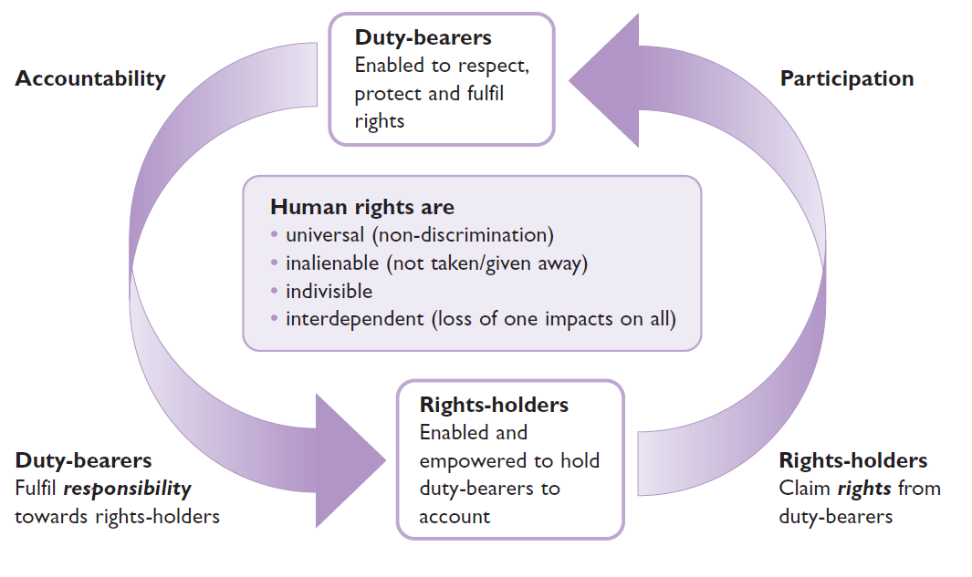
Rights holder and duty bearers
For Scotland's learners, with Scotland's educators
Getting It Right, Save the Children
Do luchd-ionnsachaidh na h-Alba, le luchd-foghlaim Alba
Notes:
This slide is around the duty-bearer and rights-holder relationship and is taken from ‘Getting it Right’ by Save the Children:
A fundamental element of rights-based approaches is the process through which duty-bearers meet, and are held to account for, their obligations, and through which rights-holders are empowered to claim their entitlements. So you will need to understand how this relationship works at various levels in your particular context. Your programme should help enable the effective functioning of the duty-bearer–rights-holder relationship. You may need to take action to hold duty-bearers to account and to support them to fulfil their obligations. You may also need to empower and strengthen the capacity of children as rights-holders (and others in civil society) to claim the entitlements to which they are due.
The diagram describes this relationship.
Who is the duty-bearer? Duty-bearers are those defined as having obligations under the UNCRC and other international human rights conventions.
The state is the main duty-bearer. It has obligations to respect, protect and fulfil people’s rights. It may delegate some of its responsibilities to others (such as private companies or civil society groups). The international community also has obligations to support the state in meeting its responsibilities to fulfil children’s rights.
Parents and others who care for children are also duty-bearers, with specific responsibilities towards children. They may be described as secondary duty-bearers. Other individuals and groups may have certain responsibilities for children, depending on the moral codes of the particular society or culture. These are generally moral duties rather than legal duties.

Slide 26
Film – How can schools and communities support children’s rights
View video on ES YouTube channel: https://youtu.be/4znwLrvVkMU
For Scotland's learners, with Scotland's educators
Do luchd-ionnsachaidh na h-Alba, le luchd-foghlaim Alba
Notes:
Trainer Tip: It’s worth having the link for this next clip ready to paste into the chat pane in case the embedded link doesn’t work. That way, participants can play the clip on their own devices and let you know when it’s finished for you to resume the presentation.
This clip is about Scotland’s Children’s Commissioner discussing why schools and communities are important in taking forward children’s rights - Everyone should be involved in building these positive relationships.

