Slide 1


Keeping the Promise Award
Notes:
Welcome back everyone.
This is the final presentation in the Keeping the Promise Award.
The purpose of the programme is to raise awareness of the potential challenges care experienced children and young people may face and how we can individually and collectively Keep Scotland’s Promise to them in terms of improving their learning experience and educational outcomes.
This professional learning helps us identify our responsibilities to these learners.
In this session you will receive information and guidance on what you can do in your day to day practice to promote the wellbeing, attainment and participation of any child or young person.
We all want to feel LOVED, SAFE and RESPECTED. We especially want our care experienced children and young people to feel LOVED, SAFE and RESPECTED.
Throughout the session, where possible, the voice and lived experience of care experienced children and young people has been used.
Hopefully this session will demonstrate the positive impact that ‘we’ as practitioners, can have on care experienced children and young people’s lives and learning.

Slide 2
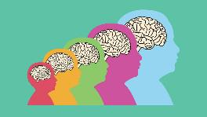

Supporting Children and Young People
(including those who have care experience)
Understanding needs & what we can do?
  Trauma
  Risk factors to wellbeing and learning
  Brain development & our Window of Tolerance
  Positive experiences & resilience
  Nurture Principles
  What children and young people say
  What do we do, what can we do?
  Every child needs a champion
  Next steps
Notes:
To support our care experienced children and young people and to actively engage in Keeping The Promise, we need to first understand how their experiences and development shape them.
Once we know this we then need to know how we can best support them.
The information shared today is relevant for all children and young people however care experienced children and young people’s lives can be very complex, more so than their non-care experienced peers, so today we will spend some time on understanding how their life journey may have impacted their wellbeing and ability to learn.
We want you to leave today knowing that there ARE things we all can do individually and collectively to support care experienced children and young people.
At the end of the session we will signpost you to further reading and resources but if there are any of the topics we haven’t covered you can mention them in the next steps session or on the evaluation form at the end.
Health warning! Traumatic experiences are more common than we know! Today we will touch on a few difficult topics including trauma, grief and loss which may trigger thoughts about your own personal experiences. It can also be difficult to think about in terms of the children we work with and care about. These thoughts can trigger strong feelings. So please remember to be aware of your own reactions and look after yourself. If you need to take a breather, feel free to step out for a bit and if you need to, reach out to colleagues or friends you trust.

Slide 3
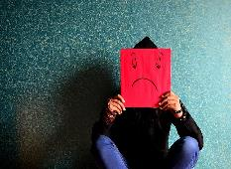
What is Trauma?
An experience, or pattern of experiences, that impairs the proper functioning of the stress-response system, making it more reactive or sensitive.
Bruce Perry
An inescapably stressful event that overwhelms people’s existing coping mechanisms.
Bessel van der Kolk
Psychological trauma is the unique individual experience of an event or of enduring conditions in which the individual’s ability to integrate his or her emotional experience is overwhelmed (i.e. his or her ability to stay present, understand what is happening, integrate the feelings, and make sense of the experience), or the individual experiences (subjectively) a threat to life, bodily integrity, or sanity.
Pearlman & Saakvitne
Notes:
We start today by considering trauma. Trauma is much more prevalent than we realise and many of us will have experienced trauma in our own lives. We are looking at trauma more closely today as many care experienced children and young people may have experienced some level of trauma and their trauma may even be connected to their care experience.
Here are some definitions from the literature:
Bessel van der Kolk – author of The Body Keeps the Score – read quote or give audience time to read quote.
Bruce Perry – big researcher in developmental trauma. Lots of books such as The Boy who was raised as a dog, What happened to you? – read quote or give audience time to read quote.
Pearlman & Saakvitne – they talk about trauma as an individual experience – ie. will affect individuals differently including individuals within the same family group
Read quotes or give audience time to read quote

Slide 4
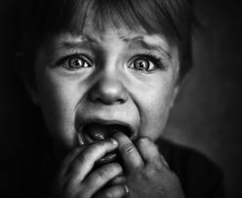
Types of Trauma?
3 Broad types
Simple Trauma
Involves experiences of events that are life threatening and/or have the potential to cause serious injury, e.g. car accidents, fires.
Complex Trauma
Involves interpersonal threat, violence and violation. It way involve multiple incidents. Examples include child abuse, bullying, domestic violence, rape and war.
Collective Trauma
The psychological reactions to a traumatic event that effects an entire society.
Notes:
Children are particularly vulnerable to trauma.
For children under four the most significant trauma is witnessing a threat to a parent or carer.
Children and young people are not always consciously aware of the trauma they have witnessed, therefore, may not be able to respond or process this effectively.
Our bodies may display a physiological response to trauma in response to fear and threat. This includes increased heart rate, sweating, shaking, needing the toilet, difficulties sleeping, changes in eating habits.
Our bodies can go into flight, fight, freeze or fawn responses in order to try and avoid further trauma.
Instinctively our bodies will focus on survival, as a result, the thinking part of the brain is overruled and instead the primitive brain takes over which does not always allow for rational thinking or responses.
This slide shows the 3 broad types of trauma.

Slide 5

Developmental Trauma:
is how complex trauma can impact on children and young people
describes how their development can slow down or become impaired following trauma
describes the impact of early, repeated abuse, neglect, separation and adverse experiences that happens within the child’s important relationships
Experiences may alter the behaviour of an adult, but it provides the organising framework of the infant and the child
An understanding of how early experiences shape neurodevelopment is imperative if we seek to impact the lives of children. This is especially true in the case of children growing up in homes plagued by violence, maltreatment and neglect.
The impact of early trauma is so profound because it occurs during those critical periods when the brain is most rapidly developing and organising.
Bruce Perry
Notes:
Children and young people who have experienced trauma may have ongoing physical responses such as: re-triggering trauma memories, flashbacks, intrusive thoughts, sleep disturbance, appetite disturbance, avoidance of people or places, mistrust of people, under or over reliance on others.
It is important to note that these are normal responses to abnormal and traumatic experiences. Responses are also dependant on a variety of factors including the intensity of the event, the experience of the individual, level of understanding/resilience and the child/young person’s developmental stage.

Slide 6
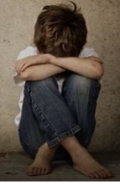
Risk factors to wellbeing and learning
Poverty
Adversity caused by neglect or abuse
Disability
Other wellbeing or health needs
Challenging family circumstances
Loss (parental separation, bereavement)
Our environment (physical, learning, social and emotional)
Notes:
Adverse childhood experiences can impact on children and young people’s wellbeing and learning. Care Experienced children and young people are more likely to have experienced a higher number of ACEs.
A UK study in 2014 found that 67% of people experienced at least one Adverse Childhood Experience with 9% of the population having experienced four Adverse Childhood Experiences. (Bellis et al, 2014)
There are no similar studies in Scotland, however, a recent Welsh study found that the most Common Adverse Childhood Experience was verbal/emotional abuse (23% of households) and parental separation.
Refer to Further Viewing - NHS video on e-learning module and podcast from Bruce Perry & Oprah Winfrey on Childhood Trauma: ACES Podcast - 40 Mins

Slide 7
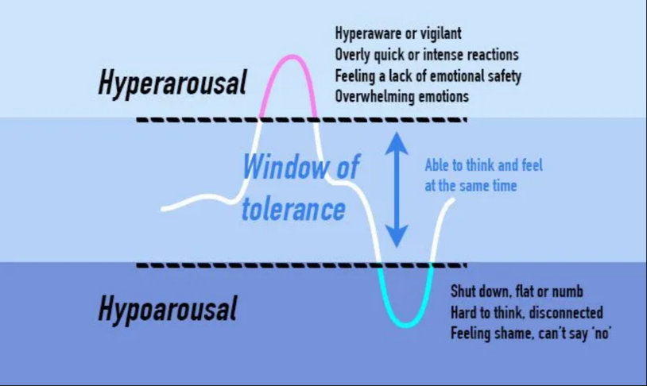
Brain development
& our Window of
Tolerance
Notes:
We are now going to watch a six-minute clip called the Window of Tolerance from the Beacon House Trust. This short clip will highlight how the brain and body react to trauma.
Refer to Further Viewing Self-Regulation Video: Helping Young Children Cope with Stress

Slide 8

Window of tolerance film
6 min
48 sec
Video courtesy of Beacon House 2023 (Therapeutic Services & Trauma Team)
www.beaconhouse.org.uk
If you are viewing this as a pdf use this link to access the film:
https://youtu.be/0ehq5-P5OSs?si=SlJCLc1o6Y5NvBiI
Notes:
Watch film -Window of Tolerance (6 min 48 sec)

Slide 9
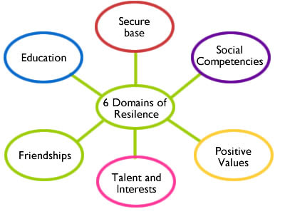
Positive Experiences
&
Resilience
Notes:
It is important to remember that children and young people also experience many positive experiences throughout their lives that can help counteract adversity and build resilience.
These include having a safe loving home (or in attachment terms a secure base), having social competency and positive values, having interests and hobbies, having connection with friends, and access to education (which is huge factor in terms of resilience).
Refer to Further Reading - Building Resilience Through Positive Childhood Experiences

Slide 10

Nurture Principles
Learning is understood developmentally
Environment offers a safe Base
All behaviour is communication
Transitions are important in children’s lives
Language is a vital means of communication
Nurture is important for wellbeing
Has experience impacted brain development
Think stage not age
Play is important at all ages
Nurture
Principles
Notes:
Many care experienced children and young people have attachment issues. We cannot mention attachment without mentioning the 6 nurture principles.
Nurture as a practice means relating to and coaching children and young people to help them form positive relationships, build resilience and improve their social, emotional and mental health and wellbeing. These six principles help staff to focus on the social and emotional needs and development of children and young people.
During this professional learning session we will only be able to touch on the Nurture Principles but it is important to recognise the value and relevance of them to understanding children’s behaviour and how we might be able to best support them.

Slide 11


Areas of Wellbeing
Emotional Wellbeing
Positive Self-identity
Security and Comfort
Physical Wellbeing
Social Wellbeing
Notes:
Wellbeing is made up of different aspects as illustrated in the diagram. These aspects broadly encompass our physical and mental wellbeing.
Emotional Wellbeing is enhanced by hobbies, spending time with friends, having time for relaxation, being mindful, being optimistic, recognising and expressing our feelings, being solution focussed.
Positive self-identity/self-esteem is enhanced by personal resilience, knowing your strengths, and being open to inspiration, learning, or being creative.
Security and comfort is enhanced by a positive environment, being organised, having a support network, and managing our finances well or making sound decisions.
Physical Wellbeing is enhanced by sleep, holidays, exercise, eating well, relaxation, pampering.
Social Wellbeing is enhanced by a sense of belonging, working as a team, positive relationships, having a healthy work life balance, humour and laughter.
Of course, physical health and mental wellbeing are interlinked, and it is important that learners understand that good physical health contributes to good mental wellbeing, and vice versa.

Slide 12

Nurture for Wellbeing & Self Esteem
I am:
Good
Deserving
Capable
I am:
Bad
Unlovable
Useless
Others are:
Understanding
Responsive
Accessible
Others (are):
Unreliable
Unresponsive
Uncaring
The world is:
Unsafe
The world is:
Safe
Insecure attachment
Secure attachment
Notes:
Children who have not had those early nurturing experiences often have very negative thoughts and feelings about themselves – they often operate in the brain stem, reptilian and reactive part of the brain rather than the cognitive, thinking part of the brain.
Children and young people who feel cared for and valued are much more likely to be happy and do well in life.
Children who know themselves well and have self-respect are more likely to be resilient and strong, cope with change and challenge in life and make good choices.
We want all children and young people to feel safe and secure and be able to work in a supportive environment that promotes respect.
We want learners to establish a pattern of ‘being’ and living that is healthy and which will be sustained into adult life. These children may become parents and will hopefully raise their children to be healthy and happy.

Slide 13
The importance of
One Good Adult
Notes:
This short film clip which we are about to play illustrates beautifully how having a supportive and trusted adult is key to how well a child or young person is connected; self-confident, future looking and can cope with problems.

Slide 14
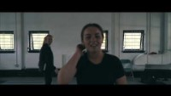
One Good Adult
2 min
58 sec
Film created by Greater Glasgow and Clyde NHS
If you are viewing this as a pdf use this link to access the film: https://youtu.be/nuEHXTQNE-k
Notes:
Watch One Good Adult NHSGGC (2mins 58sec)

Slide 15
Could you be that
One Good Adult?
Notes:
The One Good Adult concept is a key element of the NHS Greater Glasgow and Clyde child and youth mental health improvement and early intervention framework.
The absence of a supportive and trusted adult is linked to higher levels of distress, anti-social behaviour and an increased risk of suicidal behaviour.
The supportive and trusted adult can be a parent, grandparent, youth worker, sports coach, teacher, janitor or someone who is available to them in times of need.
This film shares the benefits of having a supportive and trusted adult and encourages young people to think about who theirs might be.

Slide 16

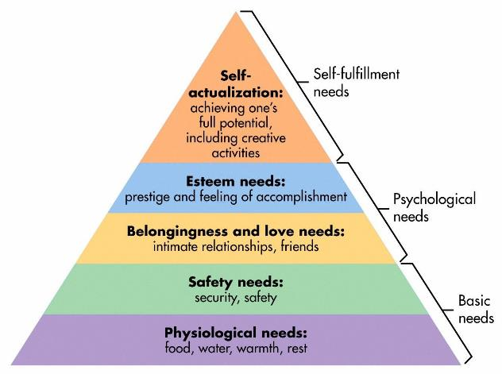
The Environment Offers a Safe Base
Maslow’s hierarchy of needs
  safety is key!
Physical safety
  environment, visuals, exit strategy
Emotional/psychological safety
  structure/relationships/key adults
Notes:
Safety is a basic human need.
Some of our pupils haven’t experienced what so many of us take for granted – safety, security, and stability throughout their lives.
Maslow’s Hierarchy demonstrates that feelings of safety, security, and connectedness underpinning higher-order areas such as self-esteem, social and emotional competence, and self-fulfilment. All these things are important for healthy relationships in their future.
Remember learning cannot really happen unless these basic needs are met first.
We may need to focus on a child’s safety and security in order for them to become learning ready before even considering developing things like resilience or growth mindsets.
So, how do we promote physical safety?
The physical environment can help create that feeling of safety and security for a child who has experienced trauma or loss. This may include creating or identifying what a safe space might look like for an individual child or young person, evaluating classroom settings, safe spaces or breakout areas, considering clutter, levels of visual or auditory stimuli etc. It’s best practice to ask the expert - the child or young person.
For emotional or psychological safety, we could look at individual support plans or other shared information. We also may need to consider options such as counselling, mentoring, or safe spaces.
You will know this is very much dependent on relationships across the school community. These need to be positive and consistent to be effective.
Knowing children well and being able to work with them to identify triggers and supportive factors is vital. Providing structure, predictability, and being prepared, showing consistency and having boundaries, using praise and reassurance, and always having positive beginnings and endings during transitions are all useful approaches to take.

Slide 17
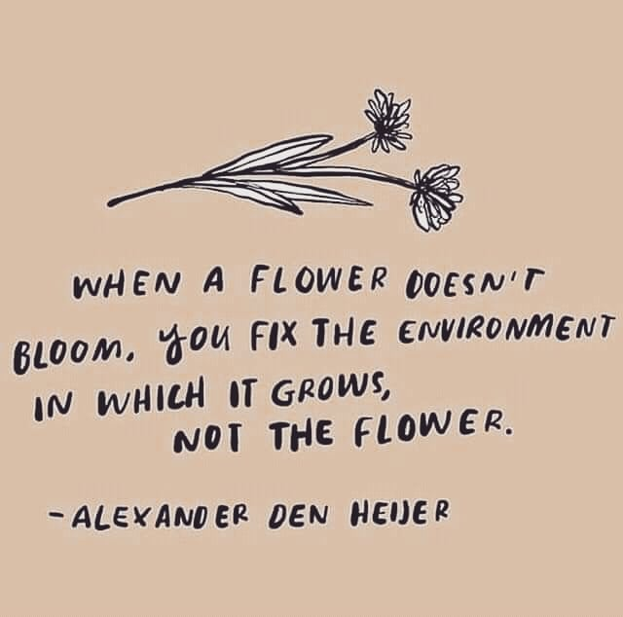
The Environment Offers a Safe Base 2
Notes:
This quote exemplifies what we are considering when promoting a sense of safety. The nurture approach aims to replace “missing or distorted” early nurturing experiences by immersing children in to warm and welcoming environments which facilitate social, emotional and cognitive development (Lucas et al, 2006)

Slide 18

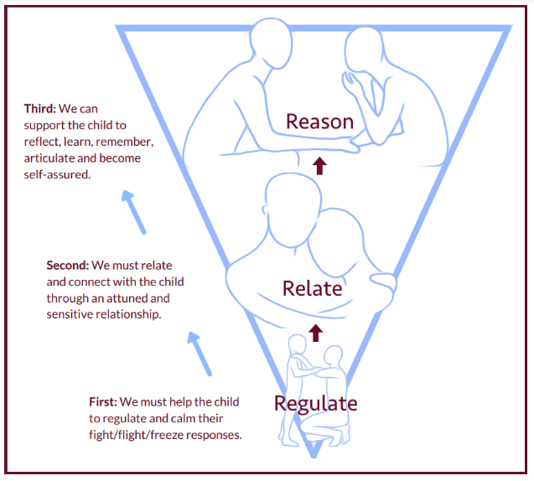
All Behaviour is
Communication
Children display both ‘desirable’
and ‘undesirable’ behaviours.
All behaviour serves a purpose.
By trying to work out the reasons, we can identify what changes we need to make our own behaviour to promote desirable ones.
Behaviour should be viewed in the context of the child’s needs and environment
The Promise there should be “no barriers to engagement”
Notes:
Even when we provide physical and emotional safety there will still be times when we are faced with challenging behaviour. Behaviour that’s possibly a response to childhood trauma.
Some behaviour may be described as “distressed” or “dysregulated” because:
It is difficult to manage and understand
Presents a risk to the young person, other young people, or adults
It is not appropriate for the environment in which it is exhibited
It is inappropriate given the child or young person’s age or developmental ability
None of these are easy to support but if we can work with the young person to reflect on what needs to change in order to minimise distressed behaviour we can move towards ensuring behaviour is not a barrier to engagement or accessing learning.
Using the sequence of engagement – 1. regulate, 2. relate and then 3. Reason
Not reasoning until they are regulated and you’ve validated their feelings, not their behaviour, means we are working with how the brain works and not against it.
This gives us the best chance to re-engage the child and move on.

Slide 19
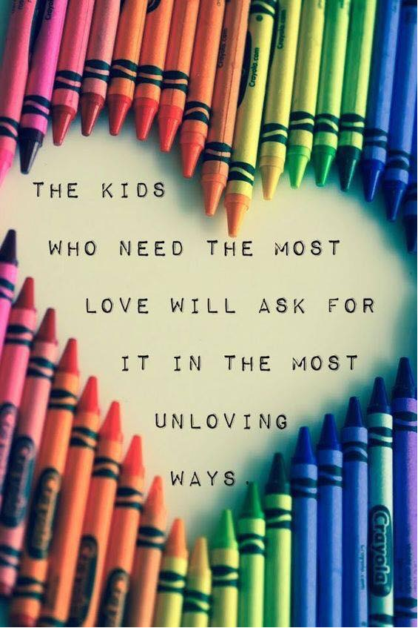
See past challenging behaviour
Notes:
This lovely graphic reminds us of what we are reflecting on! It can be difficult to see past the challenging behaviour and remain resilient and understanding at times but we should try to always remember what sits behind the behaviour.

Slide 20

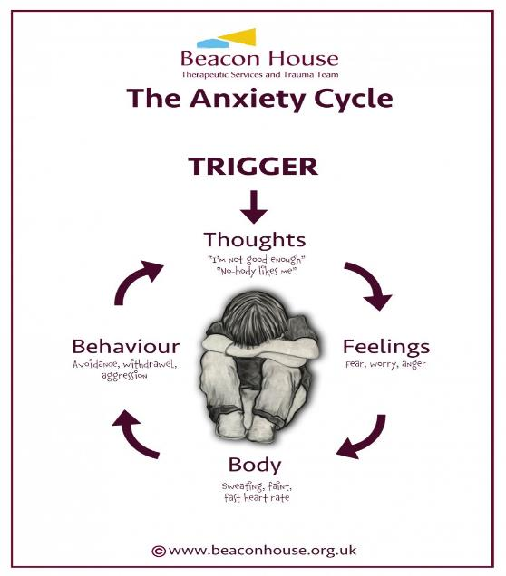
Reflection Time
What might distressed behaviour look like?
What might this be communicating?
Notes:
This activity can be adapted depending on delivery e.g. face to face, personal reflection, jam board, menti etc.
For this reflection activity take some time to consider the questions above and reflect on what this behaviour may be telling you.
You will likely have one or two children or young people in mind.
Consider what you understand about their previous or current experiences to identify what the behaviour may be telling you and where this may be coming from.

Slide 21
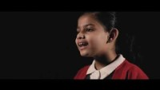
Why I am rude
2 min
26 sec
Poem written by Sarah Dillons
If you are viewing this as a pdf use this link to access the film: https://youtu.be/waeRP6jzW_U
Notes:
Watch Film

Slide 22
Why I am rude?
Notes:
This short film is a reminder to us all of what a young person may be feeling in our classrooms and what it can look and feel like when the sense of safety and security is missing.

Slide 23
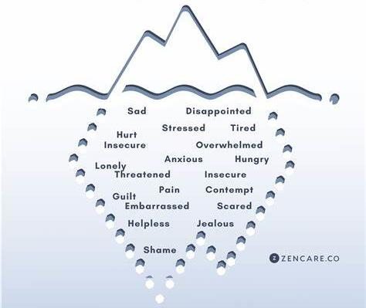
The Anger
Iceberg
Anger could be masking other feelings
Notes:
If all behaviour is communication we want to ‘get curious’ about what is causing the young person to display the behaviour. Anger is often a secondary emotion with something else underneath. Children and young people themselves often don’t have the language to articulate what they are feeling. So, at times asking them directly won’t necessarily provide us with answers. We may first need to teach, explain, or explore the language of feeling to get to the bottom of why a child or young person appears angry.
This information can be very useful for planning future support for a child or young person.

Slide 24
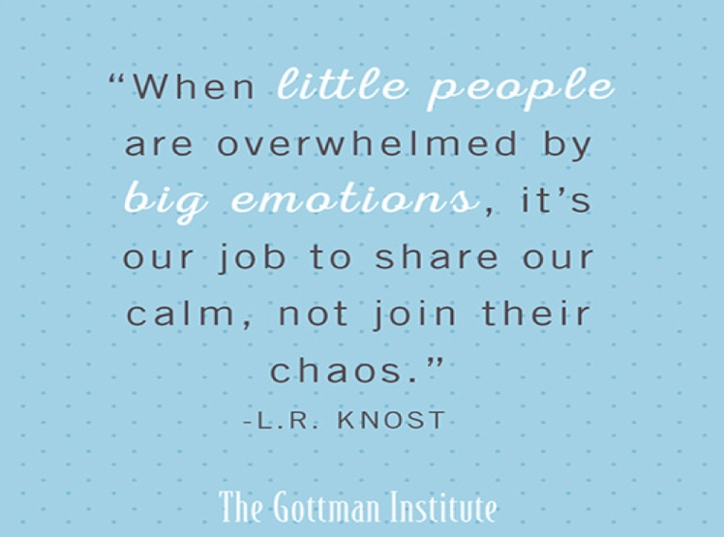
Little people with big emotions
Notes:
As practitioners, we need to be able to acknowledge the need for children to express anger, fear, sadness and disgust.
These are complex emotions to identify, understand and manage.
Anger in one person is often met with anger or fear in another.
This emotional transference can keep people locked in negative cycles within their relationships.
It is our job to change that cycle for children and young people by allowing ‘our calm’ to become ‘their calm’.
With patience and perseverance, we can teach them how to manage these big emotions safely.
We also need to make sure we are looking after our own emotional wellbeing when we work with those who have experienced significant trauma.
It isn’t just little people who are overwhelmed at times, adults can become overwhelmed too.

Slide 25
Get Curious Not Furious!
Notes:
Through curiosity, you can develop your understanding of what will work with children and young people both from a preventative and responsive viewpoint.
By getting to know the child or young person you are working with, you will be able to identify:
their early warning signs when they are finding it difficult to regulate their emotions (situations, stressors, tell-tale signs in their communication both verbal and non-verbal)
their interests and motivators
ideas that can be used to distract or divert attention
effective calming activities and de-escalation strategies
Ultimately it is through curiosity, that we demonstrate our commitment to helping children and young people when they are in crisis, and strengthen our relationships with them as a result.
Again refer to the Self-Regulation video in the Further Resources section

Slide 26

Language is a Vital Means of Communication
Playfulness
Acceptance
Curiosity
Empathy
Big gestures
Cheeky grin
Varying tone of voice
Laughing together
“Help me understand…”
“Let me see if I have this right…”
“I’ve just realised…”
“What if…”
“I can see that…”
“I’m wondering if…”
“I can see how…”
“I imagine that was…”
“It’s such a big ask…”
Notes:
One of the six nurture principles, language is a vital means of communication, applies to our internal narrative and to how people view us externally.
We want to use all the verbal and non-verbal language that we can to encourage positive interactions with children and young people, to give them a sense of safety, that they are worthy of positive attention and acceptance, that people can be playful, kind and curious and want to be there for them.
That people can be empathic to what they are needing, and to what they are going through. We can remember this through PACE. We all need to go at the right PACE with our children and young people.

Slide 27
What Happens If We Reframe Our Thinking and Language?
Angry
Aggressive
Defiant
Not engaging
Rude
Withdrawn
Attention seeking
Avoidant
Unacceptable behaviour
Distressed
Frightened
‘In fight’ survival mode
Doesn’t feel safe yet
Self protective
Cautious
Attachment seeking/attention needing
‘In flight’ survival mode
Understandable behaviour
Notes:
Our internal use of language, how we label, describe and interpret what is happening, is important as it directly influences how we respond to every given situation.
Therefore, the more accurate we are with our language, and the more we focus on positive, helpful language that encourages us to see growth and opportunity for positive change, the better placed we will be to support the young people we are working with.

Slide 28

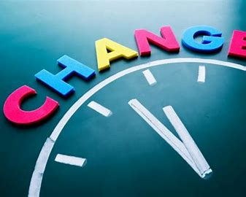
What are Transitions?
“Passing or change from one place, state or condition to another”
Notes:
When we are talking about transitions in a child or young person’s life this includes the big transitions such as a move from primary to secondary school/change of care placement but also the small transitions such as a change from class to class or even between activities in a CLD setting
This could also be subtle changes within a young persons’ environment such as a change in the way the furniture is arranged or a different member of staff leading a session.
Transitions are challenging because they force us to let go of the familiar and face the future with a feeling of vulnerability.
When children and young people have developed secure attachments with their primary care givers and when they are confident in their relationships, then transitions can be key times for development of new skills and, while causing nerves, can be approached as exciting opportunities for new experiences.
For children who have grown up with disrupted attachments at the centre of their emotional life, then any stable element of their life is held to as an anchor for their feelings and the sense of panic and dread in the approach to a transition, however small, can result in emotional disregulation and reactive behaviours that are centred on fear of the unknown and what can’t be controlled.
When all the personal aspects of their life at home have been subject to flux and unannounced change, then every element of control that they can exert in their relationships at school helps them to validate their sense of self. When this control is threatened by a transition then their immediate response is to fight for the status quo. So we may want to ‘get curious’ and ask ourselves:
Why might transitions be difficult for this child or young person?

Slide 29
Supporting all Transitions
‘Big’ transitions
Changing school
Change of care placement
Moving to a new class
Family separation
New siblings
Changes in family circumstances
Holiday periods
‘Small’ transitions
Getting up in the morning
Different staff in today
Moving from home to school
Change in class environment
Beginning an activity
Tidying up after an activity
Moving from school to home
Going to bed
Notes:
When children live through a chaotic home life with no validation of their worth from unreliable and indifferent care givers, they seek to test the relationships that develop at school on the basis that they may fracture, as all previous relationships that may have fractured in their emotional life.
Changes in their environment, routine and experience of school life will feel to them as portents of new change and disruption and as further examples of rejection and confirmation of their low self-worth.
Children who have experienced such chaotic home lives in their infancy and early childhood and have moved into new care arrangements will carry the imprint of their early experiences in how they approach change and how they cling to whatever feels permanent.
Yet change is inevitable in life and particularly in schools, where the daily, weekly and yearly routines all bring change at different times - small changes and large changes.
How do we support children to accept and work through change?
The first key principle is to give children time to process a change before that change occurs. Depending on the extent of the change then time required could be hours to months. The larger the change the more time required to talk through with the child the implications of the change and how key things will remain constant.
The second thing to emphasise is how the changes will not undermine relationships that have developed and how what has grown between staff members and a child will not be lost and can be revisited and enjoyed in other ways.
An example of a small change: Moving seat within a class – A child who is hypervigilant to threats may like to ‘scan’ a room so they have a view of what is going on around them. If the place they sit in the class has changed this may prevent them from settling to learn.

Slide 30
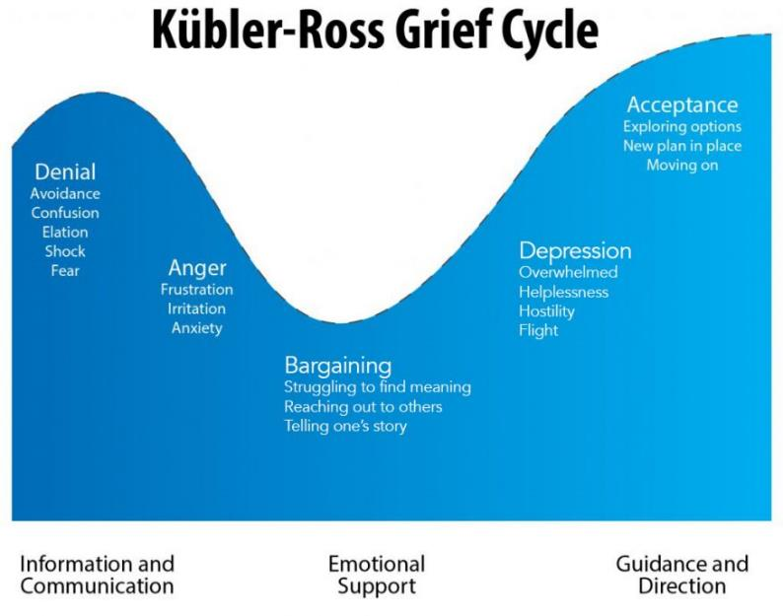
The Grief (or Change)
Cycle
It can take around 9 months for individuals to adapt following a significant life event (Williams, 1999), which for children can include moving schools.
During this period children and young people are unlikely to be in a position to learn without the appropriate social and emotional support in place.
Time is so important, for everyone.
Notes:
Looking at this cycle, you can think about how children will respond to change by following the emotions mapped out in the cycle. It can be that some children will require more scaffolding as set out in the elements underpinning the cycle.
Some children can become blocked at points in the cycle if they have not had the opportunity to experience change in a positive way with caring adult support.
Often care experienced children have suffered unexpected large changes in their lives which can leave them stuck at points in the cycle and this can be expressed in their reaction to other smaller changes.
Briefly summarise the change curve
Stage 1 - People may be in shock or in denial; the reality of the change hits, even if the change has been well planned
Stage 2 – Feelings of concern, anger, resentment or fear might emerge and be expressed; the change may be resisted passively or actively
Stage 3 – This is the turning point for individuals and a team; individuals will try out and explore what the change means as they are more accepting of the change
Stage 4 – Between the bargaining stage and acceptance people tend to feel overwhelmed, helpless and may react with hostility or withdraw.
Stage 5 – At the acceptance stage the changes have become part of day to day life; people see the improvements and embrace the change.
It can take around 9 months for individuals to adapt following a significant life event (Williams, 1999), which for children can include moving schools.
During this period children and young people are unlikely to be in a position to learn without the appropriate social and emotional support in place.
Time is so important, for everyone.

Slide 31
Care experienced children and young people were asked about their educational experiences
East Dumbartonshire Council’s
Champion’s Board
Notes:
The 15+ aged members of the Champions Board in East Dunbartonshire were keen to let us hear their voices and know their thoughts around school and education.
They were asked:
What was important to you at school?
Where did school get it right?
Where did school get it wrong?
How can school help?
What advice would you give Care Experienced Young People now?
Their response was brief, but powerful and moving.

Slide 32


EDC Champs Board Film
3 min
01 sec
If you are viewing this as a pdf use this link to access the film:
Powtoon - EDC Champs Board Education Powtoon- V3
Notes:
Play film by clicking on the slide. It will take you to the internet to access the film.

Slide 33
Jamboard
How are we currently supporting care experienced young people?
What works, how do we know?
Notes:
Create a Jamboard for this activity if the meeting is virtual or use flip chart paper if the meeting is in-person. Ensure you put people into groups here of around 5/6 if working with larger numbers.
Following on from watching the Film/Animation – ask your group/s the two questions on the slide.
What you are aiming to do is allow people to feel positive about things, using the knowledge of your establishment/setting, you could also pre-prepare some points of discussion.
What are they already doing to support CE learners – for example regular planning meetings and information sharing so staff can get things right – use of language being used – being inclusive in after school clubs, supporting transportation issues if in care out with the area – gathering pupil voice using surveys and focus groups, and so on.

Slide 34
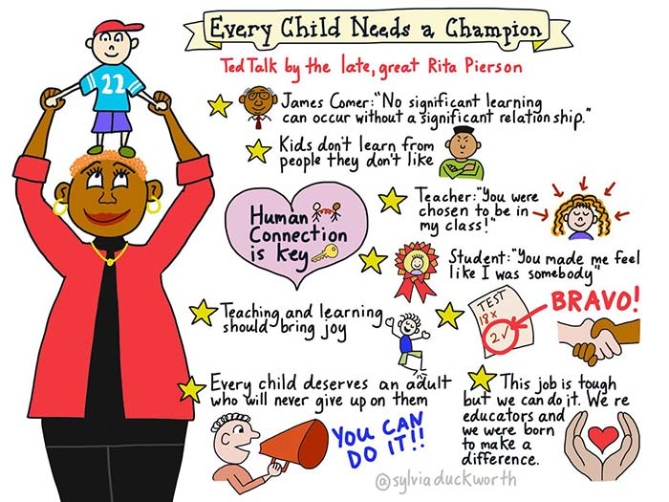
How can we be that good adult/champion?
Optional to view but it is an inspiring film
To access the film please follow this link and then return to the presentation:
https://youtu.be/SFnMTHhKdkw
7 min 48 sec
Created by TED Talk
Notes:
Optional to view but it is an inspiring film. To access the film please follow this link and then return to the presentation:
https://youtu.be/SFnMTHhKdkw
When we talk about supporting our children and young people it is vital we remember that one good, consistent, and trusting relationship (CONNECTION) can make a difference in their life. Some of our children and young people come from rather challenging backgrounds, and most remain within these. Having a good understanding of what has happened to them is beneficial in being able to make that connection, whilst appreciating how difficult this will be for them.
As people working with children and young people, no matter what role we have, it is important we recognise how we respond, react, and support our children and young people as this can have a profound impact on how they then perceive adults.
We must ensure we are consistent and relatable, allow yourself to be a human being so that our children and young people can build that relationship, and be shown that adults in their lives care about them, have aspiration, and hope for their futures.

Slide 35

Next Steps for Your CLD Setting?
So what will you do differently?
What will your setting do differently?
What will you help your community do differently?
Notes:
This activity can be done using menti, jamboard, or flipchart paper.
When responding to these questions think about The Promise foundations particularly:
Voice – Listen to our children, and involve them in decision making
People – Actively support our children in developing relationships
Family – Work together to support families and help them support their child
Scaffolding – When necessary support each other to be able to support our children and young people.
Ask the questions

Slide 36
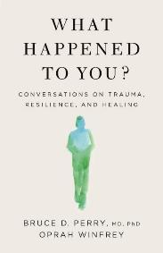
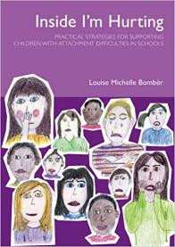
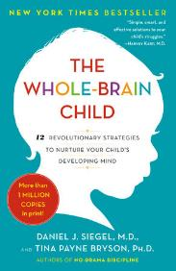
Further resources
Education Scotland - Promoting Positive Relationships and Behaviour in Educational Settings
Education Scotland - CIRCLE resource to support Inclusive Learning and Collaborative Working
Beacon House - https://beaconhouse.org.uk/resources/
EP Insight website - https://www.epinsight.com/
Bruce Perry & Oprah Winfrey on Childhood Trauma: ACES Podcast - 40 Mins
LSelf-Regulation Video: Helping Young Children Cope with Stress (2.10 mins)
Building Resilience Through Positive Childhood Experiences
Bruce Perry books
Louise Bomber books
Dan Siegal books
Notes:
Refer to resources available
This is not an exhaustive list but may be a starting place for any further reading or professional learning.

Slide 37
The Personal e-Learning Module
Please complete the e-Learning module in your own time
when you have successfully completed the quiz at the end of the module – you will be sent a Keeping the Promise Badge
When 70% of all staff in our setting have completed the End of Module Quiz successfully the Setting will receive the Keeping the Promise Award Certificate
Thank you for your participation so far!!
Notes:
Well done! That’s the end of the formal presentations for this course and there is now only one more step to complete the Award. That’s the e-Learning Module that you will have to complete independently.
At the end of this presentation you will find a live link to the E-Learning Module or alternatively you can use the QR Code to access it.
At the end of the e-learning module there will be a short Quiz. The Quiz link will be provided to you by the person leading this professional learning via email.
On successful completion of the Quiz you will receive an ‘I Promise Award’. This will be in the form of a Digital Certificate and a Digital Badge’.
When you complete the Quiz the lead for this training is notified and when 70% of everyone in the establishment completes the Quiz the establishment will receive the ‘We Promise Award.
The digital badges could be used as part of your digital signature. The Formal We Promise Certificates could also be displayed in your establishments foyers or reception areas.
However even more importantly we hope that this professional learning will positively impact the care experienced children and young people you work with.
Thank you for your participation today.

Slide 38
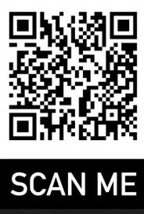
Access to the E-Learning Module
Please use the following weblink or QR code to access the E-Learning module
E-learning Module Link
On completion of the E-Learning Module please complete the Knowledge Check/Quiz (the person Leading this professional learning will be able to provide you with the link to access it)
Notes:
Link for E-Learning Module: https://rise.articulate.com/share/NI8Bga34ZBigMxlx7nP2HR51aYHT-_Y-

