Slide 1
HM Inspectors’ Update
Gaelic Local Authority Network GLAN
Joan Esson: His Majesty’s Inspector of Education
Lead Inspector - Gaelic Sector
March 2024

Slide 2
Planning for improvement
Are you preparing to evaluate practice to decide on improvement priorities for next year?
The Advice on Gaelic Education and Statutory Guidance sets standards for Gaelic Medium and Learner Education. These can be used with the ‘How good is our’ inspection frameworks to contextualise these to the Gaelic sector.
HMI are evidencing improvements from the system’s use of inspection frameworks in this way.

Slide 3
Sharing highly-effective practice to support improvement using Sketchnotes
HM Inspectors observe learning and evaluate practice and policy at first hand.
Sketchnotes are used to provide a visual description of highly effective practice and highlights from inspections.
HM Inspectors have published four Sketchnotes to support the Gaelic sector.
They aim to support building capacity and promoting improvements for all learners of Gaelic, and those learning in the medium of Gaelic.
Learners’ voice is used to relay main messages.
Sketchnotes and challenge questions are available in Gaelic and English.

Slide 4
Total immersion across the Early Years
How do you ensure the regular renewing of total immersion play contexts so that children’s learning is progressive, challenging and promotes curiosity?
Dè na prionnsabalan a th' agad, agus na gnìomhan a nì thu gus dèanamh cinnteach gu bheil ionnsachadh, teagasg agus làn-bhogadh an-còmhnaidh de chàileachd àrd, an dà chuid a-staigh agus a-muigh?

Slide 5
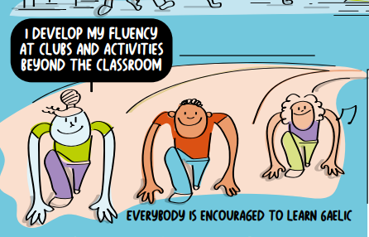
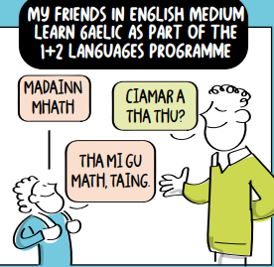
Total immersion in Primary Schools
How well do staff access and apply findings from educational research to improve learning and teaching?
How well do staff work with colleagues within and out with the school to agree standards to be achieved?
Ann an sgoiltean dà-chànanach, dè cho math ’s a tha Foghlam Luchd-ionnsachaidh na Gàidhlig air fhighe a-steach tarsainn a’ churraicealaim agus a cho-theacsa?
A bheil cothrom cunbhalach aig clann agus daoine òga air ionnsachadh, cluinntinn agus cleachdadh na Gàidhlig?

Slide 6
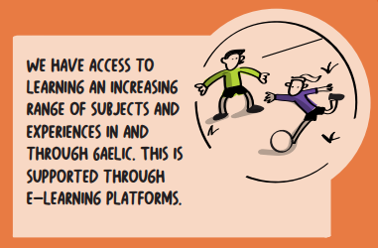
Total immersion in Secondary Schools
How well is the school promoting individualised pathways for those in Gaelic Medium Education, including vocational options and by using digital technology?
Dè cho math ’s a tha daoine òga a’ faighinn air adhart gu teisteanasan aig ceann shuas na h-àrd-sgoile ann an litearrachd, àireamhachd, agus slàinte is sunnd, cuspairean, raointean curraicealaim, coileanadh pearsanta agus ann an ionnsachadh eadar-chuspaireil?

Slide 7
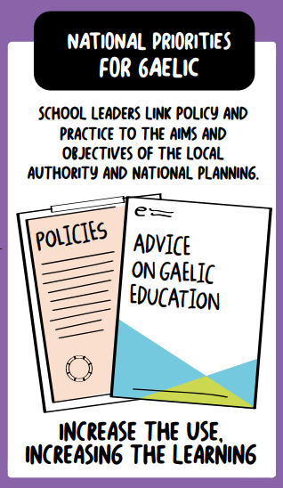
Leadership of Gàidhlig Education
How well is Gaelic language, culture and heritage captured in the school’s vision, values and aims?
Dè tha dol gu math leis an ro-innleachd agad airson na Gàidhlig?

Slide 8
Sharing highly- effective practice using case studies - celebrating difference
Children are clear about the importance of recognising and respecting differences.
The school community is well informed about children’s rights and the rights of those with protected characteristics.
The school focuses on justice and fairness for all. Children talk confidently about how this work helps them build relationships with others.

Slide 9
Gaelic language learning at Lochdonhead Primary
This case study from lochdonhead primary school references Gaelic Learners.
“all children benefit from a well-established, structured programme for Gaelic language learning and have regular access to learning, hearing and using Gaelic”.
Read more Advice on Gaelic Education.

Slide 10
Illustrations of highly effective practice from summarised inspection findings
Illustration of total immersion example 1
The headteacher leads professional learning for Pupil support staff using “The Advice on Gaelic Education”, 2022. She provides effective support and clear guidance to the Pupil support staff to bring about further improvements.
As a result, children have strong fluency and are confident in total immersion play, which is planned across the curriculum. As children move from sgoil-àraich to P1 they understand Gaelic very well. They speak Gaelic as the language of learning across all contexts from about Christmas of C1.

Slide 11
Illustration: Total Immersion 2
Pupil support staff work across the early and first level, both in the sgoil-àraich and at the primary stages. Importantly, the pupil support staff’s approach enable total immersion in a multi-stage class. They lead opportunities for children to hear and use Gaelic in exciting and relevant spaces as part of planned learning, while also responding to children’s interests and needs. The pupil support staff model high-quality Gaelic to children and engage in regular, quality interactions with children. They provide highly effective commentaries and songs in Gaelic, while building phrases through prompting, rephrasing and acting. This includes while learning outdoors and in role-play. As a result, children in Gaelic Medium Education are supported very well to make very good progress in their listening and talking.

Slide 12
Illustration of strategic planning 1
The headteacher shows very strong leadership of Gaelic Education. She has been instrumental in taking forward a 3 -18 provision in the community, working with parents, the secondary school and The Highland Council.
She demonstrates a strong vision for strengthening Gaelic in the primary school. The headteacher has introduced a Sgoil-Àraich delivering 1140 hours of total immersion. Staff work with colleagues in Glenurquhart High School to increase the provision of Gàidhlig in the curriculum. This is improving children’s progression in learning and streamlining their transition experiences. The newly opened Sgoil-Àraich is already raising children’s attainment in Gaelic.

Slide 13
Illustration of strategic planning 2
Children enjoy learning in the outdoor environment through working with various businesses and partners for Gaelic.
There is a strong focus on the skills children will require as they grow, develop and move on to be successful. Children apply these skills in a variety of real-life contexts across the curriculum.
Children contribute to the work of promoting and celebrating Gaelic in the local community through their social enterprise project. The class for Gaelic Medium were runners up in a Social Enterprise Academy competition.

Slide 14
Illustration of strategic planning 3
All children in P5-7 Gaelic Medium and English Medium classes took part in a Developing the Young Workforce project with a focus on Gaelic Employability, learning about how these skills support work.
Commendably, the school was the first primary school in Scotland to achieve a Scottish Centre of Languages (SCILT) Gold Languages and Employability Award in Gaelic. This has enabled children and staff to share their work with a large number of partners in Scotland and internationally.

Slide 15
Illustration of strategic planning 4
Children enjoy learning in the outdoor environment through working with various businesses and partners for Gaelic.
There is a strong focus on the skills children will require as they grow, develop and move on to be successful. Children apply these skills in a variety of real-life contexts across the curriculum.
Children contribute to the work of promoting and celebrating Gaelic in the local community through their social enterprise project. The class for Gaelic Medium were runners up in a Social Enterprise Academy competition.

Slide 16
Website resources
The following learning resources are available on our website:
Sharing inspection evidence on the Gaelic medium education secondary curriculum
Improving the Gaelic Medium Curriculum in Broad General Education and the Senior Phase
Sharing inspection evidence on Gaelic Medium Education in early learning and childcare
Sharing inspection evidence for leadership in primary Gaelic Medium Education
Gaelic Sector HM Chief Inspector reports and guidance

