Slide 1

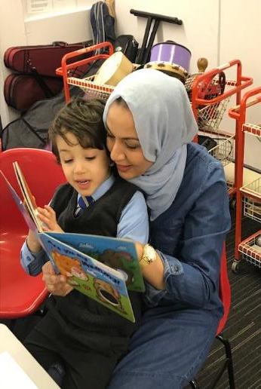
Definitions of:
Parental Involvement
Parental Engagement
Family Learning
Learning at Home
Home Learning Environment
For Scotland’s learners with Scotland’s educators

Slide 2

Terms and phrases in Education but what do they mean?
‘Parental involvement’
‘Parental engagement’
‘Family learning’
Poverty
Closing the gap
‘Learning at home’
‘Barriers to learning’
Budgets
Competing demands
‘Home learning
environment’
‘Parents as partners’
Workload
Evidence
‘Diverse and varied parent body’
For Scotland’s learners with Scotland’s educators

Slide 3
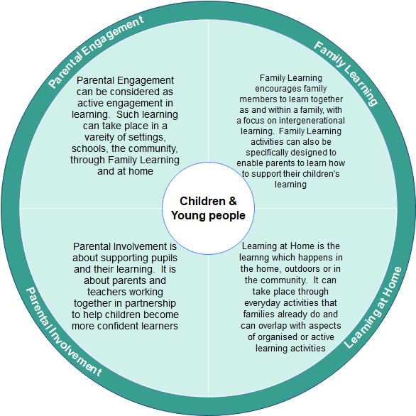
Definitions
For Scotland’s learners with Scotland’s educators

Slide 4
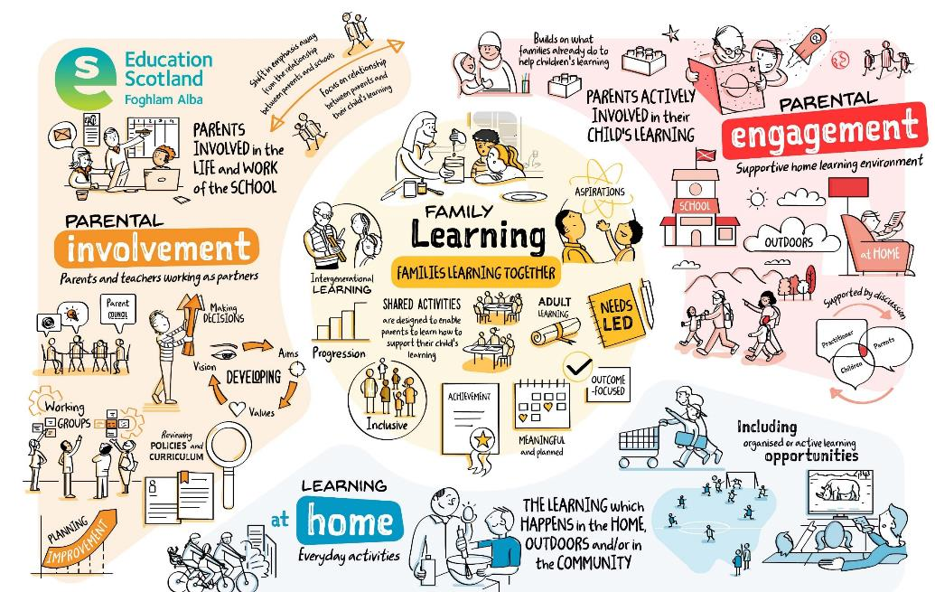
Engaging families in learning – A thematic inspection of family learning | National Thematic Inspections | HM Chief Inspector Report | Inspection and review | What we do | Education Scotland
For Scotland’s learners with Scotland’s educators

Slide 5

What is Parental Involvement?
Parental involvement is:
not a clearly or consistently defined term in research
described as:
  representing many different parental behaviours
  parenting practices eg parental aspirations for child’s academic achievement
  parental communication with child and/or staff about school
  parental participation in school activities
  parental rules at home which are considered to be education-related
multi-faceted in nature because it subsumes a wide variety of parental behavioural patterns and practices
Harris, A. and Goodall, J. (2007), Engaging Parents in Raising Achievement: Do Parents Know They Matter? Research Report DCSF-RW004. University of Warwick. Department for Children, Schools and Families.
For Scotland’s learners with Scotland’s educators

Slide 6

What is Parental Involvement? (Cont.)
Parental involvement most often focuses on parents getting involved in the life and work of the establishment. This can include:
Vision, aims, rationale of setting/school
Improvement planning
Decision-making on education matters affecting child’s learning
Developing/reviewing policies
School fayres, discos
Using parents’ skills to enhance/enrich the curriculum
Short-life working groups
Developing the young workforce
Parent Council
Parent Teacher Association
Parental representation at school, local authority and national levels
Getting involved in the life and work of the school
For Scotland’s learners with Scotland’s educators

Slide 7

‘Parental involvement is about supporting pupils and their learning. It is about parents and teachers working together in partnership to help children become more confident learners’.
(Parental Involvement Act, 2006)
Definition – Parental Involvement
For Scotland’s learners with Scotland’s educators

Slide 8
What is Parental Engagement?
Parental engagement:
is active and meaningful engagement in children’s learning in a variety of settings including:
  Early Learning and Childcare Settings (ELC)
  Schools
  the community
  through Family Learning
  through Learning at Home
is supported by discussions between parents/practitioners
focuses on how families can build on what they already do to help child’s learning and provide supportive home learning environment
For Scotland’s learners with Scotland’s educators

Slide 9
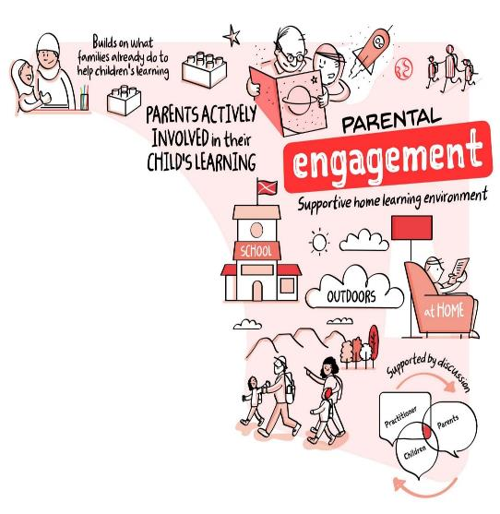
Definition – Parental Engagement
Parental engagement can be considered as active engagement in learning. Such learning can take place in a variety of settings including early learning and childcare, schools, the community, through family learning and at home.
Parental engagement represents a greater ‘commitment, ownership of action’ than parental involvement within educational settings such as early learning and childcare or schools.
(Goodall and Montgomery, 2014)
For Scotland’s learners with Scotland’s educators

Slide 10
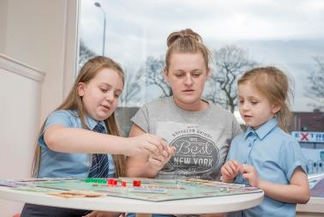
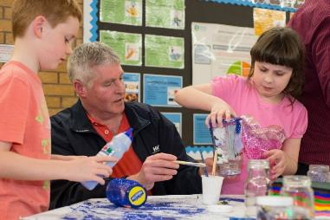
What is the relationship between Parental Involvement and Parental Engagement?
There is a progressive continuum between Parental Involvement and Parental Engagement. The movement between the two represents a ‘shift in emphasis, away from the relationship between parents and schools, to a focus on the relationship between parents and their children’s learning’.
(Goodall and Montgomery, 2014)
For Scotland’s learners with Scotland’s educators

Slide 11
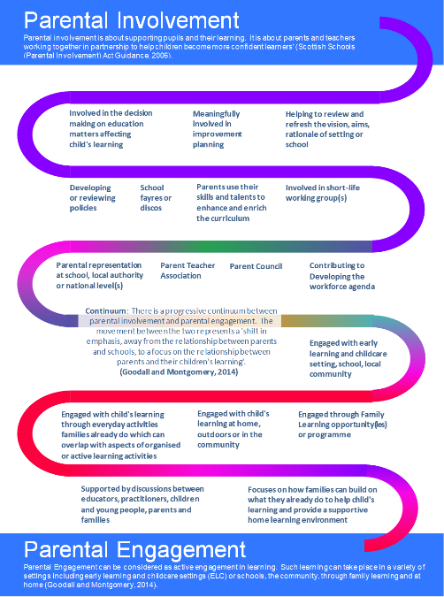

Parental Involvement examples and how it continues through to Parental Engagement examples

Slide 12
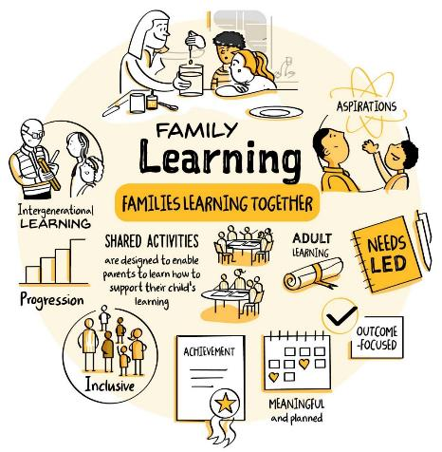
Definition – Family Learning
Family Learning encourages family members to learn together as and within a family, with a focus on intergenerational learning. Family learning activities can also be specifically designed to enable parents to learn how to support their children’s learning.
‘Family learning is a powerful method of engagement and learning which can foster positive attitudes towards life-long learning, promote socio-economic resilience and challenge educational disadvantage’
(Family Learning Network, 2016).
For Scotland’s learners with Scotland’s educators

Slide 13
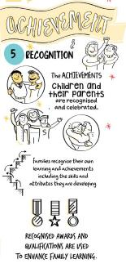
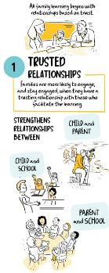
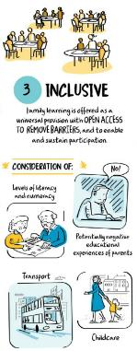
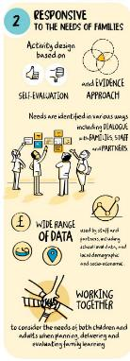
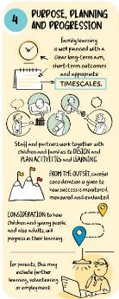
Key characteristics of Family Learning?
Family learning recognises and values diversity of culture, race, relationships and beliefs.
Equal partnership is the basis for all developments in family learning: all learners and educators, regardless of generation, recognise that learners and educators can frequently exchange ideas.
Achievements within family learning benefit the wider learning community through promoting change and empowering individuals and communities.
Family learning raises aspirations and all outcomes of the process, including those which may not be overt, are of equal significance and importance.
Family learning operates within a culture of mutual respect for individuals, communities, colleagues and organisations.
Learning can be fun!
Family learning recognises the role of the parent as the first educator.
Family learning is inclusive and is to be offered as a universal provision with open access.
Family learning recognises that it is acceptable to make mistakes, which are part of the process of reflective learning.
.
For Scotland’s learners with Scotland’s educators
Notes:
A National Occupational Standard describes what an individual needs to do, know, and understand in order to competently carry out a particular job or function. There are 8 values that underpin the national occupational standards for family learning which are shown in the presentation alongside the findings from the Engaging families in learning – A thematic inspection of family learning. More information and links to the current Family Learning NOS can be found here: Parents and families | Resource Themes | Education Scotland

Slide 14




What is the difference between Parental Engagement and Family Learning?
Parental Engagement focuses on:
Family Learning focuses on:
wider life of the setting or school
within the family
and involved in the
of each individual
with their child‘s learning
that meets the needs
actively engaged
a learning outcome
Supporting parents to become
Engaging families in
For Scotland’s learners with Scotland’s educators

Slide 15
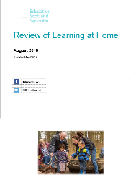
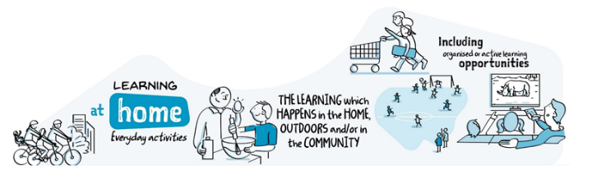
What is Learning at Home?
Parents have a vital role in a child’s learning and development throughout their lives. Early learning and childcare settings, schools and communities can also play a key part in recognising, developing and resourcing this.
‘Learning at home is the learning which happens in the home, outdoors or in the community. It can take place through everyday activities that families already do and can overlap with aspects of organised or active learning activities’
(Scottish Parental Involvement Officers Network, 2018).
For Scotland's learners, with Scotland's educators

Slide 16
Why is Learning at Home important?
Research has shown that around 80% of the difference in how well children do at school is dependent on what happens outside the school gates.
(Rasbash et al 2010; Save the Children 2013)
Learning at home is crucial for children to learn and develop. Research shows that learning at home can have significant immediate and longer-term impacts on children in different ways:
a child’s early learning
later achievements
nurture
resilience
wellbeing
social mobility
skills for life
Learning at
Home
Home / School partnership
Parental representation
Parental Involvement Act 2006
and Statutory Guidance
For Scotland’s learners with Scotland’s educators

Slide 17

How can Learning at Home happen?
A range of events including:
play, leisure activities, fun events, sports, trips, cultural or volunteering experiences.
It can also happen through:
curriculum related activities, homework, reading and sharing books.
For Scotland’s learners with Scotland’s educators

Slide 18
What do we mean by the home learning environment?
Combination of everything in a home
Time that a child spends out and about which affects their learning and development - including:
  having space and time to learn
  toys, books, outings
  people who provide the love, security, encouragement, conversation and positive role models to help a child to thrive
A good home learning environment encourages children and young people to have positive attitudes to learning, to be curious, creative and to have confidence in themselves.
https://education.gov.scot/parentzone/learning-at-home/home-learning-environment/
For Scotland’s learners with Scotland’s educators

Slide 19
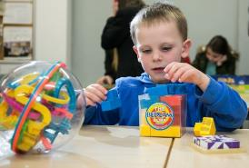
Why is the home learning environment important?
Research shows that when parents and carers engage in their children’s learning, and when children and young people live in a supportive home learning environment, it improves their attainment and achievement
(2024 National Improvement Framework and Improvement Plan, 2023).
For Scotland’s learners with Scotland’s educators

Slide 20

Home learning activities - Growing up in Scotland Study
Children from less advantaged households are less likely to experience a wide range of ‘home learning’ activities than children from more advantaged households.
Children who experience a wide range of activities like being read to, singing nursery rhymes and drawing, from an early age score higher in cognitive ability tests at age 3 than children with less experience of these activities.
Parenting and children’s activities in the early years can make a difference to children’s outcomes.
The influence of home learning environment was over and above that of standard measures of family socio-demographic factors such as parental education, socio-economic status and income.
(Melhuish, 2010)
For Scotland’s learners with Scotland’s educators

