Slide 1
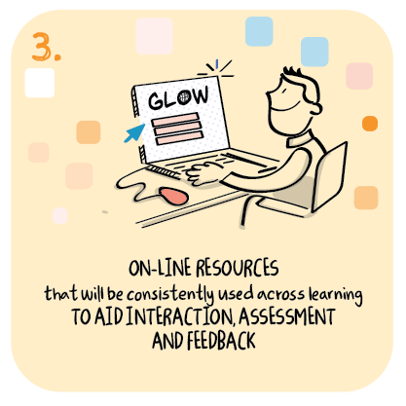
Use of virtual classrooms Bell’s Brae Primary School, Shetland Islands Council
>National overviews of practice<

Slide 2
Bell’s Brae Primary School
Bell’s Brae staff have been developing a contingency plan for future lockdowns since November 2020. This included upskilling of staff, children and parents in the use of digital platforms and sharing of information.
Staff have streamlined platforms in use, particularly for families with multiple siblings.
Children from ELC-P2 use Glow blogs and the rest of the school use Microsoft Teams.
Virtual classrooms have been developed used across the school.
Staff led this development, sharing their expertise with others, for example developing a video to show how to establish and operate a virtual classroom.
The school shared the following slides and this video to support others to set up a virtual classroom:
https://youtu.be/msjPx83tYHo - a guide to creating a Virtual Classroom

Slide 3
Welcome
Click here for the learning grid!
This is our virtual classroom! If you see anything blue & underlined, click on it to take you to that activity! Check the pinboard on the right for our Learning Grid activities. You can also click on some of the objects on the shelves. The star will take you back to which ever day you clicked on, and the chalkboard will take you to the days of the week here.
Monday
Tuesday
Wednesday
Thursday
Friday
You can always email me if you have any questions – my address is:

Slide 4
Monday 18th January 2021
Click here for extra activities
You can email me if you have any questions.
gw08graycarly@glow.sch.uk
If you see anything blue & underlined, click on it to take you to that activity! Check the pinboard on the right for some extra activities. You can also click on some of the objects on the shelves.
Today’s Activities
Spelling
Maths
Art
Watch Newsround – look at the shelves to find the link
Daily Mile – if the weather allows get outside for some fresh air! Remember to tell Mrs Redfern how many miles you do!

Slide 5
Spelling
Group 1
Group 2
Group 3
Click here for extra activities
Fast Finisher Activities

Slide 6
Circles
Squares
Triangles

Slide 7
Tuesday 19th January 2021
Click here for extra activities
This is our virtual classroom! If you see anything blue & underlined, click on it to take you to that activity! Check the pinboard on the right for some extra activities. You can also click on some of the objects on the shelves.
You can email me if you have any questions.
gw08graycarly@glow.sch.uk
Today’s Activities
Reading
Maths
Class Novel
Music
Daily Mile – if the weather allows get outside for some fresh air!

Slide 8
Reading
Reading groups
Click here for extra activities
If you are a Nessy user, please play 20 minutes of Nessy. Look on the shelves for the link.

Slide 9
Class Novel
Class Novel
Click here for extra activities

Slide 10
Circles
Shetland Sumdog Contest
15th – 21st January
Join Here!
Triangles
Squares

Slide 11
Wednesday 20th January 2021
Click here for extra activities
This is our virtual classroom! If you see anything blue & underlined, click on it to take you to that activity! Check the pinboard on the right for some extra activities. You can also click on some of the objects on the shelves. The star will always bring you back here.
You can email me if you have any questions.
gw08graycarly@glow.sch.uk
Today’s Activities
Writing
Maths
Gym
Daily Mile – if the weather allows get outside for some fresh air!

Slide 12
Writing

Slide 13
Handwriting
Click here for extra activities
Please complete Unit 2 in your handwriting booklet in your lined jotter.

Slide 14
Primary 5
Learning Grid
Try to do all the other activities first before using the grid.

