Slide 1
Effective use of data
5. Developing a data informed culture
Senior and middle leaders
Notes:
All information is correct as of May 2024
These slides are intended to support senior leaders, middle leaders and practitioners in schools and local authorities to explore the effective use of data for improvement. There are a set of six workshops available for senior leaders and middle leaders and a set of six workshops for practitioners. The workshops were co-designed with educators from across Scotland and are based on an Education Scotland literature review: The Effective use of data for improvement in education.
Establishing the purpose and use of data
Defining and classifying data
Creating effective processes and systems
Interpreting and analysing data
Developing a data informed culture
Using data for improvement
(hyperlinks for each workshops can be found on the next slide)
The PowerPoint is a template that presenters can adapt to suit their own context and style of presenting. The workshops can be delivered individually or grouped together and delivered in a longer session. Individual workshops have been designed for facilitators to deliver in 1 to 2 hours.
Within the slide notes key messages, suggested tasks, ‘talking-points’ and reflective questions are included.
It is anticipated the facilitator will have read the Education Scotland literature review: The Effective use of data for improvement in education.

Slide 2
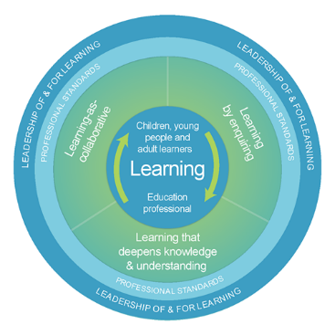
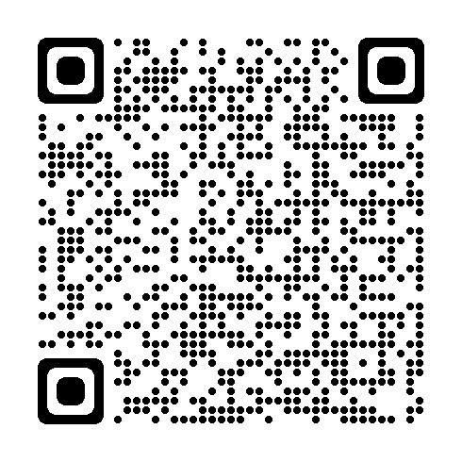
The national model of professional learning
The national model of professional learning | Professional Learning | Education Scotland
Notes:
Key Messages
This module has been designed using the national model of professional learning and the principles of adult learning or andragogy. It has been designed to think about:
The why – opportunities for participants to understand the rationale through professional standards, research, current policy landscape and national/local priorities.
The what – opportunities for participants to consolidate and develop relevant knowledge and skills
The how – opportunities for participants to take part in peer discussion, explore case studies or share experiences
Apply – a chance to reflect on learning, next steps and further support
A link to further information about the national model of professional learning can be found below.
edscot-model-of-professional-learning-outline.pdf (education.gov.scot)

Slide 3
Draft Group Agreement and Protocols
Work together
Learn from, with, and on behalf of each other.
Create a safe space to share ideas and build learning.
Agree that everyone is an equal and valued participant.
Remain in the room (emails and phone protocol)
Notes:
Key Messages
Take a moment to establish group protocols.
Ask participants to check and comment on anything they would like to add or amend.
The protocols on the slide are suggestions and may be amended for your school context.

Slide 4
Connector
In groups/pairs share a good book recommendation. It can be something you have read recently or an all-time favourite. Please share the name of the book and a brief explanation of why you enjoyed it.
Notes:
Key Messages
This is an example of a simple connecter activity. It is recommended that facilitators use a connector activity that allows participants to take part in an informal discussion.
This is to ensure that participants are relaxed, focused and ready for an interactive workshop.

Slide 5
Re-cap
In workshop 1 we looked at the purpose and use of data including: the meaning of data and evidence, the ways in which data is used and what we mean by ‘big’ and ‘small’ data.
In workshop 2 we considered different categories of data and how these may be intersected to support improvement.
In workshop 3 we looked at the importance of developing effective data systems and processes.
In workshop 4 we looked at ways to analyse data from a range of sources including contextual, attainment and comparator data.
Notes:
Key Messages
This slide offers a brief recap of content covered in previous workshops.

Slide 6
Aims
In this workshop we will consider:
national guidance and research,
what an effective data culture may look like,
key considerations when developing a positive data culture, and
improving a data culture scenarios.
Notes:
Key Messages
The aims of the session to read to participants.

Slide 7
Content coverage
National guidance and research
Defining a positive data culture
Key considerations
Scenarios activity
Reflection and feedback
Notes:
Key Messages
This slide shows the content covered throughout the workshop. Further details and suggested timings are provided below. Facilitators can amend content and timings to suit their needs and context.
National guidance and research – This section explores guidance and research. It contains a task in which participants are asked to reflect on a selection of quotes about culture. Allow 20 mins for this section with 10 mins for the quotes task. It can be extended to 30 mins if facilitators wish to provide time for participants to read and discuss the relevant section of the evidence review.
Defining a positive data culture – This section is a task in which participants are asked to consider the key components of a data culture. Allow 20 mins for this activity.
Key considerations - This section explores some key considerations for leaders developing positive data cultures. Allow 15 minutes for this section. It can be extended to 25 if facilitators wish to ask participants to watch the TED talk clip on ‘high challenge, low threat.’
Scenarios activity - this section contains a task that provides participants the opportunity to discuss how they would approach different data culture scenarios. Allow 20 mins for this activity.
It is expected that this workshop should take between 1 hour and 30 mins and 2 hours to deliver.

Slide 8
Culture quotes
It’s a butterfly effect. In positive cultures, the most effective teachers talk to each other about teaching, learning and assessment.
Sir Tim Brighouse
Leaders create culture. Culture drives behaviour. Behaviour produces results.
Urban Mayer
Culture doesn’t happen by accident and if it does, you are taking a risk.
Monique Winston
When a culture is strong people work with each other for each other. A culture is weak when people work against each other for themselves.
Simon Sinek
My definition of a good culture is just one that is consistent between what it thinks, what it says and how people act. I think the frustration and dissatisfaction most people have is from inconsistency.
Bob Glazer
Notes:
Key Messages
This workshop will focus on developing positive data cultures.
Please read the culture quotes and share with a partner/group any that resonate with you and why.

Slide 9
GTCS Standard for Middle Leadership
Self-evaluation
3.4.1 enable and sustain a culture of trust and mutual respect where colleagues, learners and the learning community engage in self-evaluation with confidence and integrity
3.4.1 contribute to an inclusive, resilient and adaptive culture of improvement using critically informed leadership practices and approaches
3.4.1 facilitate an open, honest and critical stance through modelling and promoting good practice in self-evaluation; and
3.4.1 build supportive relationships which promote and support the culture of self-evaluation.
3.4.2 promote and contribute to a culture of critically informed practice using evidence, including research, and analysis against relevant benchmarks;
Standard for Middle Leadership
Notes:
Key messages
The standards for middle leadership and headship include many that are relevant for developing positive cultures.
Read through / allow time for participants to some of the relevant standards for middle leadership on the slide.
Talking Points
Facilitators may wish to ask participants which words stand out in terms of culture e.g. confidence, open, critically informed, relationships etc.

Slide 10
GTCS Standard for Headship
Self-evaluation
3.4.1 establish, enable and sustain an inclusive, resilient and adaptive culture of improvement using critically informed leadership practices and approaches
3.4.1 build supportive relationships which help and support the culture of self-evaluation
3.4.1 enable and sustain a culture of trust and mutual respect where colleagues, learners and the learning community engage in self-evaluation with confidence and integrity;
3.4.1 facilitate an open, honest and critical stance in examining practice through modelling and promoting good practice in self-evaluation at every level.
3.4.2 develop a culture of critically informed practice by using evidence, including research, and analysing against national and international benchmarks
The Standard for Headship
Notes:
Key messages
There are similar messages contained within the relevant standards for headship.
Allow time to read/participants to read through the standards.
Talking Points
Facilitators may wish to draw out the language that indicates a leader's role in developing a culture – establish, build, sustain, develop.

Slide 11
HGIOS 4
Our school has a collegiate learning culture demonstrated through, for example, collaborative practitioner enquiry, peer learning, constructive feedback, professional dialogue and debate (1.3)
Leadership of our school is clearly founded on the key governance principles of high-quality learning, learner engagement and quality culture (1.4)
Staff capability, capacity and leadership are well developed to support the culture of learning (1.4)
Notes:
Key Messages
How Good is Our School 4 describes the importance of culture.
These examples come from leadership of change and leadership and management of staff and highlight the clear role for leaders in developing positive cultures.
There are similarities in language around culture to some of the GTCS standards – collegiate, collaborative, capacity, developed etc.

Slide 12
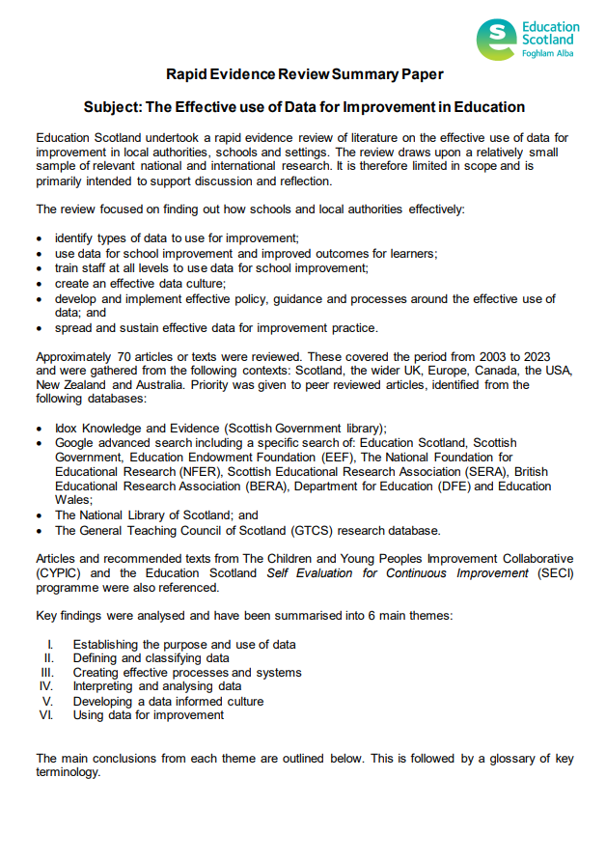
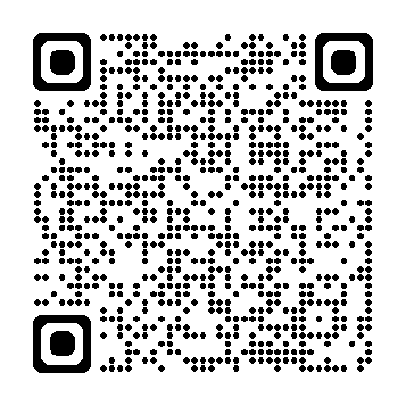
Rapid Evidence Review Paper
Section five of the Education Scotland Rapid Evidence Review on developing a data informed culture highlights that:
Utilising different types of data to share stories can ‘win over’ people to an improvement approach.
It is vital to provide time for collaboration and discussion around data.
Foster a ‘high challenge, low threat’ approach to data.
It is important that data for improvement is understood and utilised at all levels.
Clear policies, frameworks and governance can help to clarify roles and expectations.
Leaders have a key role in facilitating the effective use of data for improvement.
Notes:
Key Messages
Section five of the rapid evidence review on creating effective processes and systems highlights that:
Utilising different types of data to share stories can ‘win over’ people to an improvement approach.
It is vital to provide time for collaboration and discussion around data.
Foster a ‘high challenge, low threat’ approach to data.
It is important that data for improvement is understood and utilised at al levels.
Clear policies, frameworks and governance can help to clarify roles and expectations.
Leaders have a key role in facilitating the effective use of data for improvement.
The Effective use of data for improvement in education
Talking Points
This may be a good point to ask participants to read section five on developing a data informed culture.
Reflective Questions
How have you supported a data informed culture? What have the challenges been? What was successful?

Slide 13
What is a positive data culture?
A culture is often defined as the attitudes, beliefs and practices of a specific group of people / organisation.
A culture is also about behaviours.
Let’s consider what a positive data culture might look like in schools / educational settings.
What would it look like?
What would it feel like?
What sorts of things would happen?
Notes:
Key Messages
This task is designed to provide participants with an opportunity to establish a vision around what an effective or positive data culture might look like.
Facilitators may wish to take extended feedback and record key features on a flipchart that can be referred to later / throughout the workshop.

Slide 14
Clear and consistently applied policy and guidance
Establishing clear policy and guidance around data use, systems and processes can help to ensure consistency and clarity. You may wish to consider:
Have we established clear and accessible guidance/policy around the use of data?
Are staff aware of how and when we use data during different parts of the improvement cycle?
Does everyone know how or where to access support?
If guidance is in place – is it being applied effectively?
Notes:
Key Messages
This section explores some key considerations for leaders developing positive data cultures.
Establishing clear policy and guidance around data use, systems and processes can help to ensure consistency and clarity. You may wish to consider:
Have we established clear and accessible guidance/policy around the use of data?
Are staff aware of how and when we use data during different parts of the improvement cycle?
Does everyone know how or where to access support?
If guidance is in place – is it being applied effectively?

Slide 15
Clear and consistently applied policy and guidance – part 2
This slide is a place holder for facilitators to consider adding in any local authority links to guidance or policy around data.
This slide can be added to or removed as appropriate.
Notes:
Key Messages
It may be helpful for facilitators to insert local examples of commonly used data, presented in the ways in which school leaders would be expected to read and analyse.
This would provide participants with an opportunity to review and check their understanding of how to read the data that they may access through the local authority if this is additional to / different from national data examples.

Slide 16
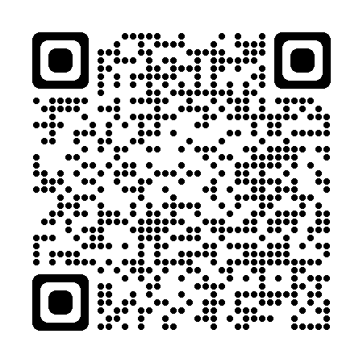
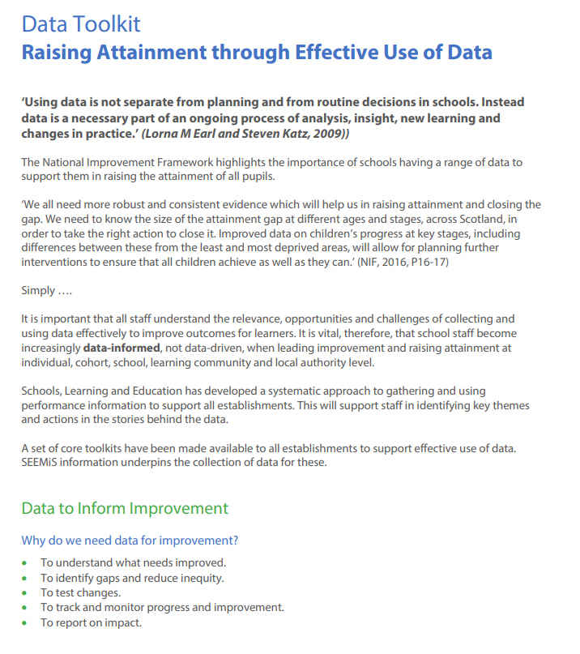
Policy and guidance improvement hub case study
Stirling’s Excellence and Equity Strategy | Resources | National Improvement Hub (education.gov.scot)
Notes:
Stirling’s Excellence and Equity Strategy | Resources | National Improvement Hub (education.gov.scot)
Key Messages
Signposting to a case study from Stirling local authority on the Education Scotland Improvement hub.
Stirling have developed a data toolkit.

Slide 17
Clear roles and responsibilities
It is important the whole staff, learners, partners and families are aware of the way in which data is used and their roles and responsibilities around it.
Levels of knowledge, skill and engagement may vary between roles, but it is important to establish that data is ‘everyone’s business.’
Try to avoid data gatekeeping. This is often seen in schools where one or a small number of staff (usually leaders) collect, analyse and develop actions around the data.
Data and evidence are only impactful if everyone is engaged. Improvement is often most directly influenced by those working closest to the learner.
Notes:
Key Messages
It is important the whole staff, learners, partners and families are aware of the way in which data is used and their roles and responsibilities around it.
Levels of knowledge, skill and engagement may vary between roles, but it is important to establish that data is ‘everyone’s business.’
Try to avoid data gatekeeping. This is often seen in schools where one or a small number of staff (usually leaders) collect, analyse and develop actions around the data.
Data and evidence are only impactful if everyone is engaged. Improvement is often most directly influenced by those working closest to the learner.
Reflective Questions
Do you have any data gatekeepers in school? Why is this?
Why is it important to encourage all staff, learners, families and partners to engage in data at an appropriate level?

Slide 18
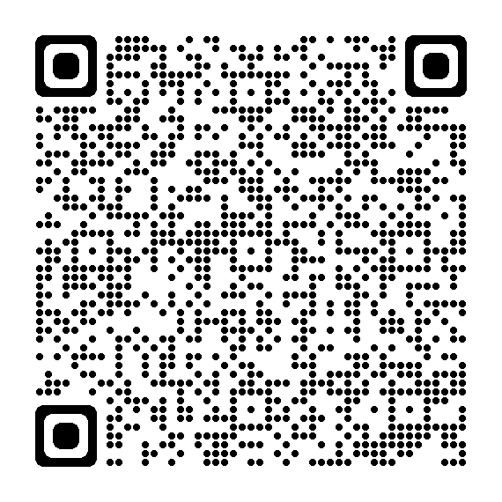
Training and development
Reinforce initial training with expert follow-on support
Create opportunities for staff to reflect on their existing beliefs and practices and challenge them in a non-threatening manner.
Make training interactive, with active learning through observation, meaningful discussion and reflection, demonstration of skills, deliberate practice, and feedback.
Provide structured support to help staff apply learning.
If you are developing training manuals and resources, ensure they are tightly aligned to key objectives.
Notes:
Key Messages
It is likely that your staff levels of knowledge, skills, confidence and experience around data will be varied.
It is important to have a clear view of the range and development needs so that leaders can plan to ensure that everyone has the skills and knowledge they need to engage with data.
The Education Endowment Foundation have produced a guidance report on implementation for schools. This contains some advice around training and development that can be applied to data training for staff. EEF_Implementation_Guidance_Report_2019.pdf (d2tic4wvo1iusb.cloudfront.net)
Reinforce initial training with expert follow-on support
Create opportunities for staff to reflect on their existing beliefs and practices and challenge them in a non-threatening manner.
Make training interactive, with active learning through observation, meaningful discussion and reflection, demonstration of skills, deliberate practice, and feedback.
Provide structured support to help staff apply learning.
If you are developing training manuals and resources, ensure they are tightly aligned to key objectives.
Reflective Questions
What are the skills, knowledge and confidence of staff in using data? How do you know / might you find out?

Slide 19
Meaningful collaboration and dialogue
The Sutton Trust produced a report in 2015, on Developing Teachers . It highlights that ‘professional collaboration benefits all and leads to innovation and creativity’.
When thinking about fostering positive data dialogue and collaboration, it may be helpful to consider whether:
staff engage in formal or informal collaborative discussions, analysis and planning involving data or evidence,
leaders are modelling informal and formal data discussions, and if
we look outwards and seek to collaborate with other schools to improve our understanding and use of data.
Notes:
Key Messages
The Sutton Trust produced a report in 2015, on Developing Teachers . It highlights that ‘professional collaboration benefits all and leads to innovation and creativity’.
When thinking about fostering positive data dialogue and collaboration, it may be helpful to consider whether:
staff engage in formal or informal collaborative discussions, analysis and planning involving data or evidence,
leaders are modelling informal and formal data discussions, and if
we look outwards and seek to collaborate with other schools to improve our understanding and use of data.

Slide 20
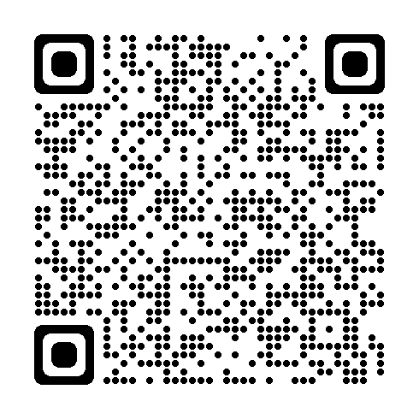
Data dialogue – using a data driven dialogue approach
Taking a data driven dialogue approach is one way of supporting staff to increase their knowledge, skills and confidence in analysing data.
Using their own school level data or a set of sample data, participants go through four phases of analysis and interrogation. These are: prediction, go visual, observations and inferences.
This approach can provide a frame for staff when approaching data analysis.
As the name suggests, it is important that this is carried out collaboratively.
A link to the protocol and sample data can be found using the link or QR code.
NCS_PS_Toolkit_BST_Set_C_DataDrivenDialogue.pdf (uchicago.edu)
Notes:
Key Messages
A reminder of the data driven dialogue process highlighted in workshop 4. This is one way of formally supporting staff to work collaboratively to analyse data.
Taking a data driven dialogue approach can support staff to increase their knowledge, skills and confidence in analysing data.
Using their own school level data or a set of sample data, participants go through four phases of analysis and interrogation. These are: prediction, go visual, observations and inferences.
This approach can provide a frame for staff when approaching data analysis.
As the name suggests, it is important that this is carried out collaboratively.
A link to the protocol and sample data for carrying out a data driven dialogue can be found using the link or QR code on the slide.

Slide 21
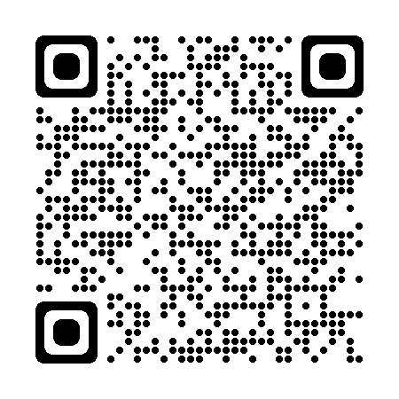
High challenge, low threat
Develop a reflective culture.
Remember that it is okay to make mistakes.
Separate ‘the work’ from ‘the person’
Build positive relationships: remember the ‘bank of goodwill.’
Be selective about the evidence you collect and the analysis that you do.
Ensure that data/evidence is manageable, rich and balanced.
(161) High Challenge, Low Threat- How top leaders find the balance. | Mary Myatt | TEDxNorwichED - YouTube
Notes:
Key Messages
One of the challenges around data and developing a positive data culture can be how staff view data and data discussions. For some, the idea of sharing data or having open data discussions may feel difficult or personal, it may be something that they are concerned about doing.
A positive data culture will thrive where people feel challenged but also psychologically safe.
The educationalist, Mary Myatt, expands on this idea of culture by talking about the importance of creating ‘High challenge and low threat’ in her book of the same name.
Mary Myatt reminds us that schools are built on the ‘bank of goodwill’. She says that it is important to create a culture where people are challenged but feel safe and empowered.
She argues that humans are a challenge seeking species and points to things such as crosswords right up to hobbies such as skydiving as evidence of this. However, she also notes that people are less likely to embrace challenges when they feel threatened.
She argues that a way to achieve this is to distinguish between the work and the human being and to create and model a culture that welcomes questioning, curiosity and constant reflection.
Her book has lots of other` tips and ideas. In terms of data and evidence one chapter stands out where she talks about the amount of evidence we gather. She suggests that good leaders are selective. They ensure that they choose a rich body of evidence, involve learners and families but they also know that you can't possibly analyse and evidence everything.
Facilitator note - If time permits you could watch the video clip linked on the screen until 6.42 ( finish after she says the sentence ‘corrected on route’ as after this she talks more about the classroom and learner challenge). Ask people to note down anything of interest as they listen. Think about how the messages may apply to positive data cultures.
(161) High Challenge, Low Threat- How top leaders find the balance. | Mary Myatt | TEDxNorwichED – YouTube

Slide 22
An embedded and ‘joined up’ approach
In an effective data culture, the use of data and evidence is embedded throughout all areas of the improvement cycle.
Data and evidence are used to plan, track, monitor and evaluate improvement at whole school and classroom level.
Informal and formal data discussions take place between educators who feel challenged but psychologically safe. They openly share and are curious about data.
All stakeholders understand the role of data and evidence in school and their part in utilising it effectively.
The use of data and evidence is part of ‘normal’ everyday activity.
Notes:
Key Messages
In an effective data culture, the use of data and evidence is embedded throughout all areas of the improvement cycle.
Data and evidence are used to plan, track, monitor and evaluate improvement at whole school and classroom level.
Informal and formal data discussions take place between educators who feel challenged but psychologically safe. They openly share and are curious about data.
All stakeholders understand the role of data and evidence in school and their part in utilising it effectively.
The use of data and evidence is part of ‘normal’ everyday activity.

Slide 23
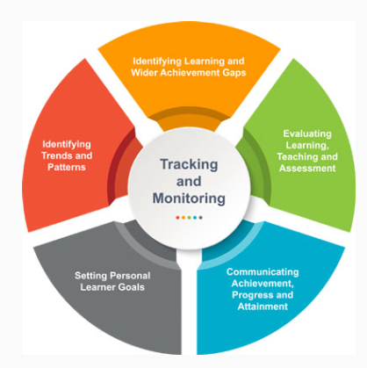
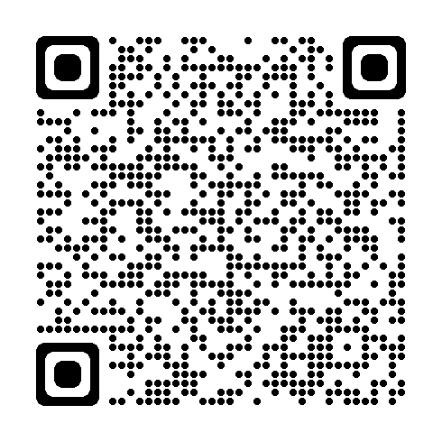
An embedded approach – signposting to tracking and monitoring guidance.
Resources to support effective tracking and monitoring | Resources | Education Scotland
Notes:
Key Messages
A link to signpost participants as appropriate to an Education Scotland resource with guidance around effective tracking and monitoring and how this may be imbedded into your systems and processes (also referenced in workshop 3).

Slide 24
Data culture challenges activity
A. Data is viewed as the role or domain of the leadership team.
B. Low levels of formal and informal staff discussion around data.
C. Learners, families and partners are not involved in data.
D. Data systems and processes are unreliable, inconsistently used or inaccurate.
E. Educators feel as if they have a lot of data but are unsure how to use it – data paralysis.
F. Data is gathered and analysed but it is not used to effectively improve outcomes – planning, ongoing tracking and evaluation.
Notes:
Key Messages
This activity has been designed to give participants the opportunity to problem solve fictional scenarios around ensuring a positive data culture.
Ask participants to work in pairs or small groups with an allocated or chosen scenario. (Facilitators may wish to adapt scenarios to known needs in their context as appropriate).
Participants should discuss and note down
Why the scenario is an issue? What are the problems/risks?
What may be the likely cause for this scenario?
How would they as leaders look to improve the scenario?
Facilitators can take feedback from around the room or ask groups with different scenarios to share with each other.

Slide 25
Aims Review
In this workshop we will consider:
national guidance and research,
what an effective data culture may look like,
key considerations when developing a positive data culture, and
Improving a data culture scenarios.
Notes:
Key Messages
The aims of the session to read as a recap for participants.

Slide 26
Reflection activity
Area | 0 | 1 | 2 | 3 | 4 | 5 | Actions?
Clear and applied policy and guidance
Effective data training and development
Established roles and responsibilities
Regular collaboration / data dialogue opportunities
High challenge and low threat environment – psychological safety around data
Data and evidence is embedded in everything we do – being data informed is ‘the norm’ for all staff.
Notes:
Key Messages
This reflection activity is designed for individual participants to consider where their school is in each area. They can rate it from 0-5 and note down some brief actions as appropriate.
Facilitators may wish to copy and print the table for participants or create a version using an online tool. It is intended to be a personal reflection. It is advised that any online collection approach is anonymous and that participants can still ‘take-away’ their thoughts for further consideration in their school/setting.

Slide 27
Feedback
Insert you own evaluation code here
Notes:
You can insert your own feedback link here.
Thank-you. We hope that you found this resource useful.
Please provide feedback on the materials here https://forms.office.com/e/viKTsvQj9d
Your comments are appreciated and will be used to inform future resources.
This link should not be shared with the audience.

