Slide 1


Na Seumasaich – The Jacobites
Learning about Gaelic Language and Culture Resource
Lesson 1 – Who were the Jacobites? and Saying your name in Gaelic.
For Scotland's learners, with Scotland's educators
Do luchd-ionnsachaidh na h-Alba le luchd-foghlaim Alba

Slide 2
Na Seumasaich – Lesson 1
In this Learning about Gaelic Language and Culture resource lesson we will learn:
about the Stuart Royal Family and why their supporters were called Jacobites
to say our name in Gaelic
to ask someone their name in Gaelic
to address someone by name in Gaelic
about discrimination against Gaelic names
about the clan system in the Highlands of Scotland
some common Gaelic first names and surnames
to create short texts about ourselves and others in Gaelic

Slide 3
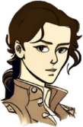
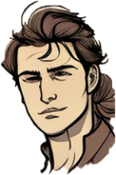
Meet Màiri and Calum
Halò. ’S mise Màiri.
Dè an t-ainm a th’ ort?
Hai a Mhàiri. ’S mise Calum
Fàilte gu na Seumasaich a Chaluim
Welcome to the Jacobites.

Slide 4
Meet Màiri and Calum 2
What’s a Jacobite? And why are they called Seumasach in Gaelic?
A Jacobite was a supporter of the Stuarts, a royal family with Scottish origins, who eventually ruled the rest of Britain as well as Ireland.
Why were they not called Stuartites then?
Lots of Stuart kings were called James. The Latin for James is Jacobus – so it became Jacobites. The Gaelic for James is Seumas – so a Jacobite was a Seumasach.
I’d like to find out more about these Stuarts.

Slide 5

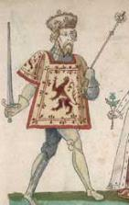
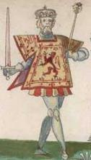
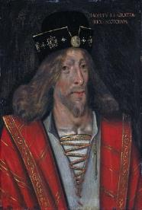
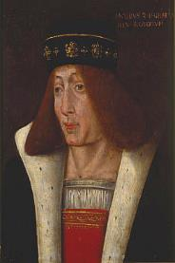
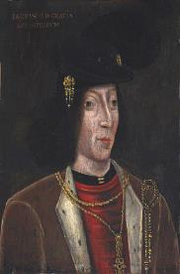
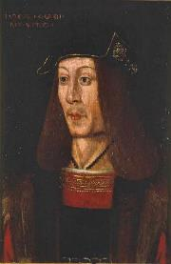
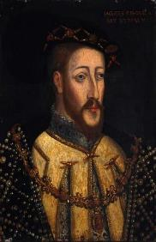
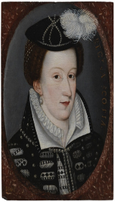
Na Stiùbhartaich – The Stewarts/Stuarts
The Stuarts were originally called the Stewarts, (Stiùbhart) because they were descended from the Stewards of Scotland. They had married daughters from the family of Robert the Bruce. The first Stewart king was also called Robert, but there were five James in a row before Mary, Queen of Scots.
Is mise Raibeart
Is mise Raibeart cuideachd
Is mise Seumas
Is mise Seumas
Is mise Seumas
Is mise Seumas
Is mise Seumas
Is mise Màiri

Slide 6
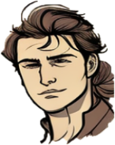
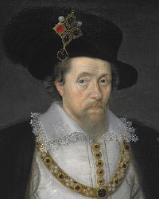
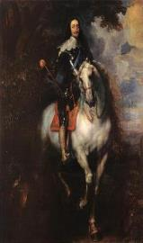
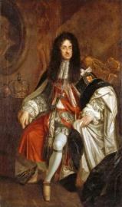

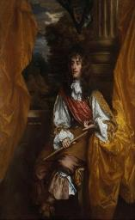
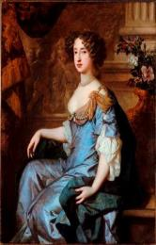
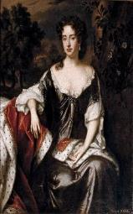
Na Stiùbhartaich – The Stewarts/Stuarts 2
The Stuarts were related to the English Royal Family due to marriage. When Queen Elizabeth I died with no heir (no child to take the throne), James VI of Scotland became James I of England as well in 1603. The last Stuart monarch, Queen Anne died in 1714.
So who are all these guys, and how did they end up ruling England and Ireland as well?
Is mise Seumas
Is mise Teàrlach
Is mise Teàrlach cuideachd
One of the main reasons was the same reason they became kings of England in the first place. Religion!
That’s a lot of Kings and Queens in a short time. Why were there so many of them? And why did they come to an end?
Is mise Seumas
Is mise Màiri cuideachd
Is mise Anna

Slide 7
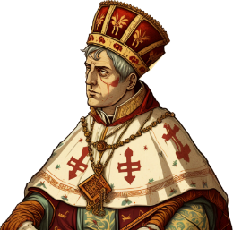
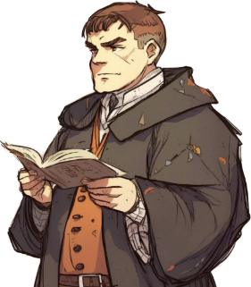
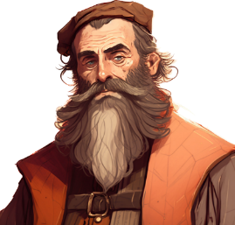
Why did the Jacobites come about – Religion and the Stuarts 1
During the 16th and 17th Centuries there was a big quarrel between Christians in Europe. This was called the Reformation. It saw new groups of Christians called Protestants challenge the Roman Catholic Church which had been the main form of Christianity in Western Europe for centuries. Martin Luther was a German priest who published his new ideas on religion and lots of people agreed with him.
Although Catholics and Protestants believed in the same God and in Jesus Christ, they disagreed on how to worship Him and so lots of wars and battles happened.
Some countries stayed Roman Catholic and treated their Protestant populations poorly, but in some countries Protestants took power and treated the Catholics badly as well. In some countries the rulers remained Catholic but the majority of the public became Protestant – this happened in Scotland. Mary Queen of Scots was Catholic and this caused problems for her, in particular John Knox, a famous Protestant minister.
One worry was that Catholic kings and queens would be loyal to the Pope, who was the leader of all Catholics, and ruled in Rome
.

Slide 8
Why did the Jacobites come about – Religion and the Stuarts 1 - Questions
Q1 - Which two groups of Christians fell out during the Reformation?
Q2 – What religion was Mary Queen of Scots?
Q3 – Use the internet to find out three facts about John Knox, Martin Luther or Pope Leo X.
.

Slide 9
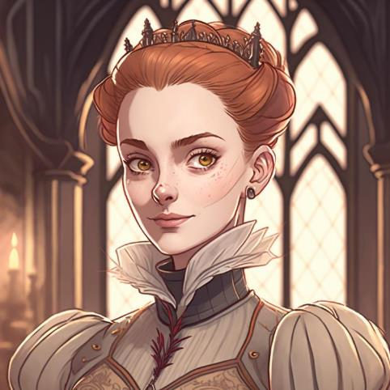
Why did the Jacobites come about – Religion and the Stuarts 2
When Mary, Queen of Scots went to France to marry the son of the French king (who then died), she changed the spelling of her name from Stewart to the French spelling Stuart. She was a Catholic and when her husband died she returned to Scotland.
She was forced to abdicate in 1567 and her son James was made king. Mary would be executed by beheading on the order of her cousin Queen Elizabeth I of England in 1587. In 1603 James became King of England as well because he was the closest living relative of Queen Elizabeth when she died.
When the Stuarts moved to England they often found themselves in trouble. They believed in the “Divine Right” of Kings. This meant they believed God had chosen them to rule and they could do what they wanted. This meant they often fell out with other powerful people and bodies such as the Church, the nobility and Parliament.

Slide 10
Why did the Jacobites come about – Religion and the Stuarts 2 – Questions
Q1 – Why did Mary Queen of Scots change the spelling of her surname?
Q2 – Use the internet to find out what the word abdicate means?
Q3 – How did Mary Queen of Scots die?
Q4 – What does the term “Divine Right of Kings” mean?

Slide 11
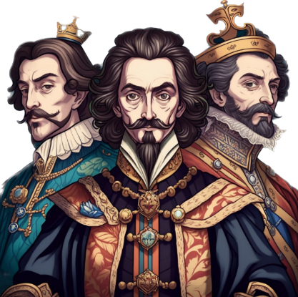
Why did the Jacobites come about – Religion and the Stuarts
As a Protestant King, James VI and I (VI of Scotland and I of England) lived a long life and ruled Scotland and England as separate Kingdoms. He liked burning witches and also commissioned a famous English translation of the Bible, called the King James Version.
However, his son Charles I was removed from power and had his head chopped off in 1649 by Oliver Cromwell who ran England and Scotland as religious commonwealths.
Charles I son Charles II had to run away, but was eventually returned to the throne in 1660. He would have lots of children, but none with his wife so they couldn’t take the throne.
The throne fell to his brother James VII and II in 1685, and this is where the trouble really began and the Jacobites came about.

Slide 12
Why did the Jacobites come about – Religion and the Stuarts 3 - Questions
Q1 – What two things did James VI & I do?
Q2 – How did Charles I die?
Q3 – Why did James VII and II become king after his brother Charles II died?

Slide 13
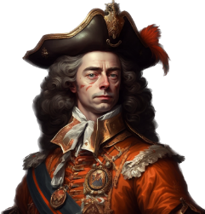
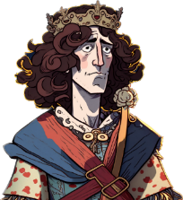
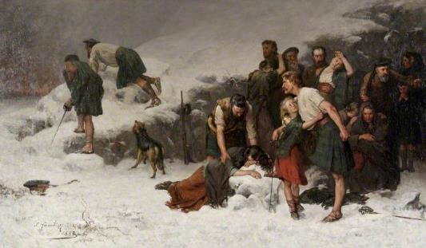
Why did the Jacobites come about? Religion and the Stuarts 4
James VII and II became a believer in Roman Catholicism in the late 1660s. This was controversial as the country was still very anti-Catholic. His daughters Mary and Anne were ordered by their Uncle Charles II to be raised as protestant.
However, James then had a son, also called James, and he was to be raised as a Catholic. This caused a lot of trouble, and eventually James was thrown of the throne and replaced by his daughter Mary, and her Dutch Protestant husband William of Orange (who was also Mary’s first cousin) in 1689.
This was the reason for the very first Jacobite rebellion, which in 1689 saw the Jacobites win at Killecrankie, but their leader Bonnie Dundee killed.
In 1691, William made all the Clan Chiefs in Scotland sign a pledge of allegiance. In 1692, he ordered the Massacre of Glencoe against the Macdonalds of Glencoe who had been late in making their pledge.

Slide 14
Why did the Jacobites come about? Religion and the Stuarts 4 - Questions
Q1 – Why was James VII & II removed from power?
Q2 – Who was King William of Orange?
Q3 – Why was the Massacre of Glencoe ordered?

Slide 15
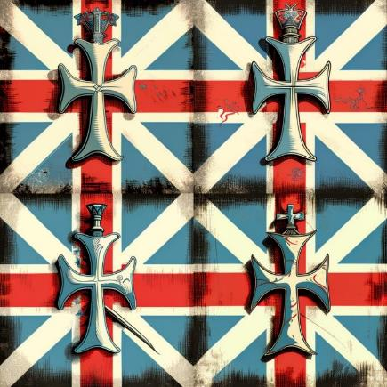
Why did the Jacobites come about? Religion and the Stuarts 5
In 1701, the Act of Succession banned any member of the Royal Family who was a Roman Catholic from becoming monarch. (This rule stills applies today!). James VII also died this year.
William and Mary did not have children either. So Anne took the throne. In 1707, she became the first monarch of the United Kingdom of Great Britain with the Act of Union between the English and Scottish Parliaments.
Although Anne had 17 children, they all died before her and so in 1714, the rule of Great Britain skipped over her Catholic brother James VIII and went to a cousin from Germany, George. We’ll find out more about him and his family next lesson.

Slide 16
Why did the Jacobites come about? Religion and the Stuarts 5 - Questions
Q1 - What does the Act of Succession ban?
Q2 - What happened in 1707?
Q3 - When did Queen Anne die?

Slide 17
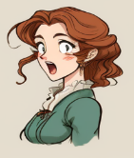
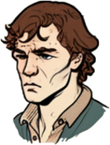
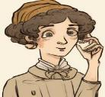
How to talk about your name in Gaelic.
Dè an t-ainm a th’ oirbh?
To say I am in Gaelic, you say Is mise… or ’S mise…
To ask someone their name, you ask
Dè an t-ainm a th’ ort?
Or if they are older or there is more than one
Dè an t-ainm a th’ oirbh?
’S mise Calum
Is mise Eilidh
’S mise Ruairidh
Is mise Catrìona

Slide 18

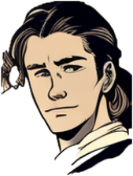
Task one – Asking and saying our names in Gaelic
Your teacher will ask you Dè an t-ainm a th’ ort? Reply with ’S mise and then your name. If you already know the Gaelic version of your name use that, but if not don’t worry. See below for an example.
Dè an t-ainm a th’ ort?
’S mise Caleb

Slide 19
Finding out our first names in Gaelic
Discuss – how would you feel if you were banned from using your own name or made to change it against your will?
At one time, many Gaelic speaking people were discouraged from using their Gaelic name. They would have their name registered in an English version. This was sometimes a version of the same name, but sometime instead they would take a name from the Bible or Greek mythology to replace the traditional Gaelic name. This had the effect of making people feel that their own names and culture were worth less than English and Lowland Scottish culture.
Research – use the internet to find a Gaelic version of your name or of people in your friends and family.
List of Scottish Gaelic given names - Wikipedia
Some Gaelic Names
Iain – John
Seumas – James
Eilidh – Helen
Calum – Malcolm
Màiri – Mary
Coinneach – Kenneth
Teàrlach – Charles
Catrìona – Catherine
Eachann – Hector
Daibhidh – David
Mòrag - Marion

Slide 20


Task two - writing
You are going to create two profiles – one for yourself, and one for a Highlander boy or girl from the time of the Jacobites.
Write a sentence in Gaelic stating your first name
Write a sentence in Gaelic stating the first name of your Highlander
Example
’S mise Mohammed
’S mise Cailean

Slide 21
Gaelic surnames
In this unit we’ll talk a lot about clans – clans were big extended families that ruled much of the Scottish Highlands. In fact the word clan comes from the Gaelic word clann – meaning children.
They were all ruled by a chief who was seen as the father of the whole clan.
Small clans would sometimes befriend a larger clan for protection.
They tended to be identified with one particular area, but through marriage and travel certain names spread – see the map
Scotland Clan Map – Scotland Info Guide
Clan Donald – The Macdonalds – Skye, Uist, Islay, and Mainland
Clan MacLeod – Lewis and Skye
Clan Cameron - Lochaber
Clan MacKay - Sutherland
Clan Campbell - Argyll
Clan Chattan – A grouping of small clans who worked together in Inverness-shire, including MacPhersons, MacKintoshes and MacGillvarys
Clan Fraser – Inverness-shire
Clan MacKenzie – Ross-shire
Clan MacLean – Mull and the Inner Hebrides
Clan MacGregor – Highland Perthshire and Rannoch

Slide 22
How to talk about your surname in Gaelic.
Dè an t-ainm a th’ oirbh?
In Gaelic, there are two types of surname.
Many surnames in Gaelic begin with Mac.
As Mac means “son”, for those who are daughters it gets replaced by “Nic”
Dòmhnall MacDhòmhnaill
Anna NicDhòmhnaill
For surnames that don’t use Mac or Nic, where possible, they “lenite” (they add an h after the second letter to show the sound has changed) for women’s surnames
Seumas Caimbeul
Iseabail Chaimbeul
List of Scottish Gaelic surnames - Wikipedia
’S mise Calum MacLeòid
Is mise Eilidh NicLeòid
’S mise Ruairidh Camshron
Is mise Catrìona Chamshron

Slide 23
Task three - writing
You are going to add to your two profiles – one for yourself, and one for a Highlander boy or girl from the time of the Jacobites.
Write a sentence in Gaelic stating your first name and surname
Write a sentence in Gaelic stating the first name and clan name of your Highlander
Example
’S mise Chloe Kowalcyk
’S mise Mairead NicLeòid
’S mise Ruairidh Caimbeul
’S mise Iseabail Stiùbhart

Slide 24
Task four - talking
Hai. Dè an t-ainm a th’ ort?
Go around the class and follow this example.
Greet each other with a simple Hai or Halò
Ask each other your name using Dè an t-ainm a th’ ort?
If you ask the name second say Dè an t-ainm a th’ ort fhèin?
Halò
’S mise Calum MacLeòid. Dè an t-ainm a th’ ort?
’S mise Màiri NicDhòmhnaill.

Slide 25

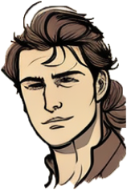
Conversation time
Let’s go back to the very first conversation you heard me and Calum have.
Take note of how we change each other’s names when we speak to each other.

Slide 26
Meet Màiri and Calum – revision – notice how they respond to each other’s names.
Halò. ’S mise Màiri.
Dè an t-ainm a th’ ort?
Hai a Mhàiri. ’S mise Calum
Fàilte gu na Seumasaich a Chaluim
Welcome to the Jacobites.

Slide 27


The vocative case
Halò. ’S mise Seumas
When we address someone by name in Gaelic, we change the way their name sounds. This also changes the spelling when it is written. This is called the vocative case.
We usually put an ‘a’ in front of their name, change the sound and the start of the word – shown by adding an ‘h’ and with boys, we add an i after the last vowel
Seems like a lot? It’s not too bad if we think about the name Seumas.
Seumas > A Sheumais!
Màiri > A Mhàiri!
Halò a Sheumais!
Hai a Sheumais!
Halò a Mhàiri!

Slide 28
Task five - talk
Halò. ’S mise Seumas
Choose the name Màiri or Seumas.
It doesn’t matter what gender you are.
Go round the class and introduce yourself with ’S mise Màiri or ’S mise Seumas.
When someone introduces themselves remember to use the vocative case a Mhàiri or a Sheumais! when speaking back to them.
Halò a Sheumais!
Hai a Sheumais!
Halò a Mhàiri!

Slide 29

Task six - factfile
Research a Stuart King or Queen of Scotland, or of Great Britain and present at least 5 facts about their life.
Where were they born?
How long did they live for?
How did they die?
What are they famous for?
Any other useful information
You could use a picture of them to illustrate your factfile
What was their name in Gaelic?

Slide 30


For Scotland's learners, with Scotland's educators
Education Scotland
Denholm House
Almondvale Business Park
Almondvale Way
Livingston EH54 6GA
T +44 (0)131 244 5000
E enquiries@educationscotland.gsi.gov.uk

