Slide 1
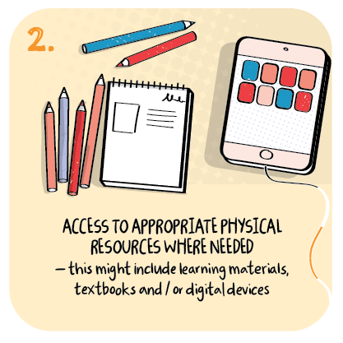
Continuing partnership working to ensure the needs of children with complex autism are met during remote and face to face learning. St Francis RC Primary School, Dundee City Council
>National overviews of practice<

Slide 2
St Francis RC Primary School
The school made use of the Scottish Government’s roll out of tablet computers and wherever possible ensured that families most in need were prioritised.
PEF money was also used buy laptops for those families who were facing new socioeconomic challenges because of Covid.
In addition, the school used a pre-existing and strong partnership with a local supermarket to acquire a laptop for all remaining children. Wi-Fi bundles were provided, where needed.
A family development officer gave parents face to face doorstep instructions in setting up the devices.
Initially, specialist partners worked from home providing online support for children in school and working at home. To ensure children have a consistent and familiar routine at home the school sends visual timetables and other visual resource packs to families to support continuous communication development.
Speech and language therapists (SLT) continue to provide consultancy to families remotely. However, the head teacher negotiated with the SLT to provide continuing professional learning opportunities for staff so that they could become speech and language partners.
This enables staff to continue SLT communication programmes in school and provide door step support to families at home. Families value this extra support.
Vulnerable families are supported by Women’s Aid, Barnardos and other third sector organisations and continue to provide in school support.
A music therapist provides recorded remote learning sessions for all children with complex needs. Children enjoy and engage well in these sessions.
The following information has been shared from the school to further illustrate their approach.

Slide 3
Staff at St Francis RC Primary have created a Sway to tell more about their remote learning approach.
You can view this Sway at :
http://stfrancis.ea.dundeecity.sch.uk/remote-learning

