Slide 1
Inclusion Wellbeing & Equalities Professional Learning Framework Window of Tolerance Informed Level
@ESInclusionTeam
For Scotland's learners, with Scotland's educators
Do luchd-ionnsachaidh na h-Alba, le luchd-foghlaim Alba
Notes:
Purpose of these Slides
Read title​
This professional learning is pitched at an informed level and suitable for anyone working with children and young people in an educational context.
How to use the slides:
To be used to facilitate professional learning in a group or whole-setting, or as a self-directed learning activity as an individual.
General Guidance
There is a requirement to cover all the slides.
Please do not change the provided slides.
Facilitators are welcome to add slides or activities relevant to your own setting, to support discussion and exploration of the topic. Facilitators will know their participants’ needs best.
Anyone who works in an educational setting can be a facilitator and use these slides.
It is important to establish a safe space which encourages respect and honesty to ensure that everyone is able to participate.

Slide 2
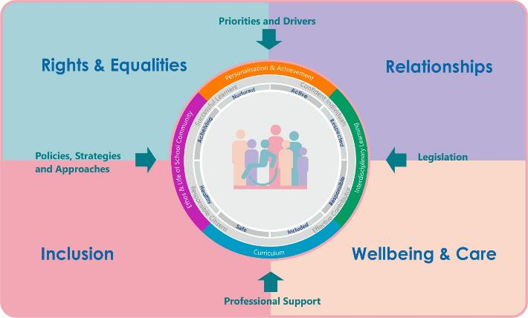
Interconnectivity
Notes:
All of the professional learning in the Framework fits into one of these four themes. The four themes are interconnected and interdependent.​
This activity forms part of the professional learning in the Relationship theme.

Slide 3
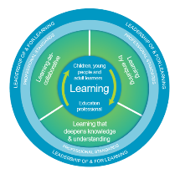
How to use this resource
These slides can be used to facilitate professional learning in a group or
whole-setting, or as a self-directed learning activity as an individual.
Facilitation notes are included at the bottom of each slide.
Please do not remove or change any of the slides included.
Facilitators are welcome to add slides or activities relevant to your own setting, to support discussion and exploration of the topic. Facilitators will know their participants’ needs best.
Anyone who works in an educational setting can be a facilitator and use these slides.
For reflection or discussion activities, it is important to establish a safe space which encourages respect and honesty to ensure that everyone is able to participate.
Notes:
Option to skip slide as these are instructions for facilitators only. No need to read to audience.

Slide 4
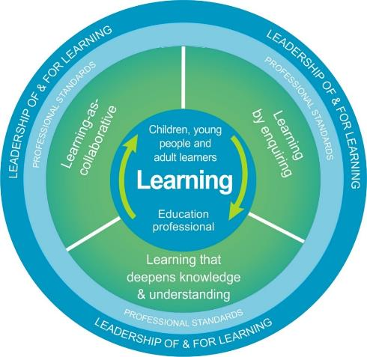
National Model for Professional Learning
This professional learning resource will support you to deepen your knowledge and understanding.
You will have the opportunity to consider how to take this learning forward on your own and with others.
The National Model of Professional Learning (education.gov.scot)
Notes:
This professional learning forms part of the national model for professional learning and is designed to help you gain more knowledge and have a deeper understanding of inclusion, wellbeing and equalities​​
On completion of this professional learning, you will be asked to consider what your next steps will be​​.
Please take some time to consider the reflection questions at the end

Slide 5
Welcome
This session provides an opportunity to:
To explore the Window of Tolerance and why we need to know about it
To understand what happens when we are outside our Window of Tolerance
How we can expand our Window of Tolerance
How we can help others to stay inside, or expand, their Window of Tolerance
Notes:
Link activity to national model

Slide 6
Window of Tolerance
4:26 mins
It is the best emotional zone for us to be in to function well
When we are in our Window of Tolerance we can regulate our emotions and cope with everyday things
If viewing as a PDF please click this link to watch the film https://youtu.be/TNVlppGz0zM Video by Teresa Lewis of Lewis Psychology
Notes:
First described by Professor Dan Siegel at the UCLA School of Medicine.
It is a helpful way to describe the best emotional ‘zone’ for us to be in to function well.
When we are within our window of tolerance we are emotionally regulated and have the capacity to cope with everyday things.
The following video describes the window of tolerance specifically from a child and trauma perspective however we too have a window of tolerance so when watching the film please consider yourself and what might keep you in or push you out of your window of tolerance.

Slide 7
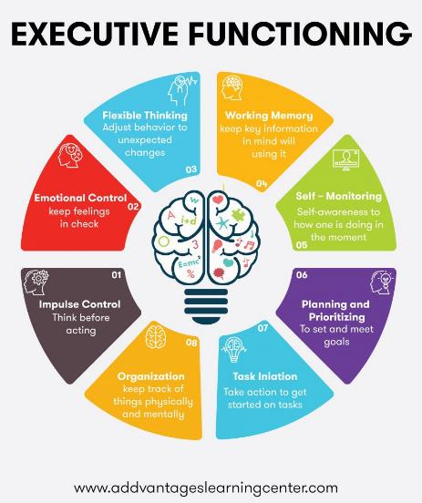
Why do we need to know about the Window of Tolerance?
To function well in everyday life and build healthy relationships we need to exist, for most of the time, within our window of tolerance. Inside our window of tolerance we are use the ‘thinking’ part of our brain and we can access skills which allow us to work, relate to others, and to problem solve. These skills (executive functions) include the ability to organise, plan and prioritise tasks, stay focused, regulate emotions, practice self-control, and manage our time.
Notes:
To function well in everyday life and build healthy relationships we need to exist, for most of the time, within our window of tolerance.
Inside our window of tolerance we are use the ‘thinking’ part of our brain and we can access (executive functioning) skills which allow us to work, relate to others, and to problem solve.
These (executive functioning) skills include the ability to organise, plan and prioritise tasks, stay focused, regulate emotions, practice self-control, and manage our time.
When we are outside our window of tolerance we generally stop using the thinking part of our brain and lose access the executive skills we need to function well. This is when we are more likely to make poor choices, display behaviours that aren’t helpful to us, or do/say things that harm our relationships with others.
We will all move outside our window of tolerance at times
We want to make it our goal to improve our capacity to return to our window of tolerance as quickly as we can and to improve our resilience.

Slide 8
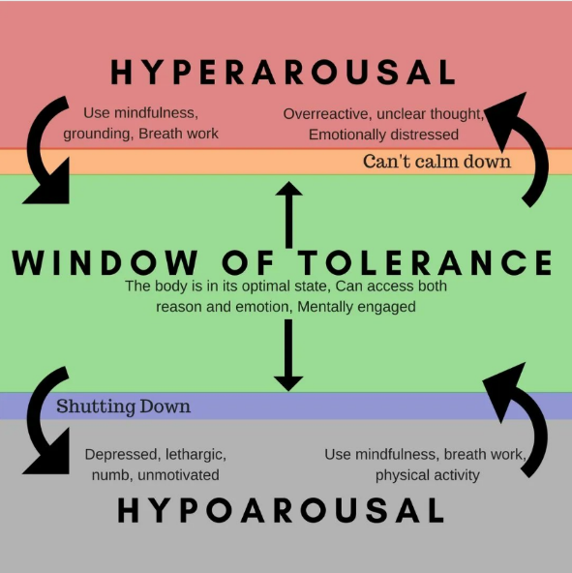
Inside and outside our window of tolerance
When we are​ hyper-aroused​ we may feel:​ we can’t calm down anxious​ fearful​ panicky​ hypervigilant​ defensive​ angry​
When we are​ hypo-aroused​ we may feel:​ like we are shutting down numb​ feelingless​ drained of energy​ unable to think or respond​ less able to move​ ashamed​
Notes:
Internal or external stressors can cause us to move outside of our window of tolerance
Outside our window of tolerance when we are hyper-aroused we can appear angry, panicky, irritable, anxious, overly excited or vigilant, overwhelmed, ready to fight/flee.
Outside our window of tolerance when we are hypo-aroused we can look withdrawn, flat, shut down, depressed, or disconnected.
We all have different windows of tolerance depending on factors such as our temperament, personality, background (including any trauma), our social supports and our physiology.
People who have experienced trauma may have smaller windows of tolerance.
With support our window of tolerance can be expanded.

Slide 9
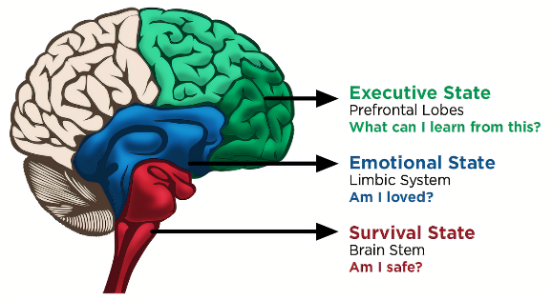
When we are outside our window of tolerance:
We stop using the thinking part of our brain and lose access to our executive skills
We start to exclusively use the parts of the brain responsible for emotion and survival instincts
We are also more likely to make poor choices, display behaviours that aren’t helpful to us, or do/say things that harm relationships
Notes:
When we are outside our window of tolerance:
We stop using the thinking part of our brain and lose access the executive skills
We start to exclusively use the parts of the brain responsible for emotion and survival instincts
We are also more likely to make poor choices, display behaviours that aren’t helpful to us, or do/say things that harm relationships

Slide 10
How do we expand our window of tolerance?
Manage our physical environment
Practice good self care
Be kind to our mind
Make connections
Develop helpful strategies or habits
Notes:
How do we expand our window of tolerance?
Manage our physical environment: create or organise our living and/or working environments to reduce stressors (think about lighting, sound levels, clutter, etc…)
Practice good self care: get enough sleep and exercise, eat well, and address any health issues.
Be kind to our mind: engage in activities that mentally stimulate us and help us to focus, find time to play, and allow our minds to rest. Do things that soothe our senses- calming music, scented candle, getting into comfortable clothes,…. whatever works for you!
Make connections: try to build and maintain some healthy relationships and find a purpose (for example, exporing your spiritual self or taking time to enjoy nature).
Develop helpful strategies or habits: to help us soothe ourselves, regulate our emotions, and redirect our minds away from from unhelpful or harmful thoughts. Try writing things down, challenge negative thoughts with positive ones, practice deep breathing…..
Of course these are also things that we can do or support a child or young person to do tin order for them to expand their window of tolerance.

Slide 11
We all move outside our window of tolerance at times!
To improve our capacity to stay in, or return to, our window of tolerance as quickly as possible we could try some of the following things:
Learn to notice of signs in our body when we are approaching the edge of your window of tolerance
Learn the triggers that threaten to push us out of our window oftolerance
Learn to self-regulate more effectively we may initially need help with this
Increase our happiness by being creative, socialising, getting outdoors, laughing
Reduce SHAME by showing self-compassion, reframing our thoughts
Build resilience through connections, wellness, having purpose
Practice mindfulness to be more aware, open, accepting, present
But remember ALL of these things take PRACTICE!

Slide 12
Helping others stay within their Window of Tolerance
We can help others (colleagues, learners or parents/carers) to stay within their Window of Tolerance by:
Sharing information about, or teaching them about, the Window of Tolerance
Sharing information, or teaching, strategies that will help us stay within, or even expand, our Window of Tolerance
Use of Posters on the walls of staffrooms or classrooms may be useful prompts or reminders
Help others begin to notice triggers that take them outside their window of tolerance

Slide 13
Reflection
From what you have learned so far, think about:
How has this made you feel?
What has this made you think about?
What one action would you like to take forward?
How can you link what you plan to do with others in your setting?
How you will know that this learning has made a difference?
Notes:
Facilitation notes:
You can do this in groups...
Encourage educators to take this forward in an enquiry
Consider impact of the actions / learning

Slide 14
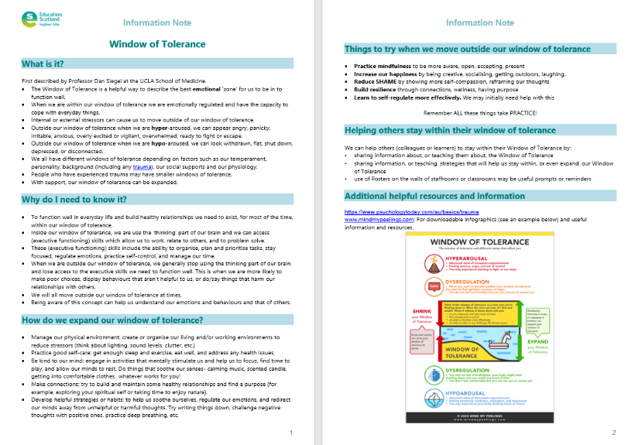
Resources and Information to help

Slide 15
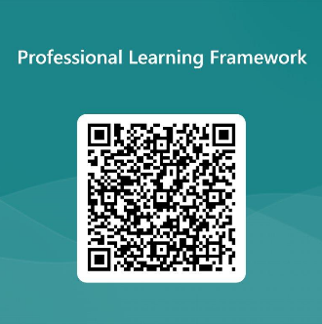
We value your feedback
From now until March 2024 we will be taking feedback on these resources so that we can make changes in advance of a formal launch of the Professional Learning Framework in June 2024
Your feedback could help us improve this resource
Please complete this short form, using the link or QR code, to let us know what you thought of it and any suggestions you have on how it could be improved
LINK: https://forms.office.com/e/b5PCpJJJ3P

Slide 16
For Scotland's learners, with Scotland's educators
Do luchd-ionnsachaidh na h-Alba, le luchd-foghlaim Alba
Education Scotland
Denholm House
Almondvale Business Park
Almondvale Way
Livingston EH54 6GA
T +44 (0)131 244 5000
E enquiries@educationscotland.gsi.gov.uk

