Slide 1
Inclusion Wellbeing & Equalities Professional Learning Framework Bereavement
@ESInclusionTeam
Notes:
Purpose of these Slides
This professional learning is pitched at an informed level and suitable for anyone working with children and young people in an educational context.
How to use the slides:
To be used to facilitate professional learning in a group or whole-setting, or as a self-directed learning activity as an individual.
General Guidance
There is a requirement to cover all the slides.
Please do not change the provided slides.
Facilitators are welcome to add slides or activities relevant to your own setting, to support discussion and exploration of the topic. Facilitators will know their participants’ needs best.
Anyone who works in an educational setting can be a facilitator and use these slides.
It is important to establish a safe space which encourages respect and honesty to ensure that everyone is able to participate.

Slide 2
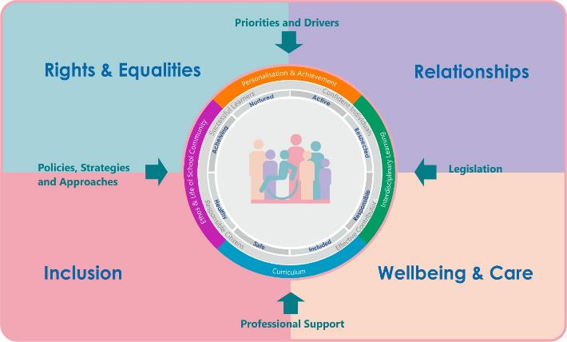
Interconnectivity
Notes:
All of the professional learning in the Framework fits into one of these four themes. The four themes are interconnected and interdependent.​
This activity forms part of the professional learning in the Wellbeing and Care theme.

Slide 3
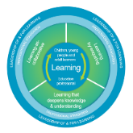
How to use this resource
These slides can be used to facilitate professional learning in a group or whole-setting, or as a self-directed learning activity as an individual.
Facilitation notes are included at the bottom of each slide.
Please do not remove or change any of the slides included.
Facilitators are welcome to add slides or activities relevant to your own setting, to support discussion and exploration of the topic.
Facilitators will know their participants’ needs best.
Anyone who works in an educational setting can be a facilitator and use these slides.
For reflection or discussion activities, it is important to establish a safe space which encourages respect and honesty to ensure that everyone is able to participate.
Notes:
Option to skip slide as these are instructions for facilitators only. No need to read to audience.

Slide 4
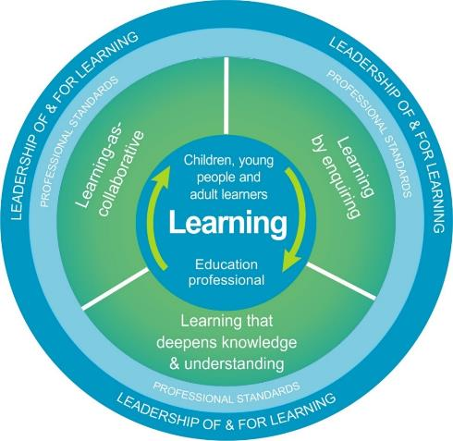
National Model for Professional Learning
This professional learning resource will support you to deepen your knowledge and understanding.
You will have the opportunity to consider how to take this learning forward on your own and with others.
The National Model of Professional Learning (education.gov.scot)
Notes:
This professional learning forms part of the national model for professional learning and is designed to help you gain more knowledge and have a deeper understanding of inclusion, wellbeing and equalities​​
On completion of this professional learning, you will be asked to consider what your next steps will be​​.
Please take some time to consider the reflection questions at the end

Slide 5
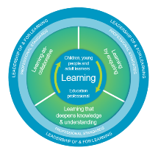
Welcome
This session provides an opportunity to:
Understand the nature, prevalence and impact of bereavement.
Explore the understanding of death at different ages and ways to talk to bereaved children and young people.
Notes:
This session provides an opportunity to:
Understand the current educational context in terms of the need for nurture
Consider the evidence for nurture

Slide 6
What do we mean by bereavement?
‘the death of someone important in the life of a child or young person’
From ‘Growing up Grieving: A report by the National bereavement Project’ 2022
Notes:
This definition of bereavement is the one used by a Scottish project looking at the experience of ‘Growing up Grieving’. The project is available here.

Slide 7
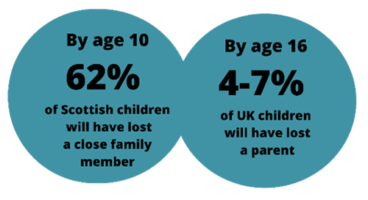
Bereavement is everybody’s business
Notes:
Using longitudinal data from the Growing Up in Scotland study, researchers Nina Vaswani (Children and young people’s centre for justice) and Dr Sally Paul (University of Strathclyde’s School of Social Work and Social Policy), looked into the impact of bereavement on children and young people in Scotland.
The research found that 50.8% of all children are bereaved of a parent, sibling, grandparent or other close family member by age 8 and this rises to 62% by age 10. The most common death experienced was that of a grandparent or other close relative.
UK data has shown by the age of 16, 4-7% of children will have lost a parent.
Young children who have been bereaved are most likely to have lost a sibling through miscarriage or stillbirth
The study also found that children born into the lowest income households are at greater risk of being bereaved of a parent or sibling than those born into the highest income households. So supporting bereaved children is an issue of equity. They are 5x more likely to experience losing a parent and 4 x more likely at risk of losing a sibling than their more affluent counterparts
The reseachers believed that the figures are actually an underestimate of the true extent of childhood bereavement in Scotland as we only looked at data which reported on the death of close relatives. We don’t know how many children experienced the death of other important people, such as other family members, close friends, neighbours, teachers and so on. They also made the decision not to include people who dropped out the GUS study

Slide 8
Bereavement - An equity issue
People experiencing multiple disadvantages encounter bereavement and loss at a disproportionate rate.
Children and young people with a lower household socio-economic status (SES) were significantly more likely to experience the death of a parent or sibling.
In addition, poverty can also inhibit recovery from bereavement.
There are correlations between experiencing bereavement and involvement in the criminal justice system but it is not known if the bereavement experience itself increases vulnerability.
Notes:
Equity means recognizing that we do not all start from the same place and must acknowledge and make adjustments to imbalances. The process is ongoing, requiring us to identify and overcome intentional and unintentional barriers arising from bias or systemic structures.
Not only do children and young people living in poverty disproportionately experience bereavement, poverty can also inhibit recovery from bereavement.
There are links to experiencing bereavement and becoming involved in the Criminal Justice System Vaswani 2014. Vaswani summarises the research into the bereavement experiences of 33 young men in prison. The prevalence of bereavement was high, at 91%, and multiple and traumatic bereavements were common.
She explains that ‘while the research is clear about the existence of an association between loss, childhood bereavement and offending, there is less understanding about the nature, direction or mechanisms of this association. For example, the association may be one of correlation rather than causation as many childhood experiences that are related in some way to vulnerability and offending (poverty, inequality, familial substance misuse or mental health issues, community violence etc.) also increase the risk of premature death and bereavement. Or there may be something about the bereavement experience, or the response to that experience, that leaves some children vulnerable to poor outcomes.’
Bereavement and offending behaviours: a role for Early and Effective Intervention (EEI)? - University of Strathclyde Vaswani 2019

Slide 9
Activity: Typical Grief Reactions
Note down some reactions to grief that you have noticed.
For Scotland's learners, with Scotland's educators
Do luchd-ionnsachaidh na h-Alba, le luchd-foghlaim Alba
Notes:
Grief has been defined as, ‘the human response to change and loss in our lives, such as the death of someone we love, parental separation or other major change. It is a natural and normal response, which has a physical impact on our bodies as well affecting our emotions and our thinking. Grief challenges the way we think about ourselves and the world and influences our spirituality and relationships.’
Mallon, B ‘Managing Loss, Separation and bereavement: Best policy and practice’ 2

Slide 10
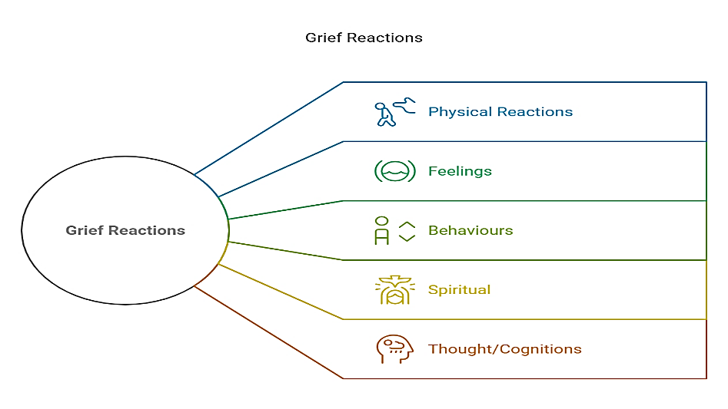
Typical Grief Reactions
.
Notes:
Examples
Physical Reactions:
Excessive tiredness despite sleep, hollow or churning stomach, tight chest, breathlessness, increased heart rate, weakness, dry mouth, more prone to minor ailments, muscle tightness, stomach aches and headaches
Feelings
Shock, sadness, anxiety and fear (including fear of separation and further loss), guilt, relief, abandonment, loneliness anger, numbness, blame including self-blame, irritability or frustration
Behaviours Restless over-activity or lethargy, sleep disturbances, clinging, vivid dreams, crying, social withdrawal, avoidance of reminders of deceased/absent person, searching and calling out, visiting places/treasuring objects linked to the deceased
Spiritual what’s it all about? what is my purpose?
Thoughts/cognitions
Disbelief, if only… ,preoccupation with what has been lost, sense of presence (of deceased person), forgetfulness, sense of not being present in own body

Slide 11
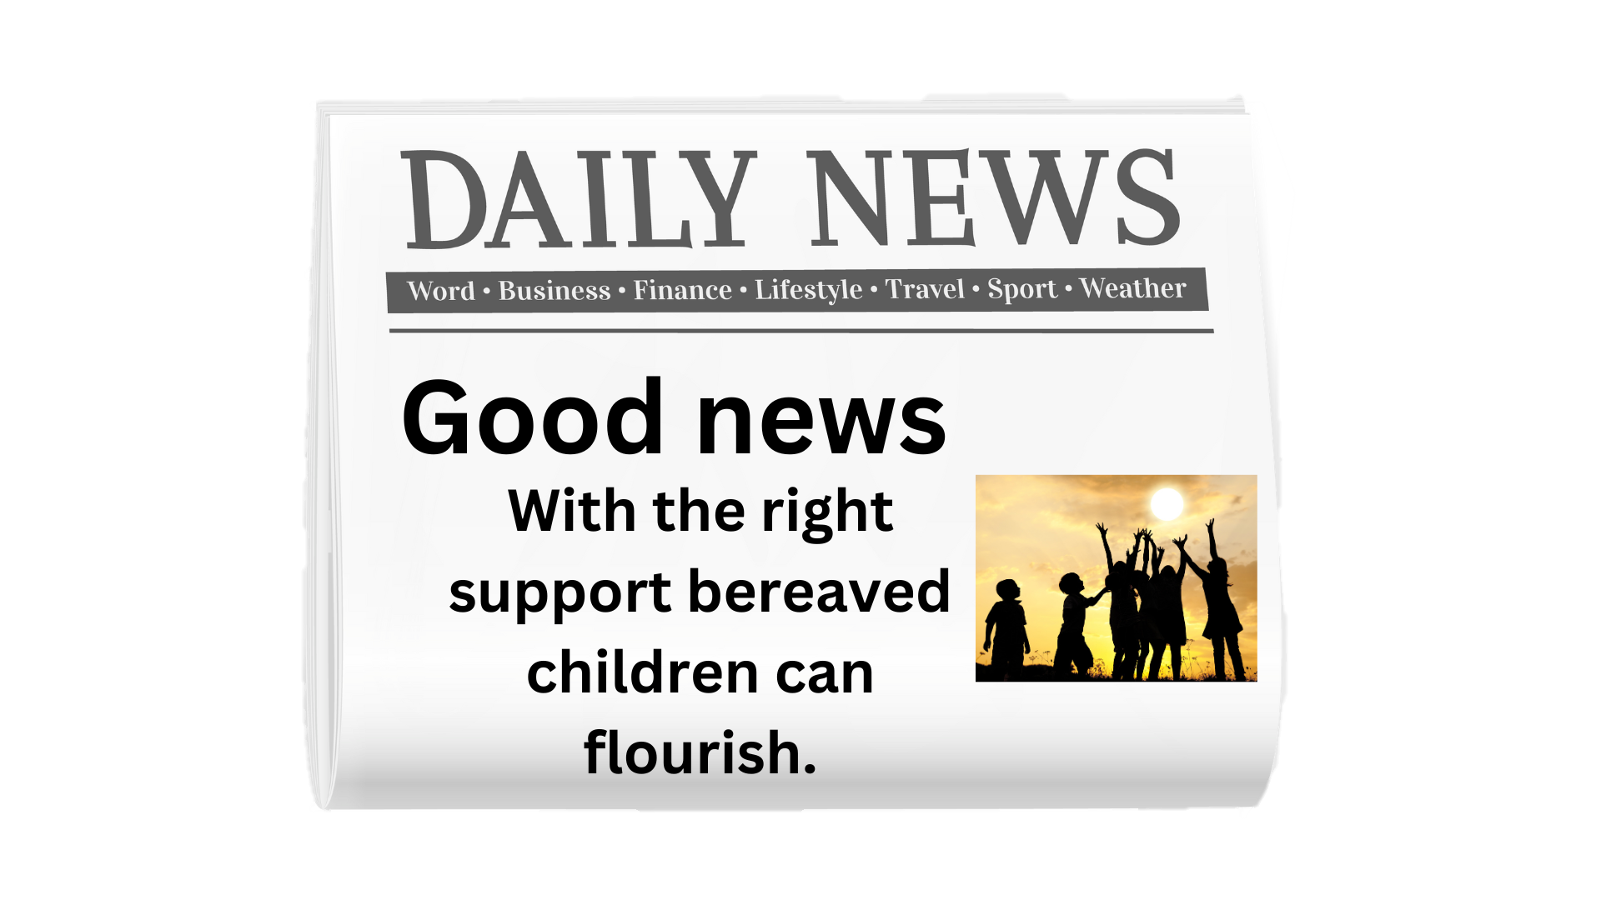
What is the impact of bereavement?
Do luchd-ionnsachaidh na h-Alba, le luchd-foghlaim Alba

Slide 12
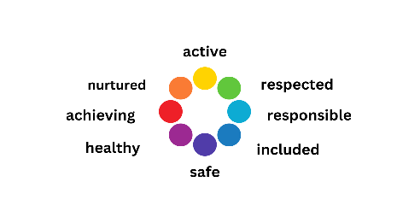
Bereavement can impact on wellbeing
Nurtured: Many care experienced learners will have experienced significant bereavements
Achieving: A UK study showed that even when controlling for other factors bereavement of a parent can reduce attainment
Healthy: Bereavement is linked to physical symptoms such as fatigue and a higher frequency of illness
Safe: some children and young people are bullied because of their bereavement
Included: a drop in income can be a barrier to opportunities
Responsible: Bereavement can reduce self-efficacy but many bereaved young people reflect on how the loss led to a growth in their maturity.
Getting it Right for Every Child
Wellbeing Indicators
For Scotland's learners, with Scotland's educators
Do luchd-ionnsachaidh na h-Alba, le luchd-foghlaim Alba
Notes:
Nurtured
Many care experienced children will have experienced a bereavement
Achieving
Worden’s 1996 study found lowered concentration a year after a bereavement
Abdelnoor and Hollins (2004, UK) found that parentally bereaved young people’s GCSE
scores were an average of half a grade lower than their non-bereaved peers even when controlling for poverty. Girls bereaved of a sibling scored almost a full grade below their controls.
Healthy
Many children complain of somatic illnesses. 10% in the first year also have a serious illness.(more than those not bereaved although this settles after first year).
34% of children experienced accidents as they moved through the first year of their bereavement, compared to 26% among non-bereaved children. Adolescent boys had the majority of accidents (Worden, 1996, US)
Analysis of ALSPAC data looked at the impact of different stressful life events on over 14,000 children born in Avon in 1991-2. Parents were asked about their children’s emotional, behavioural and social well-being at the age of 13 (Jones et al, 2013, UK).
Teenagers who experienced bereavement at any age had lower emotional well-being aged 13 than those who hadn’t been bereaved of a family member. This remained significant even taking into account emotional well-being at age 10.
Safe
Childhood bereavement UK report that bereaved young people often tell them they feel different to their peers resulting in social isolation, loneliness and, in some cases, bullying.
Included
A drop in income can be a barrier to opportunities
Responsible
Over the three years following the death of a parent, a sample of 240 young people were more likely to do things that risked their health than their non-bereaved peers. These included not wearing a seat belt, being in a car driven by someone who had been drinking, carrying a weapon, and being in a physical fight in the last year. These findings held even after taking into account correlates of bereavement and risky health behaviours, such as aggression, and antisocial or anxiety disorders of the deceased parent (Muniz-Cohen et al, 2010, US).
Active
Respected

Slide 13
Understanding of death at different ages
For Scotland's learners, with Scotland's educators
Do luchd-ionnsachaidh na h-Alba, le luchd-foghlaim Alba
Notes:
https://youtu.be/cBA2U_AFBng?si=Se34VObtuY5_1h8E 4 minutes 48s
This film from Childhood bereavement UK explores understanding of death from a developmental perspective.

Slide 14
What do children and young people need following a bereavement?
Adequate information
Fears and anxieties addressed
Reassurance they are not to blame
Careful listening
Validation of individuals’ feelings
Help with overwhelming feelings
Involvement and inclusion
Continued routine activities
Modelled grief behaviours
Opportunities to remember.
Worden 1996
For Scotland's learners, with Scotland's educators
Do luchd-ionnsachaidh na h-Alba, le luchd-foghlaim Alba
Notes:
Adequate information- this needs to be without euphemisms and repeated as necessary to allow the information to be processed. As the child develops they are likely to have new questions at different developmental stages.
Fears and anxieties addressed –children can fear that others will die too. They want to know the practical implications of the death. Who will take me to school now? Is the dead person lonely or hurting now?
Reassurance they are not to blame –when we don’t understand why something happened children often blame themselves. They might also give themselves a hard time for any actions towards the bereaved that they regret.
Careful listening
Validation of individuals’ feelings- many young people fear they are the only ones feeling the way they do and acknowledge that while grieving is distressing there is no right or wrong way to feel. Where bereaved children had complicated relationships with the deceased these are important to acknowledge.
Help with overwhelming feelings (consider looking at the input on Self-regulation in the IWE framework).
Involvement and inclusion- give children and young people the option to be part of the funeral/memorial services/seeing the body etc. All of these need preparation so that children and young people know what to expect.
Continued routine activities where possible.
Modelled grief behaviours by key adults.
Opportunities to remember. –memory boxes, sharing stories about the deceased, anniversaries.

Slide 15
Talking to Bereaved Children before and just after a death
For Scotland's learners, with Scotland's educators
Do luchd-ionnsachaidh na h-Alba, le luchd-foghlaim Alba
Notes:
This NHS animation explores what children and adolescents want to know before and after a death as well as the impact on infants 5m22s
Talking to children who are bereaved

Slide 16
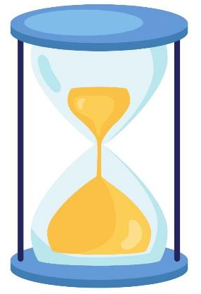
There is no time limit to the impact of bereavement
For Scotland's learners, with Scotland's educators
Do luchd-ionnsachaidh na h-Alba, le luchd-foghlaim Alba
Notes:
As children mature they have greater understanding of their loss and this can evoke new grief reactions and new questions.
Many things can remind us of the death of our loved one-a smell, an event at which they are not present, another death even if it is not someone we are close to. These can make us feel the rawness of grief despite the death being some time ago.
Some people try to put limits on grief 'It's more than a year since they lost their mum, they shouldn't be so upset'. This may reflect the person's lack of ease and insight rather than the nature of grief.
It is helpful to keep significant bereavements in pastoral notes as well as key dates that might be difficult for the young person or their family. This information should be highlighted during transitions.
This page explores this topic in more detail.

Slide 17
Consider whether the bereavement is an additional support need
A child or young person has additional support needs if, for any reason, they need extra or different help than others their age to benefit fully from their education. Bereavement might therefore lead to additional support needs.
For Scotland's learners, with Scotland's educators
Do luchd-ionnsachaidh na h-Alba, le luchd-foghlaim Alba
Notes:
Bereavement as an additional support need
An assessment of a child’s needs should align with GIRFEC policy guidance and Additional Support for Learning legislation and statutory guidance.
It is also important to consider your learners who already have additional support needs and how that might impact their experience of bereavement.

Slide 18
Resources
https://www.thinglink.com/view/scene/1966505798225888100
Notes:
A range of resources can be accessed through this Thinglink. An accessible version is available here. (insert resources page on hub)

Slide 19
Final Reflection
From what you have learned so far, think about:
How has this made you feel?
What has this made you think about?
What one action would you like to take forward?
How can you link what you plan to do with others in your setting?
How you will know that this learning has made a difference?
Notes:
Now consider the following reflective questions. Thank-you for taking part.

Slide 20
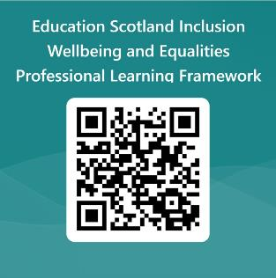
We value your feedback
Education Scotland is taking feedback so that we can continue improving our professional learning resources.
Your feedback could help us improve this resource
Please complete this short form, using the link or QR code, to let us know what you thought of it and any suggestions you have on how it could be improved.
LINK: https://forms.office.com/e/J2NQUuCHji
Notes:
Education Scotland is taking feedback on these resources so that we can continue improving our professional learning resources.
Your feedback could help us improve this resource
Please complete this short form, using the link or QR code, to let us know what you thought of it and any suggestions you have on how it could be improved

Slide 21
For Scotland's learners, with Scotland's educators
Do luchd-ionnsachaidh na h-Alba, le luchd-foghlaim Alba
Education Scotland
Denholm House
Almondvale Business Park
Almondvale Way
Livingston EH54 6GA
T +44 (0)131 244 5000
E enquiries@educationscotland.gsi.gov.uk

