Slide 1

Session 5:
His Majesty’s Inspectorate of Education in Scotland (HMIE)
Steven McPherson - Head of Inspection

Slide 2


Additional Support Needs
Findings from HM Inspectors
Steven McPherson
Head of Inspection

Slide 3


Introduction
HM Inspectors evaluate schools using How Good Is Our School? 4th edition (HGIOS4)
  Focus areas:
Leadership of change (QI 1.3)
Learning, teaching and assessment (QI 2.3)
Ensuring wellbeing, equality, and inclusion (QI 3.1)
Raising attainment and achievement (QI 3.2)
  Additional themes:
  Learning pathways (from QI 2.2 Curriculum)
  Parental engagement (from QI 2.7 Partnerships)
  Safeguarding and Child Protection (QI 2.1) is also a feature of every school inspection.

Slide 4
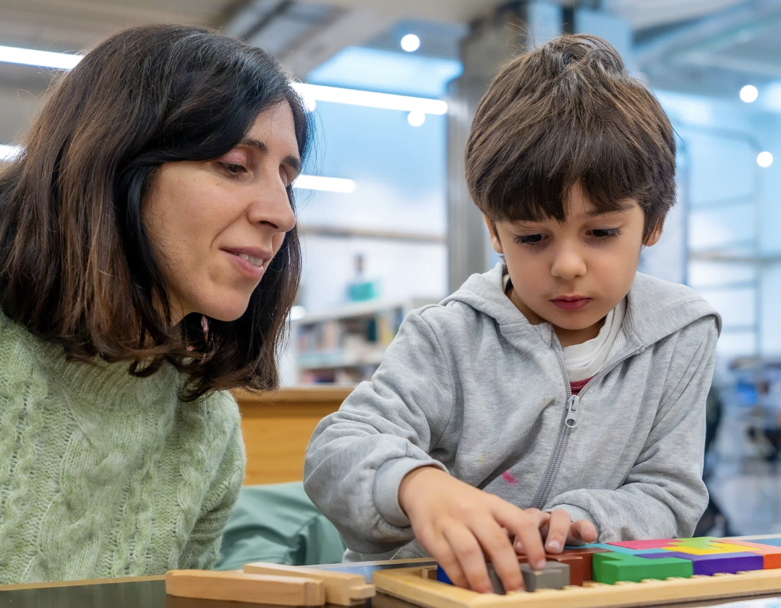
Inspecting the quality of provision for ASN
Inclusive practices – support for children with ASN in mainstream schools including personalised strategies.
Identification, planning and monitoring of ASN – aligned with ASL legislation and the GIRFEC framework.
Support during transitions – education transitions, post-school destinations and unplanned changes.
Impact of ASN provision and targeted interventions – resulting improvement in wellbeing, engagement and attainment.
Rights-based approaches – tailored learning to individual need through IEPs, staged intervention and multi-agency work.

Slide 5

Key strengths (I): In most schools
Staff build strong, trusting relationships, enabling personalised support for learners and families.
Staff are increasingly creating more inclusive environments.
Staff are accessing valuable CLPL, including nurturing principles and trauma-informed approaches.
Strong frameworks to support personalised planning for ASN.

Slide 6
Key strengths (II): In most schools
Staff are increasingly gathering valuable data and evidence to help measure progress and inform next steps.
Children and young people’s wellbeing needs are being met, with staff understanding their statutory duties.
Children and young people with ASN are making good or better progress in literacy and numeracy
(this is a stronger feature in primary schools).
Young people are being supported to move into positive destinations successfully.

Slide 7


Challenges
Increasing numbers of children and young people with ASN.
Greater diversity and complexity of needs.
Staffing challenges and limited professional learning affecting consistent support.
Variable access to specialist colleagues and external agencies.
Learners with ASN continue to be more likely to be excluded, experience interrupted learning and lower attainment.

Slide 8

Key areas for improvement
Ensure children and young people with ASN have a stronger voice in decisions which affect them.
Strengthen data-informed planning to improve outcomes.
Ensure targets are specific, measurable and achievable.
Develop more personalised support strategies.
Evaluate the impact of targeted interventions more rigorously.
Strengthen universal classroom support through providing sufficient challenge and high-quality approaches to differentiation.

Slide 9

Inspection findings suggest that staff would benefit from professional learning in:
Differentiation and pupil voice – professional learning to strengthen inclusive classroom practice.
Neurodiversity and mental health – deeper understanding to support learners better.
Support during transitions – improving planned and unplanned transition support.
De-escalation and co-regulation strategies – strengthening positive behaviour support.
Specialist communication and sensory support – training in AAC, BSL, braille and assistive technologies.
Professional learning for support staff – structured training aligned with learners’ needs (e.g. dyslexia, dyspraxia).

Slide 10
What the evidence tells us – key takeaways:
Inclusive practice is strengthening across most schools, with nurturing relationships, supportive environments and effective personalised planning frameworks.
Learners with ASN generally make good progress, particularly in primary schools, supported by targeted interventions, wellbeing provision and growing use of assessment data.
System pressures persist – rising levels and complexity of need, staffing challenges and inconsistent access to specialist services continue to impact experiences and outcomes.
Children and young people’s voices need strengthened, with targets often too generic and insufficient influence from learners on decisions that affect them.
Universal classroom practice must improve, through high expectations, clearer differentiation, stronger challenge, and enhanced professional learning around neurodiversity, behaviour support and inclusive pedagogy.

Slide 11

Reflective discussion questions
What are your approaches to providing and improving universal support for children and young people?
What support would help you improve universal support and inclusive pedagogy from local authorities, Education Scotland and other partners?

Slide 12
Thank you
Steven McPherson
Head of Inspection

