Slide 1


The Additional Support for Learning Engagement Event 2026
Sharing What Works: Improving ASN Together
12 March 2026

Slide 2


Session 3:
Wallace High School
Supporting Inclusive Learning in Practical Subjects
Through Video and Differentiated Success Criteria
Adele McAdam - Faculty Leader of Creative Industries and Education Scotland Associate for Differentiation and Adaptive Teaching.
Emma Paterson - Music Teacher
Notes:
This slide is for information when developing the presentation and will be taken out of the final version.

Slide 3
The Issue
Independence
Learners were unable to work independently
01
Forgetting
Learners forget teacher demonstrations
02
As a faculty, we were all feeling like we were not doing enough to meet the needs of all learners.
Time
Teachers were struggling to get round all learners in a period
03
Expectations
Do Learners know what ‘good’ looks like and are they all being challenged?
04
05
Increasing Demands
Increasing levels of need with limited SLA support
Notes:
When we came back from lockdown, we noticed increasing levels of need. Lessons that worked well before were now becoming more challenging to get through due to diverse needs in the classroom.
Discussed as a faculty,
No resources to support practical subjects, something that works across all practical subjects so learners have a consistent experience.

Slide 4







Our Journey
Learner Voice
Learner's admitted that they did not know their working levels and that they often forgot teacher demonstrations.
Assessment
Rubrics developed to assess learner work at different levels based on support levels
Content
Practical demonstrations, audio recordings and screen recordings of computer work.
02
04
06
01
03
05
Faculty Discussion
We discussed as a team how we could better support learners consistently
Differentiated outcomes
We agreed on expectations at gold, silver and bronze for assessed benchmarks
Video Creation
We created a series of videos and shared them with S1-3 learners on Google Classroom.
Notes:
We trialed using some lock down, software demo videos and pupils responded well to them in class. This gave us the idea of creating more

Slide 5
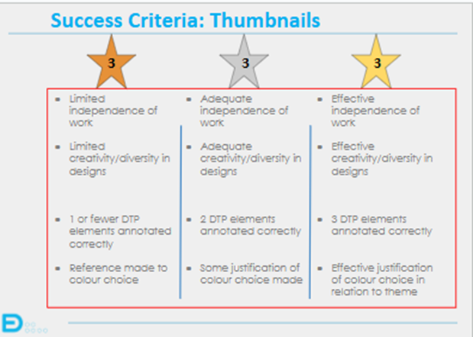
Differentiated Outcomes
Collectively we agreed what we expected learners to produce for assessed benchmarks at a level appropriate to them.
Notes:
Different success criteria that take into account different abilities
Consistency and moderation of BGE became easier – especially with new staff
Taking into account independence of work is in line with QS standards for PWW and PMW.

Slide 6
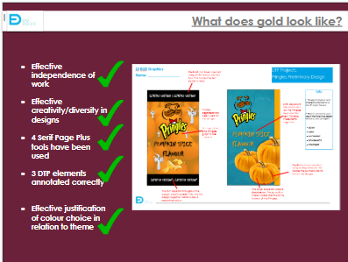
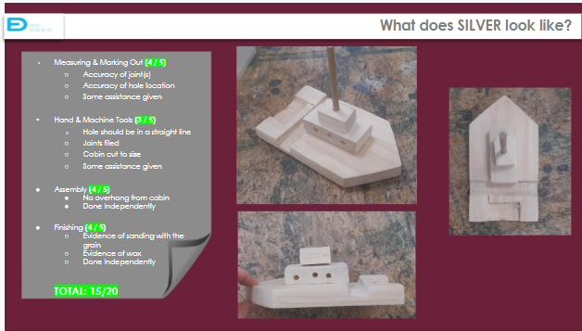
Differentiated Outcomes Examples
Learners are shown exemplars.
Notes:
Moderation of BGE decided what we were looking for at B,S,G for each benchmark, examples were identified in meetings and shared with learners

Slide 7
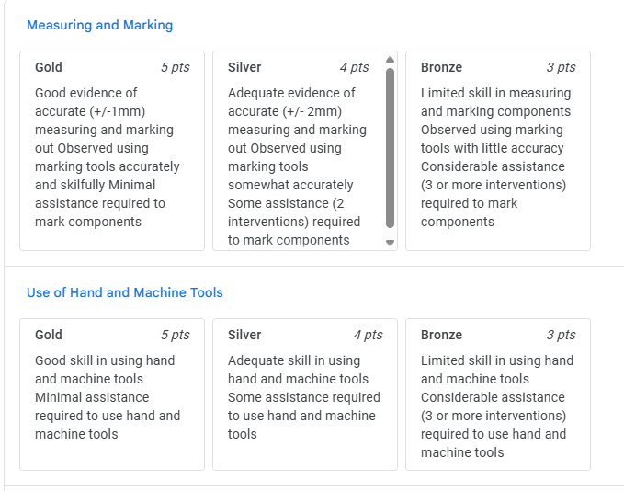
Assessment Criteria
Design and Engineering - Use of Marking Rubrics which consider ‘Level of Assistance’ needed.
This mirrors practical assessment marking approaches at N4/5.
Notes:
Learners often produce the same item. The quality of the finished product can be high if they had a lot of support or worked completely independently, this must be taken into account.

Slide 8


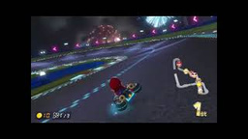

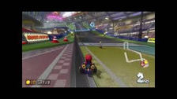
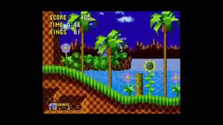
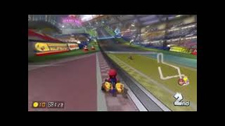
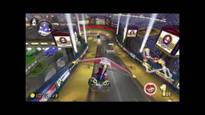
Differentiated Outcomes
Level 2
2
2
2
  Create a simple soundtrack using loops on Garageband.
  Create a simple soundtrack using loops on Garageband making sure to beat match and change loops.
  Add in a few simple sound effects downloaded from the internet.
Level 3
3
3
3
  Create a simple soundtrack using loops on Garageband adding in volume automation and panning.
  Add in appropriate sound effects downloaded from the internet. Making sure sound effects are placed on the correct timing.
  Add volume automation and panning to sound effects.
  In addition, use reverb to make sound effects heard more clearly.

Slide 9
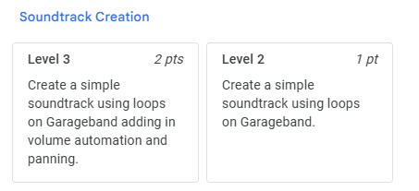
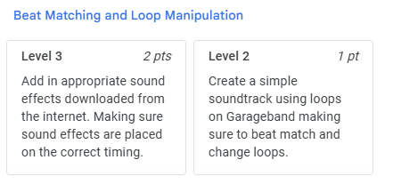
Assessment Criteria Music
Music - Use of differentiated assessment criteria

Slide 10
Assessment Criteria.
Music - Use of clear criteria to encourage all learners to push themselves further.
Third Level/L3 | Bronze | Silver | Gold
Keyboard | Can play some of the melody, within an octave, using 4/5 fingers | Can play crotchets and quavers in the melody with 3 LH chords | Can play, with fluency using 4/5 fingers, the melody with 4 LH chords and accompaniment
Ukulele/ Guitar chords | Can play 4 chords with breaks to change | Can play 5 chords with simple strumming pattern and consistent, steady tempo | Can play, with accompaniment, a total of 5 chords with a strumming/picking pattern
Tuned percussion | Can play melody, within an octave, using 2 beaters | Can play crotchets and quavers in the melody, with correct tempo, with 2 beaters | Can play a melody with more challenging rhythms using 2 beaters, with accompaniment
Bass guitar | Can use both thumb and fingers to pluck to minims and crotchets | Can play pieces with minim and crotchet rhythms using frets 1-3 | Can read tab and play frets 1-3 with accompaniment using good fingering
Guitar Lead/ Ukulele tab | Can read some easy tab with crotchet rhythms and change strings/frets confidently | Can read tab and play crotchet/quaver rhythms using frets 1-3 without accompaniment | Can read tab and play crotchet/quaver rhythms using frets 1-3 with good fingering and accompaniment
Drumkit | Learning to play a new style with 3 way independence | Can play 3 way independence in 2 styles with 2 fills and consistent tempo | Can play 3 way independence with 2 fills, 2 styles and backing track/accompaniment

Slide 11
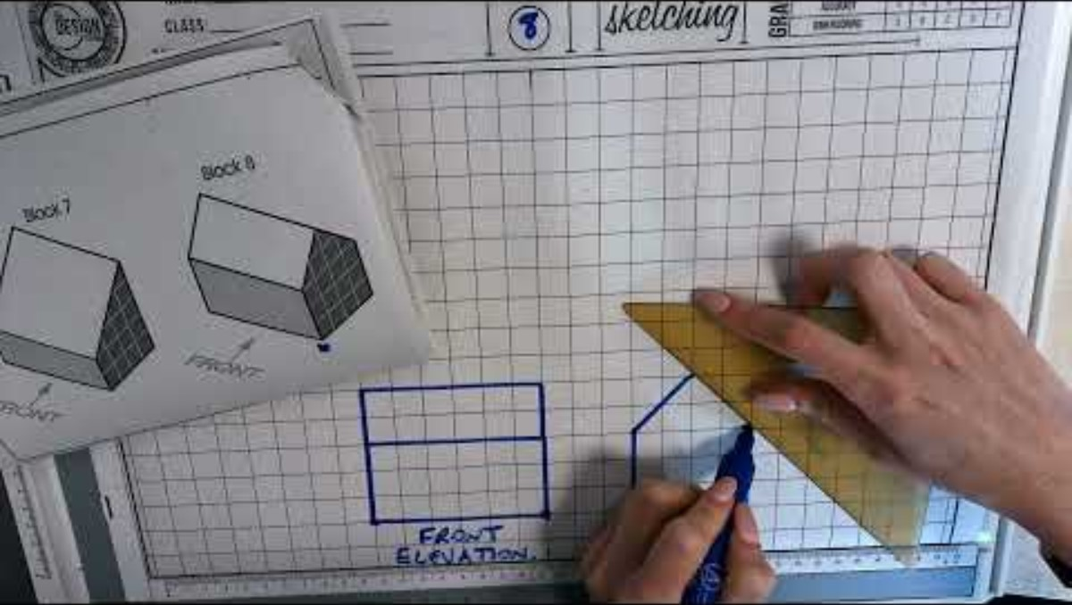
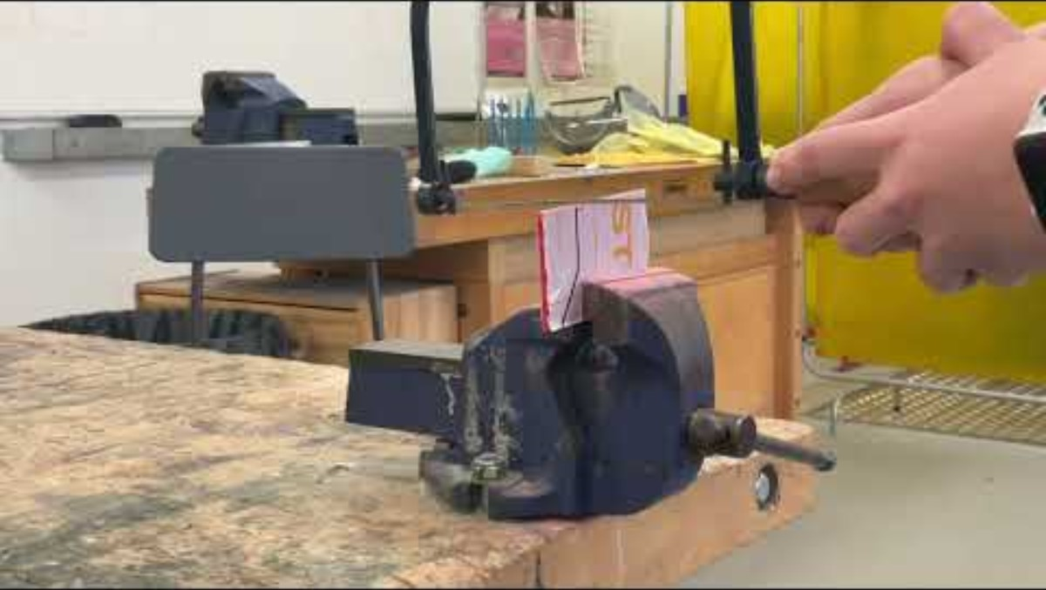
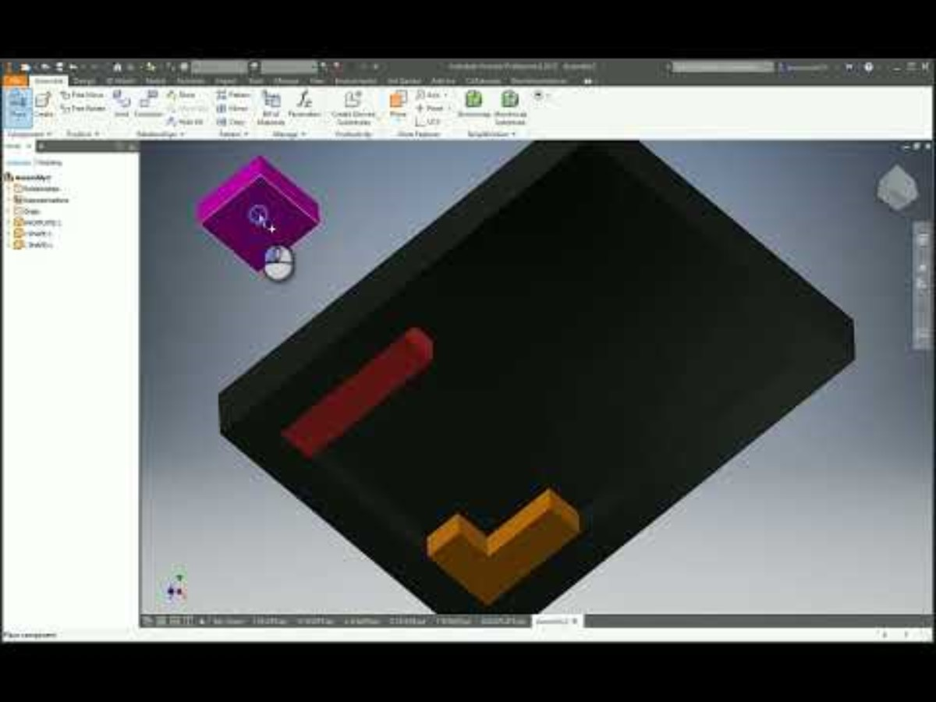
Video Resources
Universal support videos have been created to help learners to understand the requirements of their projects.
In D+E videos show practical teacher demonstrations and software and drawing guidance.
In Music, tutorial videos are used to explain steps of a project in Music Technology.
For performing there are video demonstrations of each instrument.
Technical Drawing
Practical Work
CAD Work

Slide 12

The Videos and demonstration of levels
Demonstration of Level 3 Keyboard.
Tutorial video for Music Tech Project.
Learner led demo teaching guitar chord's.

Slide 13
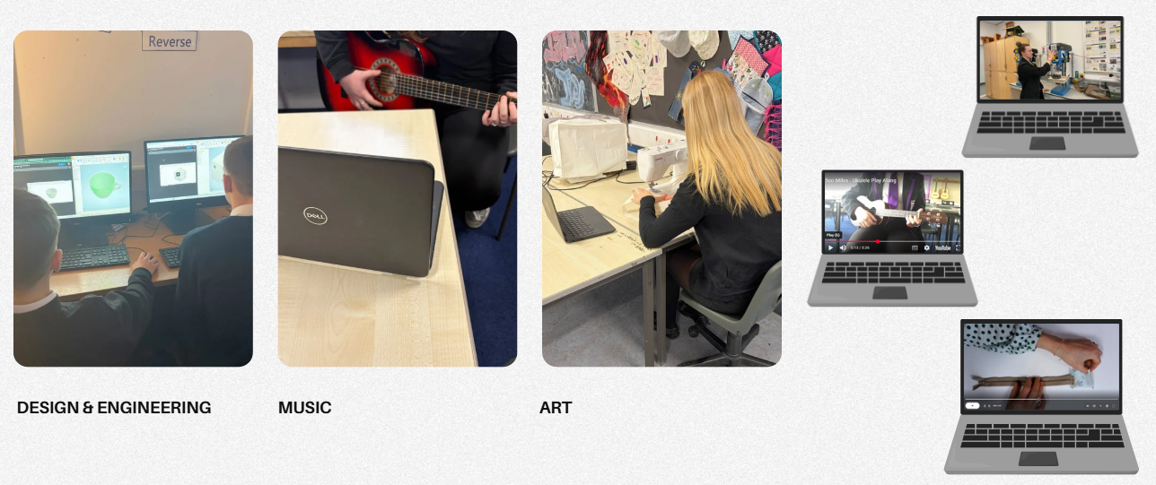
What does it look like in practice?
Notes:
Calm, settled and very inclusive – everyone makes use of the videos and it is not obvious what level you are working at. In particularly challenging projects all learners were able to access the task and produce at a level that suits their needs, crucially pupils are able to articulate what level they are working on and the next steps in their learning journey.

Slide 14
Staff and Learner Feedback
  Learners
  77% of learners felt that they were able to push themselves further with tasks.
  "They help me when I'm stuck on a task and I can re watch them if I need."
  "It shows me exactly what to do when I'm ready for it, so I don’t always have to wait for the teacher to come round“
  Staff
  83% of staff felt that they had seen increased levels of engagement from pupils since using the videos.
  "I strongly believe that the videos allow for a better flowing lesson and definitely aid with classroom management"
  "The videos have allowed pupils to problem solve for themselves and have given me the opportunity to ensure pace and challenge is more personalised for pupils."
  " I am now enjoying teaching again."
Notes:
Throughout the process we have taken extensive pupil and staff voice.

Slide 15
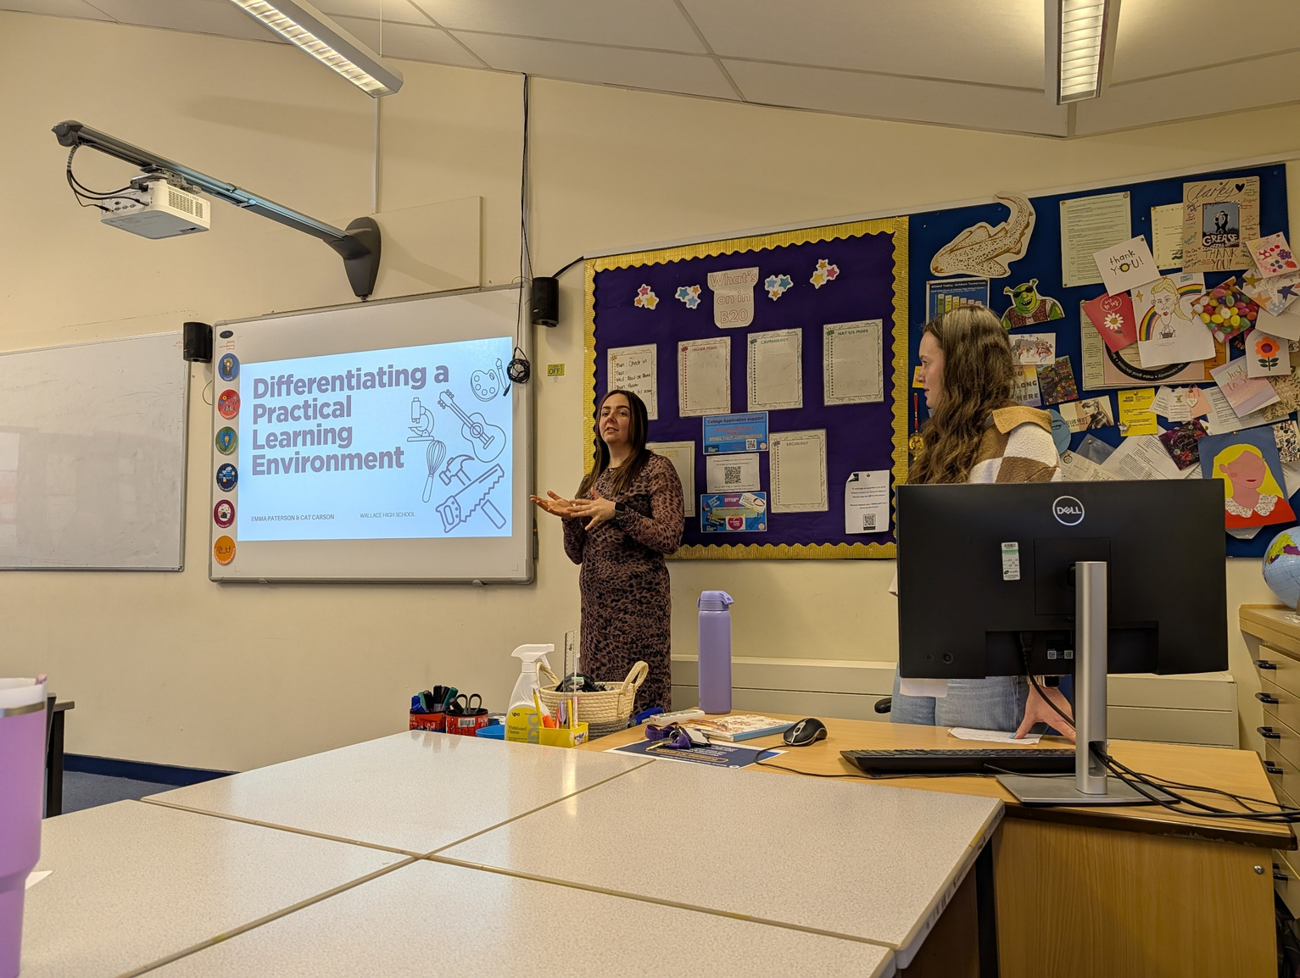
Next Steps…
  Expand our offering of Videos into Home Economics.
  Continue to take feedback from learners about our approaches.
  Devise ways to push more able learners using videos - Could we exemplify skills and encourage learners to apply them in another context?
  Work with colleagues across Stirling to share resources.

Slide 16
Education Scotland logo: white on teal background

