Slide 1
Inclusion, Wellbeing and Equalities Professional Learning Framework
Talking about Diversity
Level – Informed
@ESInclusionTeam
For Scotland's learners, with Scotland's educators
Do luchd-ionnsachaidh na h-Alba, le luchd-foghlaim Alba
Notes:
Slide 1:
Inclusion Wellbeing & Equalities Professional Learning Framework – Talking about Diversity
This professional learning is pitched at an informed level and is suitable for anyone working with children, young people and adult learners in an educational context.

Slide 2
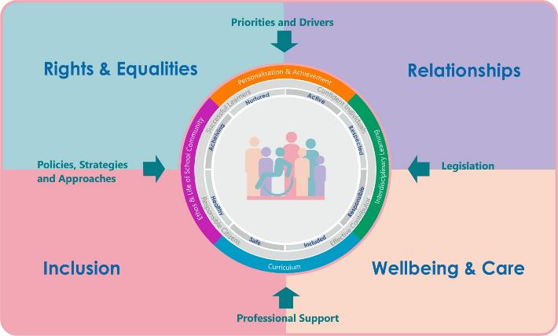
Inclusion, Wellbeing and Equalities Professional Learning Framework
Notes:
Slide 2
This professional learning resource comes under the Rights and Equalities theme of the Inclusion, Wellbeing and Equalities Professional Learning Framework.

Slide 3
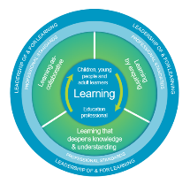
How to use this resource
Pause for Thought…
These slides can be used to facilitate professional learning in a group or whole-setting, or as a self-directed learning activity as an individual.
Facilitation notes are included at the bottom of each slide
Please do not remove or change any of the slides included.
Facilitators are welcome to add slides or activities relevant to your own setting, to support discussion and exploration of the topic. Facilitators will know their participants’ needs best.
Anyone who works in an educational setting can be a facilitator and use these slides.
For reflection or discussion activities, it is important to establish a safe space which encourages respect and honesty to ensure that everyone is able to participate.
Notes:
Slide 3:
[Option to skip this slide as instructions for facilitators only. No need to read to audience]
These slides can be used to facilitate professional learning in a group or whole-setting, or as a self-directed learning activity as an individual.
Facilitation notes are included at the bottom of each slide
Please do not remove or change any of the slides included.
Facilitators are welcome to add slides or activities relevant to your own setting, to support discussion and exploration of the topic. Facilitators will know their participants’ needs best.
Anyone who works in an educational setting can be a facilitator and use these slides.
For reflection or discussion activities, it is important to establish a safe space which encourages respect and honesty to ensure that everyone is able to participate.
FACILITATION NOTES can also be found on a separate Word document on the Education Scotland Inclusion, Wellbeing and Equalities Professional Learning Framework.

Slide 4
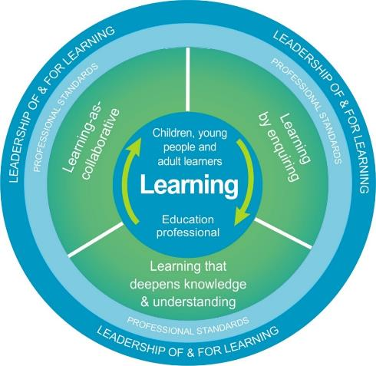
National Model for Professional Learning
This professional learning resource will support you to deepen your knowledge and understanding.
You will have the opportunity to consider how to take this learning forward on your own and with others.
The National Model of Professional Learning (education.gov.scot)
Notes:
Slide 4:
This professional learning resource follows the national model for professional learning and is designed to help you gain more knowledge and have a deeper understanding of inclusion, wellbeing and equalities.
You will have the opportunity to consider how to take this learning forward on your own and with others and, on completion of the professional learning, you will be asked to consider what your next steps will be.
Please take some time to consider the reflective questions at the end of this resource
Links: The National Model of Professional Learning

Slide 5
Welcome
Pause for Thought…
This session aims to provide an opportunity to:
Explore some of the different types of human diversity that exist in the Scottish context.
Consider the language of diversity and useful approaches to support you to talk about diversity and take action.
Notes:
Slide 5:
This session aims to provide an opportunity to:
Explore some of the different types of human diversity that exist in the Scottish context.
Consider the language of diversity and useful approaches to support you to talk about diversity and take action.

Slide 6
What do we mean by "diversity"
and "diverse people"?
Pause for Thought…
Notes:
Slide 6:
When thinking about equality and inclusion, we often talk diversity and diverse people. It’s helpful to clarify first what we mean by diversity. What do you understand by "diversity"? What do you understand by "diverse people"?
[If there is time in a group setting, you can pause here for a short discussion of participants' understanding of those terms]

Slide 7
Diversity
Linguistic
Religion/Belief
Pause for Thought…
Socioeconomic
Ethnic/Cultural/Racial
Disability
Gender/Sex
Neurodiversity
Sexual Orientation
Age
Family
Notes:
Slide 7:
When exploring the concept of “diversity” - whether it is about embedding it in the curriculum, increasing diversity in the workforce, or ensuring diversity is valued and not the cause of discrimination - it is worth considering this diagram illustrating some of the features of diversity.
Look at the types of diversity illustrated on the diagram (linguistic; religious/belief; ethnic/cultural/racial; gender/sex; sexual orientation, family; age; neurodiversity; disability; socioeconomic). For each feature of diversity, there are different groups of people to keep in mind. For example, diversity of family can include care-experienced learners, young carers, LGBT+ families, lone parent families, religious and cultural diversity in families and more. Challenges and discrimination experienced by these groups can include, for example, homophobia, racism, antisemitism and isolation.
The features of diversity represented on the diagram have been inspired by the protected characteristics (disability, age, race, religion & belief, sex, gender reassignment, pregnancy and maternity, sexual orientation and marriage and civil partnership) from the Equality Act 2010, the non-protected characteristics that are most relevant in the context of Scottish education and groups that are protected under the Education (Additional Support for Learning) (Scotland) Act 2004.
When we take a closer look at different features of diversity, it’s important to remember that the groups of people and issues mentioned are not exhaustive. It is also worth bearing in mind that diverse people are not homogenous, we all hold unique identities and strengths, and we should not be viewed through a lens of deficit.
Are there are any types of diversity that you would like to explore further?
[option to pause for discussion in groups]
For a closer look at the different features of diversity, please refer to the other “Diversity” resources under the Rights and Equalities theme of Education Scotland’s Inclusion, Wellbeing and Equality Professional Learning Framework.

Slide 8
Common Challenge: Language Paralysis
Professor Rowena Arshad uses the term "language paralysis" to describe the common feeling of being stuck when we don't know which language to use when talking about diversity.
This is often because of our lack of confidence, fear of embarrassment and fear of offending.
Language is complex and constantly evolving; words that were acceptable in the past are no longer appropriate today.
For example, "coloured people" and "that's gay" are no longer acceptable.
Notes:
Slide 8:
Professor Rowena Arshad uses the term "language paralysis" to describe the common feeling of being stuck when we don't know which language to use when talking about diversity.
This happens when we don’t feel confident about which language to use to describe diverse groups of people. We might be worried about embarrassing ourselves for not being aware of the most current terminology. And we might be worried about causing offense for using the wrong words to describe a person or group of people.
These are all normal feelings considering how language is complex and constantly evolving. And caution around outdated language is wise when some outdated language can genuinely cause offense and harm.
For example, terms and expressions such as “coloured” and “that’s so gay” were relatively acceptable in the recent past. But today, these are no longer accepted and risk triggering feelings of stress, low self-esteem, anxiety, depression and trauma. Note that the term “coloured people” has evolved into “people of colour” which is often a preferred and positive expression.

Slide 9
Growth of the Language of Diversity
New words emerge to help us better understand diversity. Terms that might seem unfamiliar at first can often become commonplace.
Examples: "Cisgender" and "neurotypical"
Older terms that might have been offensive in the past have been reclaimed by empowered people who have historically been marginalised.
Example: "Queer"
Notes:
Slide 9:
At the same time, new words emerge to help us better understand diversity. Terms that might seem unfamiliar at first can often become commonplace. It’s best to remain open to new terminology and to learning the reasons for language changing.
For example, the terms “cisgender” and “neurotypical” are relatively new, emerging in the 1990s. The word “cisgender” describes people whose sense of gender identity corresponds to the biological sex they were assigned at birth. And “neurotypical” describes people who are not autistic or who do not display any other neurologically atypical patterns of thought or behaviour.
At the same time, some older terminology that might have been offensive in the past has been reclaimed by empowered people who have historically been marginalised.
An example would be the term “queer” which has a history of being used as an insult, but it is now generally accepted as an inclusive umbrella term for the spectrum of sexual and gender identities under the acronym LGBT+ (Lesbian, Gay, Bisexual, Transgender and more).
So, ensuring that language is respectful and inclusive is central to equality and anti-discriminatory practice.

Slide 10
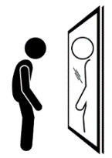
Roots and Impact of Harmful Words
Harmful language has a history of violence.
We might think of words that were uttered during the oppression of certain groups of people...
Those histories have a lasting impact today.
Those same words today can cause a person to hide or even hate one aspect of their diverse identity: whether they are hiding their gender identity, their religion, their language, the colour of their skin, their disability and more.
Notes:
Slide 10
Outdated and harmful language tends to have a history of inciting violence on marginalised people. We might think of words that were uttered during the oppression, lynching and burning of certain people based on an aspect of their diverse identity.
Unfortunately, much of those histories will have a lasting impact today. Those same words being uttered can cause a person to hide or even hate one aspect of their diverse identity: whether they are hiding their gender identity, their religion, their language, the colour of their skin, their disability and more.

Slide 11
When we make mistakes...
Developing language that is respectful and inclusive is a skill that requires time and practice.
Instead of feeling defensive or embarrassed when someone points out that we used the wrong language...
It’s more effective to be curious, humble and open, adopting a growth mindset.
When we make a mistake:
we can apologise and thank people for raising our awareness
do our best to listen and learn from the mistake (so we don’t keep repeating the mistake)
keep learning, talking about, and taking action on the issues.
Notes:
Slide 11
Developing language that is respectful and inclusive is a skill that requires time and practice.
Instead of feeling defensive or embarrassed when someone points out that we used the wrong language or harmful terminology, it’s more effective to remain curious, humble and open, adopting a growth mindset whereby making mistakes and learning to grow from them is the way forward.
When we make a mistake, 1) we can apologise and thank people for raising our awareness, 2) do our best to listen and learn from the mistake (so we don’t keep repeating the mistake) and 3) keep learning, talking about, and taking action on the issues of diversity, equality and social justice.

Slide 12
An apology can look like this:
Sorry, I didn't know you used the "they/them" pronouns. I'll do my best to use your correct pronouns and I'm grateful for your patience with this as it might take me a while to adjust.
I'm sorry, I wasn't aware that terminology was outdated. Thank you for raising my awareness. I'll make sure to use better language next time.
Notes:
Slide 12
An apology can look like this:
“I’m sorry, I wasn’t aware that terminology was outdated. Thank you for raising my awareness. I’ll make sure to use better language next time”
“Sorry, I didn’t know you used the “they/them” pronouns. I’ll do my best to use your preferred pronouns and I’m grateful for your patience with this as it might take me a while to adjust.”

Slide 13
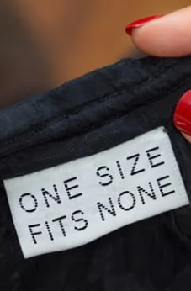
No One Size Fits All
Not everyone agrees on terminology and there is no one word / one size that fits all.
For example, the UN Convention for the Rights of Persons with Disabilities (CRPD) protects the rights of “people with disabilities” and some prefer being referred to as a "disabled people."
Either way, the word “people” is essential as it humanises the people behind the labels.
That means “disabled people” instead of “the disabled” and “ethnic minority people” instead “ethnic minorities” and “ethnics.”
If you don’t know which language to use, find out by doing your own research, being open to change, and where appropriate, asking people how they wish to be referred to.
Notes:
Slide 13
Not everyone agrees on terminology and there is no one word / one size that fits all.
For example, the UN Convention for the Rights of Persons with Disabilities (CRPD) protects the rights of “people with disabilities”. However, some people prefer to refer themselves as “disabled people” which stems from the idea that disability is not inside them, but it is the world that is not equipped to allow them to participate and flourish.
Either way, the word “people” is essential as it humanises the people behind the labels. That means “disabled people” instead of “the disabled” and “ethnic minority people” instead “ethnic minorities” and “ethnics.”
If you don’t know which language to use, find out by doing your own research, being open to change, and where appropriate, asking people how they wish to be referred to.

Slide 14
Culture: Normalising Diversity
What does that word mean?
If anyone does not understand a particular word or underlying concept, it is fine to ask and find out.
When we model the process of:
apologising
being curious and respectful
asking questions about diversity...
… we are supporting the creation a culture and ethos that values and normalises diversity, where it’s OK to make mistakes and learn.
Thanks for raising my awareness
Notes:
Slide 14
If anyone, whether educator, child, young person, adult learner, parent, carer, wider community member, does not understand a particular word or underlying concept, it is fine to ask and find out.
When we model the process of:
apologising
being curious and respectful
asking questions about diversity...
… we are supporting the creation a culture and ethos that values and normalises diversity, where it’s OK to make mistakes and learn.
Saying things like "thank you for raising my awareness" and asking "what does that word mean" creates a positive culture of openness, honesty and respect which values and normalises diversity.

Slide 15
Self-Identification
Sometimes, we don’t have much choice about which language to use (e.g. when referring to a specific study or filling in a census form).
But when we do have the choice, it is best to encourage self-identification where possible.
That means, giving people the opportunity to choose the language they feel most comfortable with.
Opportunities to self-identify can create a sense of respect, agency and of being valued.
Notes:
Slide 15
Sometimes we don’t have much choice about which language to use (e.g. when referring to a specific study or filling in a census form)
But when dealing directly with children, young people, adult learners, colleagues, families, carers and wider community members, it is best to encourage self-identification where possible. This means, giving people the opportunity to indicate which language they feel most comfortable with.
Opportunities to self-identify can create a sense of respect, agency and of being valued.

Slide 16
Self-Identification can look like this...
When talking about racism, I know not everyone likes being referred to as an ethnic minority, and some prefer to be called Black people or people of colour. How would you prefer your cultural, ethnic and racial identity to be described?
I don’t want to make assumptions about people’s diverse identities and their lived experiences of discrimination. How would you like us to describe your diverse identities?
Notes:
Slide 16
Some examples of what that might look like... [these might need to be adapted for child-friendly language]
“When talking about racism, I know not everyone likes being referred to as an ethnic minority, and some prefer to be called Black people or people of colour. How would you prefer your cultural, ethnic and racial identity to be described?”
“When talking about ableism, not everyone likes being referred to as a person with a disability, some prefer being called disabled people. How would you like to describe that aspect of your diversity?”
“I don’t want to make assumptions about people’s diverse identities and their lived experiences of discrimination. How would you like us to describe your diverse identities?”
A note of caution: it will not always be appropriate to ask people how they self-identify, and work has to be done to ensure there is trust and an inclusive, safe space first before these conversations are had. For example, asking someone the pronouns they use will not always feel safe and we have to be careful not to out people. It is perhaps more valuable to work on putting safety measures in place and taking steps such as sharing your own pronouns, making spaces accessible and taking constructive feedback. We can be cautious about asking about self-identity for people who maybe don't want to identify in a particular way or are still exploring their identity. Modelling how we identify (e.g. sharing our pronouns and other diverse identities where appropriate) can also support this.

Slide 17
Some final pointers...
Avoid making assumptions about people’s diverse identities.
Not every disability is visible. Not every racialised identity is obvious. Not every type of diversity is visible, but that doesn’t mean the diversity isn’t there.
Avoid language that erases the diversity that exists within one group.
For example, the "BAME community” or the “LGBT community” can create an assumption that all the people within those umbrellas are the same, share the same identities and beliefs. Still, some people may prefer such terminology as it creates a sense of solidarity and shared identity between a wide range of individuals.
When using acronyms, it’s best to first write (or say) them in full words to ensure a shared understanding of what they refer to.
When we avoid saying them as one word (e.g. “B-A-M-E" instead of “bame"), this can be a helpful reminder of the wide and diverse range of people covered in that acronym.
Notes:
Slide 17
Avoid making assumptions about people’s diverse identities.
No every disability is visible. Not every racialised identity is obvious. Not every type of diversity is visible, but that doesn’t mean the diversity isn’t there.
Avoid language that erases the diversity that exists within one group.
For example, the BAME community” or the “LGBT community” can create an assumption that all the people within those umbrellas are the same, share the same identities and beliefs. Nevertheless, some people may prefer such terminology as it creates a sense of solidarity and shared identity between a wide range of individuals.
When using acronyms, it’s best to first write (or say) them in full words to ensure a shared understanding of what they refer to.
When we avoid saying acronyms as one word (e.g. “B-A-M-E" instead of "bame”), this can be a helpful reminder of the wide and diverse range of people covered in that acronym.

Slide 18
Reflection
From what you have learned so far, think about:
How has this made you feel?
What has this made you think about?
What one action would you like to take forward?
How can you link what you plan to do with others in your setting?
How you will know that this learning has made a difference?
Notes:
Slide 18
[Participants can do this in groups, or as an individual.
Encourage participants to look at reflection questions and consider how they may be taken forward in enquiry.
Consider the impact of the actions on learning.]
From what you have learned so far, think about:
How has this made you feel?
What has this made you think about?
What one action would you like to take forward?
How can you link what you plan to do with others in your setting?
How you will know that this learning has made a difference?

Slide 19
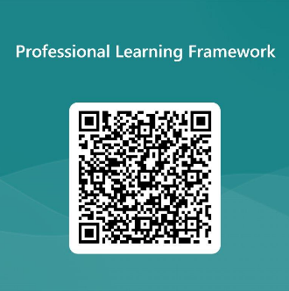
We value your feedback
From now until March 2024 we will be taking feedback on these resources so that we can make changes in advance of a formal launch of the Professional Learning Framework in June 2024
Your feedback could help us improve this resource
Please complete this short form, using the link or QR code, to let us know what you thought of it and any suggestions you have on how it could be improved
LINK: https://forms.office.com/e/b5PCpJJJ3P
Notes:
Slide 19

