Slide 1


Slide 2

Aims
To reflect on what it means to have a visible difference and its impact on the child or young person, the family and the school.
To think about unconscious (implicit) bias and its impact.
To understand more about living with a visible difference by listening
to children and young people with a visible difference and their parents.
To listen to children and young people and schools to begin to reflect on effective practices.

Slide 3

Visible difference/disfigurement
What do you understand by the terms visible difference and disfigurement?
Why do you think there is a move towards using the phrase ‘visible difference’ rather than ‘disfigurement’?
Discuss these in your groups and make notes, so we can take feedback.

Slide 4

Some causes of visible difference:
Skin conditions like eczema, acne, or vitiligo
Burns
Birthmarks
Craniofacial conditions, affecting the growth and development of the skull and face
Cleft lip/palate (a gap or split in the upper lip and/or roof of the mouth)
Cancer

Slide 5
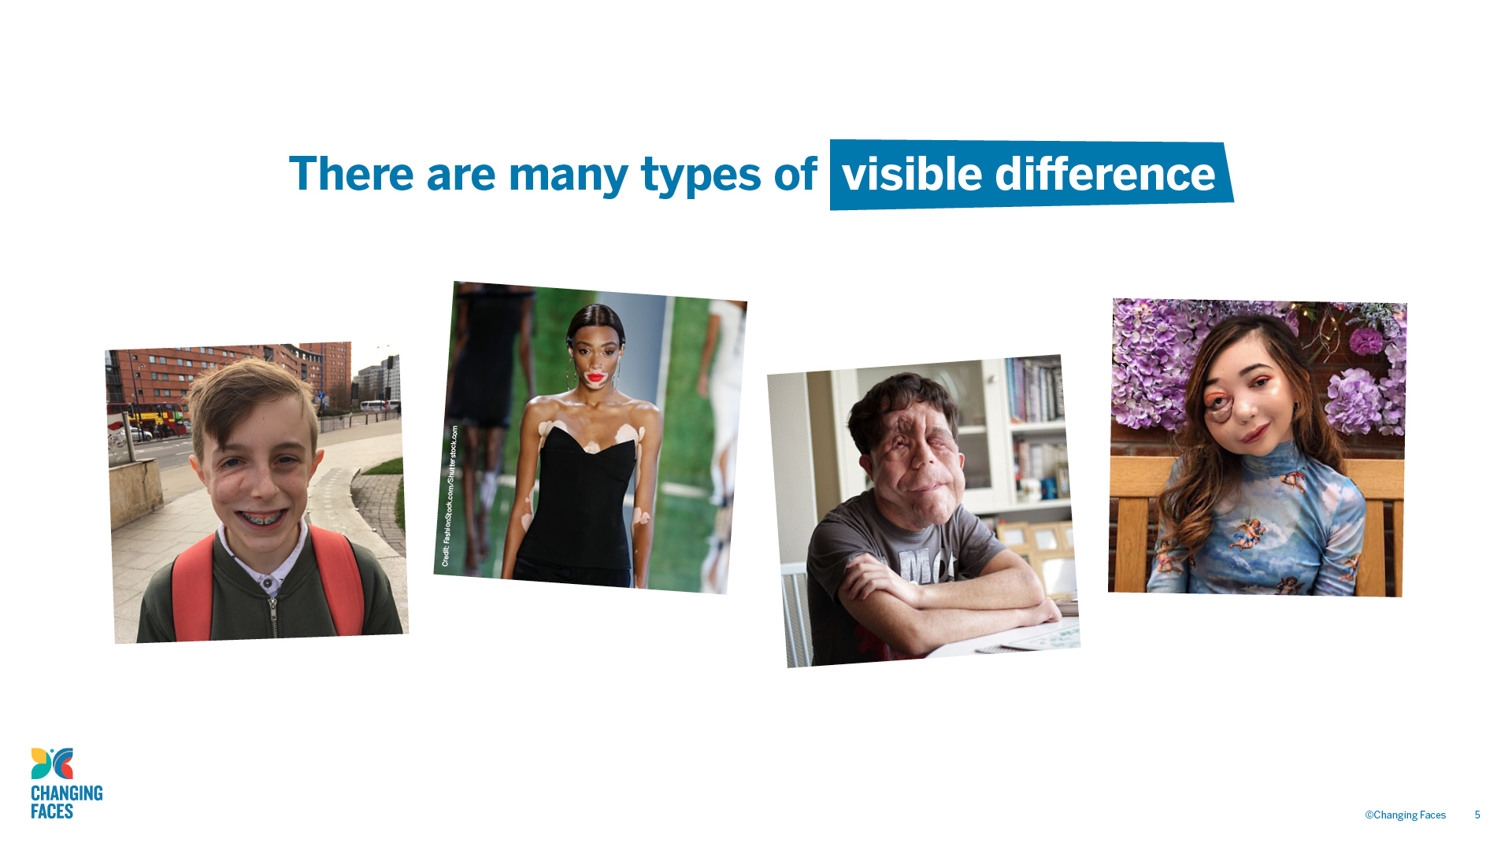

Slide 6

Equality Act (2010): Severe disfigurement
An impairment which consists of a severe disfigurement is to be treated as having a substantial adverse effect on the ability of the person concerned to carry out normal day-to-day activities.

Slide 7

GROUP
DISCUSSION
Why do you think the Equality Act includes ‘severe disfigurement’ as a disability that has an adverse effect on the ability of a person to carry out normal day-to-day activities?

Slide 8
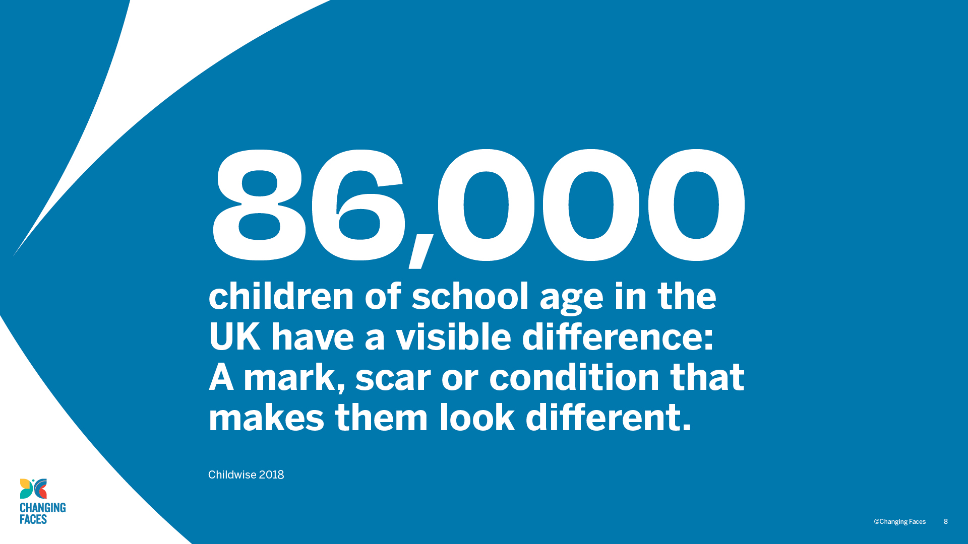

Slide 9

Perceptions of visible difference
There are a number of persistent myths and assumptions, which affect how people with a visible difference are viewed by society, such as not being very clever or being characterised as evil.
Stone (2017) found that people with a visible difference/disfigurement are viewed much less favourably than people with other disabilities that are easily identified, such as wheelchair users.

Slide 10
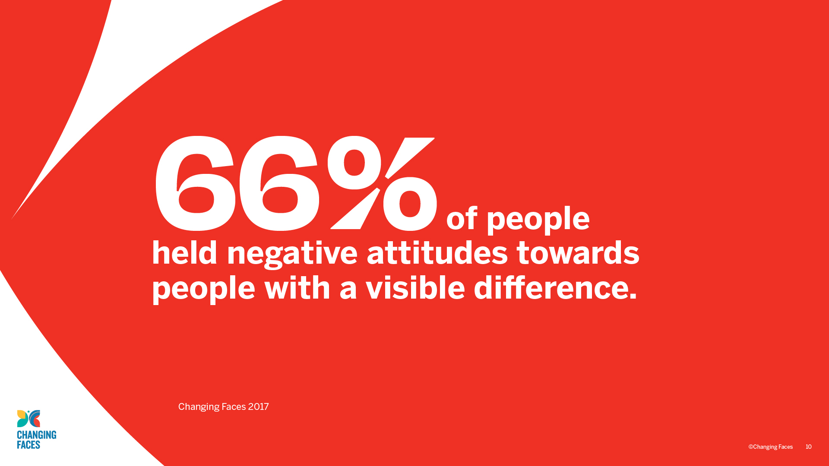

Slide 11

When participants in a study compared photos of people with a facial visible difference with those without, they judged them be:
Less out-going
Less competitive
Less assertive
More sensitive and emotional
Followers rather than leaders

Slide 12
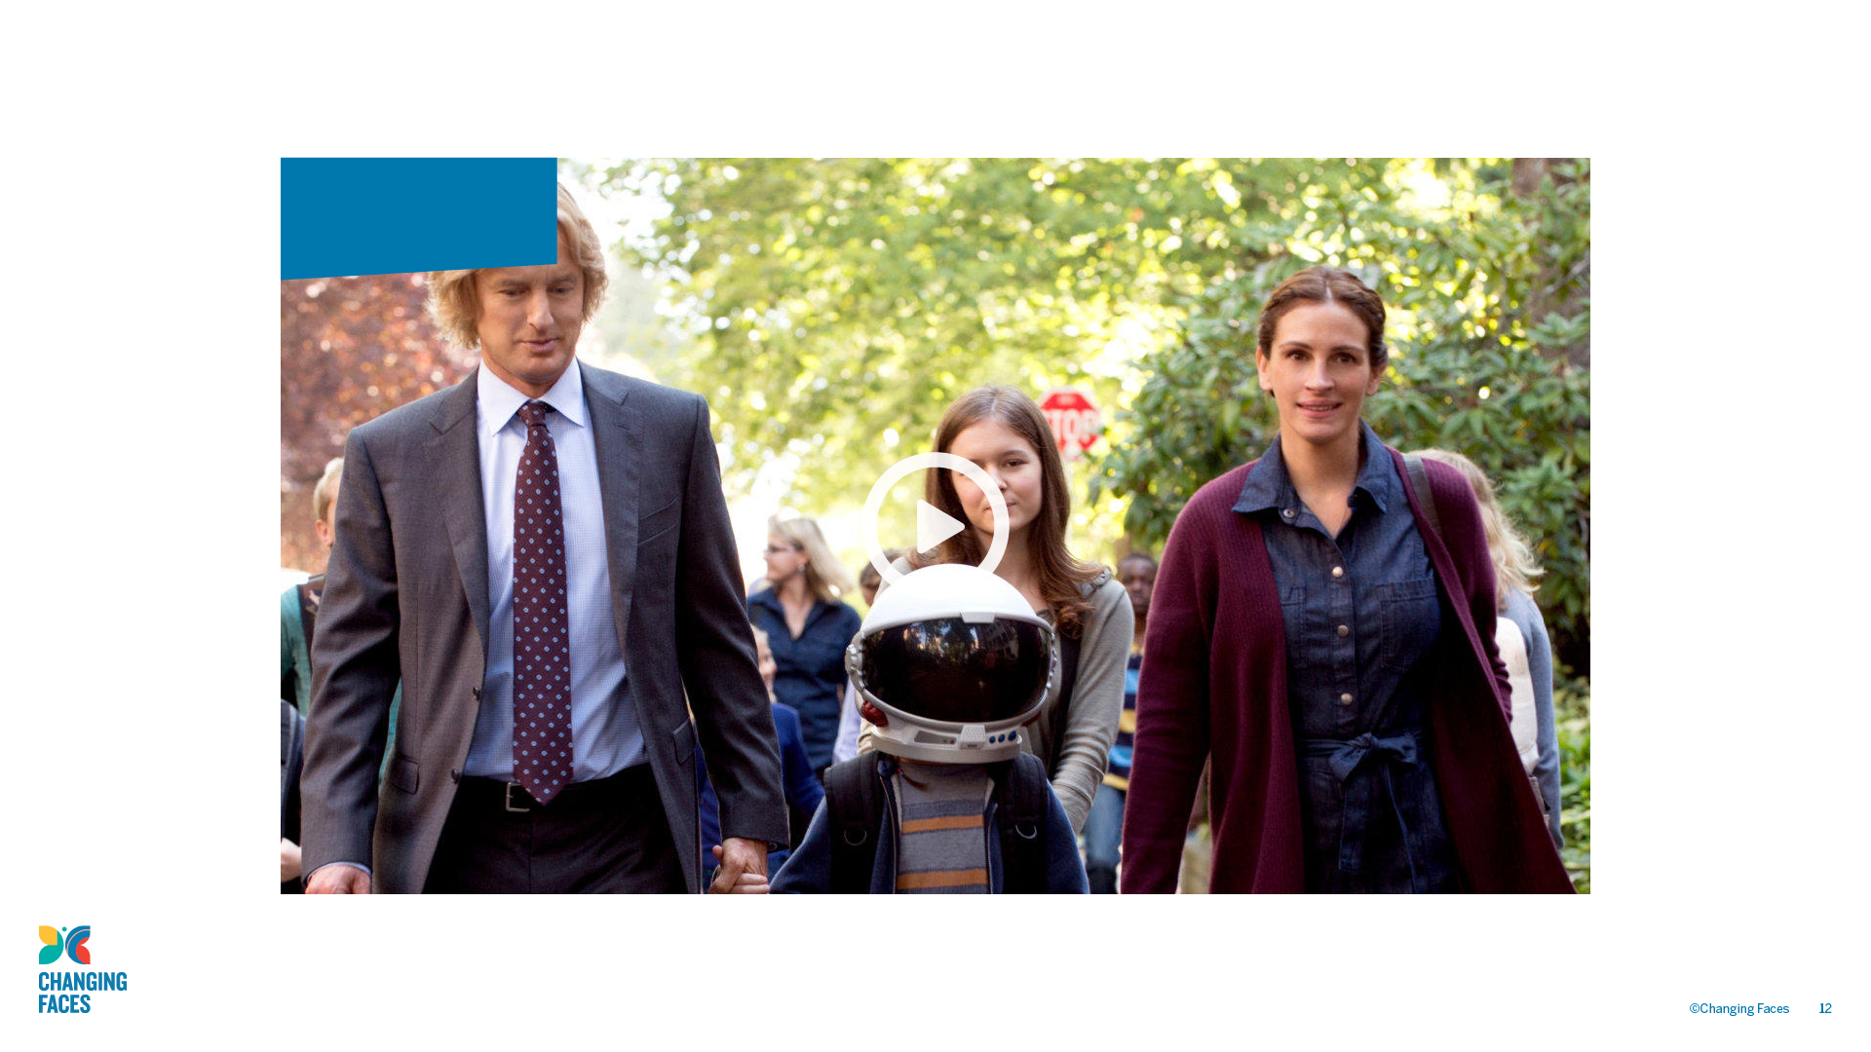
Wonder trailer

Slide 13

GROUP
DISCUSSION
When you see the clip of Wonder for the second time, reflect on the following questions and then discuss them in your groups.

Slide 14

What do you think the filmmaker wanted you to think and feel when Auggie takes off his helmet for the first time?
What did you notice as Auggie walked through the playground for the first time?
If you were Auggie, how would you feel walking through the playground for the first time?
What do you think Auggie’s parents were thinking as they watched him go into the playground for the first time?
What do you think the other children were thinking as they watched Auggie walk through the playground for the first time?

Slide 15
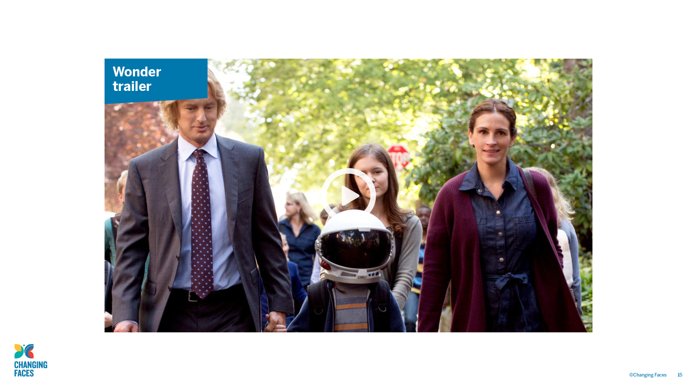
Wonder
trailer

Slide 16

What do you think the filmmaker wanted you to think and feel when Auggie takes off his helmet for the first time?
What did you notice as Auggie walked through the playground for the first time?
If you were Auggie, how would you feel walking through the playground for the first time?
What do you think Auggie’s parents were thinking as they watched him go into the playground for the first time?
What do you think the other children were thinking as they watched Auggie walk through the playground for the first time?

Slide 17

GROUP
DISCUSSION
If you had a child like Auggie joining your class, what would you want to know and what do think some of the challenges might be? If you’ve had to deal with situations like this already, it will be useful to share your experiences with colleagues.

Slide 18

GROUP
DISCUSSION
What do you think unconscious
(or implicit) bias means?

Slide 19
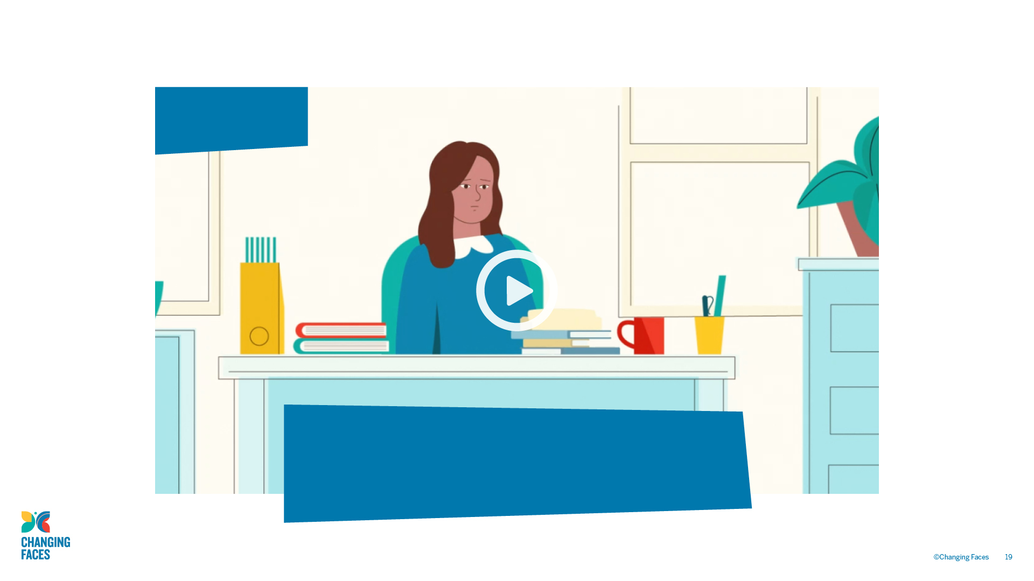
Unconscious Bias
Note the things that surprise you in this film about the impact of unconscious (or implicit) bias in the classroom.

Slide 20

Unconscious (or implicit) biases
Unlike conscious biases, unconscious (or implicit) biases are the views
and opinions that we are unaware of; they are automatically activated and frequently operate outside conscious awareness and affect our everyday behaviour and decision making. Our unconscious biases are influenced
by our background, culture, context and personal experiences.
Equality and Human Rights Commission, 2018, pp.4-5

Slide 21

Reaction and response
Our initial reaction to a situation or event is instinctive and is not something we have control over.
Our reaction to disfigurement/visible difference might be discomfort and avoidance, due to repeated associations of disfigurement/visible difference
with negative qualities that we see presented within popular culture.
By reflecting on such reactions, we can ensure that when we respond, we make the unconscious conscious. This can help us overcome our unconscious biases and unlearn our negative stereotypes.

Slide 22

Listening to children and young people
While watching the video, ask yourself:
When a child has a visible difference, what are the implications to their social inclusion and well-being?
What do you think schools should do to support inclusion of students with a visible difference?

Slide 23
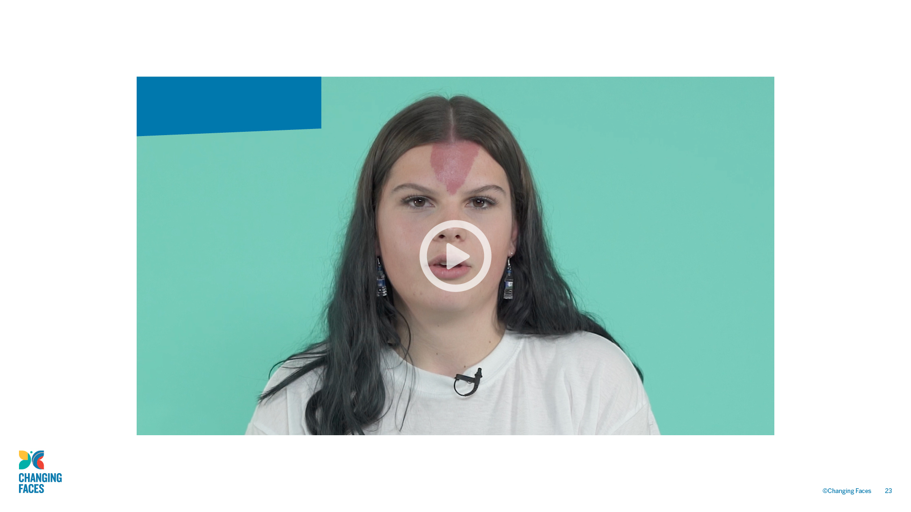
Children and young people’s voices

Slide 24

Parents’ voices
While watching the video think about:
Whether the children and their parents have different priorities and views.
The challenges that parents face when negotiating with schools and if there are practices that your school could put in place to initiate and maintain an honest and open dialogue with parents and their children?

Slide 25
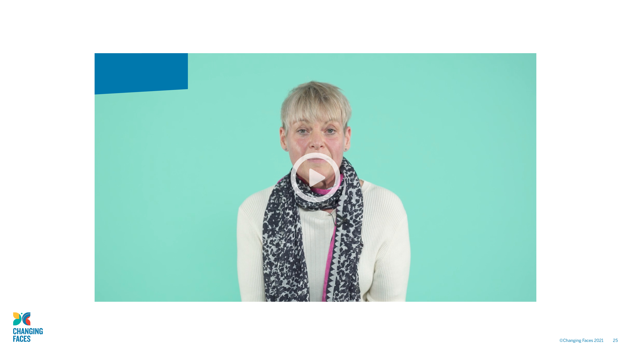
Parents’ voices

Slide 26
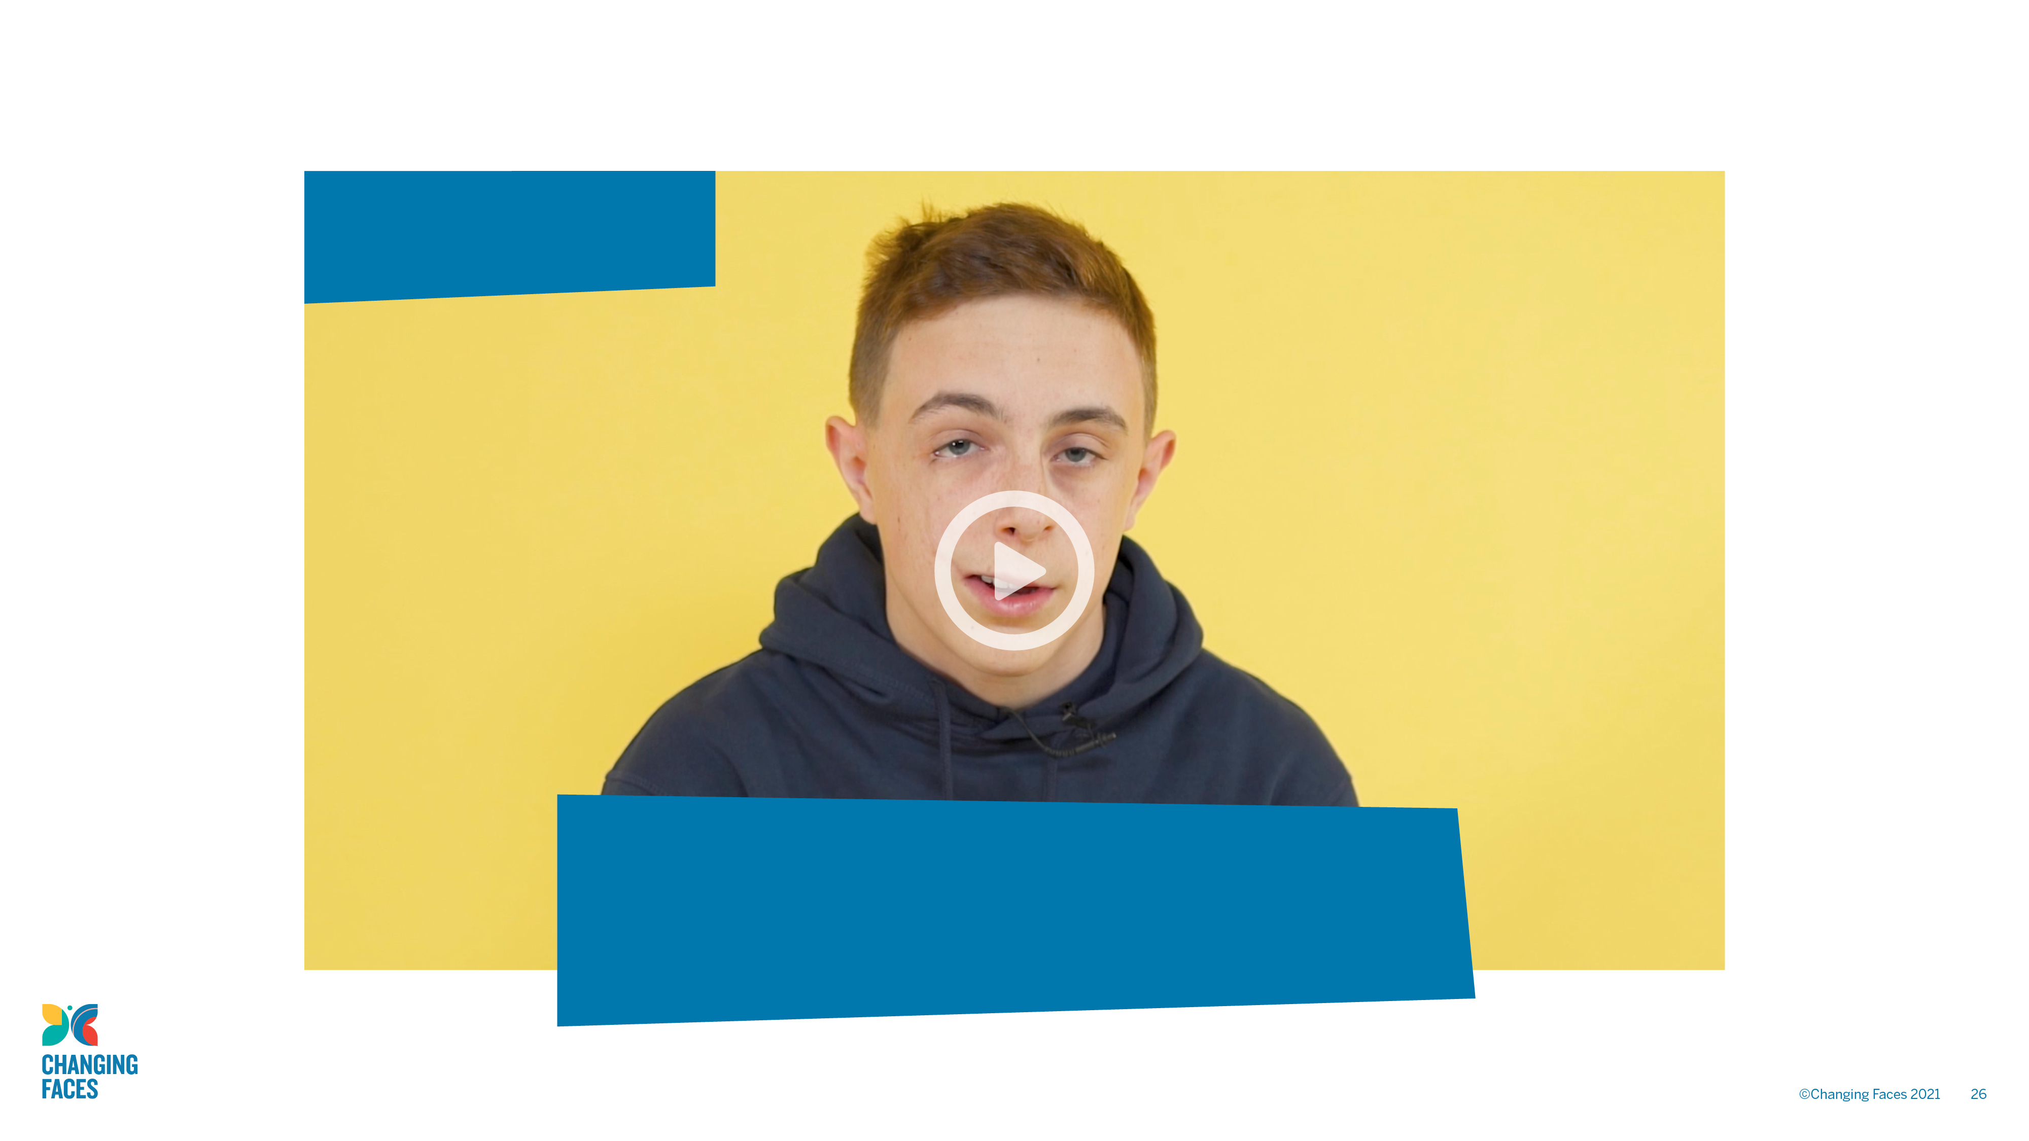
Children and young people’s voices
When watching this video, think about anything that surprises you and the key messages you take from the children and young people.

Slide 27

GROUP
DISCUSSION
Was there anything that surprised you?
What are the key messages you have taken
from the children and young people?

Slide 28

Teachers’ voices
While watching the video think about:
The key differences between what the children and young people say and what teachers say about their priorities?
How you could use both perspectives to support
a student with a visible difference in your class. Expect to make some mistakes

Slide 29
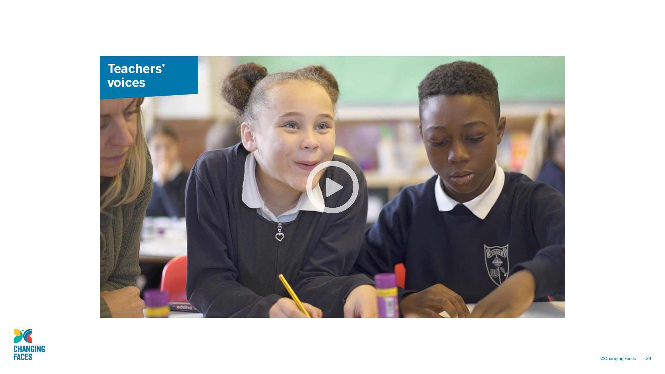
Teachers' voices

Slide 30

Face
BY HANNAH LINDFIELD
See past the scars, I can laugh and smile too See past the disability, I have a brain too
Do you really care
Or is that a hard question to ask?
With each stare or with each comment You will always open old wounds
If you see me wobble, or if I stutter
Will you help me or will you let me suffer?
After reading this poem, I hope you know
Why normal is a place where I have no wish to go!

Slide 31

Moving forward
Identify three key points that you will take away from today’s session and make a note of them.
This is just the beginning, so don’t be afraid to make mistakes.
It is better to try and fail, than not to try at all.

Slide 32

Changing Faces resources
For more advice and support from Changing Faces go to:
changingfaces.org.uk/for-professionals/teachers-youth-workers

