Slide 1


The Additional Support for Learning Engagement Event 2026
Sharing What Works: Improving ASN Together
12th March 2026

Slide 2
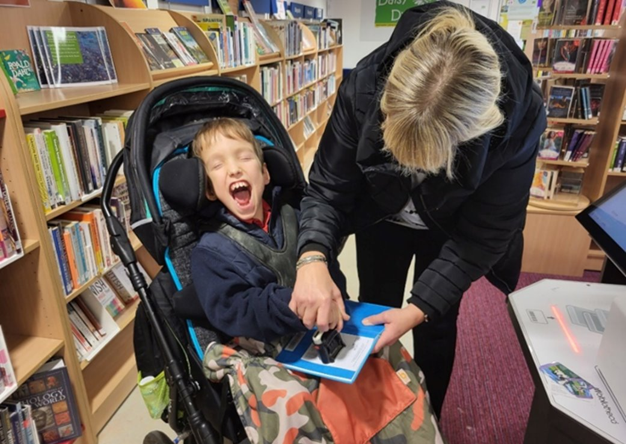

Session 4:
Beatlie School Campus
Our Lifeskills Framework:
Meaningful and Functional Learning
Debbie Green, Head Teacher

Slide 3

Context
Key focus areas that have made a difference for our young people from 3-18
Authentic Pupil Voice
Commitment to genuine partnership working
Meaningful learning focused on what our pupils need to thrive.

Slide 4
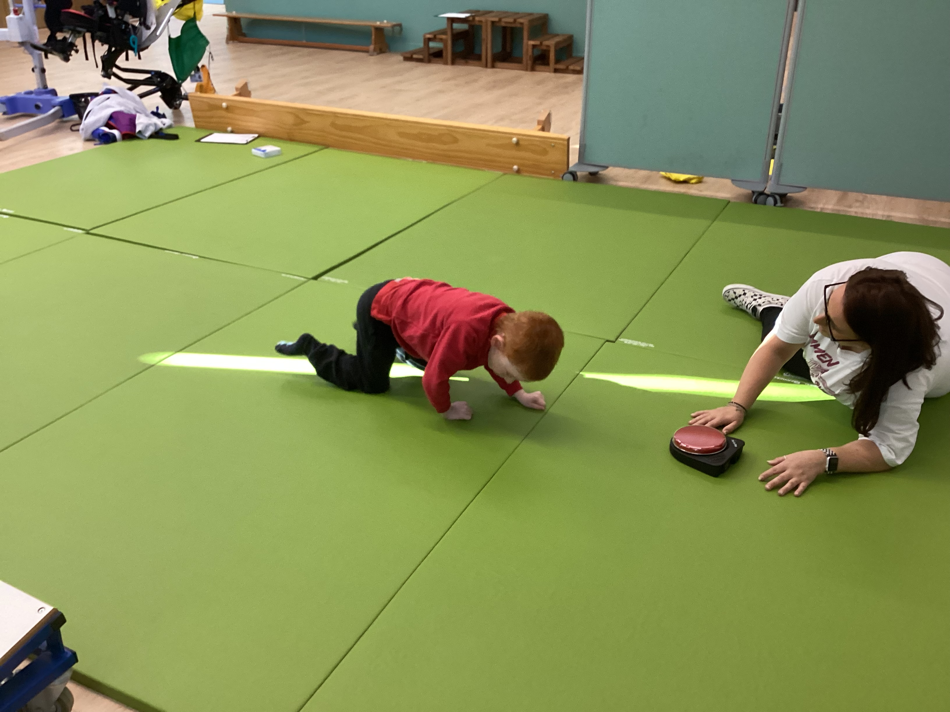
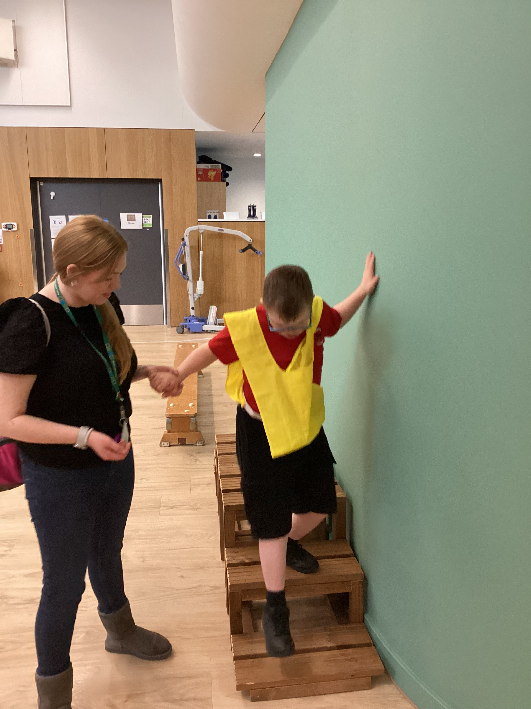
Measure what you value
What we wanted to achieve….
Create a tracking system that captured the most meaningful and relevant progress for pupils from 3-18 who are working within the pre-early level.
What we developed….
a lifeskills framework linked to the 4 capacities
a tracking system linked to these 4 areas

Slide 5
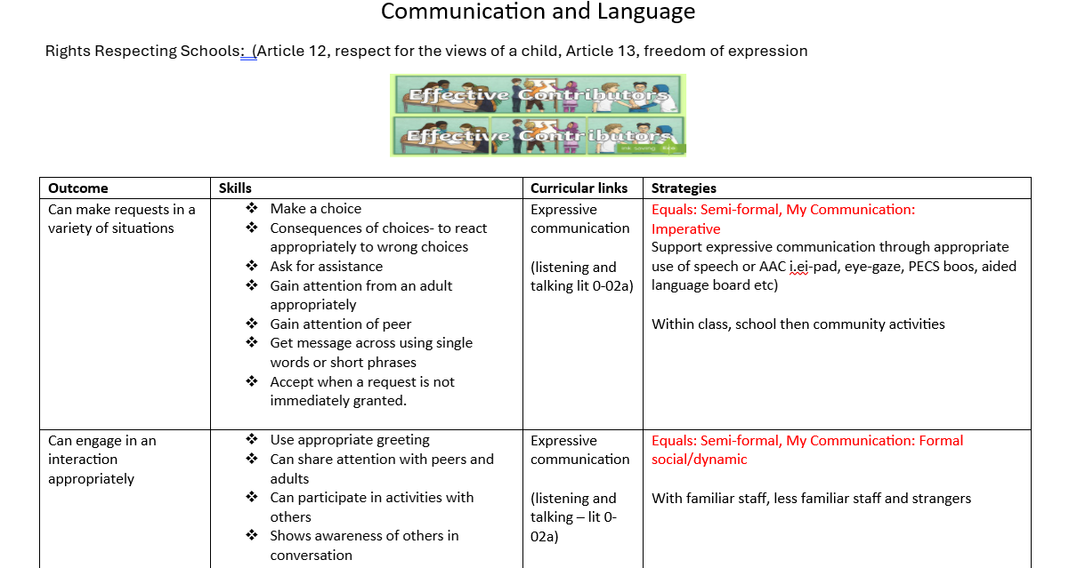
Communication and Language Tracker Example

Slide 6
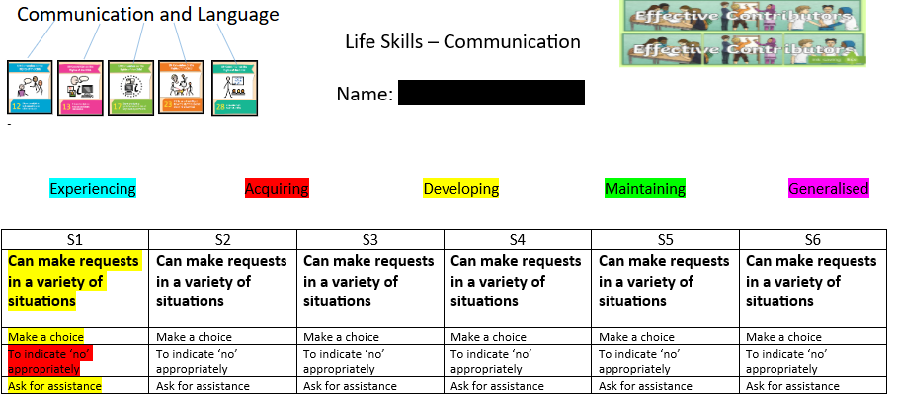
Tracker Example

Slide 7



How did we do this?
Engaged with research
Collaborated with staff, parents and partners.
Focus of School Improvement
‘reconnect with the question of purpose of Education’
(Biesta, 2009)

Slide 8
Relevant Quotes
‘Staff and parents expressed concern about the extensive work required to ensure children at the earliest levels of cognitive development were working towards relevant goals’
(Doran review, Scottish Government, 2012)
‘Standard based curriculum does not have clear links with post school outcomes for learners with severe/profound learning disabilities’
(S/PMLD)’ (Ayres et al 2012)

Slide 9
Relevant Quotes 2
‘These children and young people do not pass through set stages of development to greater autonomy as described by prevalent theories of child development and the curriculum needs to focus on a narrower range of areas that are concrete and linked to learning needs’
(Rees et al, 2017)
‘Are we measuring what we can easily measure rather than what we value, which could lead to us valuing what we (can) measure?’
(Biesta, 2009)

Slide 10
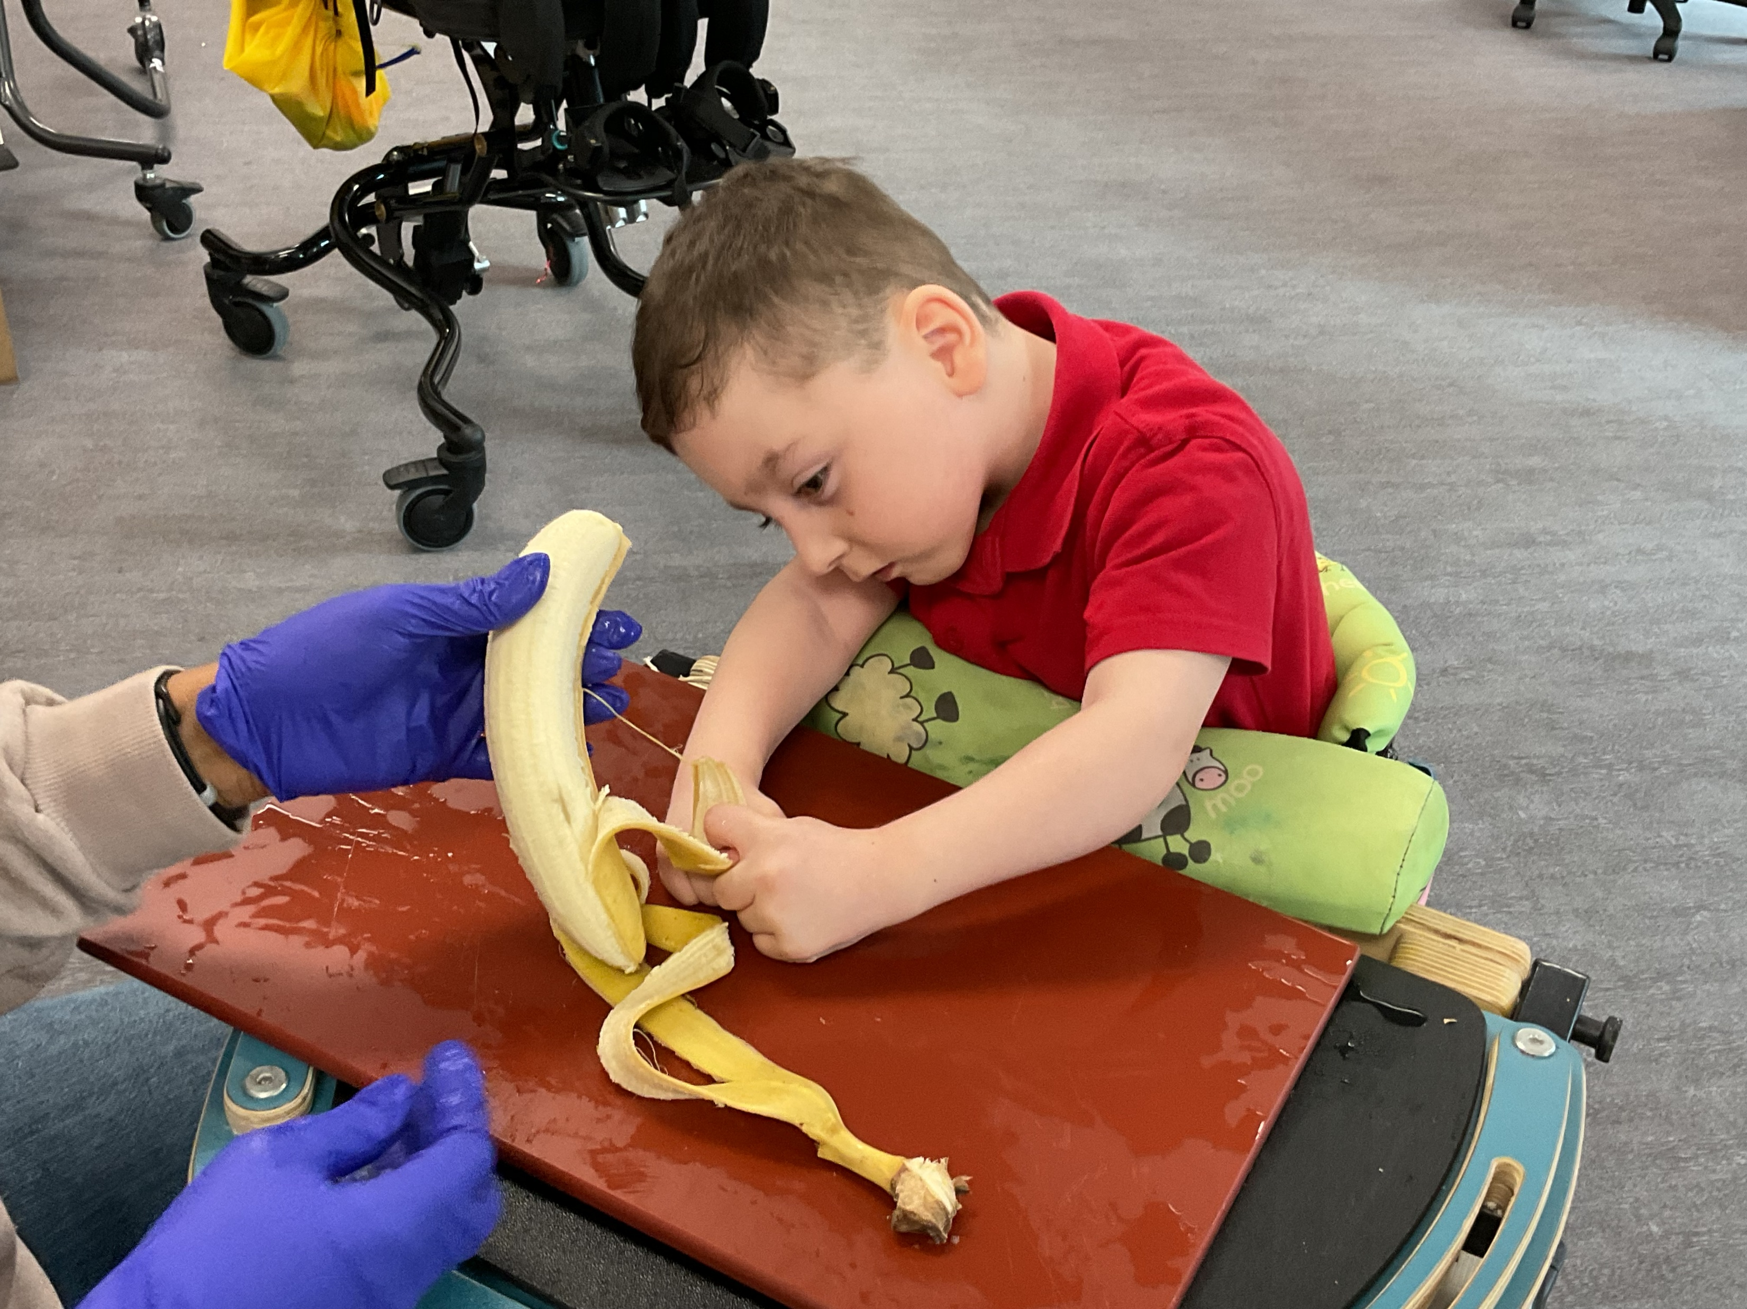
Impact
Real focus on functional, meaningful skills that can support a fulfilled life for our young people now and in the future.
Progress data that is helpful, valid and accurate

Slide 11
Key Messages
What worked well?
Attainment – what does this mean?
Contact Details:
Debbie Green – Headteacher, Beatlie School, Livingston
Debbie.green@westlothian.org.uk
Website: https://beatlieschool.westlothian.org.uk

Slide 12
Education Scotland logo: white on teal background

